Slide 1
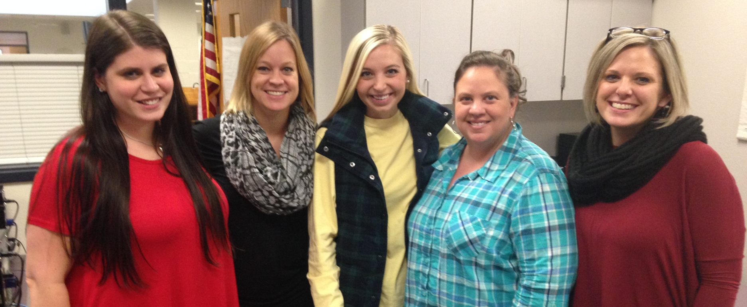
Kindergarten Unit 4
Solidifying the Foundations;
Analyzing, Comparing, Creating & Composing Shapes
Unit Planning Team:
Robin Dover (OW), Jenny Griffin (FT), Hanna Lewellen (BV),
Kasey Benson (OW), Haylee Pierce (JM)
Notes:
Hi, My name is Jenny Griffin and I worked with Hanna Lewellen, Robin Dover, Haylee Pierce and Kasey Benson to plan unit 4 Solidifying the Foundations; Analyzing, Comparing, Creating & Composing Shapes.

Slide 2
Notes:
This is a look at the unit planning process. We started by taking a look at the essential questions to make sure they were addressing the standards and the needs of our students. We then spent time locating or creating summative and performance assessments. We also attached multiple hyperlinks to this PowerPoint, taking you to options for formative assessments.
You can find daily lesson plans on our district website as well as ways to incorporate technology into our math instruction.

Slide 3
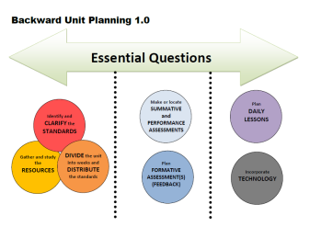
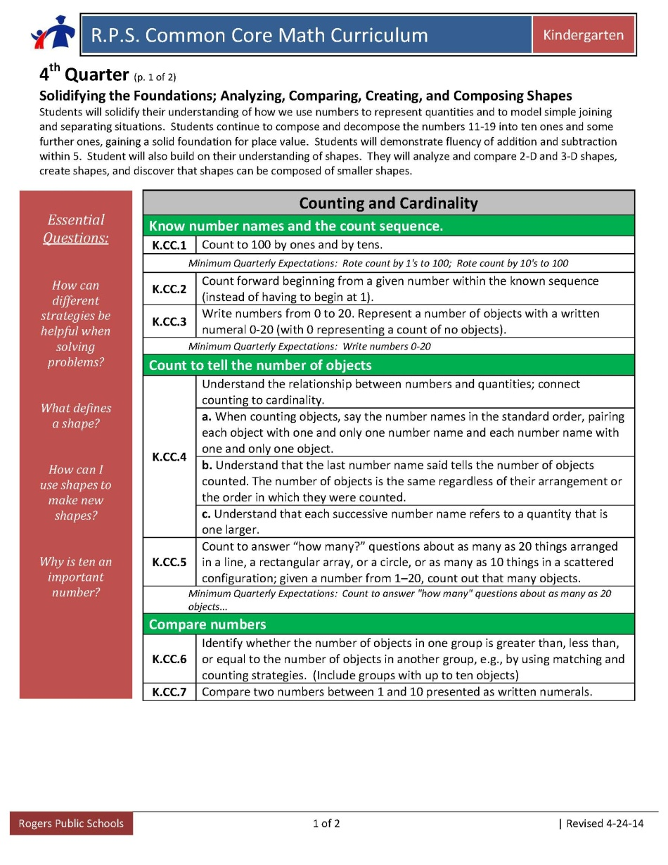
Essential Questions
Essential Questions
How can different strategies be helpful when solving problems?
What defines a shape?
How can I use shapes to make new shapes?
Why is ten an important number?
Notes:
Now lets take a look at the essential questions for Unit 4. We continued with kid friendly language as well as keeping the question: Why is ten an important number? We chose to do this in order to continue building students’ understanding for first grade. In 3rd quarter, we emphasized students showing their thinking when solving problems. In Unit 4, we have moved in sophistication to using different strategies to solve problems. If you do not use the word “strategies” with your students, you may change the language to fit the needs of your class. The essential question regarding breaking apart numbers has been removed from Unit 4, although it should still be something students continue to work on.

Slide 4
Identify and CLARIFY the
STANDARDS
4th Quarter Expectations:
Count to 100 by ones
Count by 10’s to 100
Write numbers 0-20
Count to answer “how many” questions about as many as 20 objects
K.CC.5- Students should be given ample opportunities to count with objects arranged in different ways… line, arrays, circles up to 20 and scattered up to 10.
K.CC.7- Students should be moving from comparing sets of objects to determining greater/less than with only written numerals given.
Notes:
In Unit 4, the quarterly expectations have changed. Students are expected to count to 100 by ones and count by 10’s to 100
They also need to be able to write numbers from 0-20.
We wanted to highlight the language used in K.CC.5. Students should be given ample opportunities to count with objects arranged in different ways these include… lines, arrays, and circles up to 20, but when objects are scattered, the expectation is only counting up to 10.
We also wanted to clarify K.CC.6. The kindergarten expectation is to know greater than/less than and not how many more or less.
K.CC.6 and K.CC.7 are scored together.
In regards to K.CC.7 we need to remember that as adults we know what number is bigger because we have had experiences with numbers. Therefore this standard isn’t one that we teach separately but a standard that is accomplished from teaching K.CC.3 and K.CC.6 and through compare problems. If haven’t done this already, students should be able to look at written numerals (without objects) to compare and determine which one is greater/less than the other.

Slide 5
K.OA.2, KOA.3, K.OA.4, K.NBT.1
The big idea within these standards is the number 10.
(This work should be continued as a major focus from third quarter.)
Identify and CLARIFY the
STANDARDS
Notes:
K.OA.2-When assessing, make sure sum and difference are equal or less than 10
K.OA.5-Fluency is scored in this quarter. In order to meet expectation, students need to be able to add and subtract within 5.
When looking at K.NBT.1, it is important to know that If students are developmentally ready, they can begin to call 10 ones a ten… Students who can do this accurately would be demonstrating understanding beyond K expectations. This will further prepare students for first grade, in which they call ten ones a ten.

Slide 6
K.G.4
Students need experiences with different orientations and sizes of 2-D and 3-D shapes to compare them to themselves as well as other shapes.
K.G.5, K.G.6
As students work with creating models for shapes, begin with simple shapes and use them to create 3-D shapes. K.G.6 should also incorporate composing simple 2-D shapes into more complex 2-D shapes.
Identify and CLARIFY the
STANDARDS
Notes:
In first quarter the geometry standards were K.G.1-3. This quarter we are focusing on standards K.G.4-6.
Students need experiences with different orientations and sizes of 2-D and 3-D shapes to compare them to themselves as well as other shapes.
As students work with creating models for shapes, begin with simple shapes and use them to create 3-D shapes. For K.G.6,teachers should also incorporate composing simple 2-D shapes into more complex 2-D shapes.
We have hyperlinked stem lessons and activities that correspond with K.G.5 and K.G.6. See slide 12 for hyperlink.

Slide 7
Connecting to
First Grade Big Ideas:
Identify and CLARIFY the STANDARDS
Seeing 10 as a unit, not 10 ones
Using place value understanding and properties of operations to add and subtract within 100
Problem-solving situations of adding to, taking from, putting together, taking apart, and comparing with unknowns in all positions within 20
Writing and counting to 120 from any given number
Addition and subtraction fluency within 10
Vertical Exploration
Where are they going?
How does the work in your grade level extend into the grade level above?
What do you need to emphasize this quarter to ensure they are ready for the next grade level?
Notes:
In first grade, students are expected to see 10 as a unit. In fourth quarter of Kindergarten, give students opportunities to work with larger numbers in problem solving so that students begin to see the efficiency in grouping ten into a simple unit of 10.
Fluency expectations grow in first grade to adding and subtracting within 10.
Counting continues in first grade up to 120 from any given number. Students are also expected to write those numbers.
It is important to help students acquire an understanding of counting on strategies in Kindergarten. This strategy is highlighted in first grade.

Slide 8
Week | Standards | Structure/Resources
1 | K.CC.1, K.CC.3, K.CC.4, K.CC.2 K.OA.1/K.OA.2 K.OA.3/K.OA.4 K.OA.5 K.CC.5 K.CC.6/K.CC.7 K.NBT.1 K.G.4 | Counting Collections Games for early number sense Ten frames-It Makes Sense! CGI – JCU, SRU, SCU, PPW-WU, PPW-Both Parts unknown Dot images Comparing numbers CGI-Compare problem types It Makes Sense! CGI-Multiplication and measurement division STEM lessons and Other Resources (see following slides)
2 | K.CC.1, K.CC.3, K.CC.4 K.CC.2 K.OA.1/K.OA.2 K.OA.3/K.OA.4 K.OA.5 K.CC.5 K.NBT.1 K.G.4 | Counting Collections Games for early number sense Ten frames-It Makes Sense!-Games using Ten Frames CGI – JCU, SRU, SCU, PPW-WU, PPW-Both Parts unknown Dot images It Makes Sense! CGI-Multiplication and measurement division STEM lessons and Other Resources (see following slides)
3 | K.CC.1, K.CC.3, K.CC.4 K.CC.2 K.OA.1/K.OA.2 K.OA.3/K.OA.4 K.OA.5 K.CC.5 K.CC.6/K.CC.7 K.NBT.1 | Counting Collections Games for early number sense Ten frames-It Makes Sense!-Games using Ten Frames CGI – JCU, SRU, SCU, PPW-WU, PPW-Both Parts unknown Dot images Comparing sets of objects CGI-Compare problem types It Makes Sense! CGI-Multiplication and measurement division
DIVIDE the unit into weeks and DISTRIBUTE the standards
Geometry Standards are the only new standards this quarter and will be assessed for the first time this year
(K.G.4, K.G.5, K.G.6)
Notes:
There are continuous standards that have repeated all or most of the year. These have stayed the same, due to the holistic nature of how the Kindergarten standards are laid out. Counting collections emphasizes the Counting and Cardinality standards and in Unit 4, this should be more focused on writing numbers and grouping tens.
Counting collections 1-2 times per week should be sufficient at this point in the year to focus on these standards. Geometry standards have been paced into focusing on one geometry standard in two week increments, with a week break in between each one. Although they are paced individually, connections will need to be made between them as they come up in lessons.

Slide 9
Week | Standards | Structure/Resources
4 | K.CC.1, K.CC.3, K.CC.4 K.CC.2 K.OA.1/K.OA.2 K.OA.3/K.OA.4 K.OA.5 K.CC.5 K.NBT.1 K.G.5 | Counting Collections Games for early number sense Ten frames-It Makes Sense!-Games using Ten Frames CGI – JCU, SRU, SCU, PPW-WU, PPW-Both Parts unknown Dot images It Makes Sense! CGI- Mutiplication and measurement division STEM lesson and Other Resources (see following slides)
5 | K.CC.1, K.CC.3, K.CC.4 K.CC.2 K.OA.1/K.OA.2 K.OA.3/K.OA.4 K.OA.5 K.CC.5 K.CC.6/K.CC.7 K.NBT.1 K.G.5 | Counting Collections Games for early number sense Ten frames-It Makes Sense!-Games using Ten Frames CGI – JCU, SRU, SCU, PPW-WU, PPW-Both Parts unknown Dot images Comparing sets of objects CGI-Compare problem types It Makes Sense! CGI- Multiplication and measurement division STEM lesson and Other Resources (see following slides)
6 | K.CC.1, K.CC.3, K.CC.4 K.CC.2 K.OA.1/K.OA.2 K.OA.3/K.OA.4 K.OA.5 K.CC.5 K.NBT.1 | Counting Collections Games for early number sense Ten frames-It Makes Sense!-Games using Ten Frames CGI – JCU, SRU, SCU, PPW-WU, PPW-Both Parts unknown Dot images It Makes Sense! CGI- Multiplication and measurement division
DIVIDE the unit into weeks and DISTRIBUTE the standards
Notes:
None

Slide 10
Week | Standards | Structure/Resources
7 | K.CC.1, K.CC.3, K.CC.4 K.CC.2 K.OA.1/K.OA.2 K.OA.3/K.OA.4 K.OA.5 K.CC.6/K.CC.7 K.CC.5 K.NBT.1 K.G.6 | Counting Collections Games for early number sense Ten frames-It Makes Sense!-Games using Ten Frames CGI – JCU, SRU, SCU, PPW-WU, PPW-Both Parts unknown Comparing sets of objects CGI-Compare problem types Dot images It Makes Sense! CGI- Multiplication and measurement division STEM lesson and Other Resources (see following slides)
8 | K.CC.1, K.CC.3, K.CC.4 K.CC.2 K.OA.1/K.OA.2 K.OA.3/K.OA.4 K.OA.5 K.CC.5 K.NBT.1 K.G.6 | Counting Collections Games for early number sense Ten frames-It Makes Sense!-Games using Ten Frames CGI – JCU, SRU, SCU, PPW-WU, PPW-Both Parts unknown Dot images It Makes Sense! CGI- Multiplication and measurement division STEM lesson and Other Resources (see following slides)
9 | K.CC.1, K.CC.3, K.CC.4 K.CC.2 K.OA.1/K.OA.2 K.OA.3/K.OA.4 K.OA.5 K.CC.5 K.CC.6/K.CC.7 K.NBT.1 | Counting Collections Games for early number sense Ten frames-It Makes Sense!-Games using Ten Frames CGI – JCU, SRU, SCU, PPW-WU, PPW-Both Parts unknown Dot images Comparing sets of objects CGI-Compare problem types It Makes Sense! CGI- Multiplication and measurement division
DIVIDE the unit into weeks and DISTRIBUTE the standards
Notes:
None

Slide 11
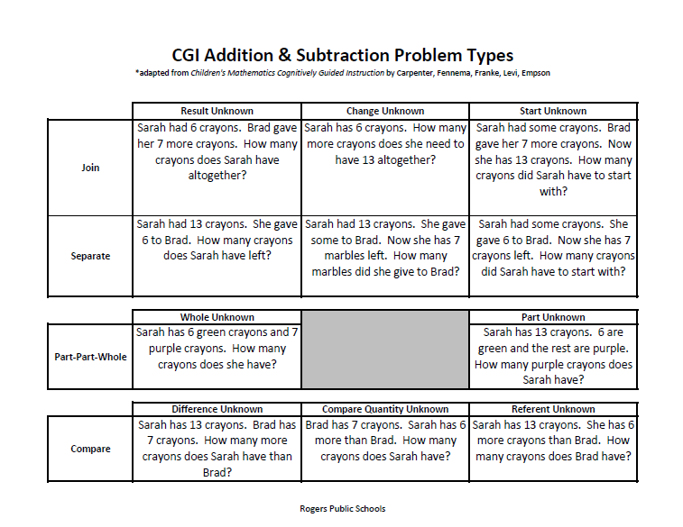
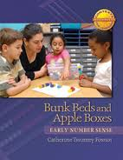
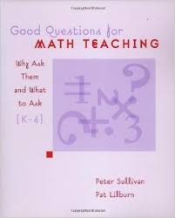
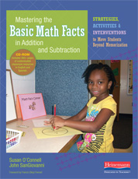
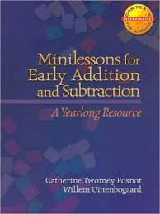
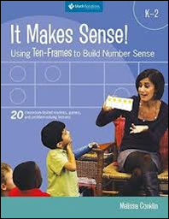
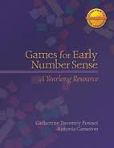
Gather and study the RESOURCES
Notes:
Resources can be found on our website in Unit 4…
We have highlighted some resources on the following slides, which you may find helpful when lesson planning.

Slide 12
Resources for Geometry Standards
(K.G.4, K.G.5, and K.G.6)
Gather and study the RESOURCES
STEM lesson Marshmallow Towers (K.G.5)
STEM lesson Design a Creature (K.G.5, K.G.6)
Marshmallow Shapes (K.G.5, K.G.6)
2D shapes song – Harry Kindergarten – https://www.youtube.com/watch?v=gepEhdI7418
3D Shapes song – Harry Kindergarten - https://www.youtube.com/watch?v=2cg-Uc556-Q
K.G.6 – use die cut to cut out shapes – each shape has a different color, glue larger shape in interactive notebook and glue smaller shapes on top
Create anchor charts for each shape: 2D and 3D
Making Shapes
Edible Shapes
See more lessons on the Teacher Created Resources page on our website
Notes:
Click on page for link to entire lesson or activity.
K.G.5 focuses on modeling shapes in the real word by building shapes from components. Marshmallow towers and designing a creature are stem activities that give experience with this standard.
The Youtube videos are fun, catchy songs that kids enjoy when learning 2D and 3D shapes.
An example of what an anchor chart might look like when teaching these standards can be found on the website under Unit 4, teacher created resources.
One activity that focuses on K.G.6 involves students building largers shapes with smaller ones. Teachers can use the die cut machine to cut out shapes with each shape being a different color. Students will glue the larger shape in their interactive notebook and find smaller shapes to fit and glue on top.
Please see Teacher Created Resources for unit 4 for over 16 different activities and assessments for these three standards.

Slide 13
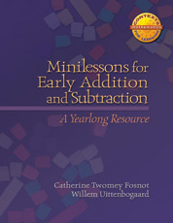
Resources for
Counting and Cardinality Standards
(K.CC.1-7)
Gather and study the RESOURCES
Contexts for Learning:
Minilessons for Early Addition and Number Sense (K.CC.4-7, K.OA.1-5)
Games for Early Number Sense (K.CC.4-7)
Number Trees These activities from Heidisongs.com provide students hands-on manipulation and creation of numbers using ten frames and other manipulatives. Use numbers appropriate to quarterly expectations. (K.CC.4, K.CC.5, K.CC.1, K.CC.2, K.CC.3) Number Trays In this series of activities, students are working with comparing sets of objects with matching and counting strategies. (K.CC.6) The Counting Cup ( K.CC.1)
Notes:
Click on page for link to entire lesson or activity.
Three activities we found beneficial for experiences in counting are hyperlinked above. These include number trees, number trays, and the counting cup. If you click on the name of the activity if will pull up the entirety of the lesson.
Counting collections are a weekly activity that we also recommend continuing throughout this quarter.

Slide 14
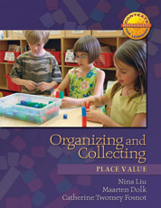
Resources for
Number and Operations in Base Ten Standard
(K.NBT.1)
Gather and study the RESOURCES
Contexts for Learning:
Organizing and Collecting: The Number System (K.NBT.1)
CGI: Multiplication and Measurement Division Problem Types using 10s to develop place value understanding
Number Rods (extend to representing ten and some ones)
Notes:
Click on page for link to entire lesson or activity.
An activity we hyperlinked above is called Number Rods. This activity was chosen due to its visual representation of base ten understanding. Going back to that Vertical Exploration we know that the first grade standards deal a lot with place value. Understanding base ten at this point in time will be great preparation before moving into 1st grade.
Ten frame activities and games also reinforce this standard (flash frames).

Slide 15
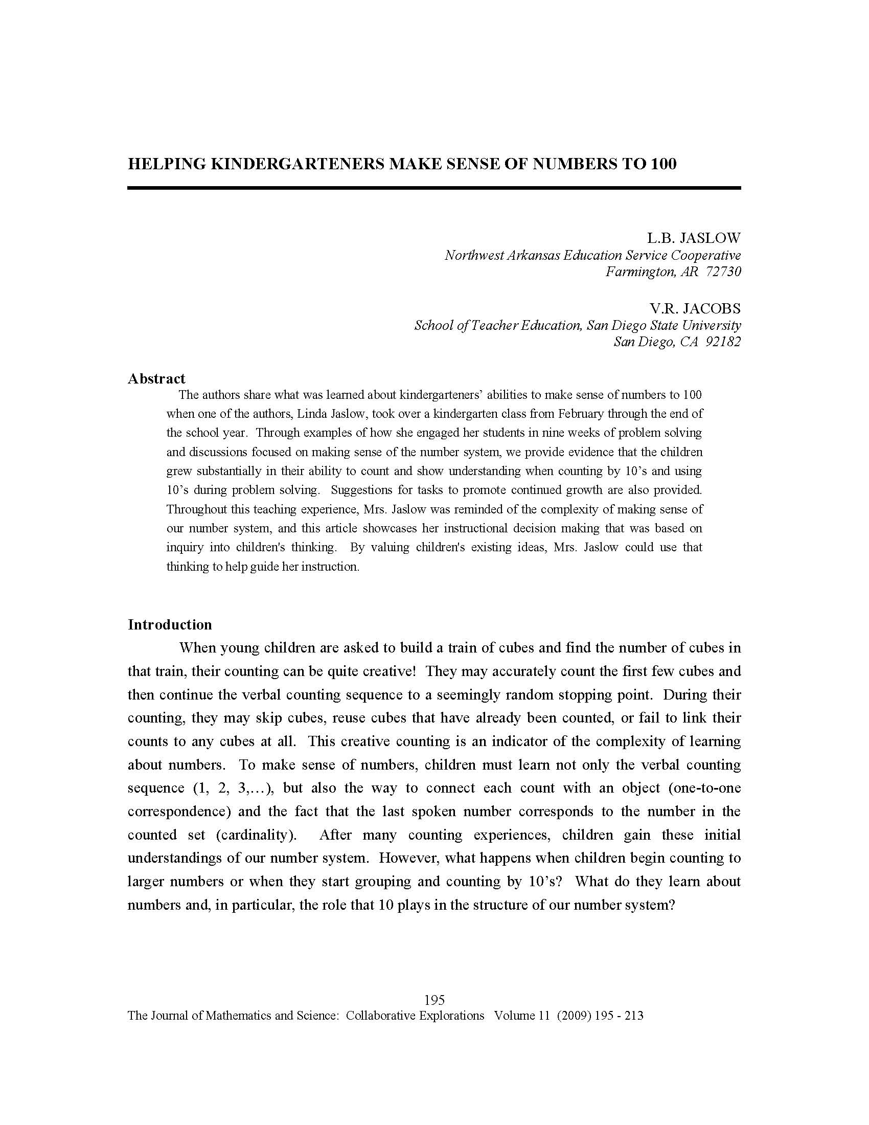
Linda Jaslow’s Article:
Helping Kindergarteners make sense of numbers to 100
Gather and study the RESOURCES
We need to:
*Inquire into children’s thinking
*Value existing ideas
*Challenge and extend understanding
*Support growth
Counting by tens (as a rote chant)
is often unconnected to any quantities. Therefore, we need to work to develop ten-to-ten correspondence among our students.
Click here to
view
article online
Notes:
This was an article that was linked in Unit 3 that we decided to link again in case you didn’t have a chance to read it. Number sense is a large foundational skills taught in kindergarten, and this article has good thoughts on how reinforce those skills.

Slide 16
Pose problems that promote base ten understanding:
Many students know that 20= 10+10,
but NOT that 11=10+1 or 24=10+10+4.
They need more experiences
working with purposeful problems.
We want our students to see ten as a group,
and then use that information to help
solve problems more effectively.
Pose problems that promote base ten understanding:
*Groups of 10’s problems
*Problems designed to help children compose
new numbers from a 10 and some 1’s
*Decompose numbers into 10’s and 1’s
*Mixing 10’s and 1’s
*Counting by 10’s from a non-decade number
Notes:
We know that 10 is an important number so using it and its power when planning problems will be beneficial throughout all of the math common core standards. These are just a few reminders/ helpful hints to remember when planning math instruction.

Slide 17
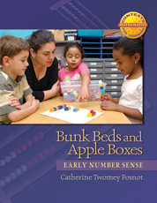
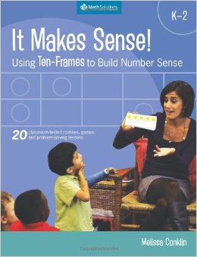
Resources for
Operations and Algebraic Thinking
(K.OA.1-5)
Gather and study the RESOURCES
Fluency Resources (K.OA.5)
Dot Images Smart Board (K.OA.5)
http://cloud.rpsar.net/edocs/Math/FluencyResources/quickimagesk2.notebook
Mental Math Practice
Contexts for Learning:
Bunk Beds and Apple Boxes
Mastering the Basic Math Facts in Addition and Subtraction (K.OA.5)
It Makes Sense: Using Ten-Frames to Build Number Sense
Notes:
We linked a few lessons, and ideas to look through when teaching the Operations and algebraic thinking standards. Since we have been teaching these standards since the beginning of the year, new and fresh ideas can be helpful and inspiring. We also added pictures of the curriculum books you may using that have get ideas on how to teach these standards.

Slide 18
Resources for
Incorporating the Standards for Mathematical Practice
Gather and study the RESOURCES
Mathematical Standards Posters:
http://cloud.rpsar.net/edocs/Math/StandMathPractice/Mathematical%20practices.pdf
Mathematical Standards "I can" statements for pocket charts:
http://cloud.rpsar.net/edocs/Math/StandMathPractice/I%20can%20statements%20for%20Mathematical%20Practices.pdf
Mathematical Standards Rubric:
http://cloud.rpsar.net/edocs/Math/2ndGrade/CIResources/Student_Math_Practice_Rubric.pdf
Mathematical Practices - Questioning:
http://cloud.rpsar.net/edocs/Math/StandMathPractice/MP.TeacherQuestionStarters.pdf
Notes:
More resources to browse through for new ideas.

Slide 19
Sample Weekly Planning breakdown…
Majority of Lesson Time Each Day:
1-2 Days of Counting Collections (K.CC.1-7)
2-3 Days of Problem-Solving with CGI (K.CC standards, K.OA standards, and K.NBT.1 standard)
1-2 Days Focused on Geometry Standards on weeks that apply (K.G.4-6)
Other Pieces to Build into Math Block Each Day (multiple standards):
Games and Activities to Reinforce Concepts
Minds on Math (choose several slides per day)
Number Talks (including dot images, ten frames, and work with number concepts)
Plan DAILY LESSONS
Incorporate TECHNOLOGY
Notes:
We decided that it might be helpful to have a breakdown of what one week might look like throughout Unit 4. Sometimes when you look at the guide above it can be overwhelming so taking it day by day can make it easier. Throughout one week you should be spending 1-2 days using counting collections to supplement you math instruction time, other random time throughout the day are great as well (morning work, quiet time, etc). 2-3 days should be spent problem solving with CGI. And 1-2 days need to be focused on the Geometry standards on weeks that it applies. On weeks that the geometry standards do not apply you should be focusing on those other math standards that you see you students struggling with. We have found that games and activities have been a nice change in teaching the standards in some weeks.

Slide 20
More Lessons and resources are available online within the unit…
Solidifying the Foundations; Analyzing, Comparing, Creating, and Composing Shapes
(BE SURE TO LOOK IN EACH SUBCATEGORY ON THE LEFT SIDE TO FIND VARIOUS RESOURCES)
Plan DAILY LESSONS
Incorporate TECHNOLOGY
Another great website with lesson resources separated by domain and standard…. http://betterlesson.com/common_core
Notes:
More lessons and resources that we researched and found that we thought really tied to the standards.

Slide 21
Options for Assessment – Available online for Unit 4
Shapes assessment
Counting objects to 20
Strategy Recording Forms
Make or locate SUMMATIVE
and PERFORMANCE
ASSESSMENTS
See Teacher Created Resources
for More Geometry Assessments
Notes:
These are a few options for assessments that we either created or found. The are also a few assessments that are not linked on here that can be found on the website under unit 4, in teacher created resources Check them out!

Slide 22
Options for Assessment – Available online for Unit 4
Assessment Options from Illustrative Mathematics:
Tasks addressing K.CC.1 Assessing Counting Sequences Part 1 Tasks addressing K.CC.2: Assessing Counting Sequences Part 1 Assessing Counting Sequences Part 2 Tasks addressing K.CC.3: Assessing Writing Numbers
Make or locate SUMMATIVE
and PERFORMANCE
ASSESSMENTS
Tasks addressing K.CC.1, K.CC.2, K.CC3: Assessing Reading Numbers Assessing Sequencing Numbers
For more ideas, visit ww.illustrativemathematics.org
Notes:
Breaking down the standards and the assessments pieces we found that align with each standard. Adjust to meet the needs of the students in your classroom.

Slide 23
Teacher Created Resources pages!!!
RESOURCES
Beth Pesnell
Elementary Curriculum Specialist
bpesnell@rps.k12.ar.us
Notes:
Under unit 4 teacher created resources on the district page you can find lots of activities, lessons, worksheets, and assessments. Check this page out!!!

