Slide 1
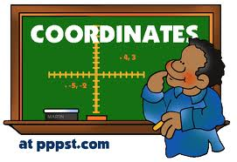
Geometry and the Coordinate Plane 3 weeks
5th Grade Unit 5
Unit Planning Team:
Stacy Dustman (ET), Pam Keith (ET), Kendra Bookout (ES),
Paige Brown (NS), Traci Rhoades (RG)

Slide 3
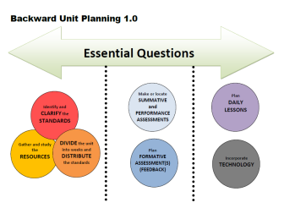
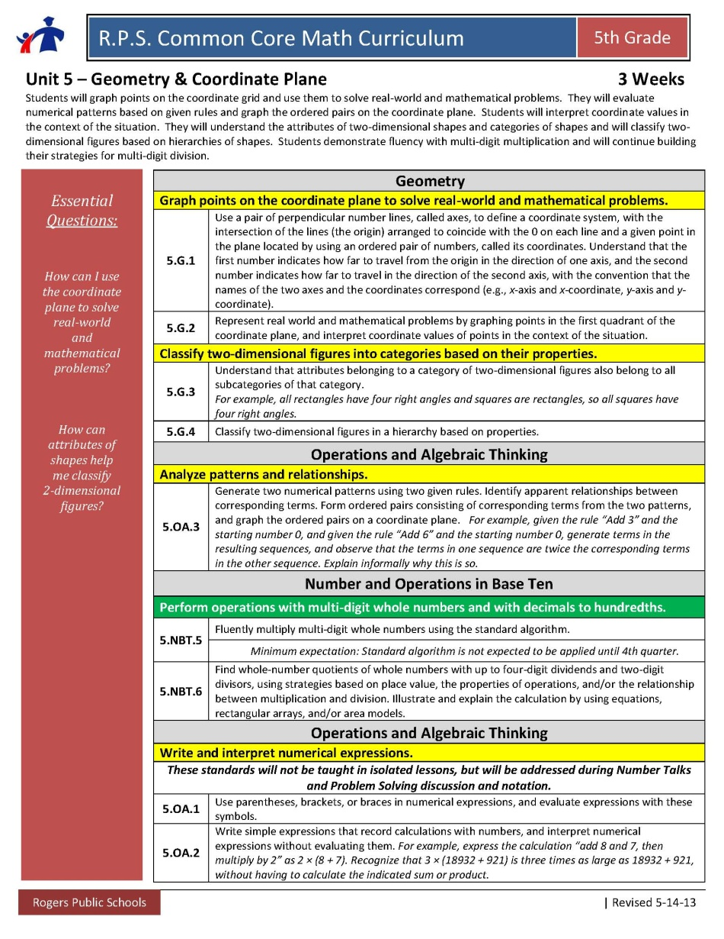
Essential Questions
How can I use the coordinate plane to solve real-world and mathematical problems?
5.G.1, 5.G.2, & 5.OA.3
How can attributes of shapes help me classify
2-dimensional figures?
5.G.3 & 5.G.4

Slide 4
5.G.1 Graphing on the coordinate grid in the first quadrant. Students need to be able to understand that you plot the x coordinate first and then the y coordinate.
5.G.2 Using the coordinate grid in the first quadrant in real world problems. Make sense of the points in context.
5.G.3 & 4 Using a hierarchy based on properties. Students will need some review on the vocabulary of the shapes and what are their defining properties. Graphic Organizers will be helpful to help students organize their ideas about the properties of each shape. This includes quadrilaterals and triangles.
5.OA.3 This standard asks student to generate a rule for a numeric pattern (such as x 2 or +3) and then plot the resulting numbers on a coordinate grid. For example, if the rule is times 2, If x is 1 then y is 2. If x is 3, then y would be 6. Students would then plot the coordinates (1, 2) and (3, 6) on the coordinate plane.
Identify and CLARIFY the
STANDARDS

Slide 5
5.NBT.5- Continue with multiplying whole numbers.
5.NBT.6 Divide whole numbers up to four-digits divided by two-digits. Strategies need to be based on place value, properties of operations, and the inverse property.
5.OA.1 & 5.OA.2 Bring these out in discussion and notation.
Identify and CLARIFY the
STANDARDS
Notes:
5. MD.1
Could use Millions to Measure book

Slide 6
Big Ideas for Unit 5:
5.G.1, 5.G.2 & 5.OA.3 – These standards go well together and all deal with the coordinate graph. Students will learn how the coordinate graph works, use it in real world problems and graph points generated by a pattern rule.
5.G.3 & 5.G.4- Properties of shapes help us to classify the shapes. A hierarchy results and the shapes in one category also belong to all the subcategories of that category.
5.NBT.5 & 5.NBT.6- Continue working with multiplication and division problems. Looking for more sophistication in student thinking.
5.OA.1 & 5.OA.2- Notation! Work on notating student thinking in their work.

Slide 7
5th Grade: 5.G.1, 5.G.2, & 5.OA.3
Coordinate Grid
6th Grade:
6.G.3 Draw polygons on the Coordinate Grid
Identify and CLARIFY the STANDARDS
Vertical Exploration
Where are they going?
How does the work in your grade level extend into the grade level above?
What do you need to emphasize this quarter to ensure they are ready for the next grade level?
5th Grade: 5.NBT.6
Divide using a variety of strategies
6th Grade:
6.NS.2 Fluently Divide
Notes:
Vertically – how do they progress to the next grade level’s standards?
Where are you going? What do you need to emphasize this quarter to ensure they are ready for the next grade level?

Slide 8
Week | Standards | Structure/Resources
1- 1 ½ | 5.G.1 Coordinate Grid 5.G.2 Coordinate Grid –real world problems 5.OA.3 Generate number patterns, determine rule, and plot points. 5.NBT.5 (x) and 5.NBT.6 (÷) 5.OA.1 Use parentheses in expression and evaluate expressions 5.OA.2 interpret expressions | Coordinate Grid SMART Notebook Graph Points on Coordinate Plane with Real-world Problems (5.G.1-2) Air Traffic Controller Earth Day Project (includes 5.OA.3, 5.OA.5) First to Arrive (includes 5.OA.3) Shoo Fly Tell Me a Story What's the Better Buy (includes 5.OA.3) http://www.k-5mathteachingresources.com/support-files/the-fly-on-the-ceiling.pdf
1 ½ -3 | 5.G.3 Understand that attributes belonging to a category of 2D figures also belong to all subcategories. 5.G.4 Classify 2D figures in a hierarchy based on properties 5.NBT.5 (x) and 5.NBT.6 (÷) 5.OA.1 Use parentheses in expression and evaluate expressions 5.OA.2 interpret expressions | Classify Two-Dimensional Figures (5.G.3-4) Investigating Quadrilaterals My Many Triangles Polygon Capture Property List of Quadrilaterals Quadrilateral Hierarchy Diagram Rectangles and Parallelograms Shapely Pairs and Logic of Shapes Tangling with Triangles Triangle Hierarchy Triangle Hierarchy ver. 1 Triangle Hierarchy ver. 2 Polygon Hierarchy Quadrilateral Hierarchy
DIVIDE the unit into weeks and DISTRIBUTE the standards

Slide 9
Gather and study the RESOURCES
Notes:
Are you highlighting any specific resource in this quarter? Borrowing/adapting from other grade level’s resources?

Slide 10
Options for Assessment – available online for Unit 5
Make or locate SUMMATIVE
and PERFORMANCE
ASSESSMENTS

Slide 11
Options for Assessment – available online for Unit 5
Make or locate SUMMATIVE
and PERFORMANCE
ASSESSMENTS

Slide 12
Week 1
Possible Lesson
Plan DAILY LESSONS
Incorporate TECHNOLOGY
Use the SMART Board linked here.
Goal: Today we will locate and identify points on a coordinate grid.
APK: Show picture of kids in a tree- Turn and Talk- How did they get there? Create Analogy with students.
New Learning: How to use a Coordinate Plane
Application: Students Act out the Coordinate Plane in small groups, then do independent practice.
Goal: Revisit Goal
5.G.1
Notes:
Conitnue

Slide 13
Week 3
Possible Lesson
Plan DAILY LESSONS
Goal: I can compare quadrilaterals based on their properties.
APK: Ask students to brainstorm how we classify shapes.
New Information: Have students take notes on the properties of the shapes listed in the word bank.
Application: Have students complete the activity in the task card.
Goal: Revisit Goal
Incorporate TECHNOLOGY
5.G.1
Notes:
Continue

Slide 14
Other Lessons and resources are available online.
Plan DAILY LESSONS
Incorporate TECHNOLOGY
Notes:
If you get here…

Slide 15
Teacher Created Resources pages!!!
RESOURCES
Beth Pesnell
Elementary Curriculum Specialist
bpesnell@rps.k12.ar.us

