Slide 1
Operations with Fractions
5th Grade Unit 4
Unit Planning Team:
Traci Rhoades (RG), Paige Brown (NS),
Brooke Bradley (LW), Stacy Dustman (ET), Pam Keith (ET)

Slide 3
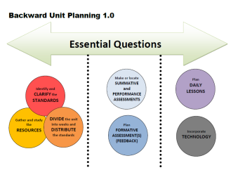
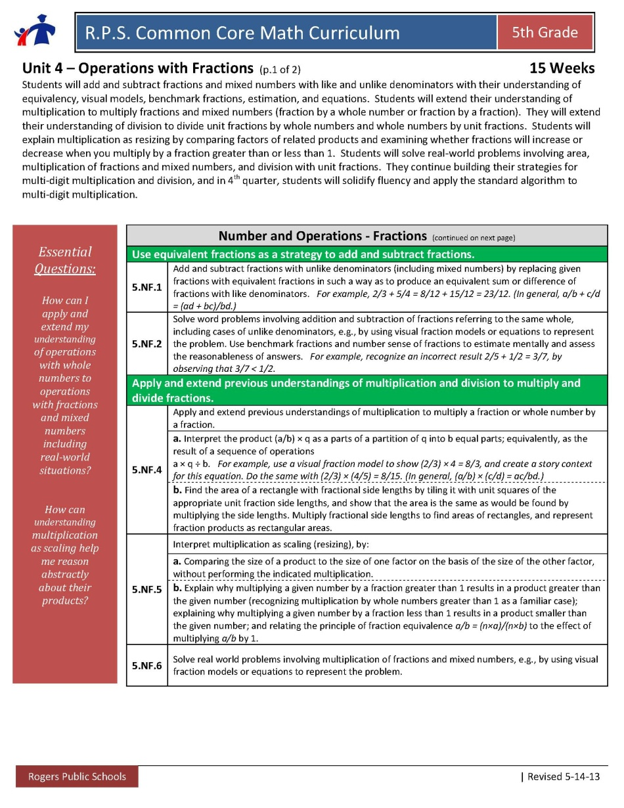
Essential Questions
How can I apply and extend my understanding of operations with whole numbers to operations with fractions and mixed numbers including real-world situations?
How can understanding multiplication as scaling help me reason abstractly about their products?

Slide 4
NF.1 and NF.2: students had
experiences in Unit 2 through their
work with equal sharing and
multiple groups problems.
NF.4 a: This standard is new. Now the number of groups is a fractional amount, not just a whole number of groups.
Fraction times a whole number and fraction times a fraction.
NF.5 : This idea continues from
4th grade multiplicative comparison.
Identify and CLARIFY the
STANDARDS
**Highlighted standards are new this unit.

Slide 5
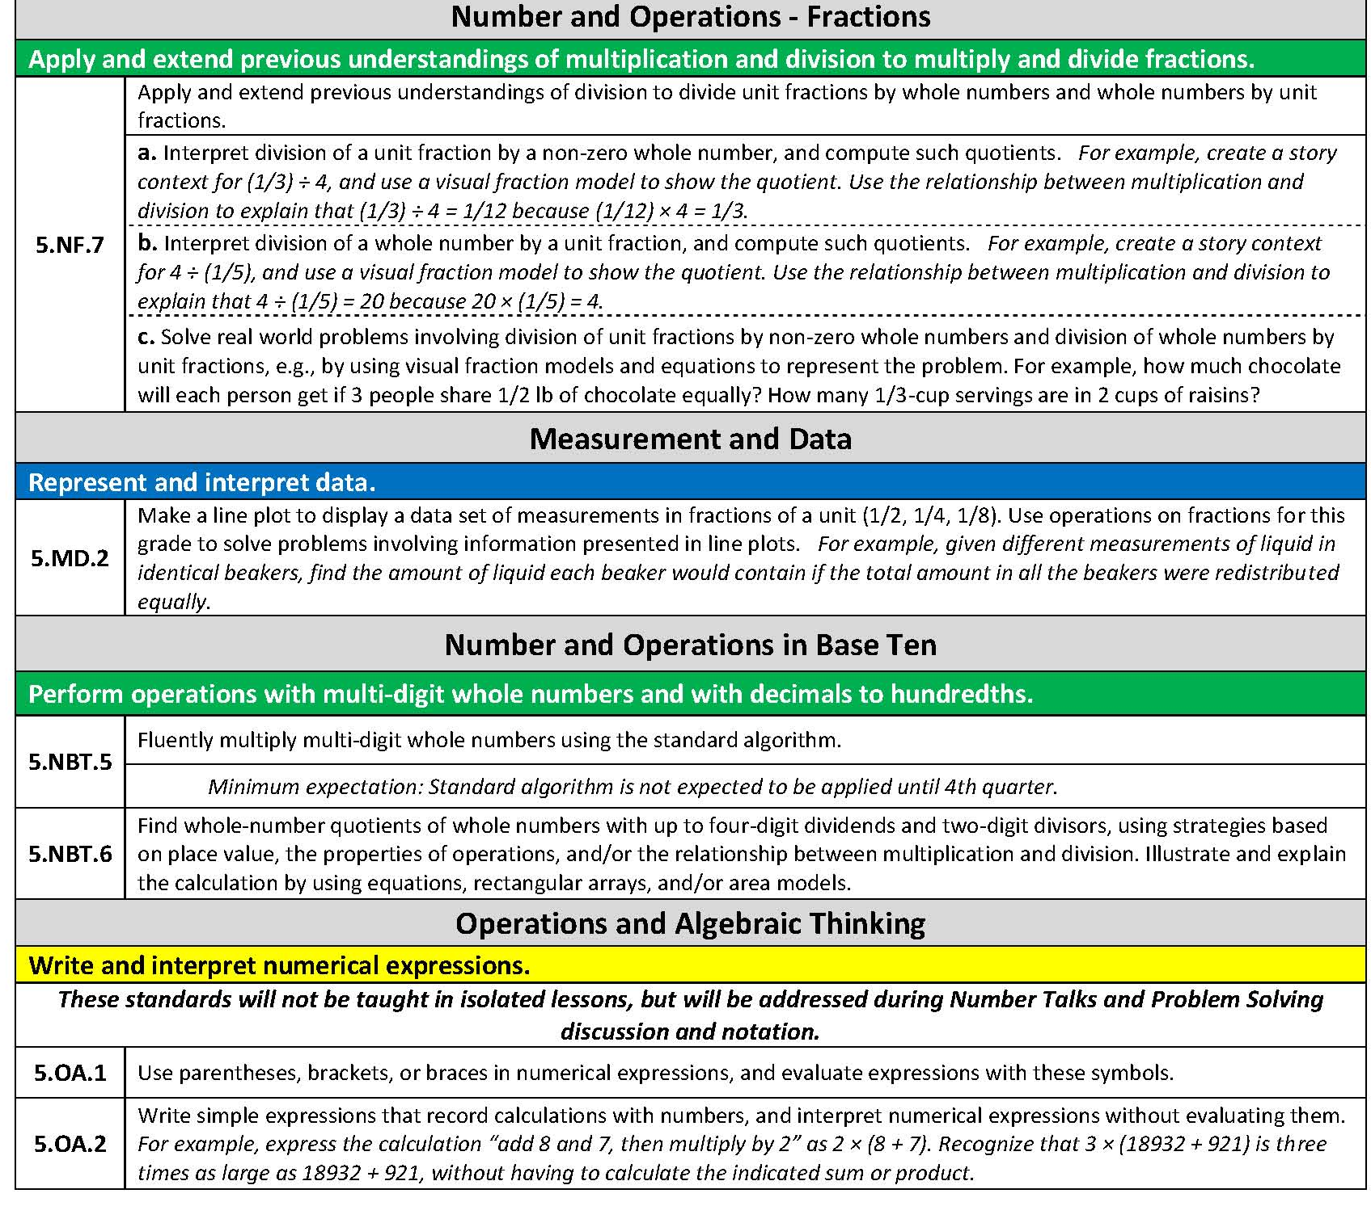
5.NF. 7a: This standard is new and addresses a unit fraction (1/2, 1/3, 1/7…) divided by a whole number.
NF.7 b continues from Unit 2
Whole number divided by a unit fraction
Identify and CLARIFY the
STANDARDS
**Highlighted standards are new this unit.
Notes:
5. MD.1
Could use Millions to Measure book

Slide 6
Big Ideas for Unit 4:
Fractions: In and out of context
Multiply fractions (including mixed numbers): NF.4, NF.5, NF.6
Unit 2: whole number X fraction
Unit 4: fraction X whole number
fraction X fraction
area problems
scaling idea
Dividing fractions: (NF.7)
Unit 2: Whole number divided by unit fraction
Unit 4: Unit fraction divided by whole number
Add/Subtract fractions: (NF.1, NF.2) with like and unlike denominators
Unit 2: experiences through equal sharing and multiple groups problems
Unit 4: Continued experiences through equal sharing and multiple
groups problems PLUS equivalency problems and addition and
subtraction problem types
(MD.2: solve fraction problems involving information presented in line plots)
Whole Number Operations: (NBT.5, NBT.6)
When solving multiplication and division problems involving fractions, whole number
sets can be included as well as decimal number sets.

Slide 7
Identify and CLARIFY the STANDARDS
Vertical Exploration
Where are they going?
How does the work in your grade level extend into the grade level above?
What do you need to emphasize this quarter to ensure they are ready for the next grade level?
Notes:
Vertically – how do they progress to the next grade level’s standards?
Where are you going? What do you need to emphasize this quarter to ensure they are ready for the next grade level?

Slide 8
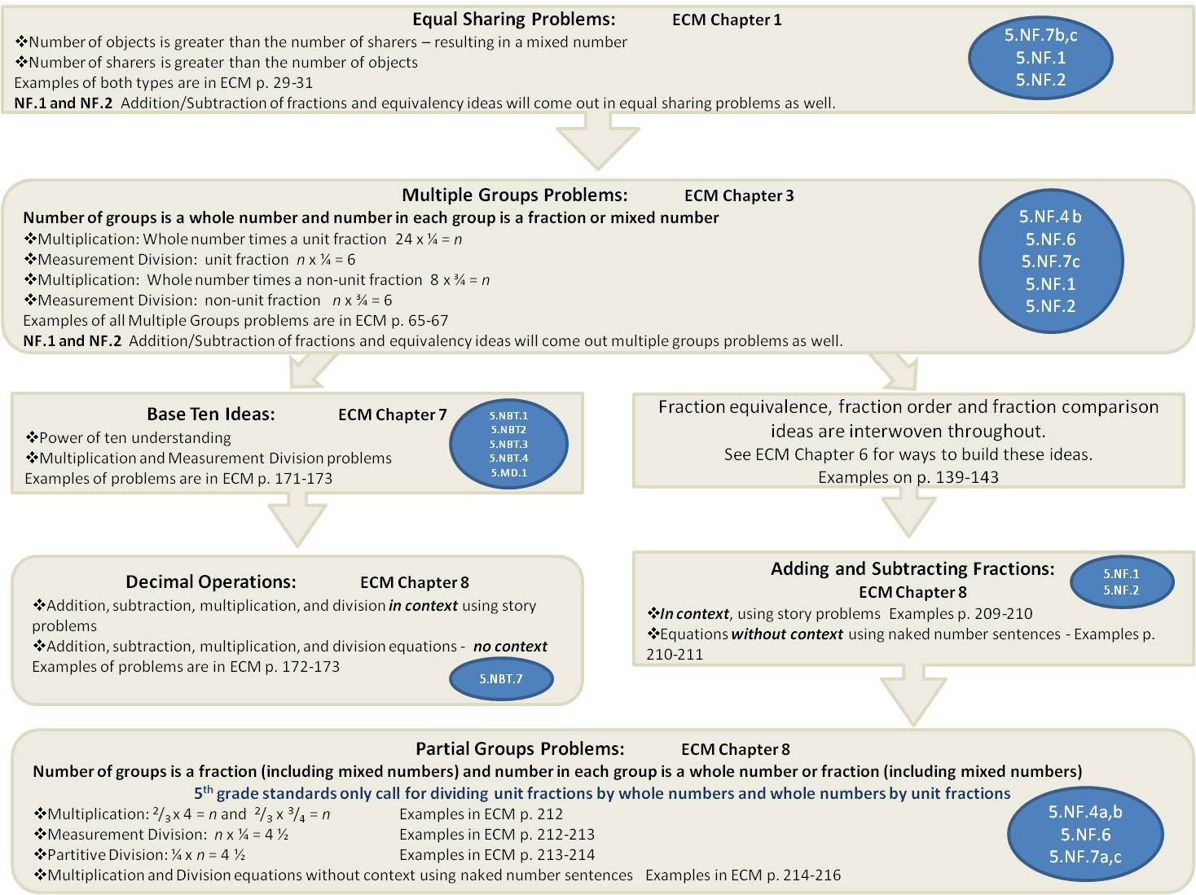
Whole Number Operations
Multi-Digit Division
with up to four-digit dividends and two-digit divisors
5.NBT.6
Multi-Digit Multiplication
5.NBT.5
Problem Type Charts

Slide 9
Equal Sharing Problems: ECM Chapter 1
Number of objects is greater than the number of sharers – resulting in a mixed number
Number of sharers is greater than the number of objects
Examples of both types are in ECM p. 29-31
NF.1 and NF.2 Addition/Subtraction of fractions and equivalency ideas will come out in equal sharing problems as well.
5.NF.7b,c
5.NF.1
5.NF.2
Multiple Groups Problems: ECM Chapter 3
Number of groups is a whole number and number in each group is a fraction or mixed number
Multiplication: Whole number times a unit fraction 24 x ¼ = n
Measurement Division: unit fraction n x ¼ = 6
Multiplication: Whole number times a non-unit fraction 8 x ¾ = n
Measurement Division: non-unit fraction n x ¾ = 6
Examples of all Multiple Groups problems are in ECM p. 65-67
NF.1 and NF.2 Addition/Subtraction of fractions and equivalency ideas will come out multiple groups problems as well.
5.NF.4 b
5.NF.6
5.NF.7c
5.NF.1
5.NF.2
Base Ten Ideas: ECM Chapter 7
Power of ten understanding
Multiplication and Measurement Division problems
Examples of problems are in ECM p. 171-173
Fraction equivalence, fraction order and fraction comparison ideas are interwoven throughout.
See ECM Chapter 6 for ways to build these ideas.
Examples on p. 139-143
5.NBT.1
5.NBT2 5.NBT.3 5.NBT.4 5.MD.1
Decimal Operations: ECM Chapter 8
Addition, subtraction, multiplication, and division in context using story problems
Addition, subtraction, multiplication, and division equations - no context
Examples of problems are in ECM p. 172-173
Adding and Subtracting Fractions:
ECM Chapter 8
In context, using story problems Examples p. 209-210
Equations without context using naked number sentences - Examples p. 210-211
5.NF.1
5.NF.2
5.NBT.7
Partial Groups Problems: ECM Chapter 8
Number of groups is a fraction (including mixed numbers) and number in each group is a whole number or fraction (including mixed numbers)
5th grade standards only call for dividing unit fractions by whole numbers and whole numbers by unit fractions
Multiplication: ²/₃ x 4 = n and ²/₃ x ³/₄ = n Examples in ECM p. 212
Measurement Division: n x ¼ = 4 ½ Examples in ECM p. 212-213
Partitive Division: ¼ x n = 4 ½ Examples in ECM p. 213-214
Multiplication and Division equations without context using naked number sentences Examples in ECM p. 214-216
5.NF.4a,b
5.NF.6
5.NF.7a,c

Slide 10
Week | Standards | Structure/Resources
1 | 5.NF.1 and 5.NF.2: students will be adding and subtracting fractions when solving equal sharing/multiple groups problems but NF.1 and NF.2 will be directly addressed through problems later in the quarter 5.NF.7b Divide whole # by fraction 5.NF.7c Real world division with fractions 5.NF.4b Area with fractional side lengths 5.NF.6 Real world multiplication with fractions | Equal Sharing/ Multiple Groups Problems (pg 29-31 ECM Book) Include whole numbers in problems to continue to address NBT. 5 and NBT.6 Number Talks: Supplemental Number Talks for Unit 4 Supplemental Number Talks for Unit 4 with Mixed Numbers Fractions and Decimals
2 | 5.NF.1 and 5.NF.2: students will be adding and subtracting fractions when solving equal sharing/multiple groups problems but NF.1 and NF.2 will be directly addressed through problems later in the quarter 5.NF.7b Divide whole # by fraction 5.NF.7c Real world division with fractions 5.NF.4b Area with fractional side lengths 5.NF.6 Real world multiplication with fractions | Equal Sharing/ Multiple Groups Problems (pg 29-31 ECM Book) Include whole numbers in problems to continue to address NBT. 5 and NBT.6 Number Talks: Supplemental Number Talks for Unit 4 Supplemental Number Talks for Unit 4 with Mixed Numbers Fractions and Decimals
DIVIDE the unit into weeks and DISTRIBUTE the standards

Slide 11
Week | Standards | Structure/Resources
3 | 5.NF.1 and 5.NF.2: students will be adding and subtracting fractions when solving equal sharing/multiple groups problems but NF.1 and NF.2 will be directly addressed through problems later in the quarter 5.NF.7b Divide a whole # by a fraction 5.NF.7c Real World Division with fractions 5.NF.4b Area with fractional sides 5.NF.6 Real world multiplication with fractions | Equal Sharing/ Multiple Groups Problems (pg 29-31 ECM Book) Include whole numbers in problems to continue to address NBT. 5 and NBT.6 Number Talks: Fractions and Decimals Supplemental Number Talks for Unit 4 Supplemental Number Talks for Unit 4 with Mixed Numbers
DIVIDE the unit into weeks and DISTRIBUTE the standards
4 | 5.NF.1 +/- fractions with unlike denominators 5.NF.2 Word problems +/- fractions with unlike denominators 5.NF.7b Divide a whole # by a fraction 5.NF.7c Real World Division with fractions 5.NF.4b Area with fractional sides 5.NF.6 Real world multiplication with fractions 5.NF.5 Interpret multiplication as scaling | Equivalence Problems from (Chapter 6 ECM) These types of problems are necessary to build idea of equivalence which is important before adding and subtracting fractions Tasks addressing 5.NF.5 Running a Mile Comparing a Number and a Product Comparing Products Comparing a Number and a Product parts a-h Calculator Trouble Fundraising Grass Seedlings Reasoning about Multiplication Half a Recipe Making Cookies Number Talks: Fractions and Decimals Supplemental Number Talks for Unit 4 Supplemental Number Talks for Unit 4 with Mixed Numbers

Slide 12
Week | Standards | Structure/Resources
5 | 5.NF.1 +/- fractions with unlike denominators 5.NF.2 Word problems +/- fractions with unlike denominators 5.NF.7b Divide a whole # by a fraction 5.NF.7c Real World Division with fractions 5.NF.4b Area with fractional sides 5.NF.6 Real world multiplication with fractions 5.NF.5 Interpret multiplication as scaling | Equivalence Problems from (Chapter 6 ECM) These types of problems are necessary to build idea of equivalence which is important before adding and subtracting fractions Tasks addressing 5.NF.5 Running a Mile Comparing a Number and a Product Comparing Products Comparing a Number and a Product parts a-h Calculator Trouble Fundraising Grass Seedlings Reasoning about Multiplication Half a Recipe Making Cookies Number Talks: Fractions and Decimals Supplemental Number Talks for Unit 4 Supplemental Number Talks for Unit 4 with Mixed Numbers
DIVIDE the unit into weeks and DISTRIBUTE the standards
6 | 5.NF.1 +/- fractions with unlike denominators 5.NF.2 Word problems +/- fractions with unlike denominators | Adding and Subtracting Fraction Problems (ECM pg 209-211) Include decimal number sets when posing these problems to keep students thinking about decimal operations Number Talks Supplemental Number Talks for Unit 4 Supplemental Number Talks for Unit 4 with Mixed Numbers

Slide 13
Week | Standards | Structure/Resources
7 | 5.NF.1 +/- fractions with unlike denominators 5.NF.2 Word problems +/- fractions with unlike denominators | Adding and Subtracting Fraction Problems (ECM pg 209-211) Include decimal number sets when posing these problems to keep students thinking about decimal operations Number Talks Supplemental Number Talks for Unit 4 Supplemental Number Talks for Unit 4 with Mixed Numbers
DIVIDE the unit into weeks and DISTRIBUTE the standards
DIVIDE the unit into weeks and DISTRIBUTE the standards

Slide 14
Week | Standards | Structure/Resources
8 | 5.NF.1 +/- fractions with unlike denominators 5.NF.2 Word problems +/- fractions with unlike denominators | Adding and Subtracting Fraction Problems (ECM pg 209-211) Include decimal number sets when posing these problems to keep students thinking about decimal operations Number Talks Supplemental Number Talks for Unit 4 Supplemental Number Talks for Unit 4 with Mixed Numbers
9 | 5.NF.1 +/- fractions with unlike denominators 5.NF.2 Word problems +/- fractions with unlike denominators 5.NF.4a Interpret products of fraction multiplication 5.NF.4b Area with fractional sides 5.NF.6 Real world multiplication with fractions 5.NF.7a Divide a unit fraction by a whole # 5.NF.7c Solve real world problems involving division of fraction by whole #s & of whole # by fractions | 2 Days: Adding and Subtracting Fractions(ECM pg 209-211) Include decimal number sets when posing these problems to keep students thinking about decimal operations 3 Days: Partial Groups Problems (ECM Book pg 212-213) **Include area problems and whole numbers for NBT.5 and NBT.6 Number Talks
DIVIDE the unit into weeks and DISTRIBUTE the standards

Slide 15
Week | Standards | Structure/Resources
10 | 5.NF.5 Interpret Multiplication as Scaling 5.NF.4 Extend understanding of multiplication to fractions 5.NF.6 Real world multiplication with fractions 5.NF.7a Divide a unit fraction by a whole # 5.NF.7c Solve real world problems involving division of fraction by whole #s & of whole # by fractions | What Is Multiplication as Scaling How Tall? Multiplication and Scale Problems 2 Days: Adding and Subtracting Fractions(ECM pg 209-211) Include decimal number sets when posing these problems to keep students thinking about decimal operations 3 Days: Partial Groups Problems (ECM Book pg 212-213) **Include area problems and whole numbers for NBT.5 and NBT.6 Number Talks SMART Notebook files with problems from the ECM book: Addition and Subtraction with Unlike Denominators (p. 209-211) Addition and Subtraction Equations (p. 210-211) Partial Groups Multiplication Problems (p.212)
11 | 5.NF.1 +/- fractions with unlike denominators 5.NF.2 Word problems +/- fractions with unlike denominators 5.NF.7a Divide a fraction by a whole # 5.NF.7c Real World Division with fractions 5.NF.4 Extend understanding of multiplication to fractions 5.NF.6 Real world multiplication with fractions | 2 Days: Adding and Subtracting Fractions(ECM pg 209-211) Include decimal number sets when posing these problems to keep students thinking about decimal operations Tasks addressing 5.NF.4b Folding Strips of Paper Seeing is Believing 3 Days: Partial Groups Problems (ECM Book pg 212-213) **Include area problems and whole numbers for NBT.5 and NBT.6 Number Talks SMART Notebook files with problems from the ECM book: Addition and Subtraction with Unlike Denominators (p. 209-211) Addition and Subtraction Equations (p. 210-211) Partial Groups Multiplication Problems (p.212)
DIVIDE the unit into weeks and DISTRIBUTE the standards

Slide 16
Week | Standards | Structure/Resources
12 | 5.NF.1 +/- fractions with unlike denominators 5.NF.2 Word problems +/- fractions with unlike denominators 5.NF.7a Divide a fraction by a whole # 5.NF.7c Real World Division with fractions 5.NF.4 Extend understanding of multiplication to fractions 5.NF.6 Real world multiplication with fractions 5.NBT.5 Fluently multiply whole #s 5.NBT.6 Divide whole #s | 2 Days: Adding and Subtracting Fractions(ECM pg 209-211) Include decimal number sets when posing these problems to keep students thinking about decimal operations. 3 Days: Partial Groups Problems (ECM Book pg 212-213) **Include area problems and whole numbers for NBT.5 and NBT.6 SMART Notebook files with problems from the ECM book: Addition and Subtraction with Unlike Denominators (p. 209-211) Addition and Subtraction Equations (p. 210-211) Partial Groups Multiplication Problems (p.212) Number Talks Tasks addressing 5.NF.6 To Multiply or not to Multiply Running to School Drinking Juice
13 | 5.NF.1 +/- fractions with unlike denominators 5.NF.2 Word problems +/- fractions with unlike denominators 5.NF.7a Divide a fraction by a whole # 5.NF.7c Real World Division with fractions 5.NF.4 Extend understanding of multiplication to fractions 5.NF.6 Real world multiplication with fractions 5.NBT.5 Fluently multiply whole #s 5.NBT.6 Divide whole #s | 2 Days: Adding and Subtracting Fractions(ECM pg 209-211) Include decimal number sets when posing these problems to keep students thinking about decimal operations 3 Days: Partial Groups Problems (ECM Book pg 212-213) **Include area problems and whole numbers for NBT.5 and NBT.6 Number Talks SMART Notebook files with problems from the ECM book: Addition and Subtraction with Unlike Denominators (p. 209-211) Addition and Subtraction Equations (p. 210-211) Partial Groups Multiplication Problems (p.212)
DIVIDE the unit into weeks and DISTRIBUTE the standards

Slide 17
Week | Standards | Structure/Resources
14 | 5.NF.1 +/- fractions with unlike denominators 5.NF.2 Word problems +/- fractions with unlike denominators 5.NF.7a Divide a fraction by a whole # 5.NF.7c Real World Division with fractions 5.NF.4 Extend understanding of multiplication to fractions 5.NF.6 Real world multiplication with fractions 5.NBT.5 Fluently multiply whole #s 5.NBT.6 Divide whole #s | 2 Days: Adding and Subtracting Fractions(ECM pg 209-211) Include decimal number sets when posing these problems to keep students thinking about decimal operations 3 Days: Partial Groups Problems (ECM Book pg 212-213) **Include area problems and whole numbers for NBT.5 and NBT.6 SMART Notebook files with problems from the ECM book: Addition and Subtraction with Unlike Denominators (p. 209-211) Addition and Subtraction Equations (p. 210-211) Partial Groups Multiplication Problems (p.212) Number Talks
15 | 5.NF.1 +/- fractions with unlike denominators 5.NF.2 Word problems +/- fractions with unlike denominators 5.NF.7c Real World Division with fractions 5.NF.6 Real world multiplication with fractions 5.MD.2 Make a line plot with fractions and solve problems using it | Fractions on a Line Plot Sacks of Flour Solve multi-step problems using information in a line plot https://learnzillion.com/lessons/3455-solve-multi-step-problems-using-information-in-a-line-plot Solve multi-step addition and multiplication problems using information in a line plot https://learnzillion.com/lessons/3554-solve-multi-step-addition-and-multiplication-problems-using-information-in-a-line-plot Redistribute items equally using the information in a line plot https://learnzillion.com/lessons/3558-redistribute-items-equally-using-the-information-in-a-line-plot Use the information from more than one line plot to solve problems https://learnzillion.com/lessons/3460-use-the-information-from-more-than-one-line-plot-to-solve-problems
DIVIDE the unit into weeks and DISTRIBUTE the standards

Slide 18
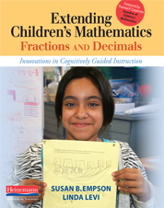
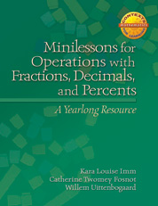
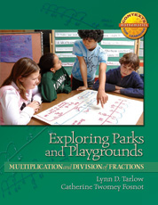
Gather and study the RESOURCES
Notes:
Are you highlighting any specific resource in this quarter? Borrowing/adapting from other grade level’s resources?

Slide 19
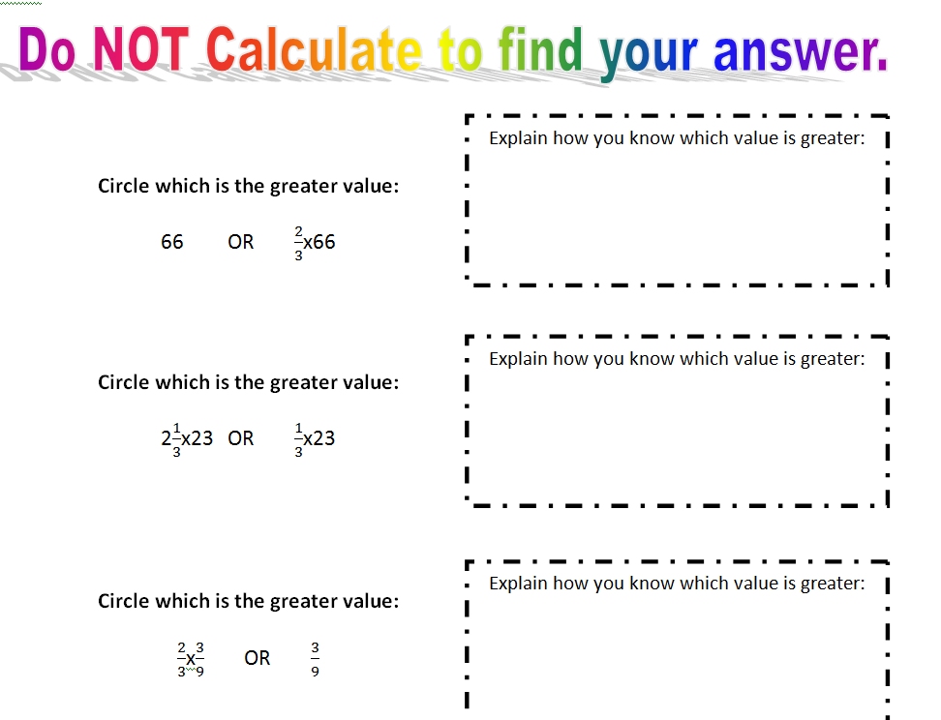
Options for Assessment – available online for Unit 4
Make or locate SUMMATIVE
and PERFORMANCE
ASSESSMENTS

Slide 20
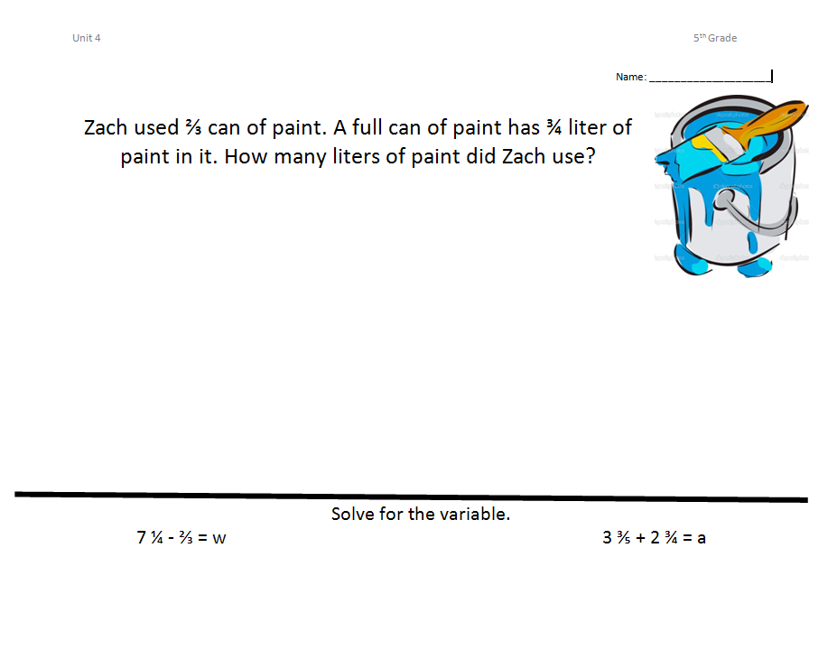
Options for Assessment – available online for Unit 4
Make or locate SUMMATIVE
and PERFORMANCE
ASSESSMENTS

Slide 21
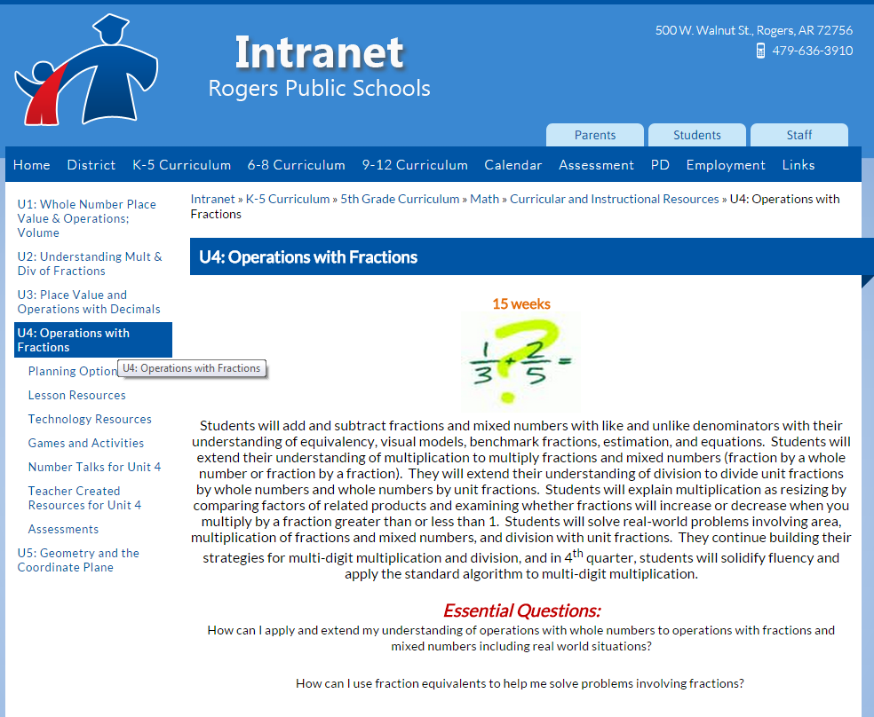
Teacher Created Resources!!!
SMART Notebook files with problems from the ECM book: Addition and Subtraction with Unlike Denominators (p. 209-211) Addition and Subtraction Equations (p. 210-211) Partial Groups Measurement Division Problems (p. 212) Partial Groups Multiplication Problems (p. 212) Partial Groups Partitive Division Problems (p. 213) Multiplication and Division Equations (p. 214-215) Multiplication and Division Open Number Sentences (p. 214) Partial Groups Sequence Problems (word doc)

Slide 22
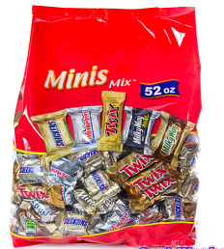
Incorporate
TECHNOLOGY
Week 10
Possible Lesson
Plan
DAILY LESSONS
Plan
DAILY LESSONS
Launch
-APK –”What’s your favorite type of candy?”
Picture of candy – “Think of a story problem involving candy”…
-Pose the problem
Students Independently Work
-Students work to solve the problem
-Teacher listens, notices and confers
Teacher selects strategies to share
Discussion
-Compare and analyze strategies, mathematical understanding, notation, misconceptions, etc.
Anticipating
student
strategies…
5.NF.6 and 5.NF.5b

Slide 23
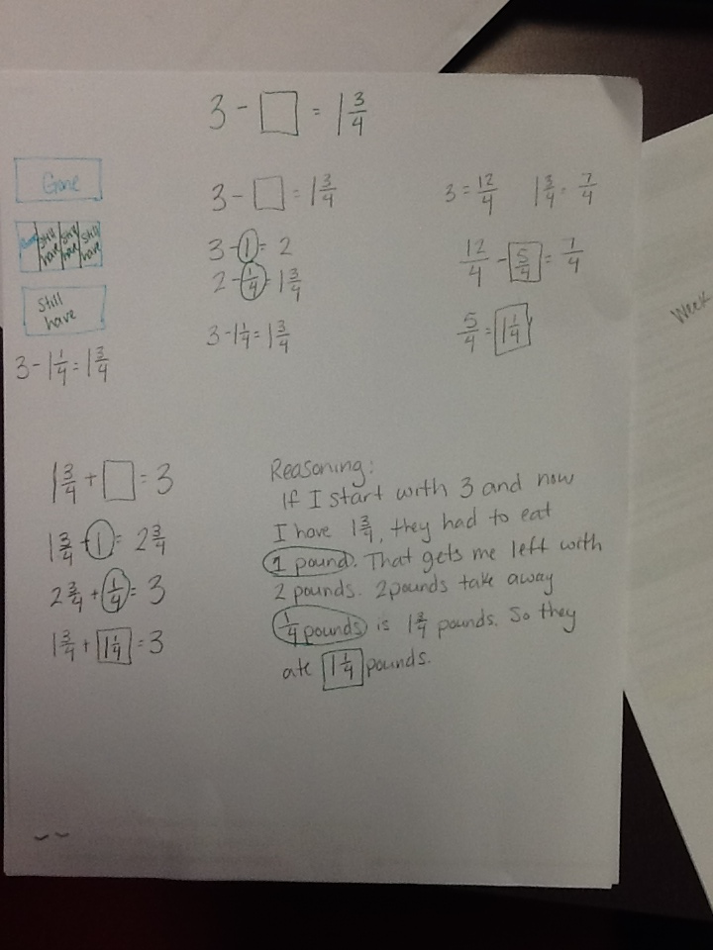
Incorporate
TECHNOLOGY
Week 11
Possible Lesson
Plan
DAILY LESSONS
Plan
DAILY LESSONS
Launch
– Show pictures of fudge. What do you think 1 pound of fudge looks like? Is it a lot or a little? How much fudge do you think you could eat (in pounds) Could you eat a whole pound?
– Introduce the problem. Have students visualize the friends eating fudge.
-It is your job to figure out how much fudge they were able to eat.
Students Independently Work
-Students work to solve the problem
-Teacher listens, notices and confers
-Teacher selects strategies to share
Discussion
-Compare and analyze strategies, mathematical understanding, notation, misconceptions, etc.
5.NF.1 and 5.NF.2
Possible student strategies

Slide 24
Incorporate
TECHNOLOGY
Week 15
Possible Lesson
Plan
DAILY LESSONS
Introductory Lesson
-APK – Show LearnZillion Video .
Students Cooperatively Work
-Students work on creating the line plot on a piece of construction paper.
-Students discuss how they will have to label their line plot.
Questions
Which length has the most?
Which length has the least?
What is the range of our line plot data?
Learn Zillion Video Resources
1
https://learnzillion.com/lessons/3455-solve-multi-step-problems-using-information-in-a-line-plot
2
https://learnzillion.com/lessons/3460-use-the-information-from-more-than-one-line-plot-to-solve-problems
5.MD.2

Slide 25
other Lessons and resources are available online.
Plan DAILY LESSONS
Incorporate TECHNOLOGY
Notes:
If you get here…

Slide 26
NEW Teacher Created Resources pages!!!
RESOURCES
Beth Pesnell
Elementary Curriculum Specialist
bpesnell@rps.k12.ar.us

