Slide 1

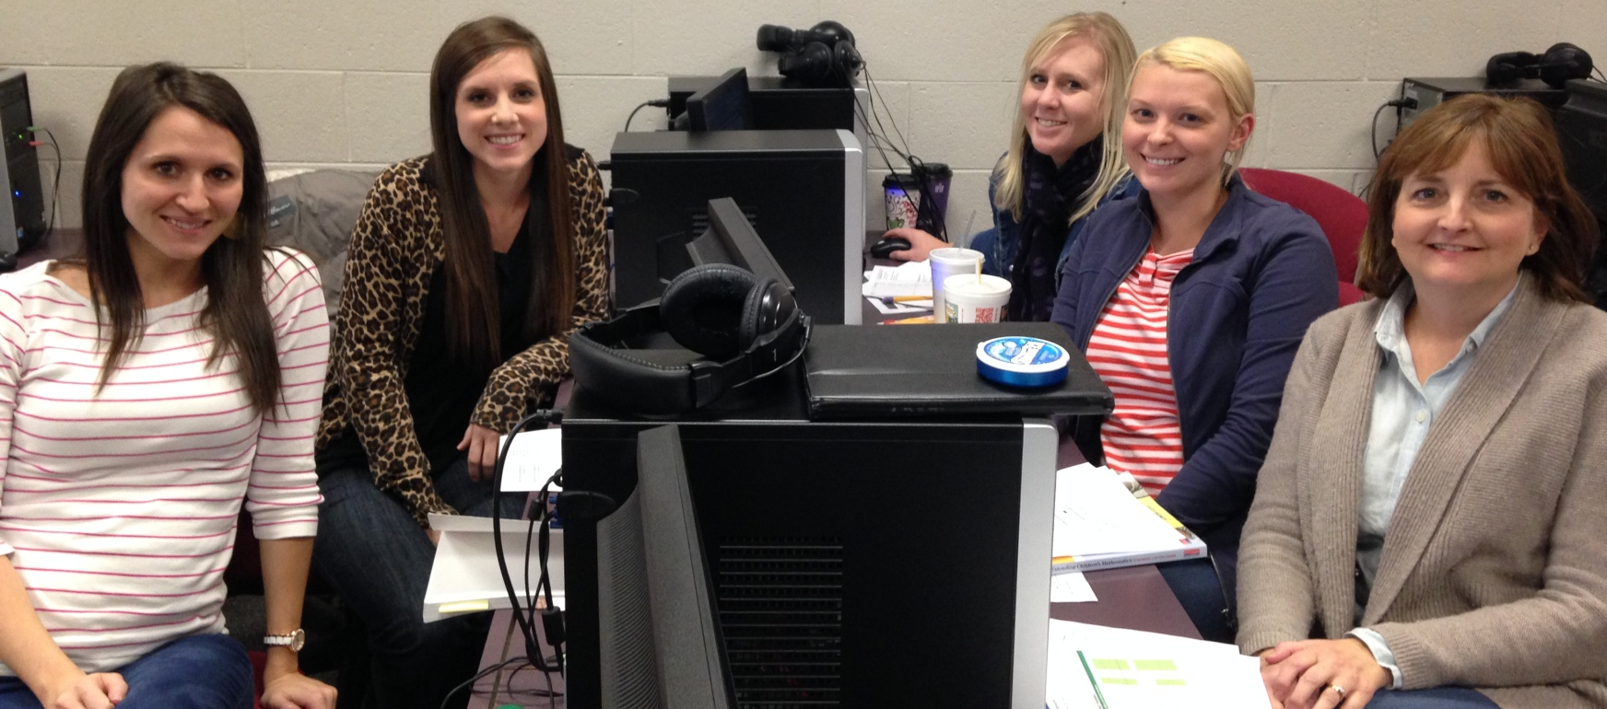

Operations with Fractions
5th Grade Unit 4
Unit Planning Team:
Traci Rhoades (RG), Paige Brown (NS),
Brooke Bradley (LW), Stacy Dustman (ET), Pam Keith (ET)

Slide 2
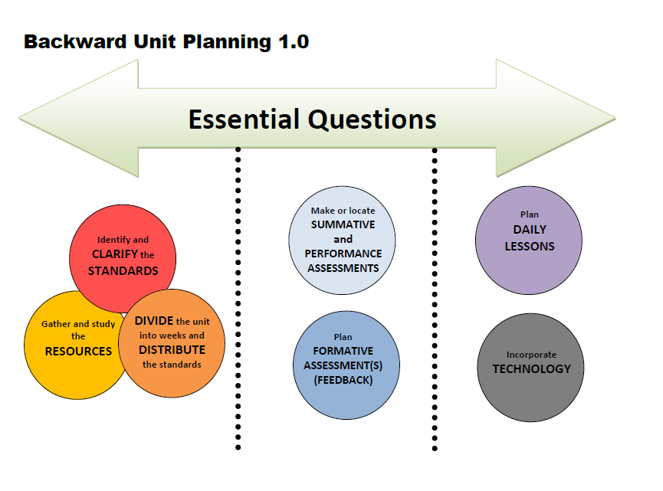

Slide 3

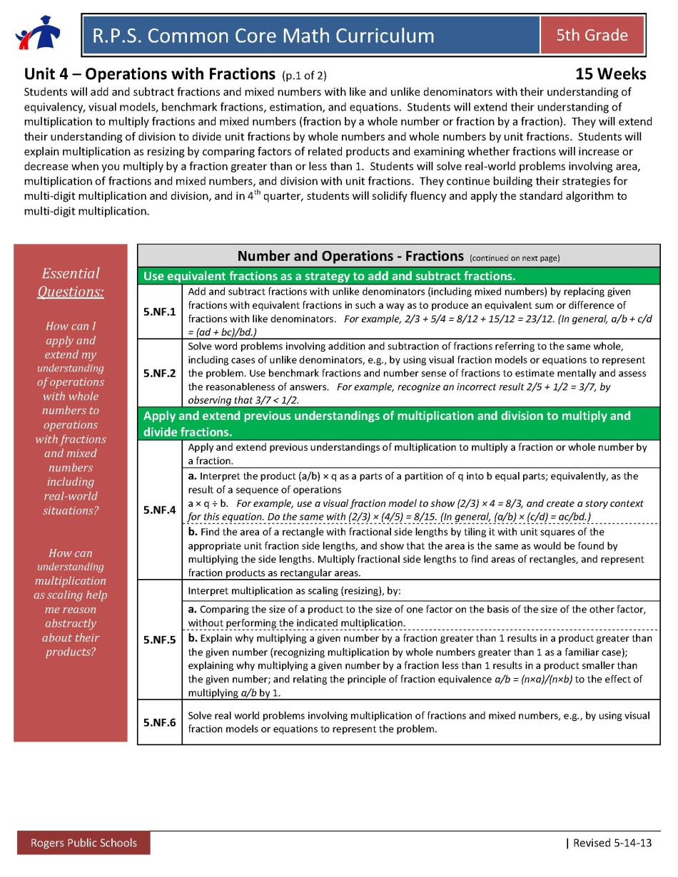
Essential Questions
How can I apply and extend my understanding of operations with whole numbers to operations with fractions and mixed numbers including real-world situations?
How can understanding multiplication as scaling help me reason abstractly about their products?

Slide 4

NF.1 and NF.2: students had
experiences in Unit 2 through their
work with equal sharing and
multiple groups problems.
NF.4 a: This standard is new. Now the number of groups is a fractional amount, not just a whole number of groups.
Fraction times a whole number and fraction times a fraction.
NF.5 : This idea continues from
4th grade multiplicative comparison.
Identify and CLARIFY the
STANDARDS
**Highlighted standards are new this unit.

Slide 5
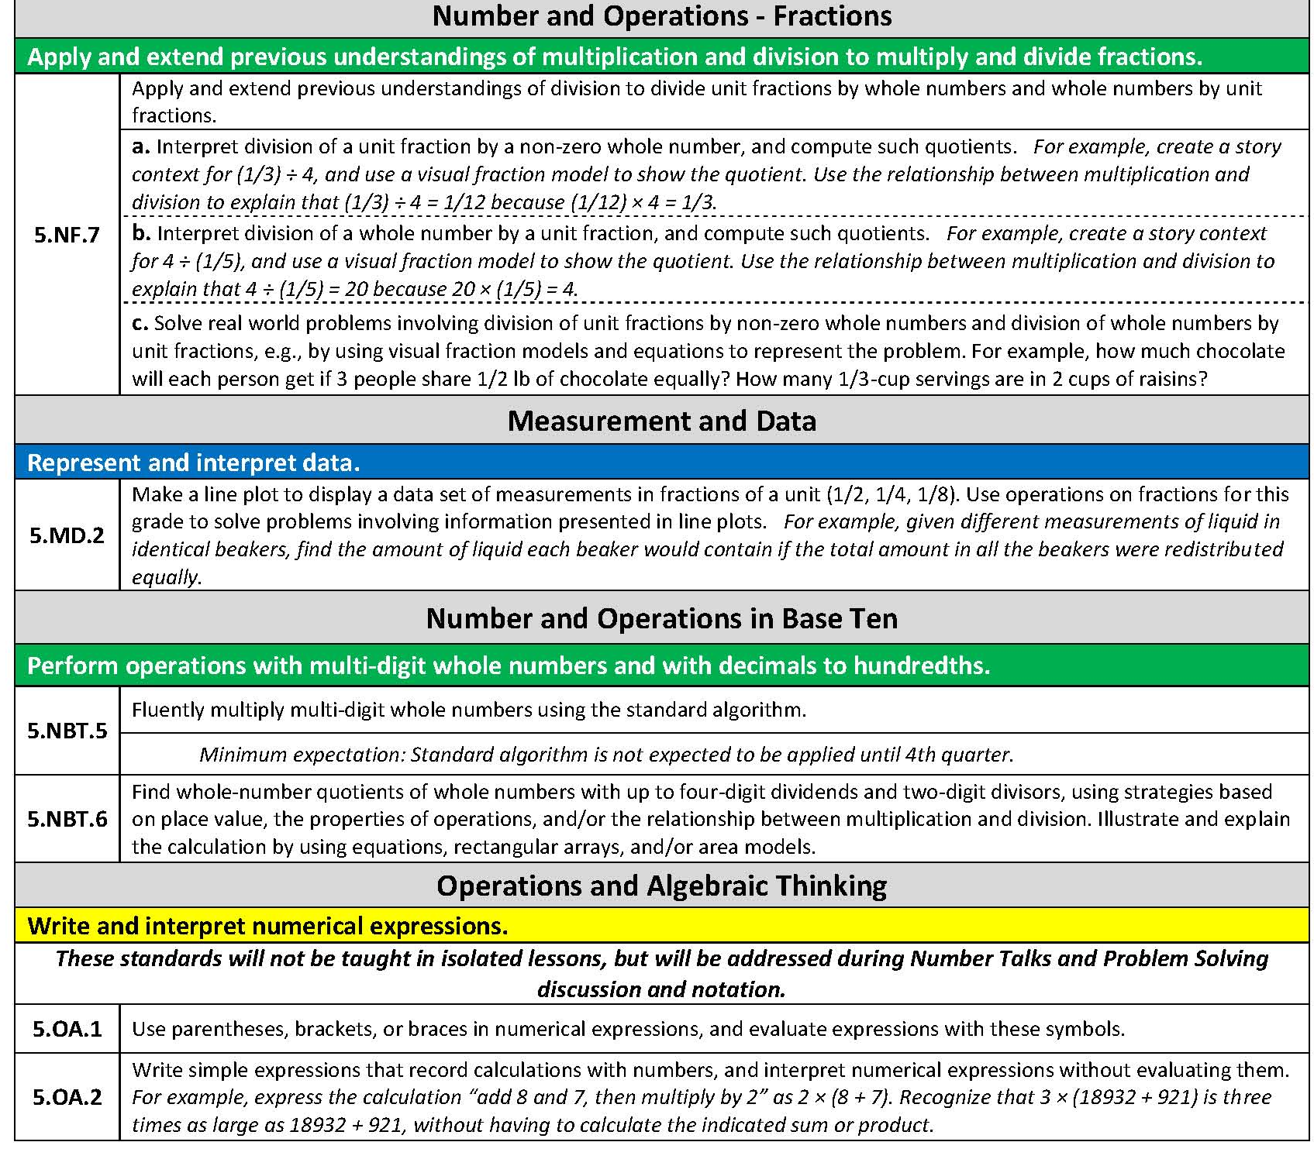
5.NF. 7a: This standard is new and addresses a unit fraction (1/2, 1/3, 1/7…) divided by a whole number.
NF.7 b continues from Unit 2
Whole number divided by a unit fraction
Identify and CLARIFY the
STANDARDS
**Highlighted standards are new this unit.
Notes:
5. MD.1
Could use Millions to Measure book

Slide 6
Big Ideas for Unit 4:
Fractions: In and out of context
Multiply fractions (including mixed numbers): NF.4, NF.5, NF.6
Unit 2: whole number X fraction
Unit 4: fraction X whole number
fraction X fraction
area problems
scaling idea
Dividing fractions: (NF.7)
Unit 2: Whole number divided by unit fraction
Unit 4: Unit fraction divided by whole number
Add/Subtract fractions: (NF.1, NF.2) with like and unlike denominators
Unit 2: experiences through equal sharing and multiple groups problems
Unit 4: Continued experiences through equal sharing and multiple
groups problems PLUS equivalency problems and addition and
subtraction problem types
(MD.2: solve fraction problems involving information presented in line plots)
Whole Number Operations: (NBT.5, NBT.6)
When solving multiplication and division problems involving fractions, whole number
sets can be included as well as decimal number sets.

Slide 7
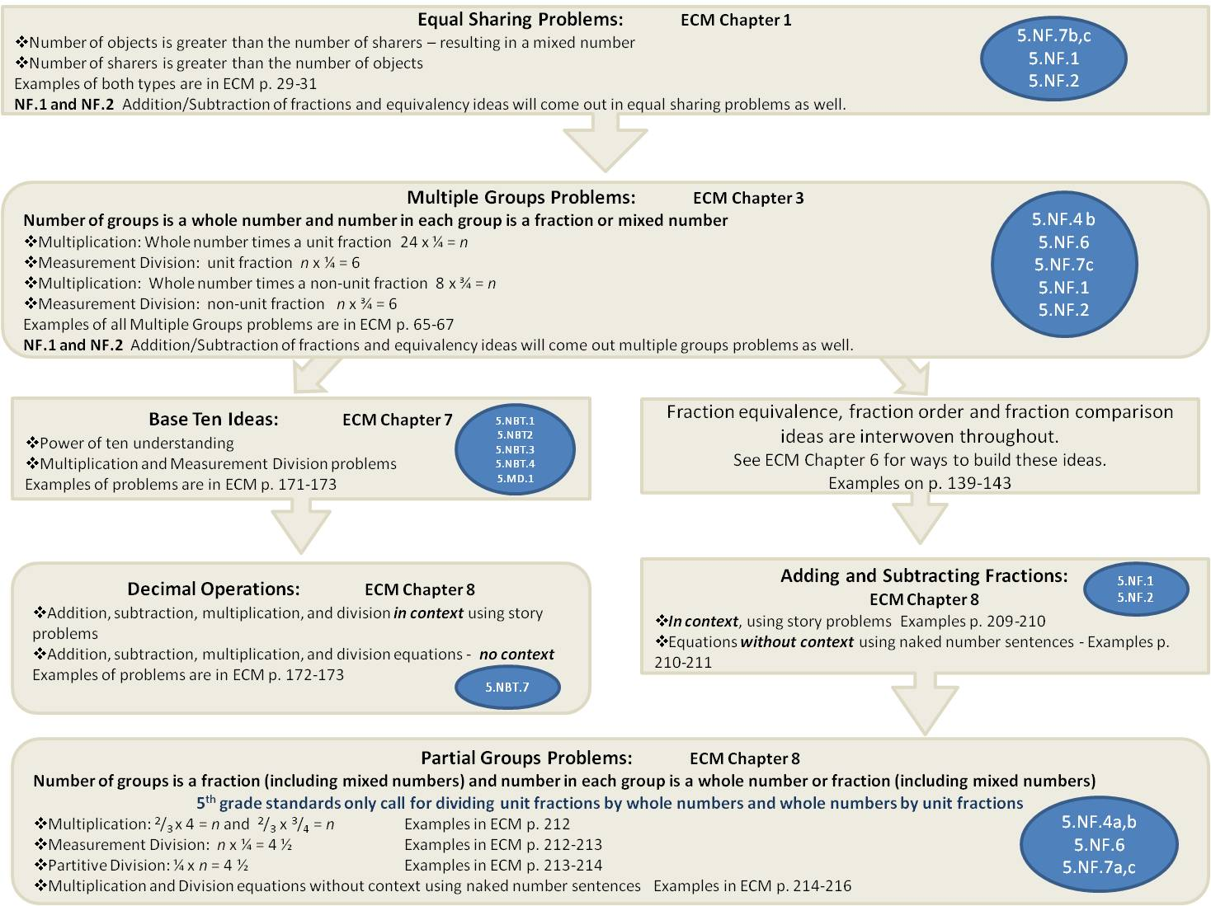
Whole Number Operations
Multi-Digit Division
with up to four-digit dividends and two-digit divisors
5.NBT.6
Multi-Digit Multiplication
5.NBT.5
Problem Type Charts

Slide 8
Equal Sharing Problems: ECM Chapter 1
Number of objects is greater than the number of sharers – resulting in a mixed number
Number of sharers is greater than the number of objects
Examples of both types are in ECM p. 29-31
NF.1 and NF.2 Addition/Subtraction of fractions and equivalency ideas will come out in equal sharing problems as well.
5.NF.7b,c
5.NF.1
5.NF.2
Multiple Groups Problems: ECM Chapter 3
Number of groups is a whole number and number in each group is a fraction or mixed number
Multiplication: Whole number times a unit fraction 24 x ¼ = n
Measurement Division: unit fraction n x ¼ = 6
Multiplication: Whole number times a non-unit fraction 8 x ¾ = n
Measurement Division: non-unit fraction n x ¾ = 6
Examples of all Multiple Groups problems are in ECM p. 65-67
NF.1 and NF.2 Addition/Subtraction of fractions and equivalency ideas will come out multiple groups problems as well.
5.NF.4 b
5.NF.6
5.NF.7c
5.NF.1
5.NF.2
Base Ten Ideas: ECM Chapter 7
Power of ten understanding
Multiplication and Measurement Division problems
Examples of problems are in ECM p. 171-173
Fraction equivalence, fraction order and fraction comparison ideas are interwoven throughout.
See ECM Chapter 6 for ways to build these ideas.
Examples on p. 139-143
5.NBT.1
5.NBT2 5.NBT.3 5.NBT.4 5.MD.1
Decimal Operations: ECM Chapter 8
Addition, subtraction, multiplication, and division in context using story problems
Addition, subtraction, multiplication, and division equations - no context
Examples of problems are in ECM p. 172-173
Adding and Subtracting Fractions:
ECM Chapter 8
In context, using story problems Examples p. 209-210
Equations without context using naked number sentences - Examples p. 210-211
5.NF.1
5.NF.2
5.NBT.7
Partial Groups Problems: ECM Chapter 8
Number of groups is a fraction (including mixed numbers) and number in each group is a whole number or fraction (including mixed numbers)
5th grade standards only call for dividing unit fractions by whole numbers and whole numbers by unit fractions
Multiplication: ²/₃ x 4 = n and ²/₃ x ³/₄ = n Examples in ECM p. 212
Measurement Division: n x ¼ = 4 ½ Examples in ECM p. 212-213
Partitive Division: ¼ x n = 4 ½ Examples in ECM p. 213-214
Multiplication and Division equations without context using naked number sentences Examples in ECM p. 214-216
5.NF.4a,b
5.NF.6
5.NF.7a,c

Slide 9

Week | Standards | Structure/Resources
1 | 5.NF.1 and 5.NF.2: students will be adding and subtracting fractions when solving equal sharing/multiple groups problems but NF.1 and NF.2 will be directly addressed through problems later in the quarter 5.NF.7b 5.NF.7c 5.NF.4b 5.NF.6 | Equal Sharing/ Multiple Groups Problems (pg 29-31 ECM Book) Include whole numbers in problems to continue to address NBT. 5 and NBT.6 Number Talks: Supplemental Number Talks for Unit 4 Supplemental Number Talks for Unit 4 with Mixed Numbers Fractions and Decimals
2 | 5.NF.1 and 5.NF.2: students will be adding and subtracting fractions when solving equal sharing/multiple groups problems but NF.1 and NF.2 will be directly addressed through problems later in the quarter 5.NF.7b 5.NF.7c 5.NF.4b 5.NF.6 | Equal Sharing/ Multiple Groups Problems (pg 29-31 ECM Book) Include whole numbers in problems to continue to address NBT. 5 and NBT.6 Number Talks: Supplemental Number Talks for Unit 4 Supplemental Number Talks for Unit 4 with Mixed Numbers Fractions and Decimals
DIVIDE the unit into weeks and DISTRIBUTE the standards

Slide 10
Week | Standards | Structure/Resources
3 | 5.NF.1 and 5.NF.2: students will be adding and subtracting fractions when solving equal sharing/multiple groups problems but NF.1 and NF.2 will be directly addressed through problems later in the quarter 5.NF.7b 5.NF.7c 5.NF.4b 5.NF.6 | Equal Sharing/ Multiple Groups Problems (pg 29-31 ECM Book) Include whole numbers in problems to continue to address NBT. 5 and NBT.6 Number Talks: Fractions and Decimals Supplemental Number Talks for Unit 4 Supplemental Number Talks for Unit 4 with Mixed Numbers
DIVIDE the unit into weeks and DISTRIBUTE the standards
4 | 5.NF.1 5.NF.2 5.NF.7b 5.NF.7c 5.NF.4b 5.NF.6 5.NF.5 | Equivalence Problems from (Chapter 6 ECM) These types of problems are necessary to build idea of equivalence which is important before adding and subtracting fractions Tasks addressing 5.NF.5 Running a Mile Comparing a Number and a Product Comparing Products Comparing a Number and a Product parts a-h Calculator Trouble Fundraising Grass Seedlings Reasoning about Multiplication Half a Recipe Making Cookies Number Talks: Fractions and Decimals Supplemental Number Talks for Unit 4 Supplemental Number Talks for Unit 4 with Mixed Numbers

Slide 11
Week | Standards | Structure/Resources
5 | 5.NF.1 5.NF.2 5.NF.7b 5.NF.7c 5.NF.4b 5.NF.6 5.NF.5 | Equivalence Problems from (Chapter 6 ECM) These types of problems are necessary to build idea of equivalence which is important before adding and subtracting fractions Tasks addressing 5.NF.5 Running a Mile Comparing a Number and a Product Comparing Products Comparing a Number and a Product parts a-h Calculator Trouble Fundraising Grass Seedlings Reasoning about Multiplication Half a Recipe Making Cookies Number Talks: Fractions and Decimals Supplemental Number Talks for Unit 4 Supplemental Number Talks for Unit 4 with Mixed Numbers
DIVIDE the unit into weeks and DISTRIBUTE the standards
6 | 5.NF.1 5.NF.2 | Adding and Subtracting Fraction Problems (ECM pg 209-211) Include decimal number sets when posing these problems to keep students thinking about decimal operations Number Talks Supplemental Number Talks for Unit 4 Supplemental Number Talks for Unit 4 with Mixed Numbers

Slide 12
Week | Standards | Structure/Resources
7 | 5.NF.1 5.NF.2 | Adding and Subtracting Fraction Problems (ECM pg 209-211) Include decimal number sets when posing these problems to keep students thinking about decimal operations Number Talks Supplemental Number Talks for Unit 4 Supplemental Number Talks for Unit 4 with Mixed Numbers
DIVIDE the unit into weeks and DISTRIBUTE the standards
DIVIDE the unit into weeks and DISTRIBUTE the standards

Slide 13
Week | Standards | Structure/Resources
8 | 5.NF.1 5.NF.2 | Adding and Subtracting Fraction Problems (ECM pg 209-211) Include decimal number sets when posing these problems to keep students thinking about decimal operations Number Talks Supplemental Number Talks for Unit 4 Supplemental Number Talks for Unit 4 with Mixed Numbers
9 | 5.NF.1 5.NF.2 5.NF.4a 5.NF.4b: area 5.NF.6 5.NF.7a 5.NF.7c | 2 Days: Adding and Subtracting Fractions(ECM pg 209-211) Include decimal number sets when posing these problems to keep students thinking about decimal operations 3 Days: Partial Groups Problems (ECM Book pg 212-213) **Include area problems and whole numbers for NBT.5 and NBT.6 Number Talks:
DIVIDE the unit into weeks and DISTRIBUTE the standards

Slide 14
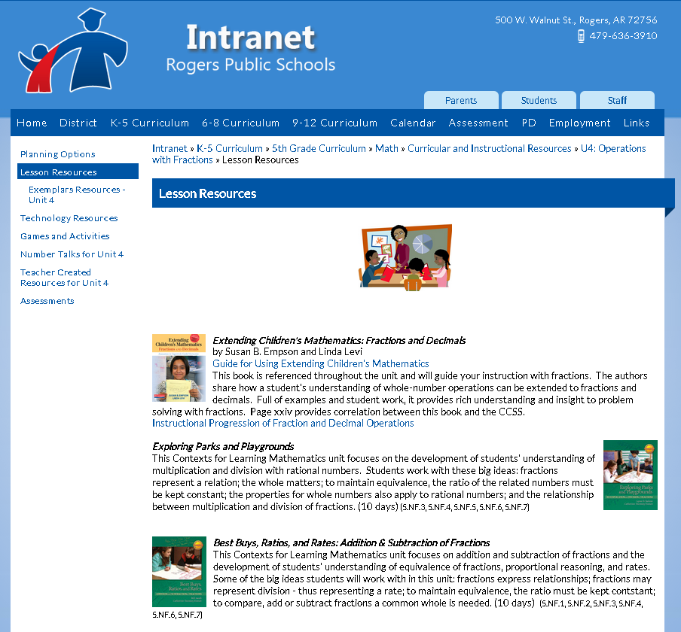
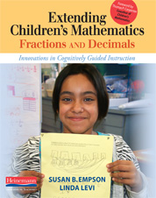
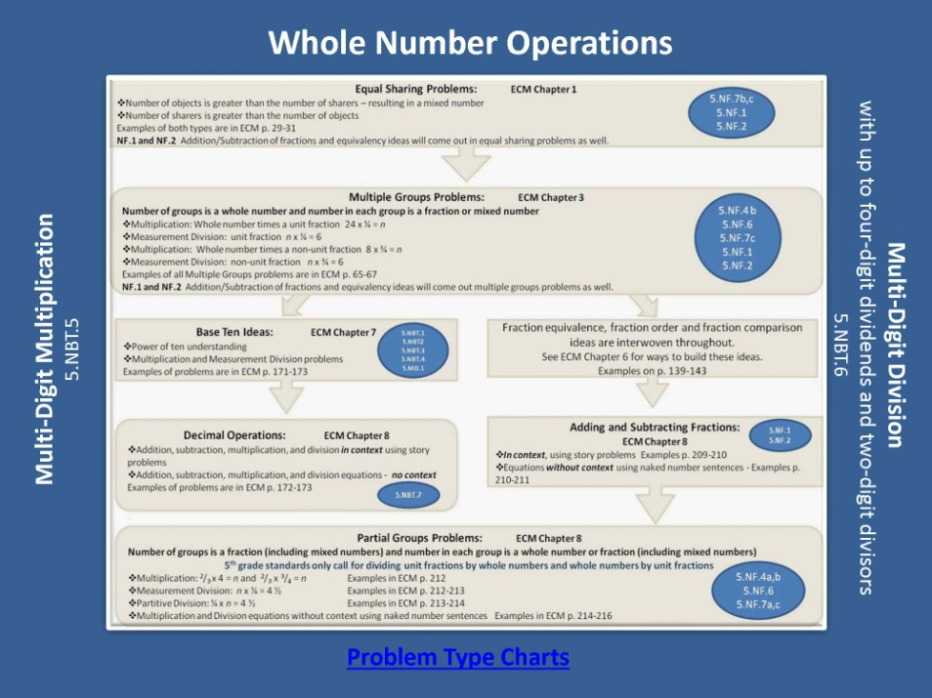

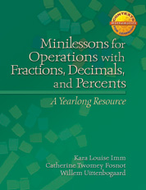
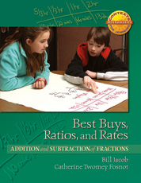
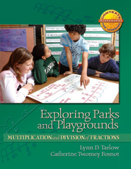
Gather and study the RESOURCES
Notes:
Are you highlighting any specific resource in this quarter? Borrowing/adapting from other grade level’s resources?

Slide 15
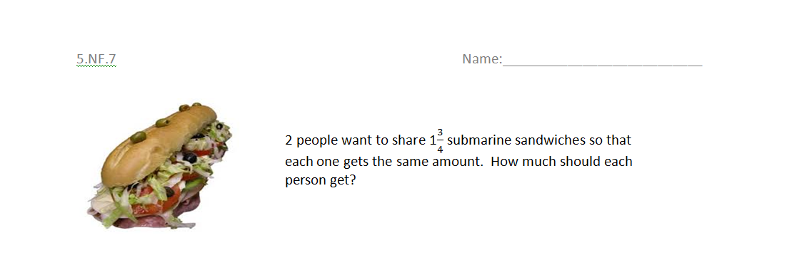
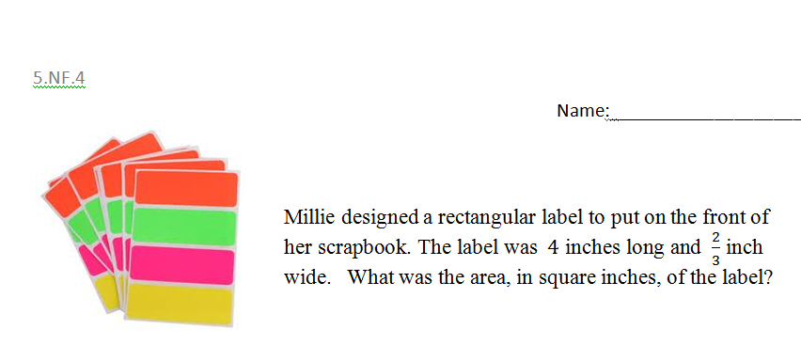
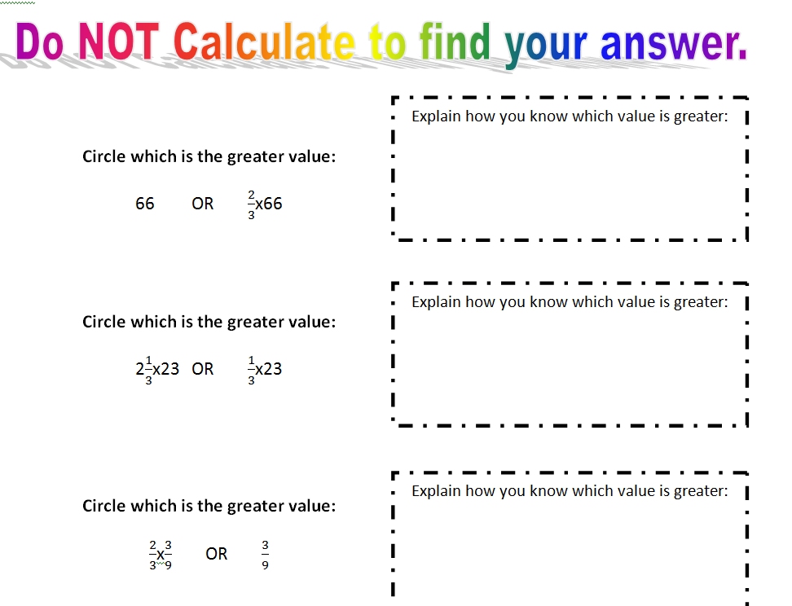

Options for Assessment – available online for Unit 4
Make or locate SUMMATIVE
and PERFORMANCE
ASSESSMENTS

Slide 16

Lessons and resources are available online.
Plan DAILY LESSONS
Incorporate TECHNOLOGY
Notes:
If you get here…

Slide 17



NEW Teacher Created Resources pages!!!
RESOURCES
Beth Pesnell
Elementary Curriculum Specialist
bpesnell@rps.k12.ar.us

