Slide 1
Kindergarten Unit 2
Model Lessons for Foundational Skills
RFK.1,b,c

Slide 2
Lesson 1
RFK.1.b,c Demonstrate understanding of the organization and basic features of print.
  b. Recognize that spoken words are represented in written language by specific sequences of letters.
  c. Understand that words are separated by spaces in print.

Slide 3
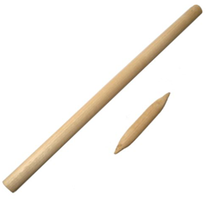
What do you notice?

Slide 4
Bed Bedroom

