Slide 1
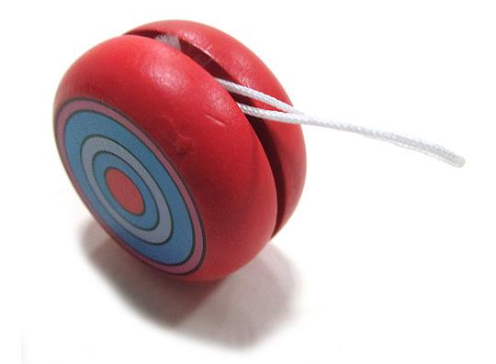
Yo yo

Slide 2
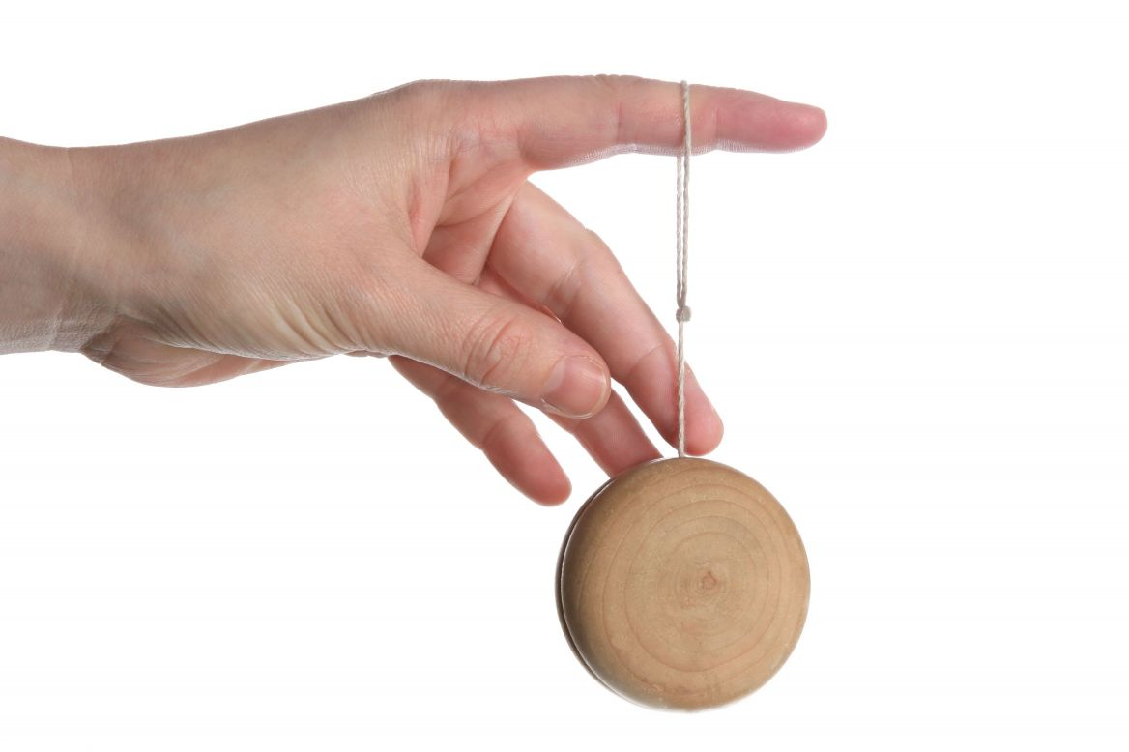

Slide 3
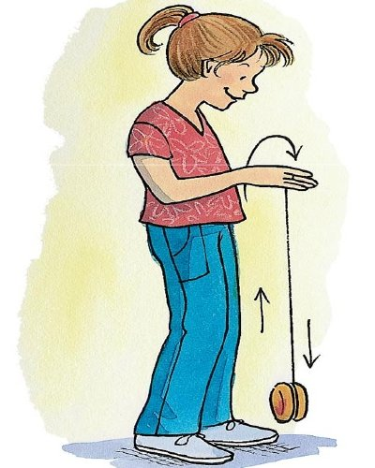
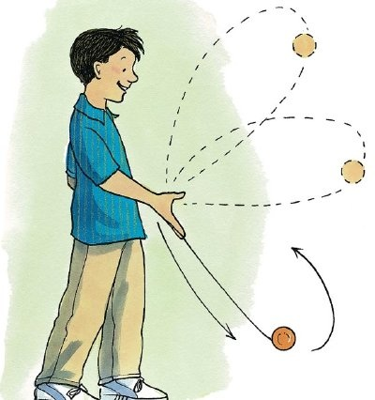

Slide 4
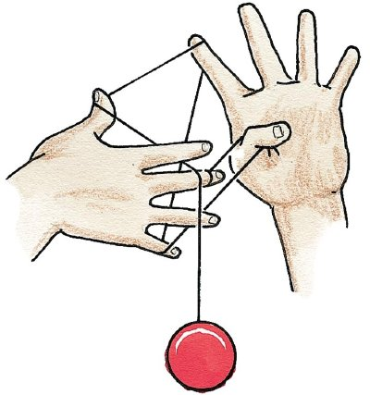

Slide 5


Slide 6

https://www.youtube.com/watch?v=KDiioSreoPc
Notes:
https://www.youtube.com/watch?v=KDiioSreoPc

Slide 7

https://www.youtube.com/watch?v=-x7ZxW4vinI
Notes:
https://www.youtube.com/watch?v=-x7ZxW4vinI

