Slide 1

Watch

Slide 2



Slide 3


Slide 4




Slide 5
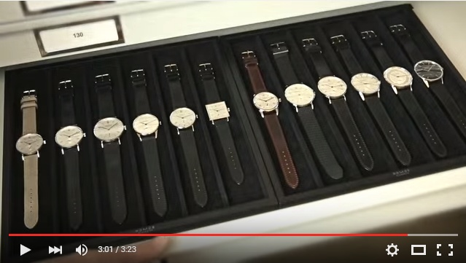
https://www.youtube.com/watch?v=UwpP_s8LV_Y

