Slide 1
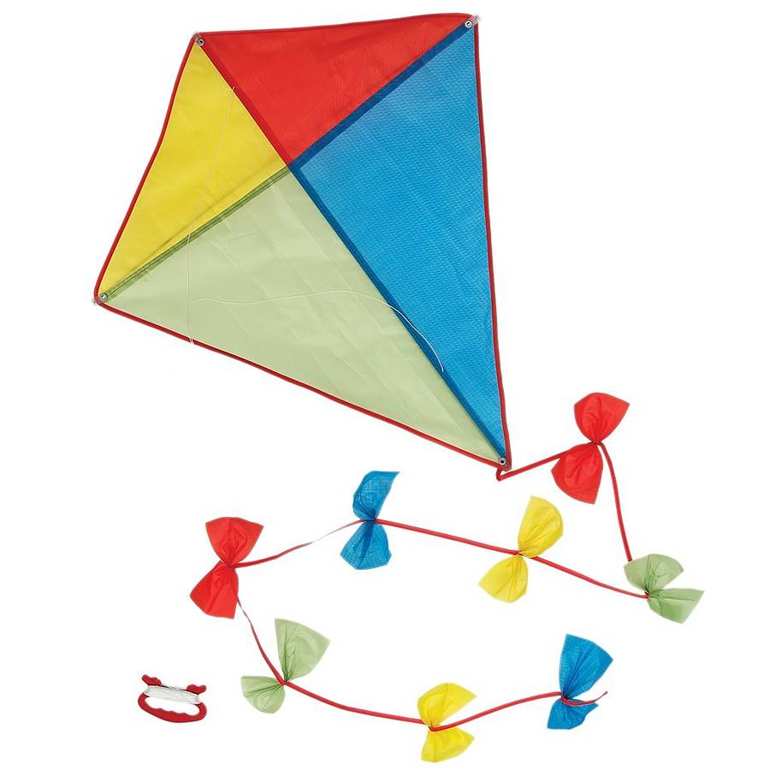
Kite

Slide 2


Slide 3
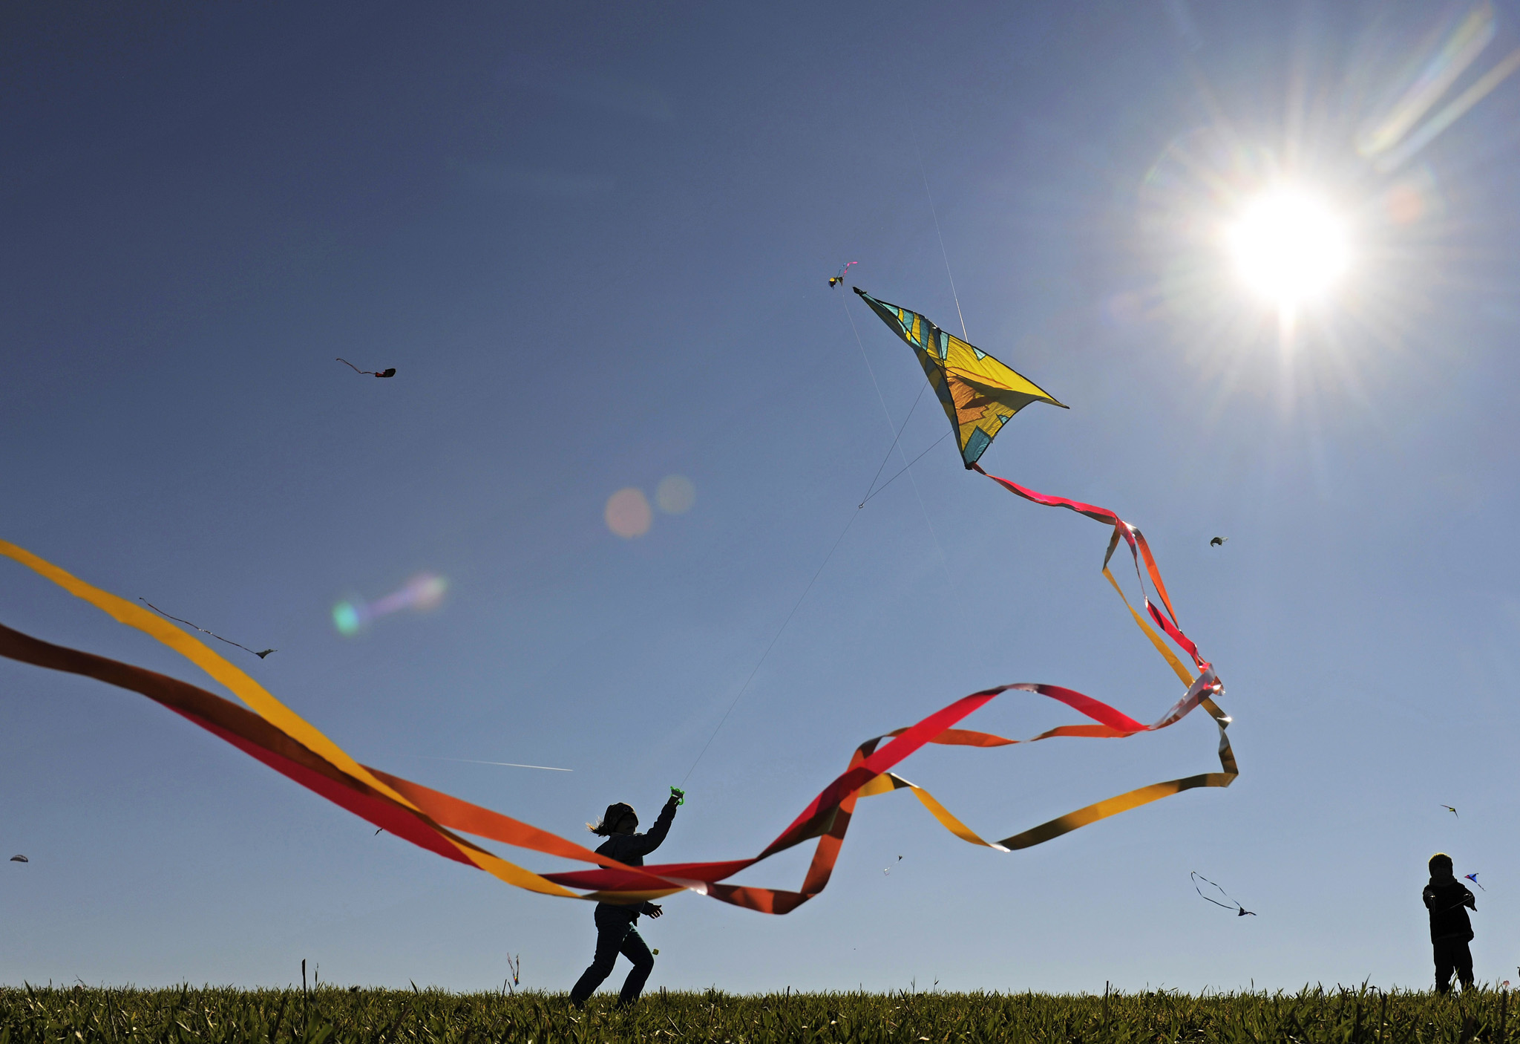

Slide 4
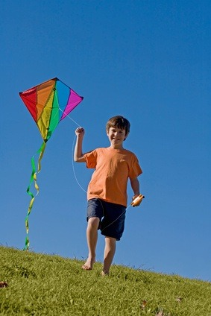


Slide 5
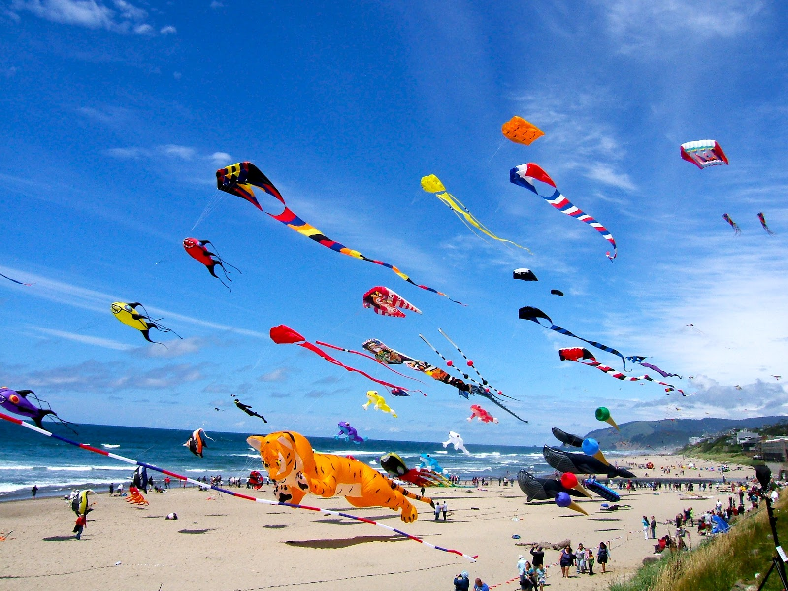

Slide 6
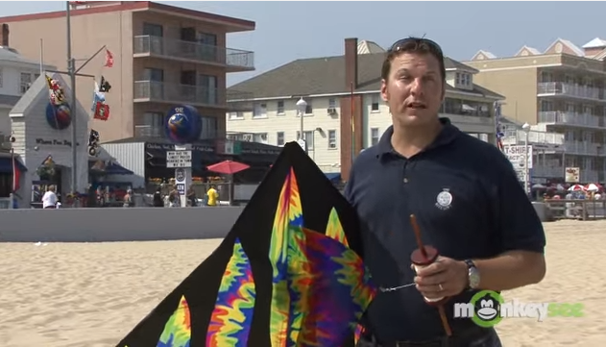
https://www.youtube.com/watch?v=QjxJYTEQn6Q
Notes:
https://www.youtube.com/watch?v=QjxJYTEQn6Q

Slide 7
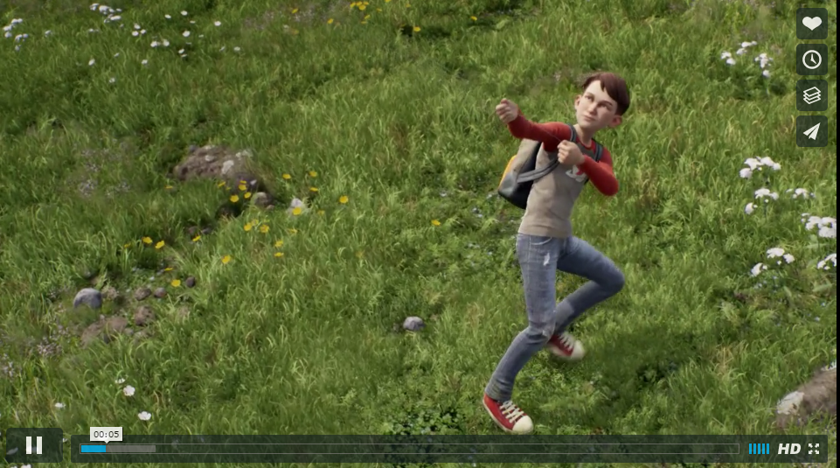
https://vimeo.com/121146483
Notes:
https://vimeo.com/121146483

