Slide 1
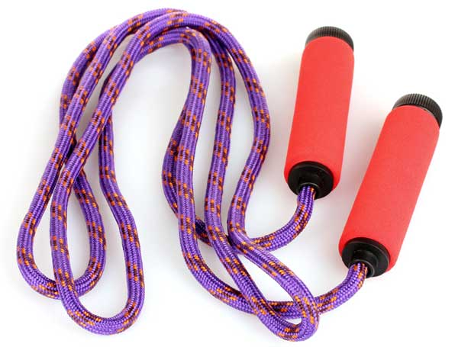
Jump rope

Slide 2




Slide 3


Slide 4

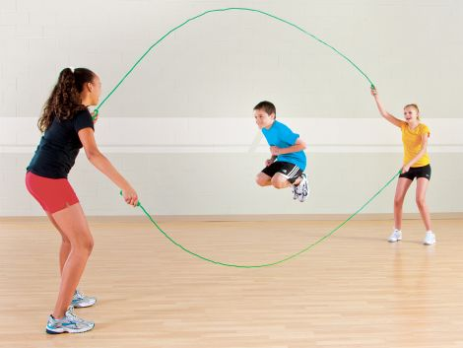

Slide 5
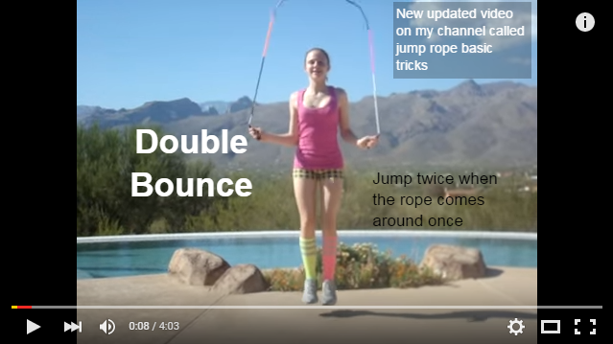
http://viewpure.com/inv9GmZ7VyI?start=0&end=0

