Slide 1
Spiral Up
Frieze Cards

Slide 2
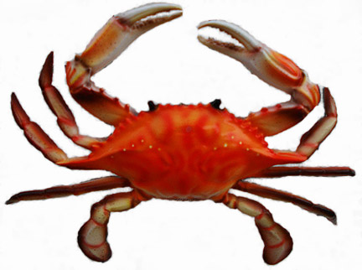
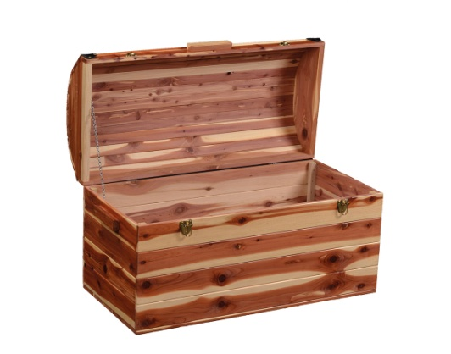
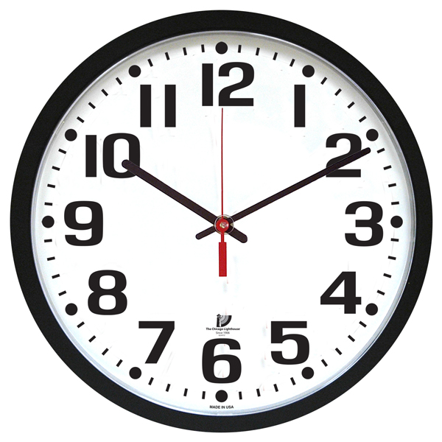
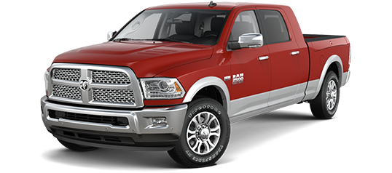
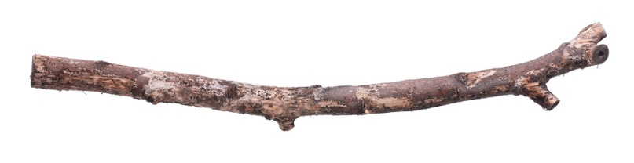
crab
chest
clock
truck
stick
Unit 1

Slide 3
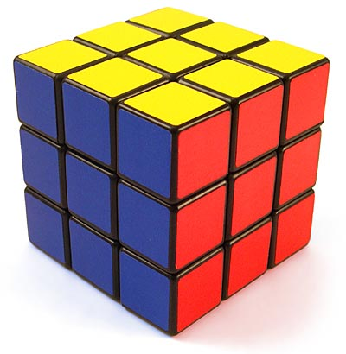
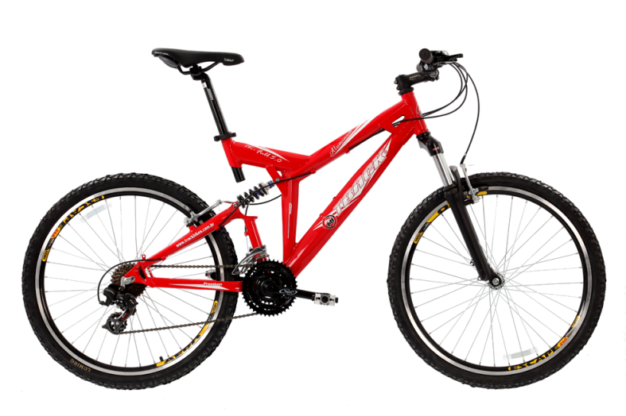

cube
bike
rose
Unit 2

Slide 4
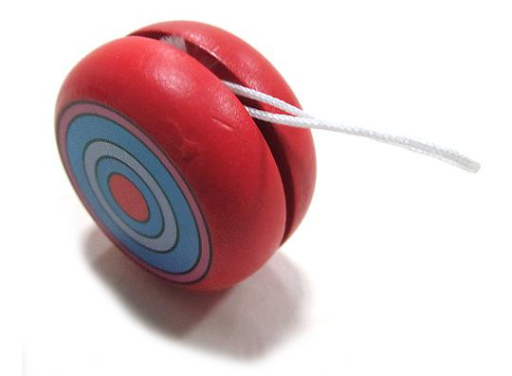
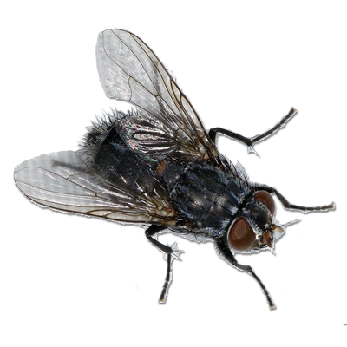
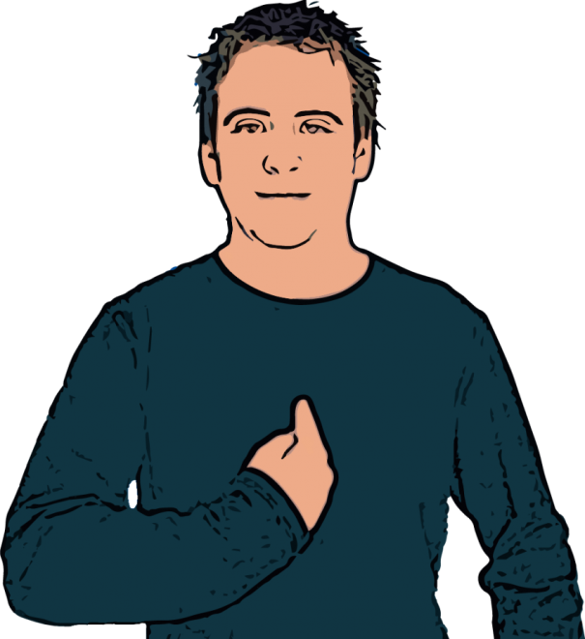
yo yo
fly
me
Unit 3

Slide 5
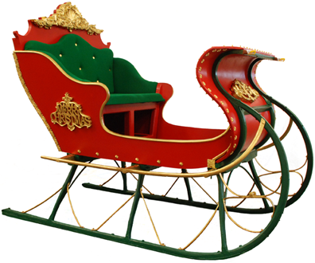
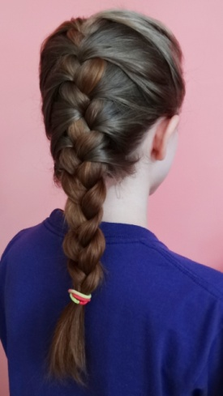
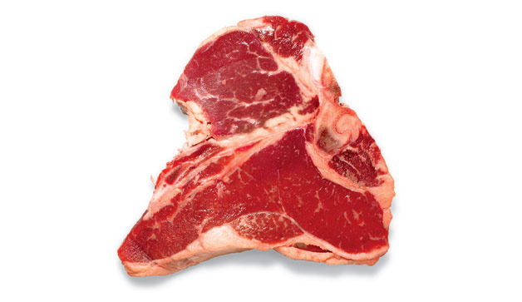
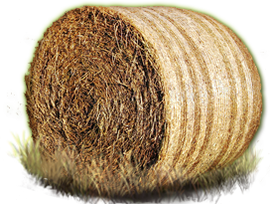
sleigh
braid
steak
hay
Unit 4

Slide 6
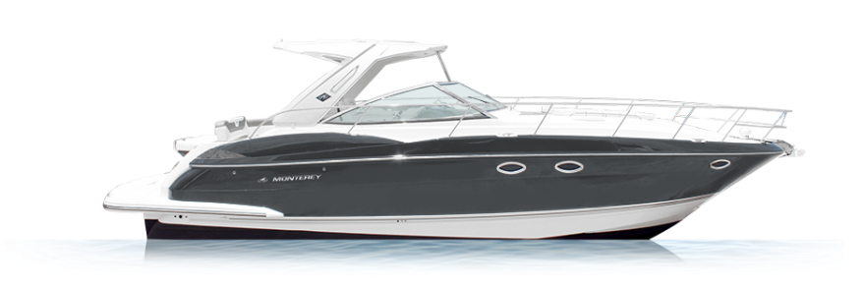
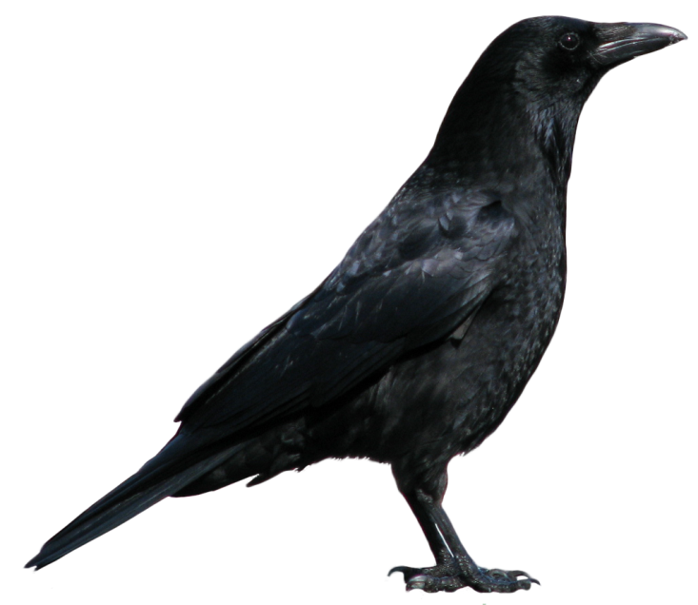
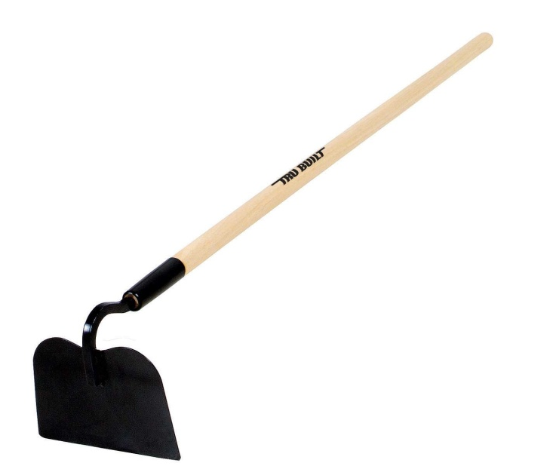
boat
crow
hoe
Unit 5

Slide 7
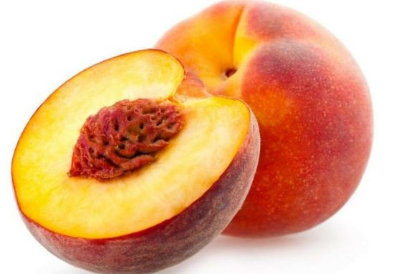
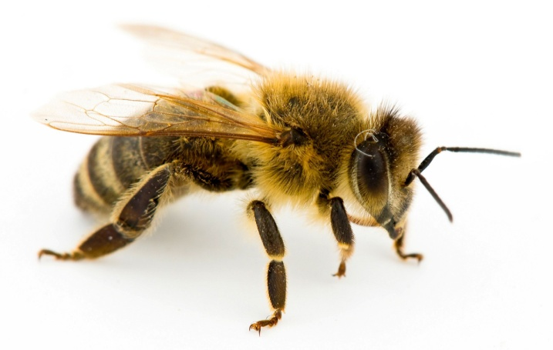
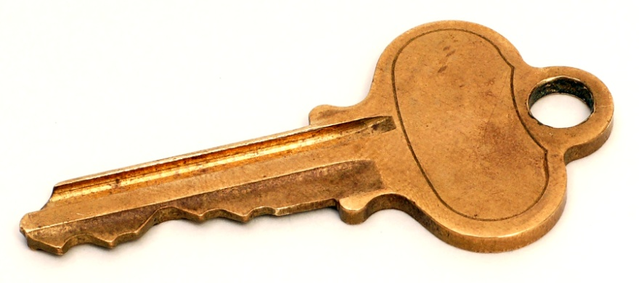

peach
bee
key
yield
Unit 6

Slide 8
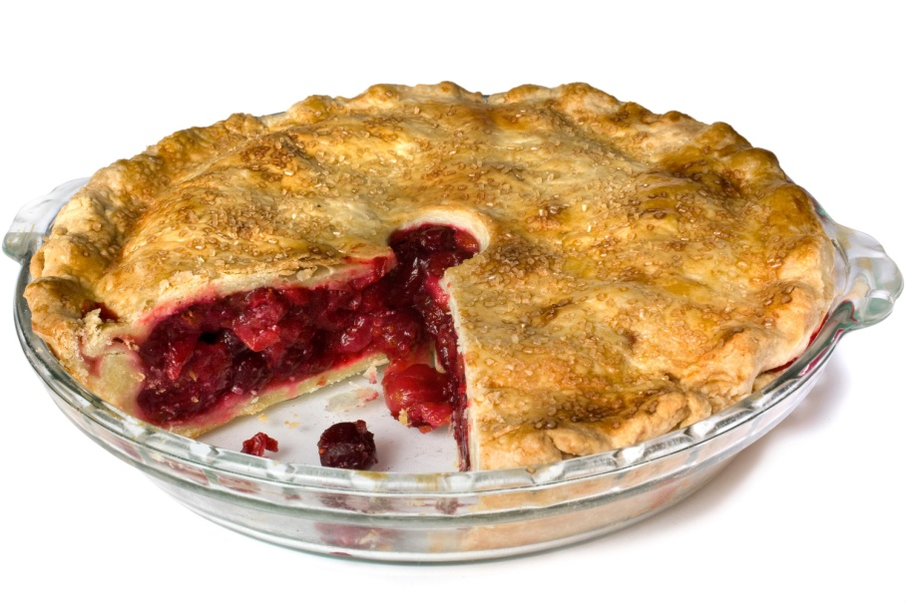
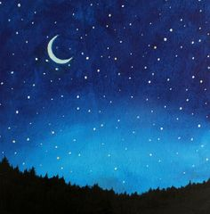
pie
night
Unit 7

Slide 9
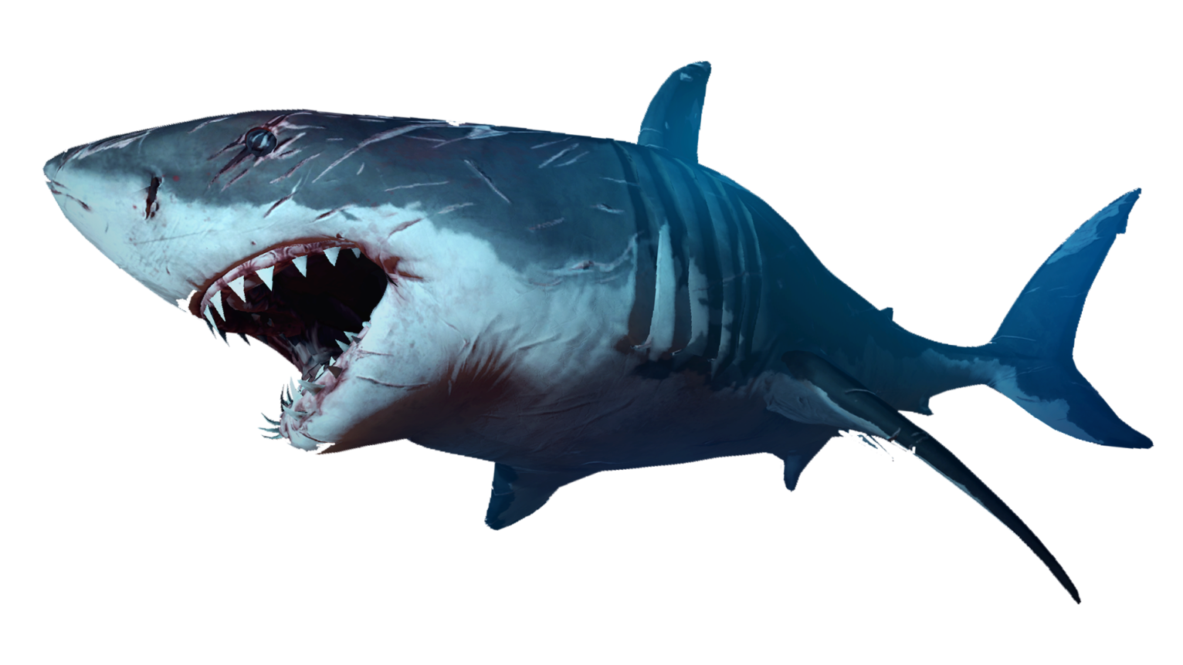
shark
Unit 8

Slide 10
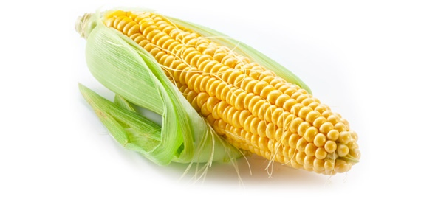
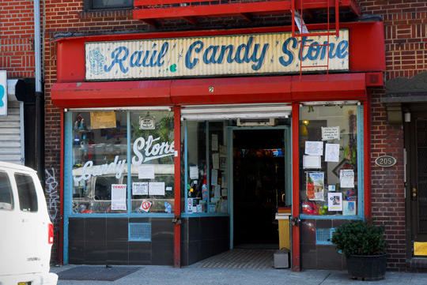

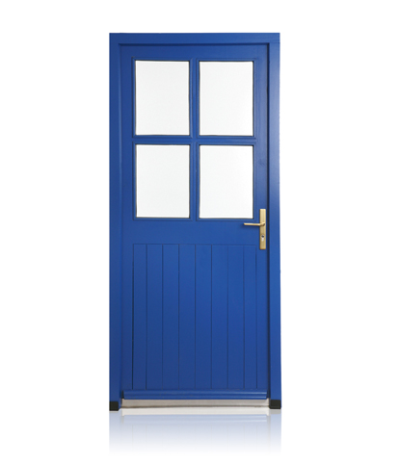
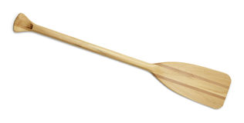
corn
store
four
door
oar
Unit 9

Slide 11
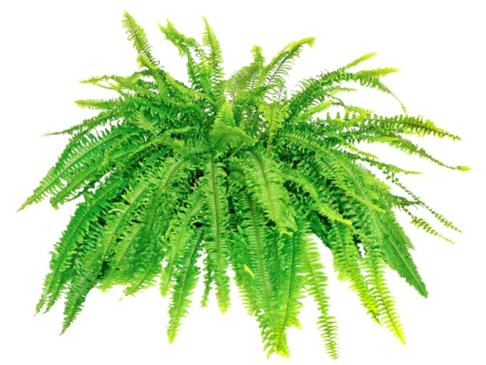
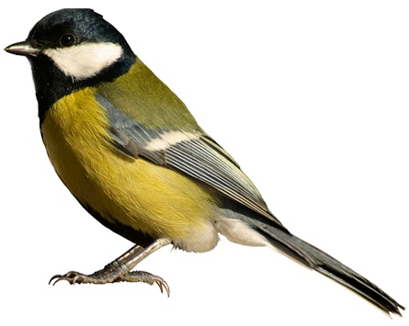

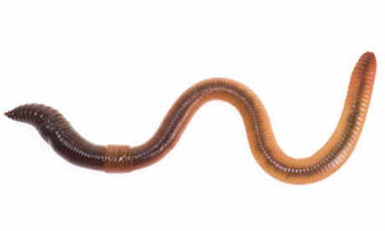
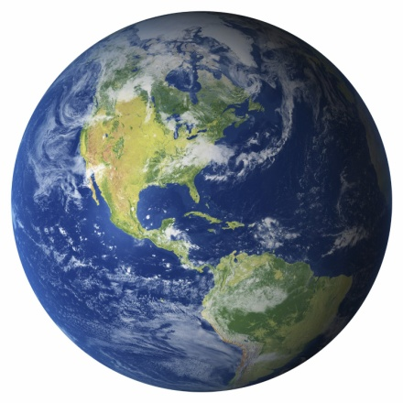
fern
bird
nurse
worm
Earth
Unit 10

Slide 12
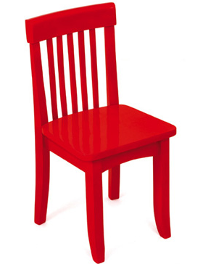
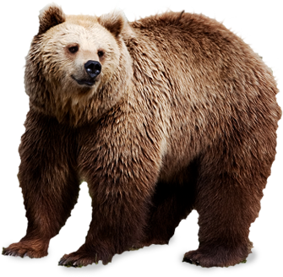

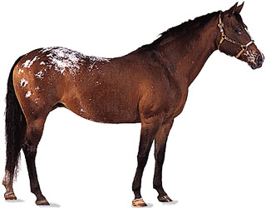
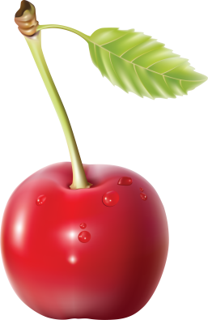
chair
bear
square
mare
cherry
Unit 11

Slide 13
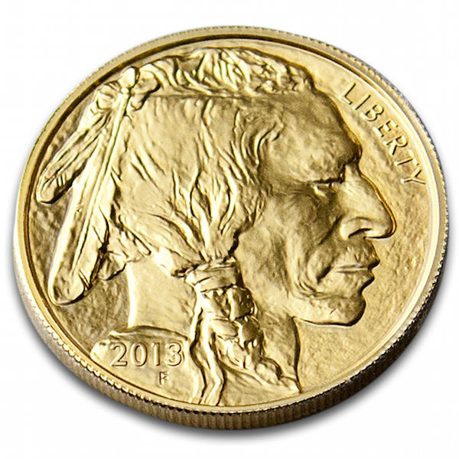
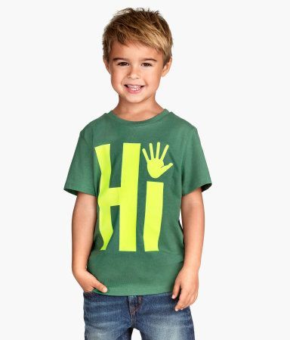
coin
boy
Unit 12

Slide 14
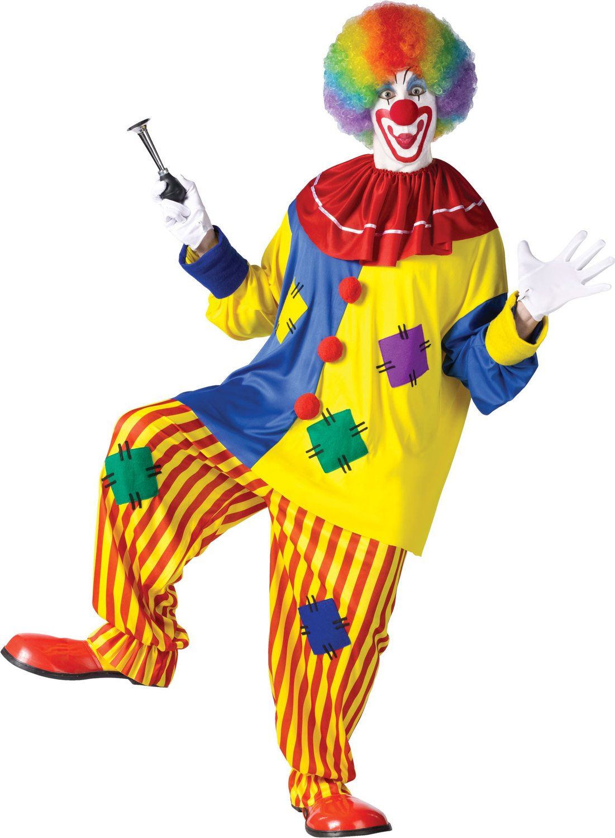
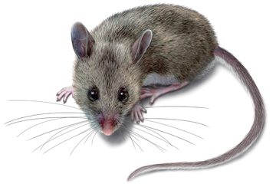
clown
mouse
Unit 13

Slide 15
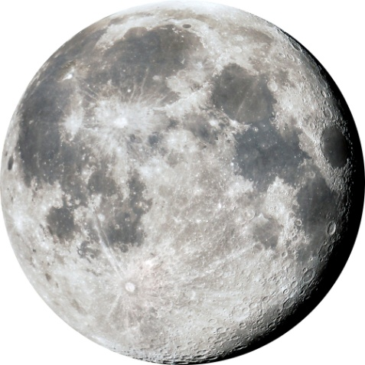
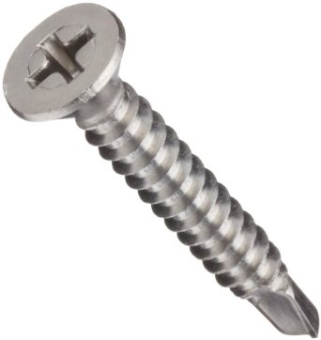

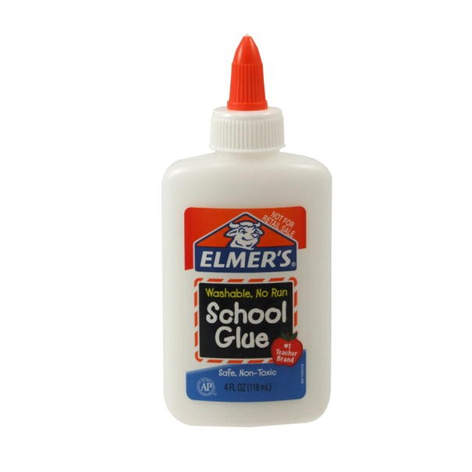
moon
screw
soup
glue
Unit 14

Slide 16

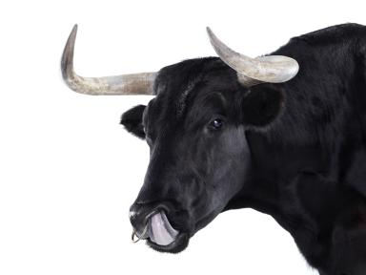
book
bull
Unit 15

Slide 17
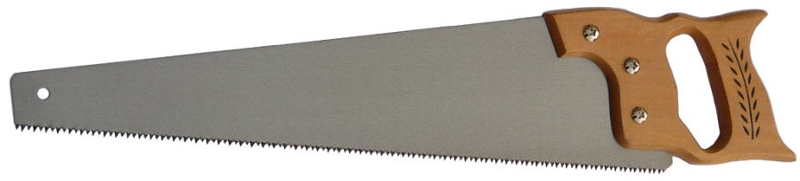
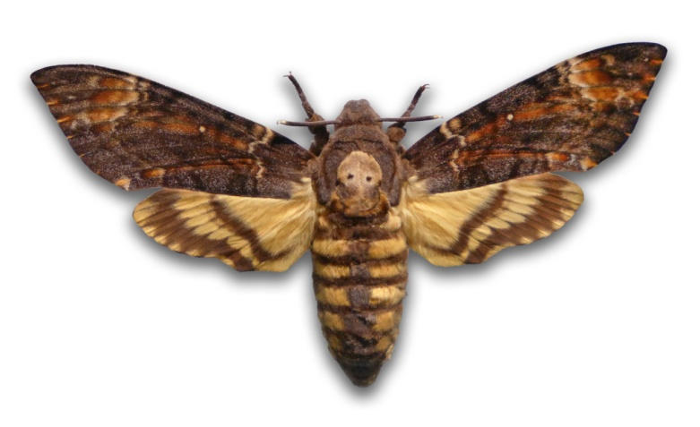
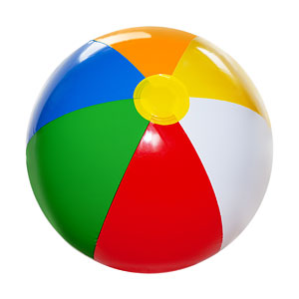
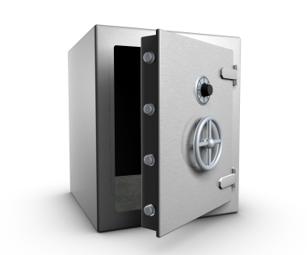
saw
moth
ball
vault
Unit 16

Slide 18

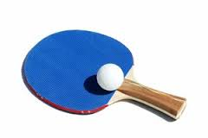
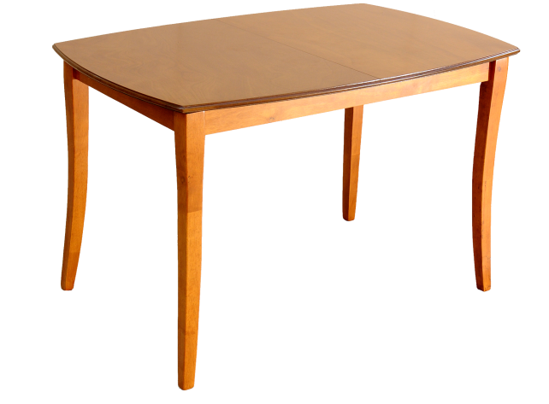
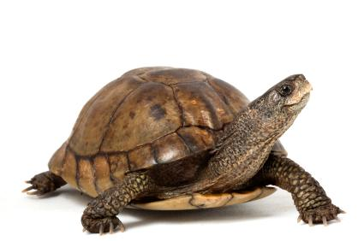
circle
paddle
table
turtle
Unit 17

Slide 19
Open
air mattress
grocery store
fire drill
sea horse
high jump
Unit 18

Slide 20
Closed
anybody
backyard
bluebird
wristwatch
sunflower
Unit 18

Slide 21
Hyphenated
merry-go-round
forty-five
grown-ups
well-known
time-out
Unit 18

Slide 22
Contractions
aren’t are not
isn’t is not
hasn’t has not
haven’t have not
Unit 19

Slide 23
Contractions
I’m I am
I’ve I have
I’ll I will
I’d I had
Unit 19

Slide 24
Contractions
she’s she is, she has
he’d he had,
he would
we’ve we have
we’re we are
Unit 19

Slide 25
Contractions
shouldn’t should not
couldn’t could not
wouldn’t would not
won’t will not
Unit 19

Slide 26
Regular Plurals
Base Word
cake
dog
dragon
puzzle
voice
apple
Word +s
cakes
dogs
dragons
puzzles
voices
apples
Unit 20

Slide 27
Regular Plurals
Base Word
bush
dish
ash
inch
peach
gas
kiss
guess
fox
Word +es
bushes
dishes
ashes
inches
peaches
gases
kisses
guesses
foxes
Unit 20

Slide 28
Regular Plurals
Base Word
baby
lady
fairy
copy
berry
country
Word-y + ies
babies
ladies
fairies
copies
berries
countries
Unit 20

Slide 29
Irregular Plurals
Singular
child
mouse
man
goose
wife
deer
wheat
fish
Plural
children
mice
men
geese
wives
deer
wheat
fish
Unit 21

Slide 30
-ed, -ing endings
BaseWord
add
lift
play
bang
help
+ed
added
lifted
played
banged
helped
+ing
adding
lifting
playing
banging
helping
Unit 22

Slide 31
-ed, -ing endings
BaseWord
fade
glide
rake
-e +ed
faded
glided
raked
-e +ing
fading
gliding
raking
Unit 22

Slide 32
-er endings
teach
write
read
farm
garden
paint
teacher
writer
reader
farmer
gardener
painter
Unit 23

Slide 33
-or endings
act
visit
sail
sculpt
direct
actor
visitor
sailor
sculptor
director
Unit 23

Slide 34
Comparatives
BaseWord
dark
fast
bright
quick
+er
darker
faster
brighter
quicker
+est
darkest
fastest
brightest
quickest
BaseWord
big
hot
+consonant +er
bigger
hotter
+consonant +est
biggest
hottest
Unit 24

Slide 35
Comparatives
BaseWord
safe
wide
-e +er
safer
wider
-e +est
safest
widest
BaseWord
silly
sunny
-y +i +er
sillier
sunnier
-y +i +est
silliest
sunniest
Unit 24

Slide 36
y endings
Base Word
grass
frost
hair
leaf
luck
snoop
push
jerk
nose
Word +y
grassy
frosty
hairy
leafy
lucky
snoopy
pushy
jerky
nosey
Unit 25

Slide 37
-ly ending
Base Word
bad
certain
glad
loud
night
perfect
strange
wild
Word +ly
badly
certainly
gladly
loudly
nightly
perfectly
strangely
wildly
Unit 26

Slide 38
Prefix un-
Base Word
pack
clog
latched
roll
clear
cooked
easy
washed
Word + un-
unpack
unclog
unlatched
unroll
unclear
uncooked
uneasy
unwashed
Unit 27

Slide 39
Prefix re-
Base Word
read
open
heat
build
sell
view
Word + re-
reread
reopen
reheat
rebuild
resell
review
Unit 28

Slide 40
Prefix dis-
Base Word
believe
agree
honest
trust
like
obey
Word + dis-
disbelieve
disagree
dishonest
distrust
dislike
disobey
Unit 29

Slide 41
Suffix -less
Base Word
spot
weight
sleep
hope
Word+less
spotless
weightless
sleepless
hopeless
Unit 31

Slide 42
Suffixes
-sion, -tion, -ion
Base Word
explode
express
collide
describe
define
subtract
add
explain
confirm
Word+ suffix
explosion
expression
collision
description
definition
subtraction
addition
explaination
confirmation
Unit 31

