Slide 1
CVe
Unit 8
Unit 9
Unit 10

Slide 2
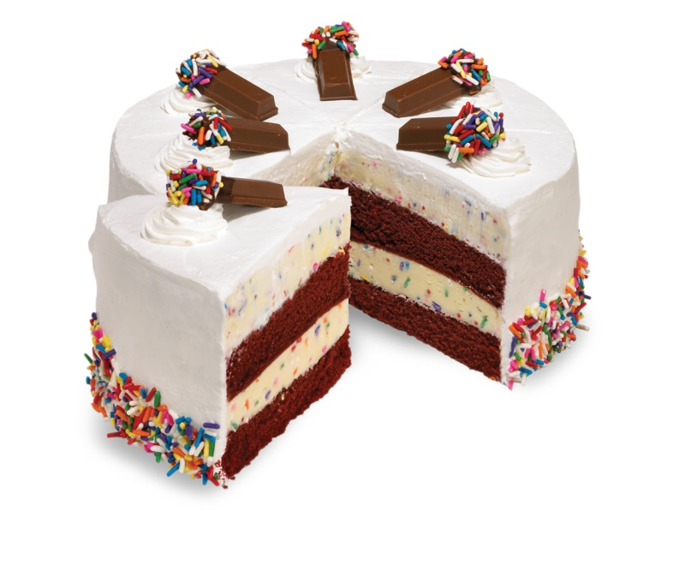
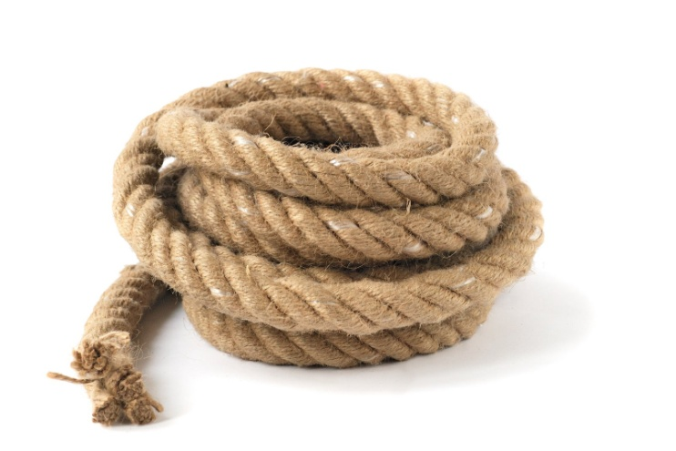
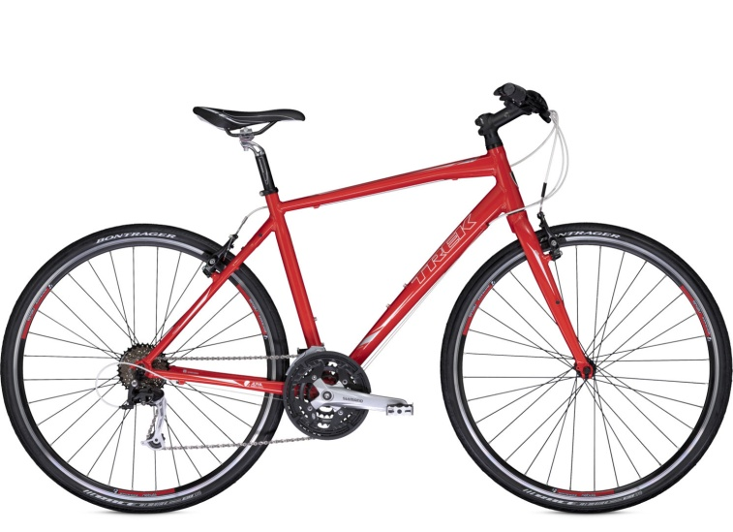
cake
rope
bike

Slide 3

cake

Slide 4
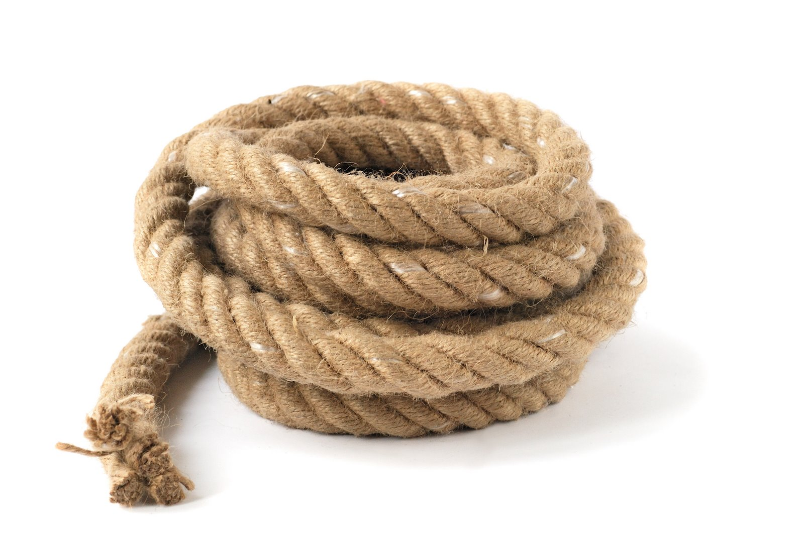
rope

Slide 5

bike

