Slide 1
Soft g
Unit 31

Slide 2
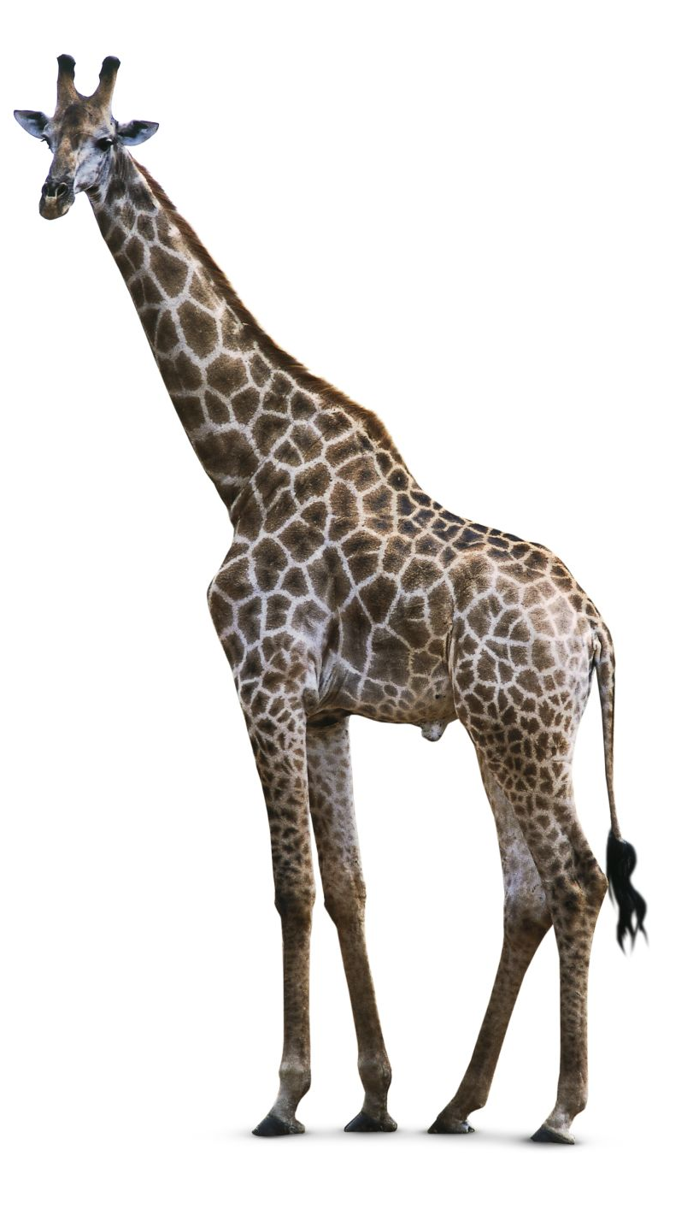
giraffe

