Slide 1
Soft c
Unit 30

Slide 2
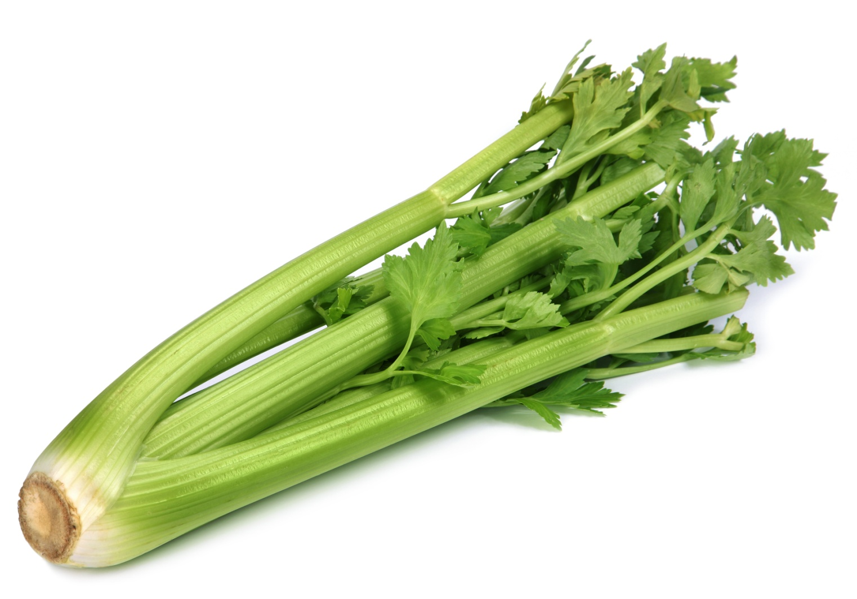
celery

