Slide 1
Dipthongs
Unit 29

Slide 2
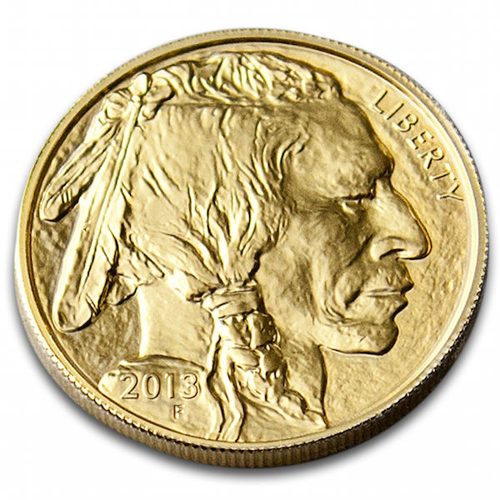

coin
boy

Slide 3
coin

Slide 4
boy

