Slide 1
Dipthongs
Unit 28

Slide 2


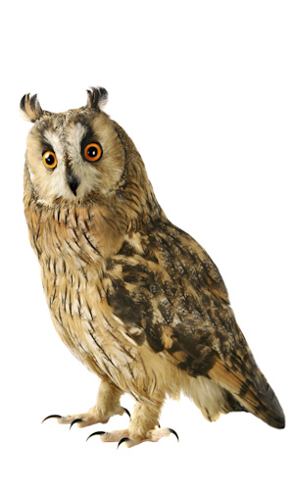
cloud
owl

Slide 3
cloud

Slide 4
owl

