Slide 1
Variant Vowels
Unit 25

Slide 2
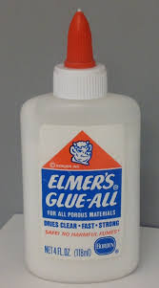
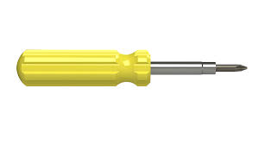
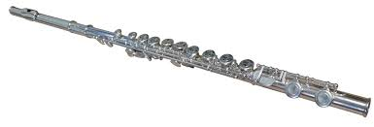
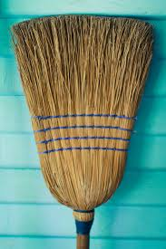
glue
screwdriver
flute
broom

Slide 3
glue

Slide 4
screwdriver

Slide 5
flute

Slide 6
broom

