Slide 1
Variant Vowels
Unit 24

Slide 2
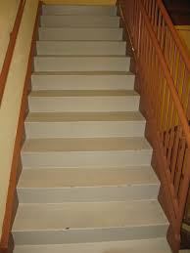
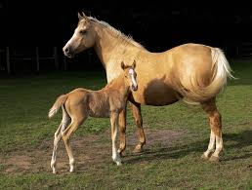
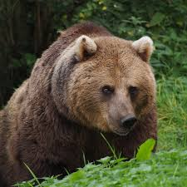

stairs
mare
bear
square

Slide 3
stairs

Slide 4
mare

Slide 5
bear

Slide 6
square

