Slide 1
R-Controlled Digraphs
Unit 23

Slide 2
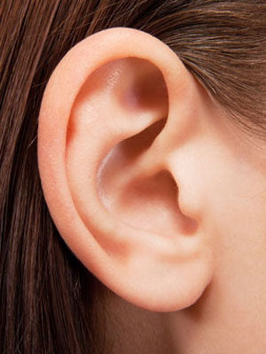
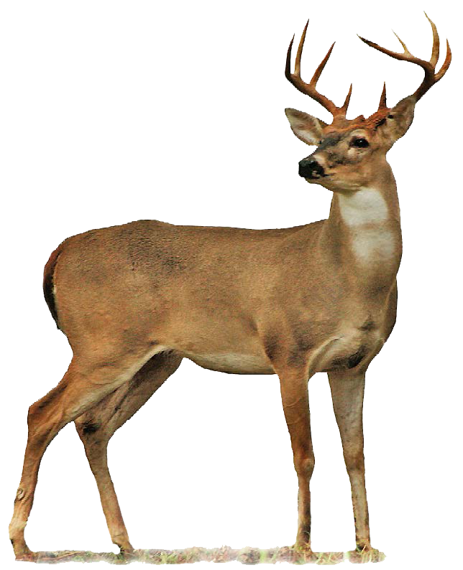
ear
deer

Slide 3
ear

Slide 4
deer

