Slide 1
Variant Vowels
Unit 21

Slide 2
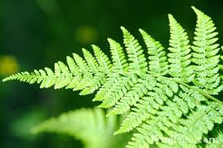
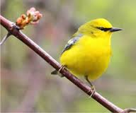
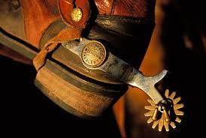
fern
bird
spur

Slide 3
fern

Slide 4
bird

Slide 5
spur

