Slide 1
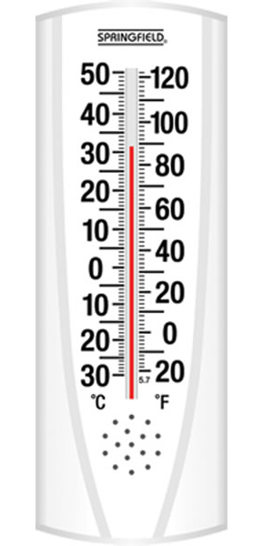

thermometer
whistle

