Slide 1
Final Digraphs
Unit 12

Slide 2
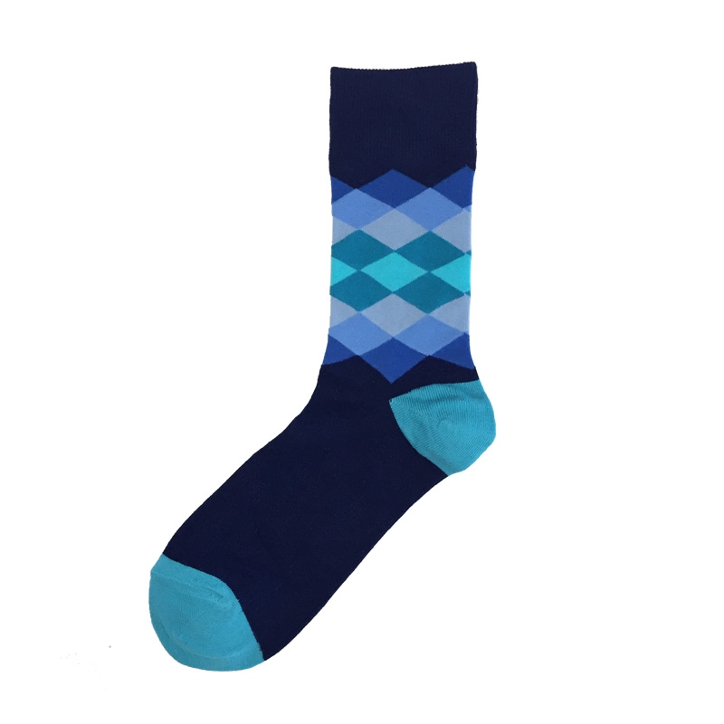
sock

