Slide 1

whistle

Slide 2


Slide 3



Slide 4


Slide 5

https://www.youtube.com/watch?v=M5dGdV5u2v4

Slide 6


Slide 7


Slide 8


Slide 9


Slide 10
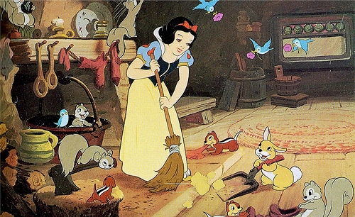
http://viewpure.com/YSnXNHUEodY?start=0&end=0

