Slide 1
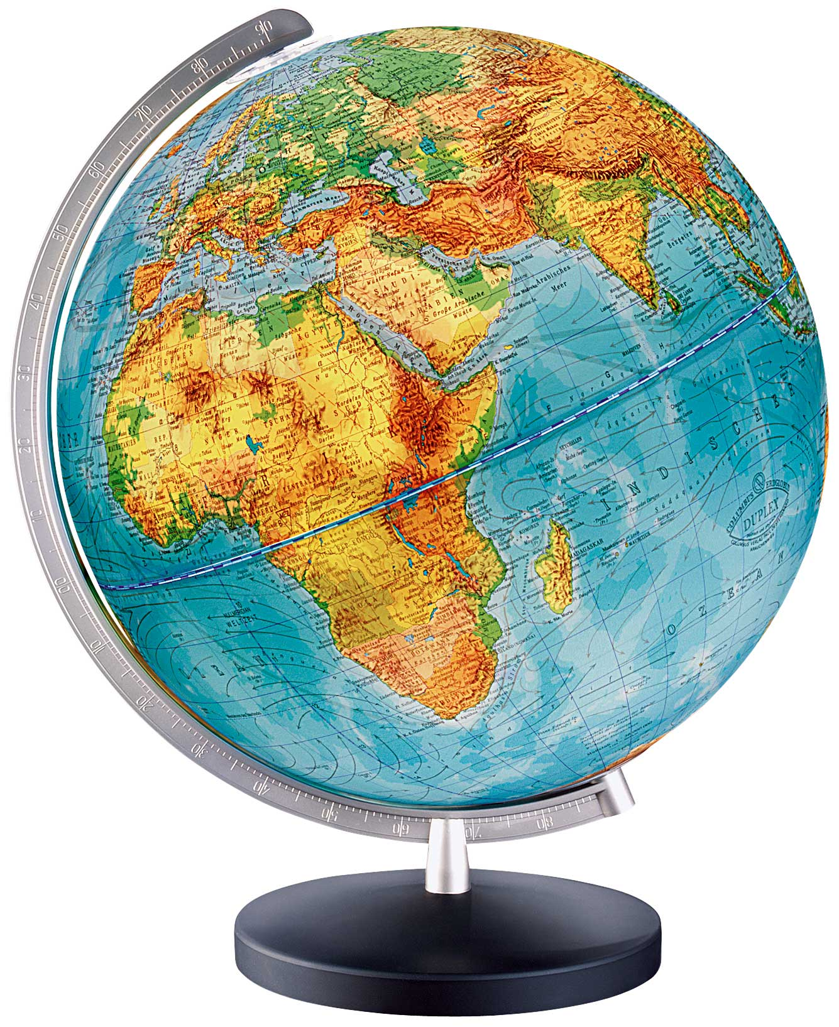
Globe

Slide 2


Slide 3
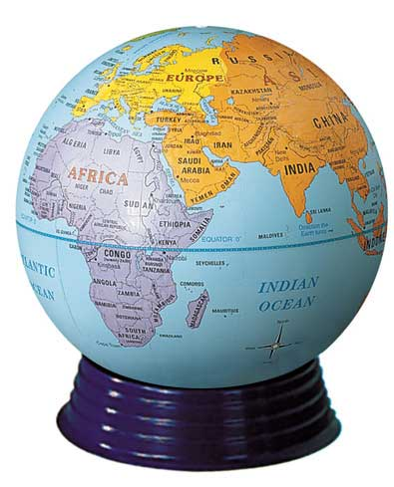

Slide 4
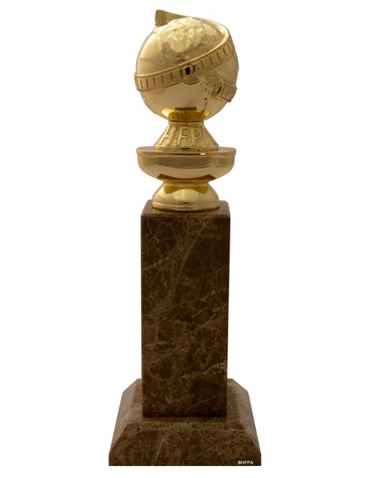
Notes:
Golden Globe

Slide 5
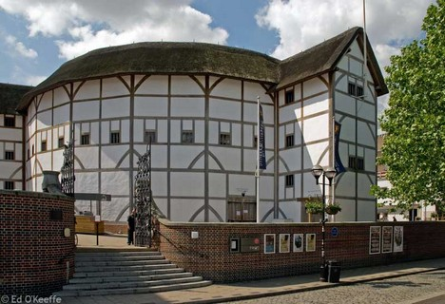
Notes:
Globe Theatre London

Slide 6
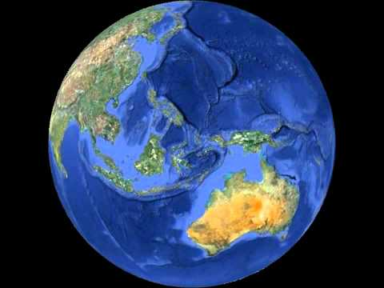
https://www.youtube.com/watch?v=Lmmp9UfNQhU

Slide 7


