Slide 1
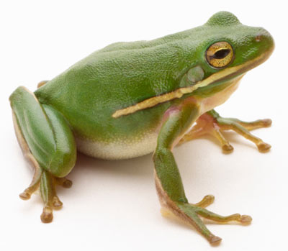
Frog

Slide 2
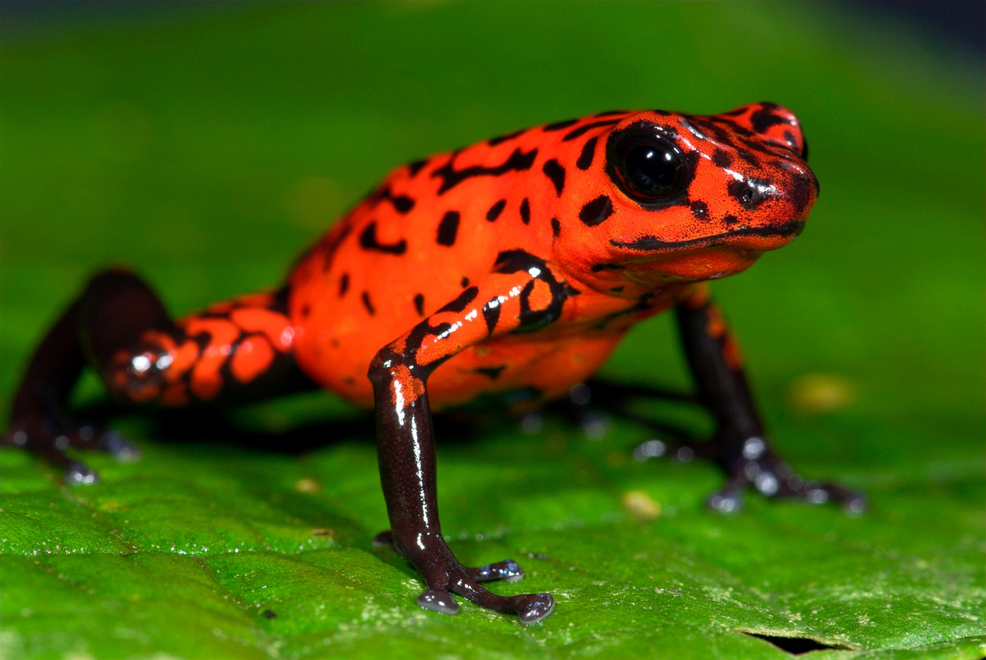

Slide 3
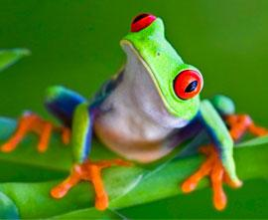

Slide 4


Slide 5
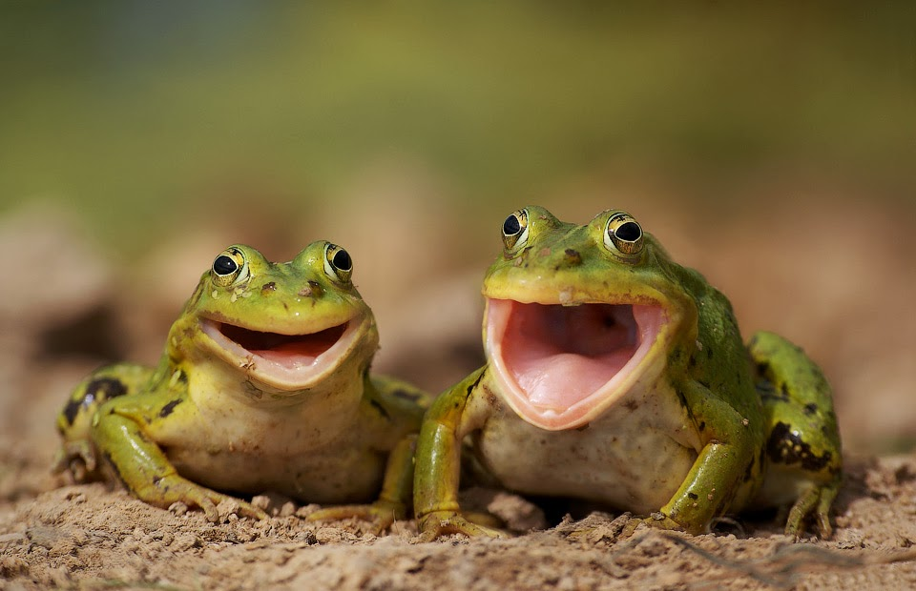

Slide 6
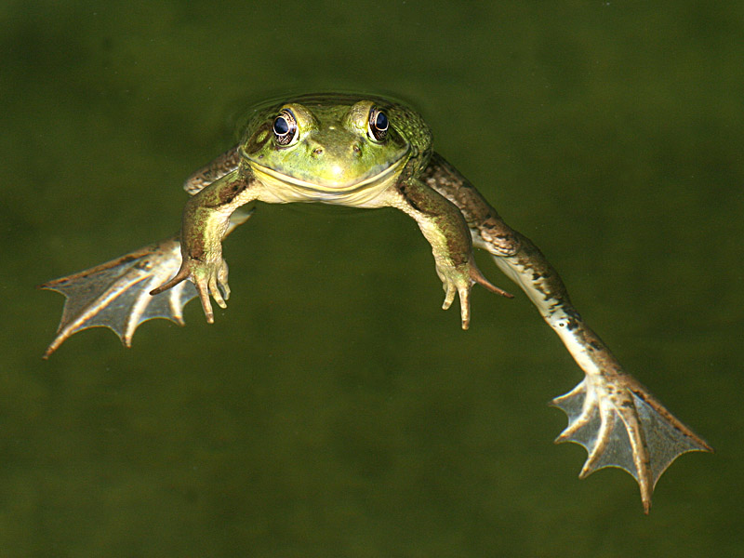
https://www.youtube.com/watch?v=KCtSxQDN37w

Slide 7


Slide 8
