Slide 1
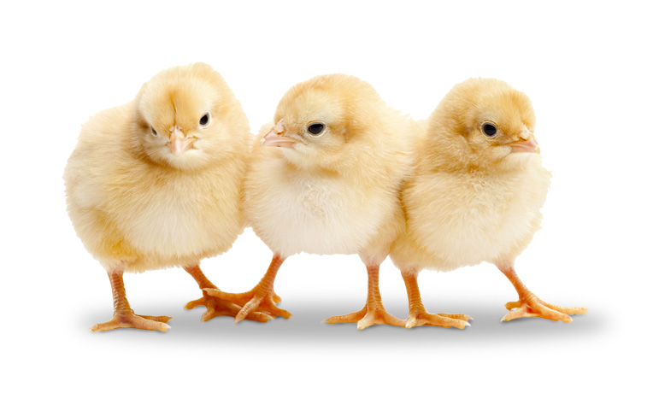
Chick

Slide 2
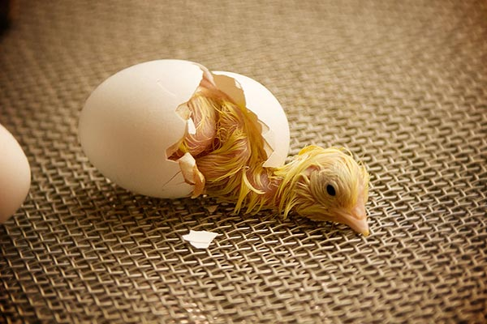
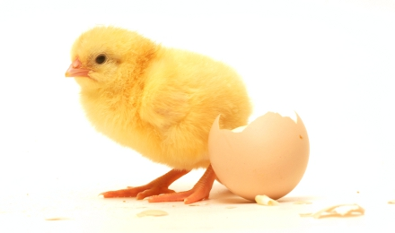

Slide 3
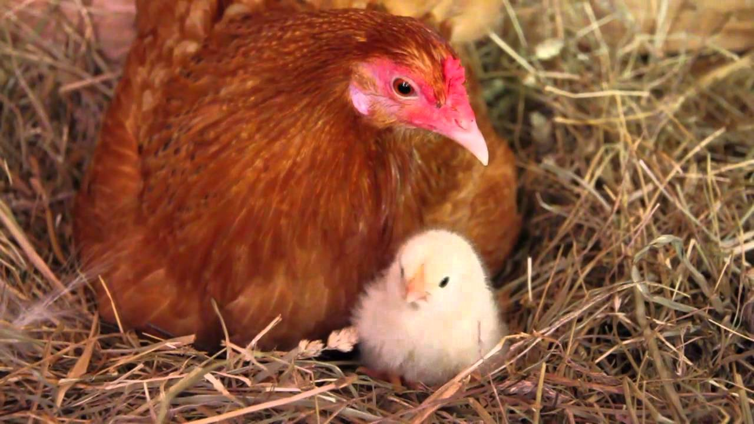

Slide 4
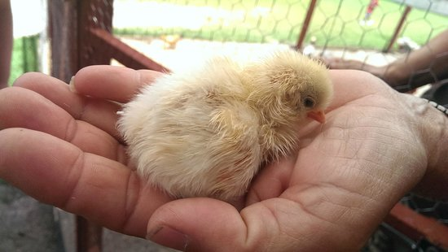

Slide 5


Slide 6
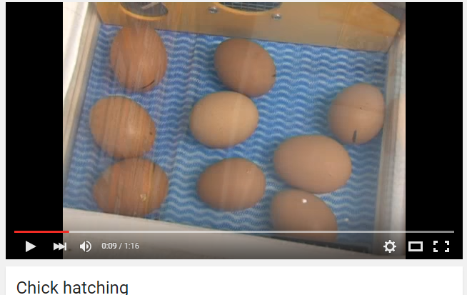
https://www.youtube.com/watch?v=tof5b1Qs_OE
Notes:
https://www.youtube.com/watch?v=tof5b1Qs_OE

