Slide 1


New Approach to Designing
Performance Level Descriptors:
PARCC ELA/Literacy Summative Assessment
July 2013

Slide 2

What are Performance Level Descriptors?
Performance Level Descriptors or PLDs describe what students at each performance level know and can do relative to grade-level or course content standards assessed.
Notes:
What are Performance Level Descriptors?
Performance Level Descriptors or PLDs describe what students at each performance level know and can do relative to grade-level or course content standards assessed.

Slide 3
Building on Work to Date
In October 2012 PARCC established 5 performance levels
  Level 5: Students performing at this level demonstrate a distinguished command of the knowledge, skills, and practices embodied by the Common Core State Standards assessed at their grade level.
  Level 4: Students performing at this level demonstrate a strong command…
  Level 3: Students performing at this level demonstrate a moderate command…
  Level 2: Students performing at this level demonstrate a partial command…
  Level 1: Students performing at this level demonstrate a minimal command…
Notes:
A vote taken by the PARCC Governing Board and Advisory Committee on College Readiness in October 2012 established 5 performance levels for the PARCC assessments.
The policy-level descriptors shown here provide information about a student’s performance at a given level—no matter the grade or course, including:
Level 5: Students performing at this level demonstrate a distinguished command of the knowledge, skills, and practices embodied by the Common Core State Standards assessed at their grade level.
Level 4: Strong command…
Level 3: Moderate command…
Level 2: Partial command…
Level 1: Minimal command…
In combination with the policy-level PLDs, the grade- and subject-specific PLDs will describe the educational implications for students who attain a particular performance level on the PARCC assessments.
However, the policy-level PLDs are different from the grade- and subject-specific PLDs because they do not describe student performance at each grade level.

Slide 4
PARCC’s Process in Developing Performance Level Descriptors
English Language
Arts Operational
Working Group
(ELA OWG) refined PLDs
ELA OWG created a
cover page to accompany
the PLDs
ELA OWG revised the PLDs
PLD Grade Band Meetings
Final PLDs
Information from
meetings gathered
and synthesis created
ELA OWG created charts that explained the three factors that determined the levels
Governing Board and ACCR
adopted the PLDs
Public release of the draft PLDs
Notes:
How were the grade- and subject-specific PLDs developed?
The PLD process began with scheduled week long PLD grade band meetings where state representatives developed the language for descriptors of the standards/evidence statements that students were expected to demonstrate at each one of the levels.
The information for each grade level PLD was gathered and formulated into a grade-level synthesis document that captured the essence of the PLD work. These were reviewed by the Center for Assessment, Educational Testing Service and College Board, and the PARCC Technical Advisory Committee.
Using this feedback, the English Language Arts Operational Working Group, also known as the “ELA OWG”, members that participated in the PLD meetings met again to add more specificity to the PLDs and to ensure that a common language for descriptors was apparent across the grade level, and that alignment to the standards and grade-to-grade consistency and differentiation were also evident. The ELA OWG is made up of state content experts from across the PARCC states.
As a result of this meeting, the ELA OWG created a chart for each grade level that explained the three factors that determined the levels. (text complexity; range of accuracy; quality of evidence)
ELA OWG members also developed a cover page to accompany the PLDs to aid public understanding of the process used to create the grade- and subject-specific PLD documents by providing information about PARCC’s decision to require a new complexity framework and a new means to develop performance level descriptors.
The PLDs were released to the public for review and commentary.
Based on the review and commentary, the ELA OWG revised the PLDS.
Finally, the governing board and ACCR adopted the PLDS .

Slide 5
Claims for ELA/Literacy
ELA/Literacy for Grades 3–11
“On Track” Master Claim/Reporting Category:
Students are “on track” to college and career readiness in ELA/Literacy.
Major Claim: Reading Complex Text
Students read and comprehend a range of sufficiently complex texts independently.
SC: Vocabulary Interpretation and Use
(RL/RI.X.4 and L.X.4-6)
Students use context to determine the meaning of words and phrases.
SC: Reading
Informational Text
(RI.X.1-10)
Students demonstrate comprehension and draw evidence from readings of grade-level, complex informational texts.
Major Claim: Writing
Students write effectively when using and/or analyzing sources.
SC: Conventions and Knowledge of Language
(L.X.1-3)
Students demonstrate knowledge of conventions and other important elements of language.
SC: Written Expression (W.X.1-10)
Students produce clear and coherent writing in which the development, organization, and style are appropriate to the task, purpose, and audience.
SC: Reading Literature
(RL.X.1-10)
Students demonstrate comprehension and draw evidence from readings of grade-level, complex literary text.
SC: Research
(data taken from Research Simulation Task)
Students build and present knowledge through integration, comparison, and synthesis of ideas
Notes:
Within the PARCC Assessment System, there are three types of claims, and each claim will have its own reporting category that will use an appropriate reporting metric. Examples of these metrics are performance level descriptors, scale scores, and raw scores.
The Master Claim is the overall performance goal for the PARCC ELA/Literacy Assessment System—students must demonstrate that they are “on track” for college and career readiness.
Major Claims are designed to elicit sufficient evidence to yield scale scores for making longitudinal comparisons. While students will receive one overall ELA/literacy scores, there will be scale scores for each of the two major claims.
Sub Claims are designed to elicit additional data in support of the Major Claims while providing data that must help educators to focus instruction on key priorities.
Master Claim: Students Are “On Track” to College and Career Readiness
This Master Claim reflects the overall goal of the Common Core State Standards and Model Content Frameworks—to prepare students for college and careers, and specifically to ensure students have the literacy skills and understandings required for success in multiple disciplines.
The measure of progress towards this essential goal will be reflected by a student’s overall performance on the summative components (both the Performance-Based Assessment and End-of-Year Assessment) of the PARCC ELA/Literacy Assessment System.
For the summative assessment, the extent to which students are “on track” for college and careers means measuring the degree to which students are able to:
(1) undertake close, analytic reading and the comparison and synthesis of ideas that are at the heart of comprehending complex literary works and informational texts;
(2) write effectively when using and/or analyzing sources;
this includes many additional skills and understandings as indicated by the sub-claims, including how well students interpret and use vocabulary, how well students read literary and informational texts, how well students express themselves in writing, how well students use their knowledge of language and its conventions, and how well students build and present knowledge through research and the integration, comparison, and synthesis of ideas.

Slide 6
Three factors that determined the levels
Three factors that determined the levels. (text complexity; range of accuracy; quality of evidence)
Grade 11
Level | Level of Text Complexity¹ | Range of Accuracy² | Quality of Evidence³
5 | Very Complex Moderately Complex Readily Accessible | Accurate Accurate Accurate | Explicit and inferential Explicit and inferential Explicit and inferential
4 | Very Complex Moderately Complex Readily Accessible | Mostly accurate Accurate Accurate | Explicit and inferential Explicit and inferential Explicit and inferential
3 | Very Complex Moderately Complex Readily Accessible | Generally accurate Mostly accurate Accurate | Explicit and inferential Explicit and inferential Explicit and inferential
2 | Very Complex Moderately Complex Readily Accessible | Inaccurate Minimally accurate Mostly accurate | Explicit Explicit and inferential Explicit and inferential
Notes:
This is a sample of Grade 11 Chart that accompanies the draft PLDs. This chart is not grade-specific.
These charts are at the beginning of each grade level in the PLD documents, along with explanations of each factor linked to reading performance-level descriptors.
Three factors determined the levels linked to reading performance: text complexity; range of accuracy; quality of evidence
These will be described in detail in the following slides.

Slide 7
PARCC’s Process in Developing Performance Level Descriptors
Grade 11
Level | Level of Text Complexity¹ | Range of Accuracy² | Quality of Evidence³
5 | Very Complex Moderately Complex Readily Accessible | Accurate Accurate Accurate | Explicit and inferential Explicit and inferential Explicit and inferential
4 | Very Complex Moderately Complex Readily Accessible | Mostly accurate Accurate Accurate | Explicit and inferential Explicit and inferential Explicit and inferential
3 | Very Complex Moderately Complex Readily Accessible | Generally accurate Mostly accurate Accurate | Explicit and inferential Explicit and inferential Explicit and inferential
2 | Very Complex Moderately Complex Readily Accessible | Inaccurate Minimally accurate Mostly accurate | Explicit Explicit and inferential Explicit and inferential
Notes:
The PARCC complexity framework reflects the importance of text complexity as it relates to the CCSS.
To determine a student’s performance level, it is critical to identify the pattern of responses when students respond to items with varied text complexities.
To determine text complexity, PARCC uses two components:
1. The first component is composed of three quantitative text complexity measures (Reading Maturity Metric, SourceRater, and Lexiles). These programs are ones that are able to determine a text’s recommended grade level analytically or through a computerized program. This provides a starting point and an initial recommendation for grade level.
2. The second component is a set of Complexity Analysis Worksheets, one for informational text and one for literary text, to determine the qualitative complexity of the texts. These measures rely largely on educator professional judgment and expertise. To determine whether a text is readily accessible, moderately complex, or highly complex, teams of trained reviewers use the data from the quantitative measures, in combination with the data from the qualitative measures.

Slide 8
PARCC’s Process in Developing Performance Level Descriptors
Grade 11
Level | Level of Text Complexity¹ | Range of Accuracy² | Quality of Evidence³
5 | Very Complex Moderately Complex Readily Accessible | Accurate Accurate Accurate | Explicit and inferential Explicit and inferential Explicit and inferential
4 | Very Complex Moderately Complex Readily Accessible | Mostly accurate Accurate Accurate | Explicit and inferential Explicit and inferential Explicit and inferential
3 | Very Complex Moderately Complex Readily Accessible | Generally accurate Mostly accurate Accurate | Explicit and inferential Explicit and inferential Explicit and inferential
2 | Very Complex Moderately Complex Readily Accessible | Inaccurate Minimally accurate Mostly accurate | Explicit Explicit and inferential Explicit and inferential
Notes:
To determine range of accuracy, PARCC has developed a reading rubric to measure comprehension of key idea and details for prose constructed response (PCR) items.
There is one generic scoring rubric for grade 3, one for grades 4 and 5, and one for grades 6 – 11.
There are three prose constructed response items on the PARCC summative assessments for ELA/literacy for each grade level.
Scores on two of the three items contribute to an evaluation of the degree to which a student can accurately comprehend a text.
For machine-scorable items (Evidence-Based Selected Response and Technology-Enhanced Constructed Response), the design of the items are such that the items help contribute to an understanding of how accurately students comprehend text.
The PARCC assessments will have four levels of accuracy at grades 3 - 5 and five levels of accuracy at grades 6 -11 that are measured using the reading data collected through the PCR, EBSR, and TECR items.
Accurate means that a student is able to accurately state both the general ideas expressed in the text(s) and the key and supporting details. The response is complete and the student demonstrates full understanding.
Mostly accurate means that a student is able to accurately state most of the general ideas expressed in the text(s) and the key and supporting details, but the response is incomplete or contains minor inaccuracies. The student demonstrates extensive understanding.
Generally accurate means that a student is able to accurately state the gist of the text(s), but fails to accurately state the key and supporting details in the text or to connect such details to the overarching meaning of the text(s). The student demonstrates basic understanding. This level of accuracy is used only in grades 6 -11.
Minimally accurate means that a student is unable to accurately state the gist of the text(s), but is able to minimally state some of the key or supporting details with accuracy. The student does not connect the specific details of the text to the overarching meaning(s) of the text. The student demonstrates minimal understanding.
Inaccurate means that a student is unable to accurately state either the gist of the text or the key and supporting details evident in the text.

Slide 9
PARCC’s Process in Developing Performance Level Descriptors
Grade 11
Level | Level of Text Complexity¹ | Range of Accuracy² | Quality of Evidence³
5 | Very Complex Moderately Complex Readily Accessible | Accurate Accurate Accurate | Explicit and inferential Explicit and inferential Explicit and inferential
4 | Very Complex Moderately Complex Readily Accessible | Mostly accurate Accurate Accurate | Explicit and inferential Explicit and inferential Explicit and inferential
3 | Very Complex Moderately Complex Readily Accessible | Generally accurate Mostly accurate Accurate | Explicit and inferential Explicit and inferential Explicit and inferential
2 | Very Complex Moderately Complex Readily Accessible | Inaccurate Minimally accurate Mostly accurate | Explicit Explicit and inferential Explicit and inferential
Notes:
PARCC’s reading rubrics measure comprehension for written responses and provide statements about the quality of evidence students use to support their statements of comprehension of texts. Scores on the written response items therefore help to determine student performance levels, as the levels reflect this factor.
Written responses require students to elicit inferential and explicit evidence from the text/s in their written responses. (Except in grade 3 – this grade requires only explicit evidence.)
As a reminder, there will be a range of complex texts for any given grade level.
Inferential evidence means that students show how inferences drawn from the text support statements made about the meaning of the text
Explicit evidence means that students show how the explicit words and phrases (details) from the text support statements made about the meaning of the text.
A student who shows that he or she can both identify explicit and inferential evidence in a range of complex texts will most likely achieve a higher level on the assessment.
All of this information is provided at the beginning of each grade level PLD.

Slide 10
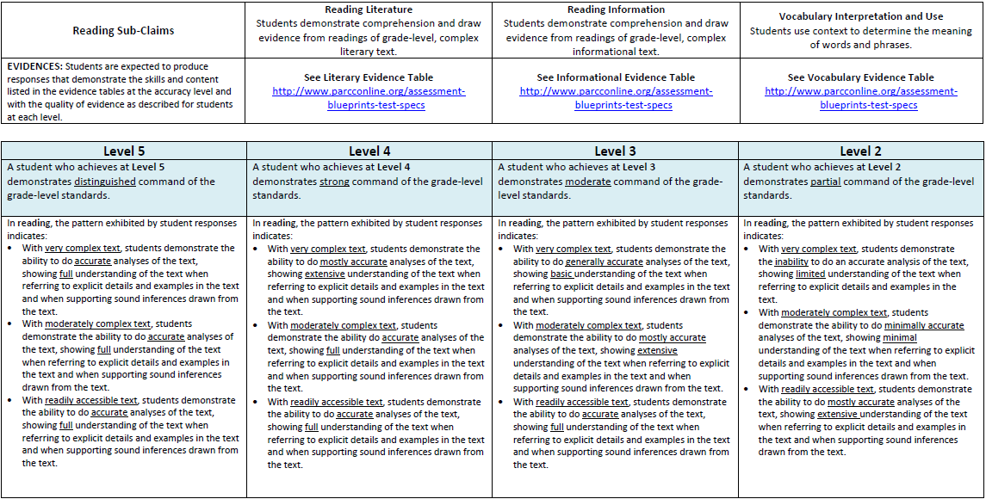
Looking at the PLDs: Reading
This row provides the sub-claim being viewed
This row provides the level being described
This row provides information about the patterns displayed by students in reading at this level
Notes:
In response to public feedback, the layout of the ELA/literacy PLDs has change from the original drafts to provide greater clarity and distinction between the different sub-claims.
All PLDs are now linked to the evidence tables as well.
First, we will review the PLDs for the reading sub-claim.
The first row provides information about the sub-claim being viewed.
The fourth row provides high-level descriptions of each level.
The final row gives information about the patterns displayed by students in reading at each level.
This is where text complexity, accuracy and quality of evidence is addressed. (The three factors that determine the levels as previously described)
Next we will review the PLDs for the writing sub-claim for written expression.

Slide 11
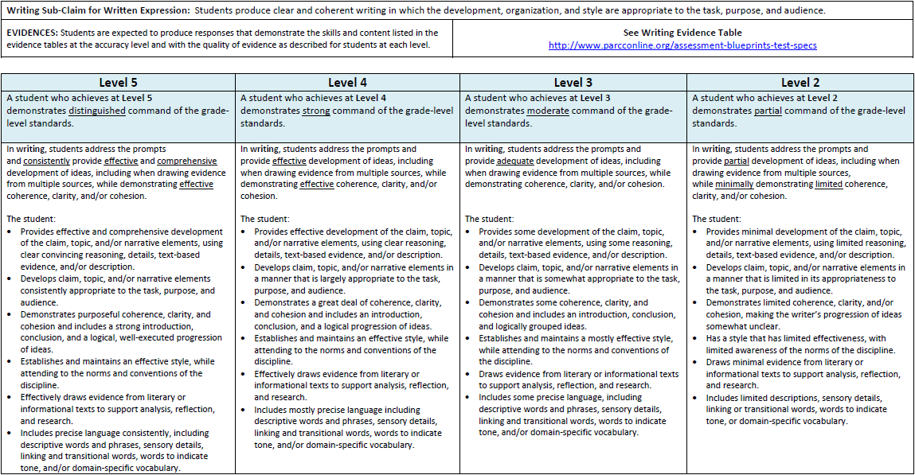
Looking at the PLDs: Written Expression
This row provides the sub-claim being viewed
This row provides the level being described
This row provides information about the patterns displayed by students in writing at this level
Notes:
This slide shows the Written Expression grade specific PLDS.
The first row provides information about the sub-claim being viewed.
The fourth row provides high-level descriptions of each level.
The last row gives information about the patterns displayed by students in written expression at each level.
This row states what students are expected to demonstrate at each level. Please view the evidence statements linked to the CCSS for each grade level as well.
Next we will review the PLDs for the writing sub-claim for knowledge of language and conventions.

Slide 12
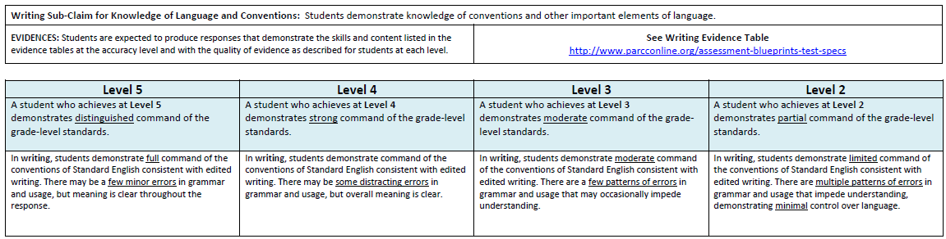
Looking at the PLDs: Knowledge of Language and Conventions
This row provides the sub-claim being viewed
This row provides the level being described
This row provides information about the patterns displayed by students in writing at this level
Notes:
This slide shows the knowledge of language and conventions grade specific PLDS.
The first row provides information about the sub-claim being viewed.
The fourth row provides high-level descriptions of each level.
The last row gives information about the patterns displayed by students in written expression at each level.
This row states what students are expected to demonstrate at each level. Please view the evidence statements linked to the CCSS for each grade level as well.

Slide 13

Staying True to the CCSS
PLD writers were committed to staying true to the language and spirit of the CCSS.
Notes:
The CCSS for reading indicated clearly that text complexity must be defined more robustly than has been the case in reading assessments.
Fewer standards were needed than previously thought because one could build reading comprehension skills using fewer standards (knowledge and skills) with an ever lengthened stair case of text complexities.
To stay true to the CCSS, any means for determining item complexity (and therefore performance-level descriptors) needed to account more heavily for text complexity.
PARCC spent considerable time and care to determine the best means to determine text complexity with reliability and developed a consistent method to do so.
Please consult the PLDs Frequently Asked Questions documents for more information on the process.

Slide 14
Standard 1 Always at Play
Standard 1
Focused on a student’s ability to find text-based evidence for generalizations, conclusions, or inferences drawn
Notes:
It is important that Standard 1 is always at play so that PLDs stay true to the CCSS.
Standard 1 focuses on a student’s ability to find text-based evidence for generalizations, conclusions, or inferences drawn from the text. This is a shift to an emphasis on text-based questions.
Although Standard 1 is important, the PLDs and the PARCC assessments as a whole also incorporate the other standards that focus on students’ ability to demonstrate their use or recognition of standards 2-9, which include evidence, summary, literary elements, vocabulary, structure, point of view, visual and multimedia, reading informational texts and comparison.

Slide 15

Capturing What Students Can Do
PLDs
capture how all students perform
show understandings and skill development across the spectrum of standards and text complexity levels assessed
Notes:
PARCC PLD writers wanted to be sure that performance level descriptors accurately captured how students, even those with limited knowledge and skills, could show understandings and skill development across the spectrum of standards and text complexity levels assessed.
The PLD writers gave credit to students who could demonstrate skills with readily accessible or moderately complex text that they might not be able to demonstrate with highly complex text, thereby capturing how all students show their understandings and skill development across the spectrum of standards and text complexity levels assessed.

Slide 16
New Approach to Designing
Performance Level Descriptors:
PARCC ELA/Literacy Summative Assessment
www.PARCConline.org http://parcc.nms.org
Notes:
For more information on the PARCC PLDs, please go to the PARCC website at www.parcconline.org.

