Slide 1

Understanding the ELA/Literacy Evidence Tables

Slide 2
What are ELA Evidence tables?
The tables contain the Reading, Writing and Vocabulary Major claims and the evidences to be measured on the PARCC Summative Assessment.
Evidences are attached to the Reading, Writing and Vocabulary claims presented by PARCC.
Evidences describe what students might say or do to demonstrate mastery of the standards.
An item on the PARCC assessment may measure multiple standards and multiple evidences.
Notes:
The evidences are attached to the Reading, Writing and Vocabulary claims presented by PARCC which will be shared on the following slide.
Evidences describe what students might say or do to demonstrate mastery of the standards and on the PARCC assessment an item may measure multiple standards and multiple evidences.

Slide 3
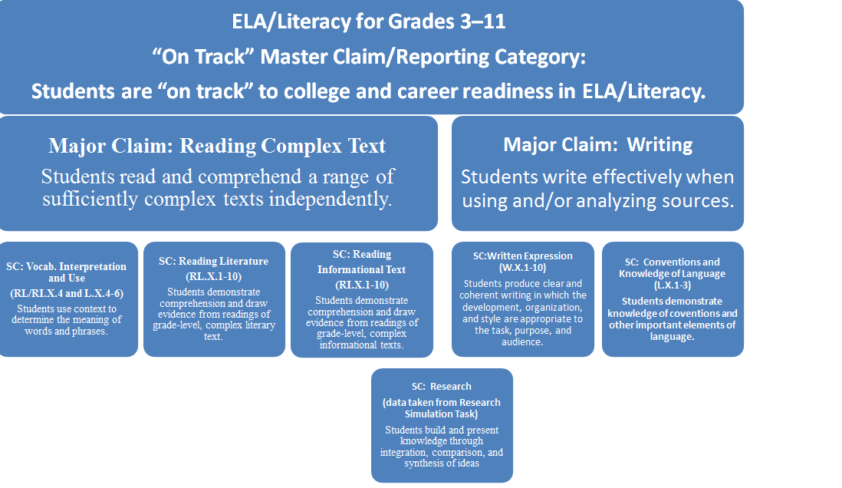
ELA/Literacy Claims for the PARCC Summative Assessments
Notes:
The claims for the PARCC assessments reinforce these instructional shifts.

Slide 4
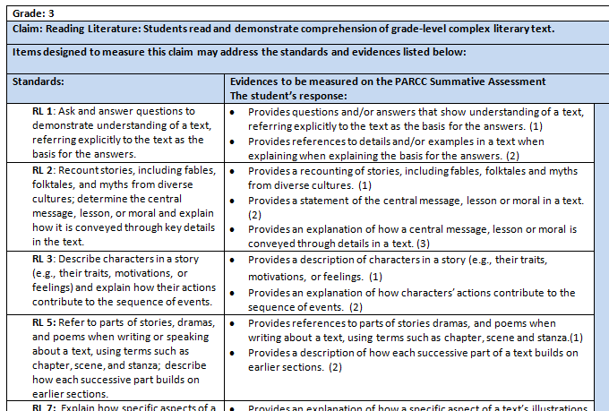
Reading an Evidence Table
Grade
Claim
Standards:
RL –Reading Literary
RI – Reading Information
Evidences
Notes:
On each evidence chart the first line indicates the grade. This is followed by the second line which lists the claim for reading literature or reading informational text or vocabulary. Next is a statement that the standards and evidences listed below may be reflected in the items designed to measure the claim.
In the first column on the left is a list of the standards. If it is a reading literature standard it be identified with the letters RL and if it is an reading informational text standard it will be identified with the letters RI.
In the next column are the evidences to be measured on the PARCC Summative Assessment. The evidences can serve as a basis for guiding classroom instruction when teaching reading.

Slide 5
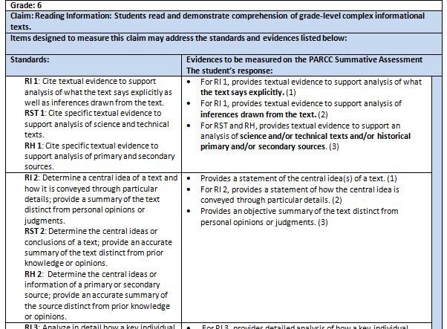
Reading an Evidence Table for
Grades 6 -11
Standards:
In Grades 6 – 11 Literacy Standards
for Reading History/Social Studies and for Reading Science/Technical
are added
RH – Reading History/Social Studies
RST – Reading Science/Technical
Notes:
In the evidence tables for grades 6th – 11th the first column on the table also lists the literacy standards for science using RST to identify the standard and the literacy standards for history using RH to identify the standard. These are circled in yellow on the chart.

Slide 6
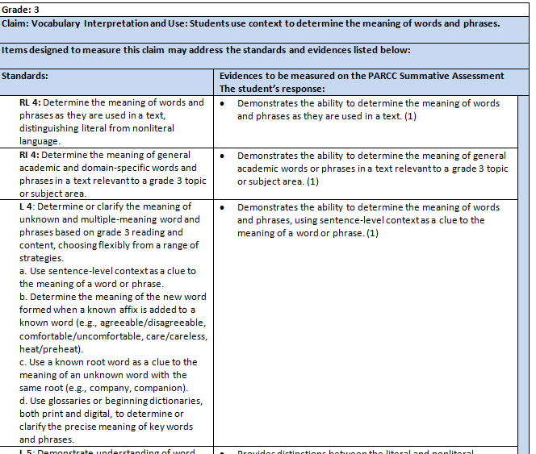
Reading a Vocabulary Evidence Table
Standards:
L – Language
Notes:
In the evidence tables for vocabulary, the first column on the table lists either the reading (RL or RI) standards or the language standards using L to identify the standard. These are circled in yellow on the chart in this slide.

Slide 7
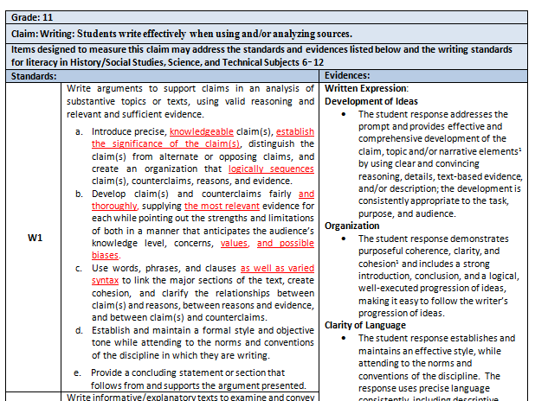
Reading the Writing Evidence Tables
Grade
Claim
Standards:
W - Writing
Evidences
Notes:
On each evidence chart the first line indicates the grade. This is followed by the second line which lists the claim for writing. Next is a statement that the standards and evidences listed below may be reflected in the items designed to measure the claim.
In the first column on the left is a list of the standards.
In the next column are the evidences to be measured on the PARCC Summative Assessment. The evidences can serve as a basis for guiding classroom instruction when teaching reading.

Slide 8
Instructional uses of the evidence statements/tables for teachers
To see ways to combine standards naturally when designing instructional tasks
To help determine alignment of a complex text with standards for instructional passage selection
To develop the stem for questions/tasks for instruction aligned with the standards
To determine and create instructional scaffolding (to think through which individual, simpler skills can be taught first to build to more complex skills)
To develop rubrics and scoring tools for classroom use

Slide 9
Standard 1 on the Evidence Tables
Standard 1
All items measuring this claim require students to read a text prior
to responding to the items (i.e. the item is text dependent)
This standard is always combined with the assessment of other standards.
All questions are text dependent.

Slide 10

Using the Evidence Table: Part 1
For example, if one were to view the third grade evidence table for Reading Information Standard 2, he/she would view the following:
To begin planning, one would need to first determine which of the evidences he/she would want students to be able to demonstrate. It is important to keep in mind that more than one evidence may be chosen.
Next, when planning lessons it would be beneficial to determine the complex informational text(s) that the students will use as a basis for determining the main idea and/or recounting the key details and/or providing an explanation of how the key details support the main idea.
Notes:
Need notes

Slide 11
Alignment of a complex text with standards for instructional passage selection
It is important when selecting texts that:
Texts stem from across the disciplines (e.g. ELA, history, science and technical subjects), are written by authors with diverse backgrounds, reflect the CCSS prescribed balances of literature and informational text, and appeal to a wide range of student audiences.
Texts are authentic works of exceptional craft and/or rich repositories of ideas and information
Text pairings, where required by the CCSS, have meaningful and significant points of comparison that invite questions beyond superficial observations
Texts appeal to student interest and appeal to a wide audience
Texts avoid highly controversial topics that may be troublesome to students
Refer to Passage Selection Guidelines for Assessing CCSS and the Bias and Sensitivity Guidelines for more detailed information about the selecting of passages for students.
Notes:
The foundation for preparing students for the linguistic rigors of college and the workplace lies in the texts with which students interact. By the time they graduate, students should be prepared to successfully read and analyze the types of complex texts they will encounter after high school. Selecting passages of appropriate type and complexity for use in assessment is integral to this preparation.
Since the CCSS call for students to comprehend a range of complex texts, it is important to balance texts written by authors with diverse backgrounds, including a balance of authors by gender and ethnicity.
The texts students encounter should be worthy of careful attention, be content rich and challenging, and exhibit professional published quality. Texts should also be of sufficient quality and complexity that students can demonstrate that they are the path to achieve college and career readiness.
Paired or multiple texts should be selected with the same care as all texts. It is important to expose students to grade-level texts of appropriate complexity—including texts from the domains of ELA, science, history/social studies, technical subjects, and the arts.
There are several additional criteria for selecting the passages for the standards that require more than one text. These criteria are based on the language of the standard and depend on the explicit purpose of the standard—what it is that students are being asked to do with the text. For more information about selecting texts you may refer tp the Passage Selection Guidelines for Assessing the CCSS drafted by PARCC.
It is equally important to select texts that appeal to students interests and diverse populations. It is important to avoid any topics or issues that are highly controversial or they may be troublesome for some students, For more information about bias and sensitivity when selecting texts you may refer to the Boas and Sensitivity Guidelines drafted by PA RCC.

Slide 12
Using the Evidence Table: Part 2
For example, if one were to view the third grade evidence table for Reading Information Standard 2, he/she would view the following:
Once text (s) have been selected it is important to consider what question(s) will be posed to the students that will be supportive of the evidences they will be asked to demonstrate.
When considering the development of such questions it is important that the text dependent questions delve systematically into a text(s) to guide students in extracting the key meanings or ideas found there.

Slide 13
Text Dependent Questions
Good text dependent questions will often linger over specific phrases and sentences to ensure careful comprehension of the text—they help students see something worthwhile that they would not have seen on a more cursory reading.
An effective set of text dependent questions delves systematically into a text to guide students in extracting the key meanings or ideas found there.
They typically begin by exploring specific words, details, and arguments and then moves on to examine the impact of those specifics on the text as a whole.
Along the way they target academic vocabulary and specific sentence structures as critical focus points for gaining comprehension.

Slide 14
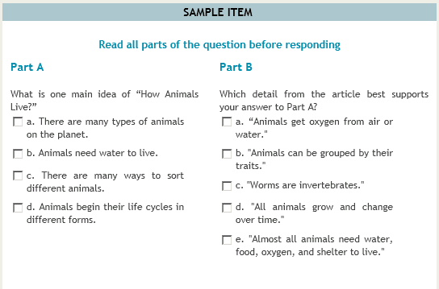
3rd Grade Sample Informational Text: Main Idea Question
RI 2 | Provides a statement of the main idea of a text. (1) Provides a recounting of key details in a text. (2) Provides an explanation of how key details in a text support the main idea. (3)
The question requires students to determine the main idea of the passage.
Students must use close reading to not only determine the main idea but to select the textual evidence that will justify the chosen main idea.
Notes:
Here is an example of and informational text dependent question in relation to the main idea.
The question requires students to determine the main idea of the passage.
Students must use close reading to not only determine the main idea but to select the textual evidence that will justify the chosen main idea.

Slide 15
Prose Constructed Response Questions
Questions that require a written response:
Allow students to elicit evidence demonstrating that they have understood a text or texts read
Allow students to demonstrate that they can communicate that understanding well both in terms of written expression and knowledge of language and conventions
Allow teachers the opportunity to provide feedback on how individual pieces of writing meet or do not meet the criteria for quality writing
Notes:
Written tasks such as this require writing to sources rather than to a de-contextualized or generalized prompt and requires students to apply the knowledge of language and conventions.
The emphasis on writing to sources will support the implementation of asking students to demonstrate the critical college- and career-readiness skills of presenting credible evidence from texts, crafting coherent and well-developed prose, and writing clearly with sufficient command of academic English. Learning to present important information from text in an organized piece of writing helps students generate a deeper understanding of a text. Indeed, whether taking notes, answering questions about a text, or crafting a summary or an extended response regarding what they have read, students improve both their reading comprehension and their writing skills as they write in response to texts.
Teachers will be able to provide feedback on how individual pieces of writing meet or do not meet the criteria for quality writing.

Slide 16
Proposed Writing Rubrics
Three primary components to the rubrics:
A reading assessment component
A written expression component (which has several sub-components)
A knowledge of language and conventions component.
The use of this single rubric—regardless of task purpose
Allows for the focus of evaluation of the quality of a written response to be on key traits of quality of reading comprehension (including providing strong evidence from texts)
Allows for focus on quality writing rather than on any single, discrete criterion
Reinforces student preparation for prose to be written in college and careers, where quality is defined by addressing the demands of a task, rather than on an isolated skill
Notes:
A proposed writing rubric for grades 3 -11 is now available to teachers. It has three primary components: a reading assessment component; a written expression component (which has several sub-components); and a knowledge of language and conventions component. (Item specific scoring guides will further define how to score specific prompts.) The use of this single rubric—regardless of task purpose—allows for the focus of evaluation of the quality of a written response to be on key traits of quality of reading comprehension (including providing strong evidence from texts) and on quality writing rather than on any single, discrete criterion. Consequently, the use of the rubric will reinforce student preparation for prose to be written in college and careers, where quality is defined by addressing the demands of a task, rather than on an isolated skill.
Teachers will be able to provide feedback on how individual pieces of writing meet or do not meet the criteria for quality writing. Consistent use of a common rubric will allow students to internalize the criteria as they take on different writing assignments throughout their academic careers.

Slide 17
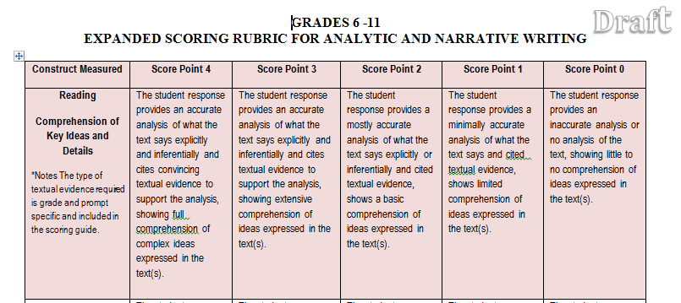
Proposed Writing Rubrics:
Reading Portion
Notes:
This is a sample of the reading portion of a grade 6 – 8 rubric where students are assessed on their comprehension of the text or texts read.

Slide 18
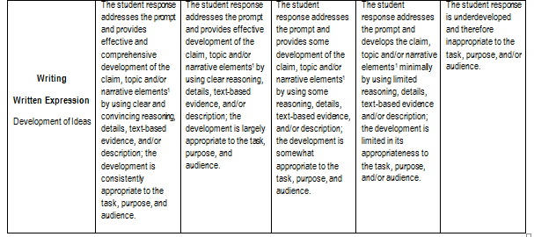
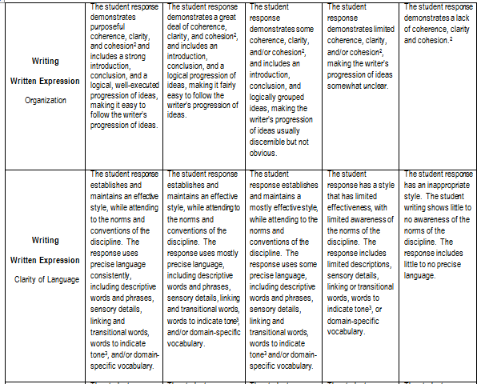
Proposed Writing Rubrics
Notes:
This is a sample of the written expression portion of a grade 6 - 8 rubric where students are assessed on their development of ideas, organization and clarity of language.

Slide 19
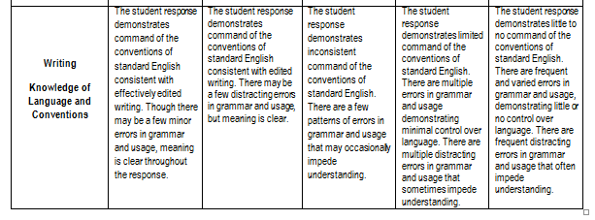
Proposed Writing Rubrics:
Knowledge of Language and Conventions Portion
Notes:
This is a sample of the knowledge of language and conventions portion of a grade 6 - 8 rubric where students are assessed on their command of conventions of standard English.

Slide 20
Key Points to Remember
In all Evidence Tables for Grades 3 – 11 Standard 1 is always combined with the teaching of any of the other standards.
More than one evidence may be combined with Standard 1.
Texts need to be complex literary or informational text (s)that students will use as a basis for their answers.
Effective text dependent questions require students to draw evidence from a text to support their answers.
Careful and close reading is required in order to determine meaning and answer questions.
Written tasks should require writing to sources rather than to a de-contextualized or generalized prompt and should require students to apply the knowledge of language and conventions.

Slide 21
Partnership for Assessment of Readiness for College and Careers
www.parcconline.org
Notes:
For more information about the PARCC assessments and additional updates on released materials, visit PARCC’s website and sign up for the PARCC newsletter.

