Slide 1
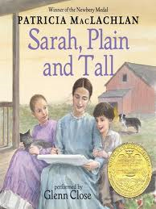
Chapters 2 & 3
Listen for these words as we read today.
pesky
clattered

Slide 2
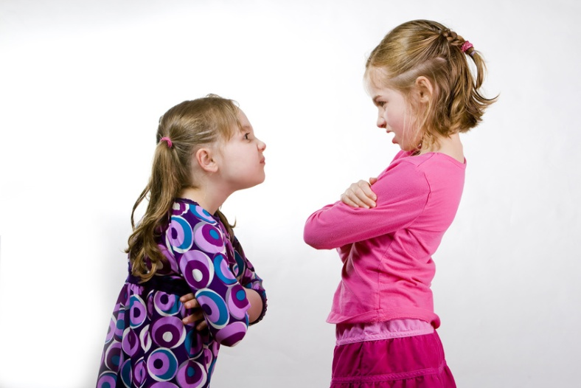
pesky
Causing trouble; annoying

Slide 3
Which of the following would be considered pesky?
A buzzing fly
Receiving a gift
Playing with your best friend
Your little sister
A gnat

Slide 4
clattered
Made or caused a continuous rattling sound

Slide 5
Which of the following would clatter?
A baby rattle
A piece of paper
An eraser
A wagon
A bag of pennies

Slide 6
Chapters 4 & 5
Listen for these words as we read today.
roamer
dune

Slide 7
roamer
Wanderer; someone or something who moves about without a purpose or plan

Slide 8
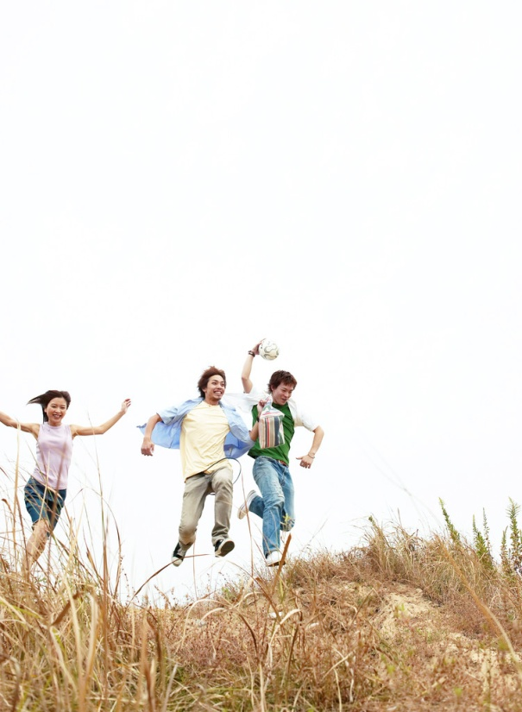
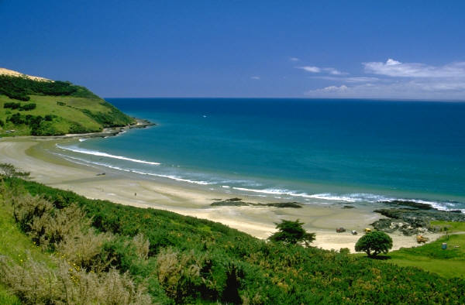
dune
A mound of sand formed by the wind especially on the sea coast

Slide 9
Chapters 6
Listen for these words as we read today.
sparkling
sputtering
gleamed

Slide 10
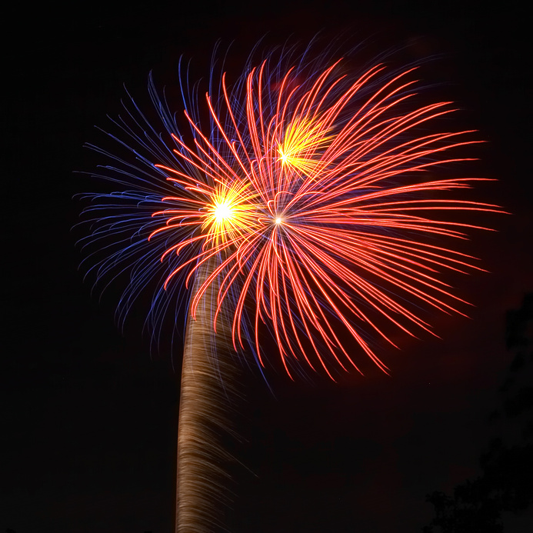
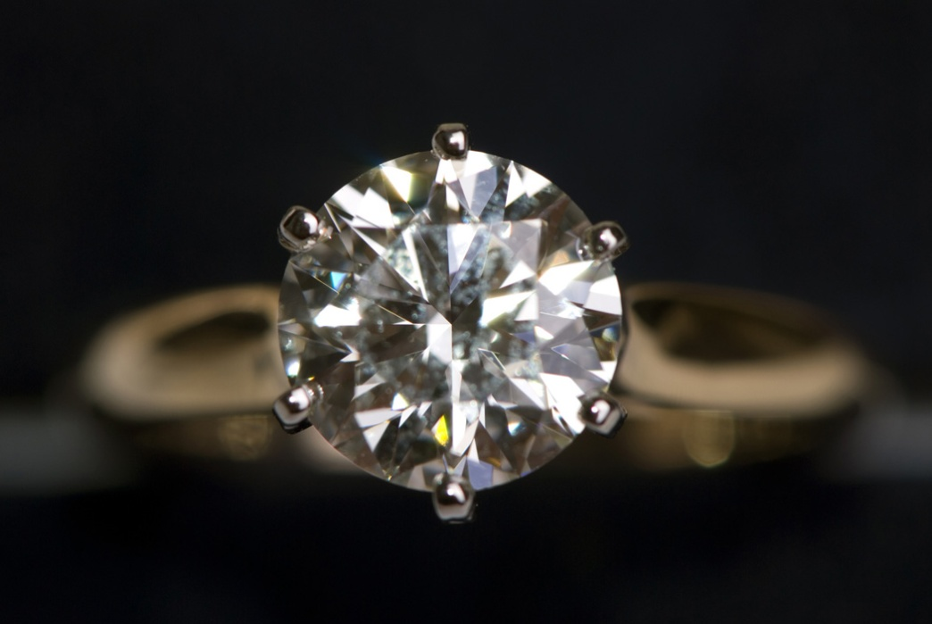
sparkling
Shining brightly with flashes of light

Slide 11
Which of the following items would sparkle?
A diamond
A piece of bark
Fireworks
A crown
A crystal
A rock

Slide 12
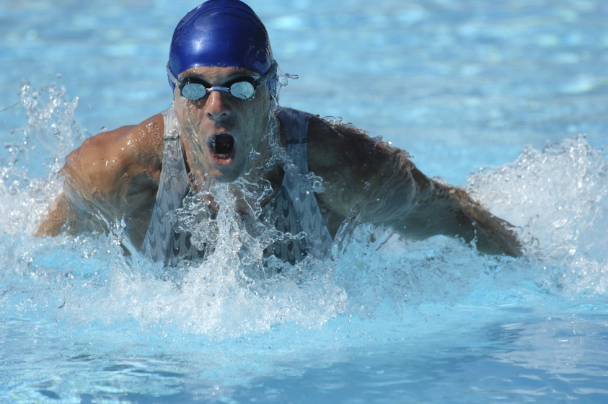
sputtering
Making a series of soft explosive sounds

Slide 13
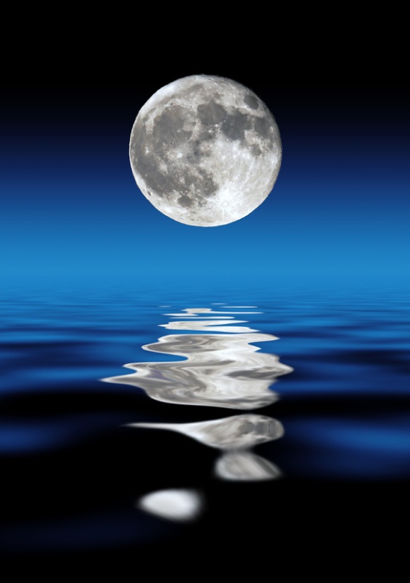
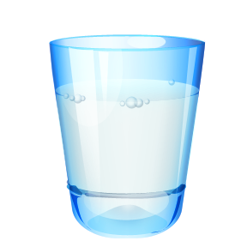
gleams
Shines brightly, especially with reflected light

Slide 14
Which 2 words below are basically synonyms?
sparkling
sputtering
gleams

