Slide 1

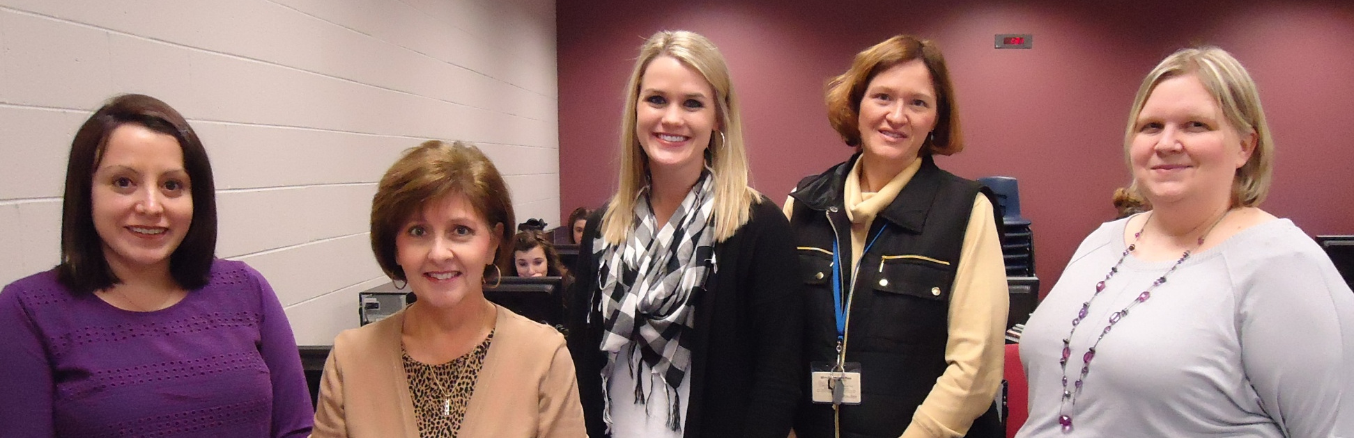

The Great Big World
Kindergarten Unit 5
Planning Team
Jessica Falcon, Mary Alyce Madden, Jessica Suitor, Gail Fenix and Audrea Myers
Notes:
Hi, My name is Jessica Falcon and I worked with Mary Alyce Madden, Jessica Suitor, Gail Fenix and Audrea Myers to plan unit 5, The Great Big World.

Slide 2
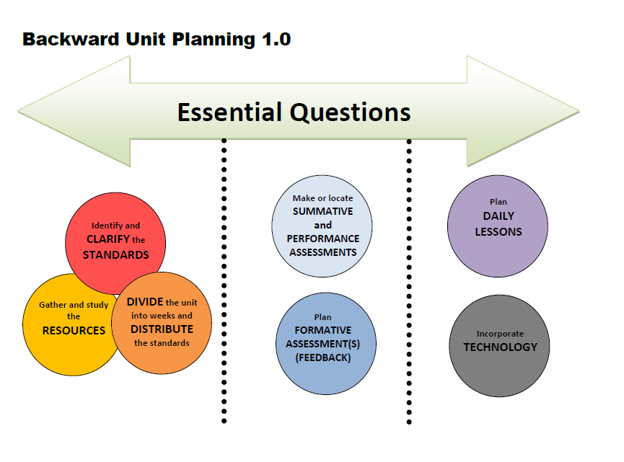
Notes:
We followed the same unit planning process as units 1-4.

Slide 3

The Great Big
World
Essential Question
How do details help people understand the world?
Notes:
First we looked at the old essential question and thought about the goals of the unit. We brainstormed some broad questions that would address the goals of the unit. We decided on the essential question, “How do details help people understand the world?” We felt like this unit really focuses on the details about each continent and how those details help us understand more about that place.

Slide 4
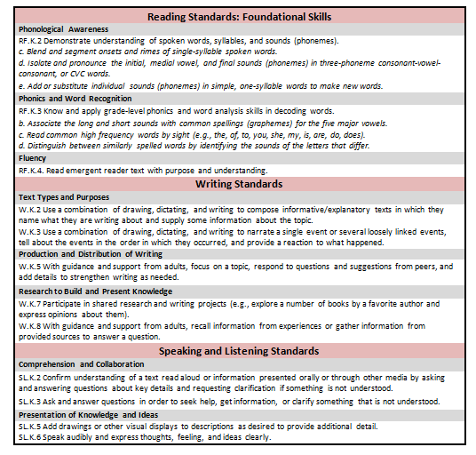
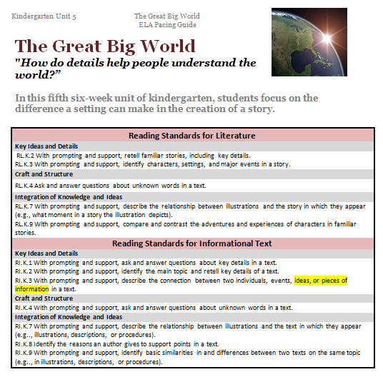
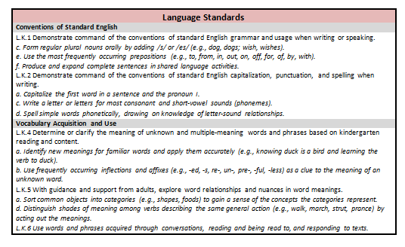
Unit 5 Pacing Guide
Notes:
Next we identified and clarified the standards…. We went through each standard and looked at if it had been focused on previously and which ones correlated with the goals of the unit. You’ll see on RL.K.3 we highlighted the portion that says, “ideas, or pieces of information” because we thought that part of the standard fit best with our focus of the continents.

Slide 5
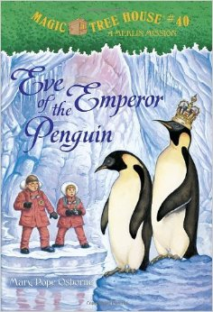

New Texts
Sets 1 & 2 already have this text
Notes:
Once the standards were clarified, we gathered and studied our resources…
We selected these two additional texts. We chose Eve of the Emperor Penguin as an alternative to Mr. Popper’s Penguins. It will be left up to the teacher whether they choose to use Eve of the Emperor Penguin or Mr. Popper’s Penguins.
Some schools did not have a Europe Rookie Reader, so those schools will be getting one.

Slide 6
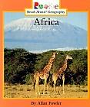
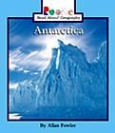

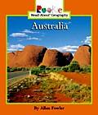
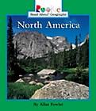
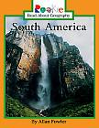
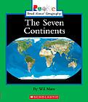
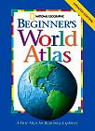
Kindergarten
Print Resources
Unit 5
Informational Text
Music & Songs
“It’s a Small World” (Walt Disney)
“London Bridge is Falling Down”
Notes:
These are the informational texts to use to explore each continent.

Slide 7
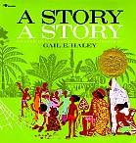
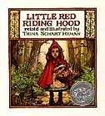
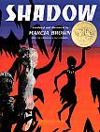
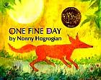

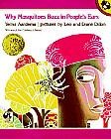
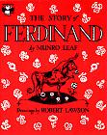
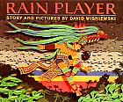

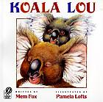
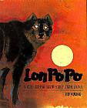

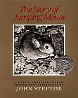
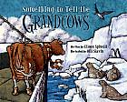
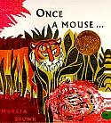
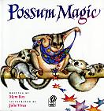
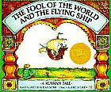
Literature
Africa
Picture Books (Read Aloud)
Chapter Book
(Read Aloud)
Europe
South America
Australia
Asia
North America
Antarctica
Notes:
There are many literature books that are linked to each continent.

Slide 8
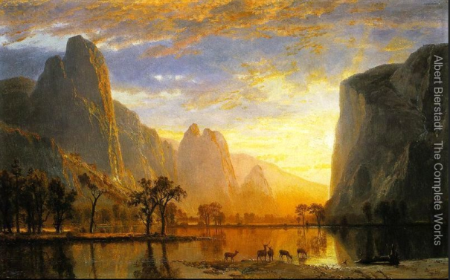
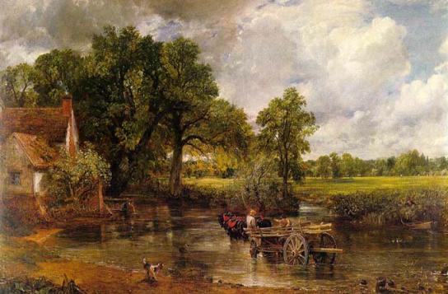
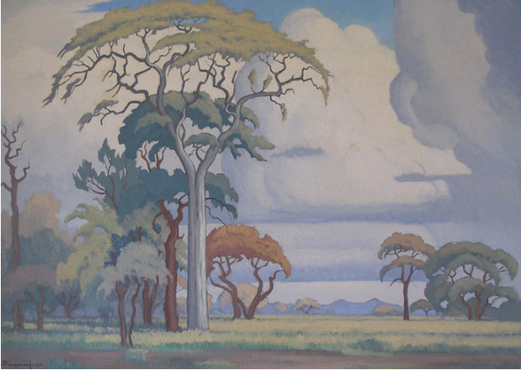

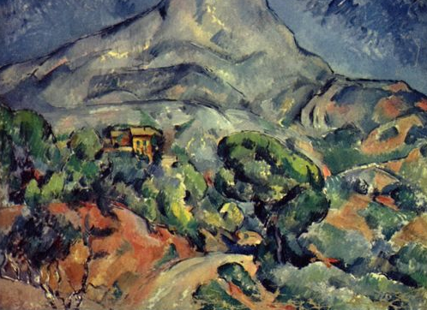
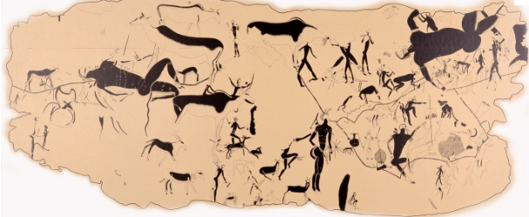
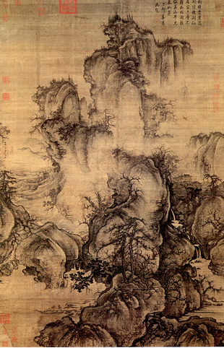
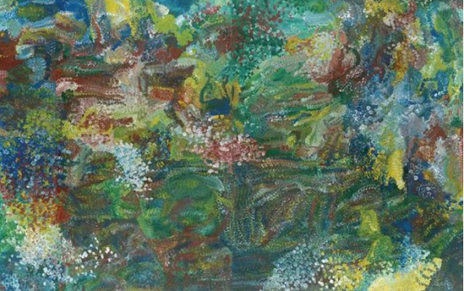
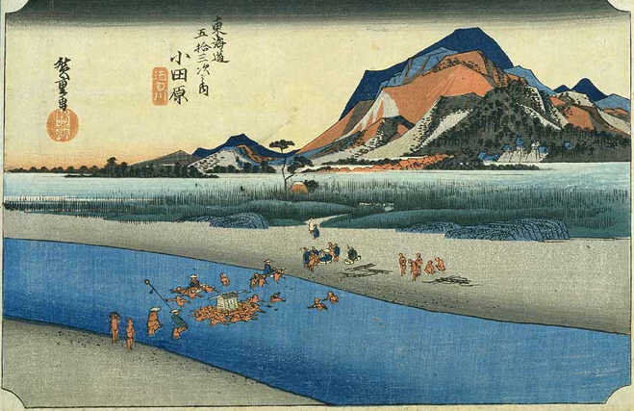
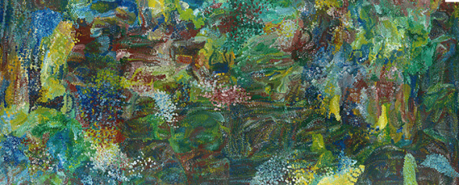
North America
Art
Europe
Africa
Asia
Australia
Notes:
There are several pieces of art that you can use to study the different continents.

Slide 9
Option 1
1 Continent/Week
Notes:
Once we had the standards clarified and knew our resources, it was time to divide the unit into weeks and distribute the standards….
We know that most teachers prefer to teach one to two continents per week throughout this unit. That is how option 1 is structured. We have also heard that some teachers have tried a new approach where they introduce all the continents during the first 2 weeks, then take the additional 4 weeks to study the literature from each continent. You will see this outline in option 2. We have given both options so that you can choose which plan suits your needs better.

Slide 10
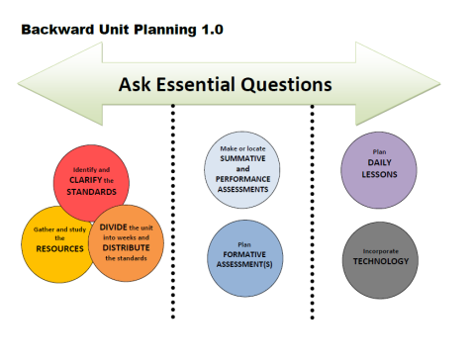

Week | Standards | Texts
Ongoing Standards throughout Unit 5 | Ask and answer questions about key details in a text (RI.K.1) Identify the main topic and retell key details of a text (RI.K.2) Ask and answer questions about unknown words in a text (RL.K.4) and (RI.K.4) Write informative/explanatory texts (W.K.2) Focus on a topic, respond to questions and suggestions from peers, add details (W.K.5) Capitalize the first word in a sentence and I (L.K.1.a) Write letters for most consonant and short-vowel sounds (L.K.2.c) Spell simple words phonetically (L.K.2.d)
1 North America and South America | Retell familiar stories, including key details (RL.K.2)—(Jumping Mouse) Identify characters, settings, and major events in a story (RL.K.3)—(Jumping Mouse) Produce and expand complete sentences in shared language activities (L.K.1.f) Use frequently occurring inflections and affixes (e.g., -ed,-s,re-,un-, pre-, -ful, -less) as a clue to the meaning of an unknown word (L.K.4.b)—(Jumping Mouse-beautiful, helpless, powerful, unselfish)
2 Europe | Retell familiar stories, including key details (RL.K.2)—(Ferdinand) Describe the relationship between illustrations and the story in which they appear (RL.K.7) –(One Fine Day-Fox lapping the milk & the tailor is sewing the fox’s tail) Identify new meanings for familiar words and apply them accurately (knowing duck is a bird and learning the verb to duck) (L.K.4.a)
DIVIDE the unit into weeks and DISTRIBUTE the standards
←Text Talk
Notes:
You’ll see at the top that we chose some ongoing standards that should be incorporated during the whole unit. The writing focus for this unit is informative/explanatory. This could be easily incorporated each week as the students write about what they learned about the different continents.
In week 1 the focus is North and South America. We’ve listed the standards to focus on and in parentheses you’ll see the text we felt you could use with that standard. We pointed out which texts are text talks in each week. Those text talks can be found under Teacher Created Resources. For standard L.K.4.b we found 4 examples of words with affixes in Jumping Mouse that you could use to teach that standard.
For week 2 we chose to focus on Europe. For standard RL.K.7 we found two pictures in One Fine Day that could be used to show the relationship between the illustration and the story.

Slide 11
Week | Standards | Texts
3 Antarctica | Describe the connection between ideas, or pieces of information in a text (RI.K.3)—(Antarctica) Describe the relationship between illustrations and the text in which they appear (RI.K.7 )—(Sort pictures into correct continent-South America & Antarctica) Identify the reasons an author gives to support points in a text (RI.K.8)—(Antarctica) Retell familiar stories, including key details (RL.K.2)—(Mr. Popper’s Penguins or Eve of Emperor Penguin) Sort common objects into categories to gain a sense of the concepts the categories represent (L.K.5.a)—(Sort pictures into correct continent) | or
4 Asia | Compare and contrast the adventures and experiences of characters in familiar stories (RL.K.9)—(Lon Po Po and Little Red Riding Hood, from week 2) Retell familiar stories, including key details (RL.K.2)—(The Paper Crane & Lon Po Po) Identify characters, settings, and major events in a story (RL.K.3)—(The Paper Crane & Lon Po Po) Form regular plural nouns orally by adding /s/ or /es/ (L.K.1.c)—(crane, cranes; ship, ships; tiger, tigers, beach, beaches)
←Text Talk
←Text Talk
^Lesson online>
←STEM Lesson
Notes:
For week 3 we focused on Antarctica. You’ll see here that you have the option of reading Mr. Popper’s Penguins or Eve of the Emperor Penguin as your read aloud text. We made a picture sort for RI.K.7 where the students must match the picture with the correct continent. It can be found on Teacher Created Resources.
In week 4 the focus is Asia. To teach RL.K.9 you can revisit Little Read Riding Hood from week 2 and compare it to Lon Po Po. There is a lesson online for comparing the adventures and experiences of the characters in those two books. For standard L.K.1.c we thought of a few plural nouns that you could use that correlate with Asia. There is also a STEM lesson online for The Fool of the World and the Flying Ship.

Slide 12
Week | Standards | Texts
5 Australia | Describe the connection between ideas, or pieces of information in a text (RI.K.3)—(Australia pg. 9) Identify the reasons an author gives to support points in a text (RI.K.8)—(Australia pg. 26-27) Retell familiar stories, including key details (RL.K.2)—(Koala Lou and Possum Magic) Compare and contrast the adventures and experiences of characters in familiar stories (RL.K.9)—(Koala Lou & Paper Crane-Lesson on Teacher created resources) Write to narrate a single event or several loosely linked events (W.K.3)—(Pretend you are invisible for a day like Possum. Write to tell what you’d do that day) Distinguish shades of meaning among verbs (e.g., walk, march, strut, prance) by acting out the meanings (L.K.5.d)
6 Africa | Describe relationship between illustrations and the text in which they appear (RI.K.7 )—(Africa pgs. 10-11) Identify basic similarities and differences between two texts on the same topic (RI.K.9 )—(Compare 2 continents for summative assessment-Smart Board lesson online) Write to narrate a single event or several loosely linked events (W.K.3)—(Pretend you live on a different continent. Use what you’ve learned to write a story telling what you’d do and see on that continent) Participate in shared research (W.K.7) Gather information to answer a question (W.K.8) Use most frequently occurring prepositions (to, from, in, out, on, off, for, of, by, with) (L.K.1.e) —(Use in narrative writing) Use words and phrases acquired through conversations, reading and being read to, and responding to texts (L.K.6) —(Narrative)
←Text Talk
^ Lesson online^
←Text Talk
Notes:
The focus for week 5 is Australia. We’ve pointed out some of the texts and lessons that are available. For the narrative writing standard, we wanted to make a connection to what they read about that week. We thought they could write a story pretending to be invisible like the Possum in Possum Magic. They could write to tell about what they did that day.
In week 6 the focus is Africa. We pointed out some different pages you could use to show the relationship between the illustrations and the text. There is a Smart Board lesson online for standard RI.K.9. We wanted to have them write another story this week that incorporated what they have been reading about. We said they could pick a continent and pretend like they live there. They’d write a story to tell about their adventure, including what they’d do and see there. Notice that standard L.K.1.e and L.K.6 could be incorporated into their narrative writing too.

Slide 13
Option 2
All continents learned, then revisit each to go deeper
Notes:
This is the second option. The first two weeks focus on the continents and the nonfiction standards. Your unit research project would be done at the end of these two weeks. The next four weeks focus on the fiction books and the standards that go with them. All of the standards and activities from option 1 are in option 2 but in a different order.

Slide 14


Week | Standards | Texts
Ongoing Standards throughout Unit 5 | Ask and answer questions about key details in a text (RI.K.1) Identify the main topic and retell key details of a text (RI.K.2) Ask & answer questions about words in a text (RL.K.4) and (RI.K.4) Write informative/explanatory texts (W.K.2) Focus on a topic, respond to questions & suggestions from peers, add details (W.K.5) Capitalize the first word in a sentence and I (L.K.1.a) Write letters for most consonant and short-vowel sounds (L.K.2.c) Spell simple words phonetically (L.K.2.d) Use words and phrases acquired through conversations, reading and being read to, and responding to texts (L.K.6)
1 The Seven Continents Non-Fiction Focus | Ask and answer questions about key details in a text (RI.K.1) Identify the main topic and retell key details of a text (RI.K.2) Describe the connection between ideas, or pieces of information in a text (RI.K.3)—(Antarctica) Describe the relationship between illustrations and the text in which they appear (RI.K.7 )—(Antarctica pgs. 20-21 and 22-23) Identify the reasons an author gives to support points in a text (RI.K.8)—(Antarctica)
2 The Seven Continents Non-Fiction Focus | Ask and answer questions about key details in a text (RI.K.1) Identify the main topic and retell key details of a text (RI.K.2) Describe the connection between ideas, or pieces of information in a text (RI.K.3)—(Australia pg. 9) Identify the reasons an author gives to support points in a text (RI.K.8)—(Australia pg. 26-27) Describe the relationship between illustrations and the text in which they appear (RI.K.7 )—(Africa pgs. 10-11) Identify basic similarities in and differences between two texts on the same topic (RI.K.9 )—(Compare 2 continents) Participate in shared research (W.K.7) Gather information to answer a question (W.K.8) Sort common objects into categories to gain a sense of the concepts the categories represent (L.K.5.a)
DIVIDE the unit into weeks and DISTRIBUTE the standards
Notes:
This is just a suggestion for the order to teach the continents. You may choose to teach them in any order.

Slide 15

Week | Standards | Texts
3 Fiction Focus Antarctica/ South America | Retell familiar stories, including key details (RL.K.2)—(Mr. Popper’s Penguins) Ask and answer questions about unknown words in a text (RL.K.4) Distinguish shades of meaning among verbs describing the same general action (e.g., walk, march, strut, prance) by acting out the meanings (L.K.5.d) Use most frequently occurring prepositions (e.g., to, from, in, out, on, off, for, of, by, with) (L.K.1.e) | Text Talk Or Text Talk
4 Fiction Focus Australia/ Europe | Retell familiar stories, including key details (RL.K.2)—(Koala Lou and Possum Magic) Write to narrate a single event or several loosely linked events (W.K.3)—(Pretend you are invisible for a day like Possum. Write to tell what you’d do that day) Retell familiar stories, including key details (RL.K.2)—(Ferdinand) Describe the relationship between illustrations and the story in which they appear (RL.K.7) –(One Fine Day-Fox lapping the milk & the tailor is sewing the fox’s tail) Identify new meanings for familiar words and apply them accurately (knowing duck is a bird and learning the verb to duck) (L.K.4.a) | Text Talk
Notes:
Week 3 starts the focus of the fictional texts. Again, you’ll notice the same standards and activities as the previous option.

Slide 16
Week | Standards | Texts
5 Fiction Focus Europe/ Asia | Compare and contrast the adventures and experiences of characters in familiar stories (RL.K.9)—(Lon Po Po and Little Red Riding Hood) Retell familiar stories, including key details (RL.K.2)—(The Paper Crane & Lon Po Po) Identify characters, settings, and major events in a story (RL.K.3)—(The Paper Crane & Lon Po Po) Form regular plural nouns orally by adding /s/ or /es/ (L.K.1.c)—(crane, cranes; ship, ships; tiger, tigers, beach, beaches) | Text Talk STEM Lesson
6 Fiction Focus Africa/ North America | Retell familiar stories, including key details (RL.K.2)—(Jumping Mouse) Identify characters, settings, and major events in a story (RL.K.3)—(Jumping Mouse) Produce and expand complete sentences in shared language activities (L.K.1.f) Use frequently occurring inflections and affixes (e.g., -ed,-s,re-,un-, pre-, -ful, -less) as a clue to the meaning of an unknown word (L.K.4.b)—(Jumping Mouse-beautiful, helpless, powerful, unselfish) Write to narrate a single event or several loosely linked events (W.K.3)—(Pretend they live on a different continent. Use what they’ve learned to write a story telling what they’d do and see on that continent) | Text Talk Text Talk
Notes:
…

Slide 17
Week | Standards | Essential Questions
1
2
3
4 |  | How do details help people understand the world?
5
6 |  | How do details help people understand the world?
Notes:
We think that students should be able to answer the essential question by the end of week 4, and revisit it during week 6.

Slide 18
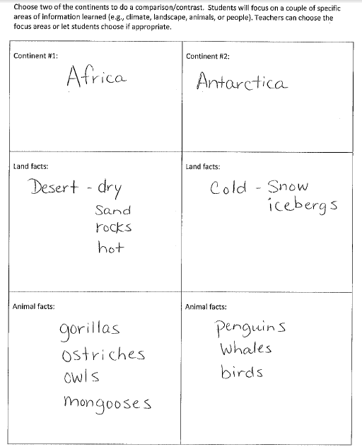
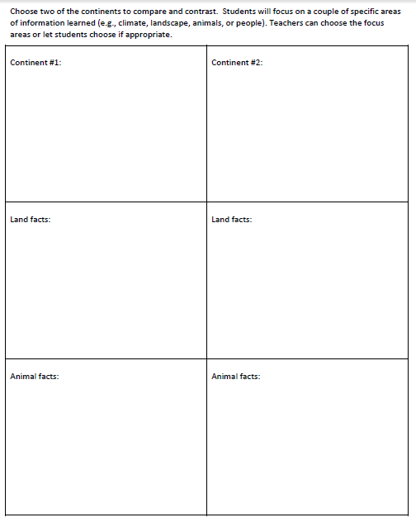
Assessment-RI.K.9
Choose two of the continents to compare and contrast. Students will focus on a couple of specific areas of information learned (e.g., climate, landscape, animals, or people). Teachers can choose the focus areas or let students choose if appropriate.
Example: *Note* Students can use words or pictures
Notes:
Here is an optional assessment for RI.K.9 where the students will compare and contrast different aspects of the continents. You can use the provided categories (land facts and animal facts) or you can change the categories to suit your needs. We’ve provided an example of a completed assessment, and noted that, if needed, students could supply a picture instead of words.

Slide 19
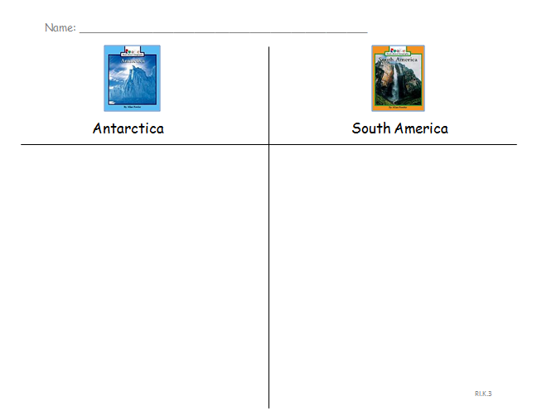
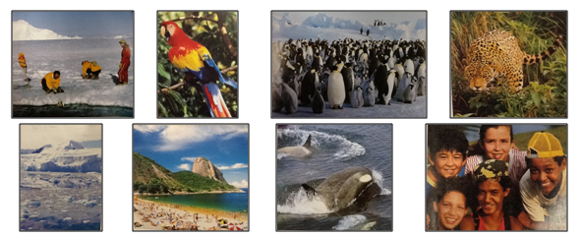
Assessment-RI.K.3
Describe the connection between ideas, or pieces of information in a text (RI.K.3)
Notes:
This assessment is for RI.K.3. Students will cut out the pictures and glue them under the correct continent. The pictures are from the Rookie Reader texts so the students should be familiar with them. This could also be done with other continents in the unit.

Slide 20
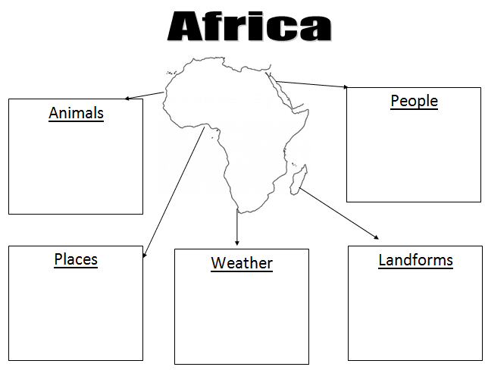
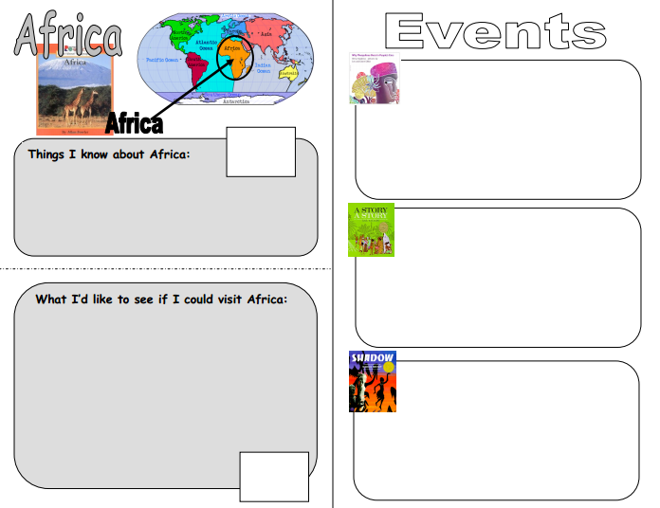
Daily Lessons- Graphic Organizers for each continent can be found online on Teacher Created Resources .
Notes:
There are graphic organizers for each continent on Teacher Created Resources. These are great for students to take notes as they learn about each continent.

Slide 21
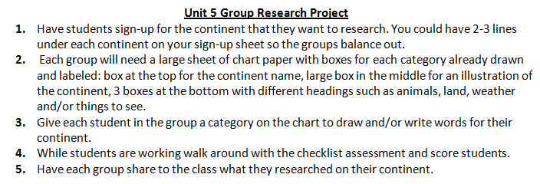
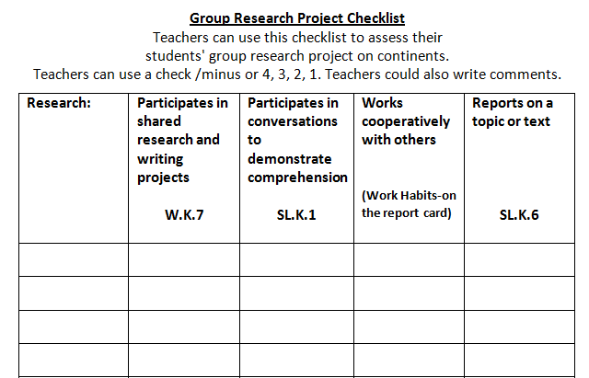
Daily Lessons
Notes:
Here is a checklist you can use for the research project. The directions and checklist can also be found on Teacher Created Resources.

Slide 22

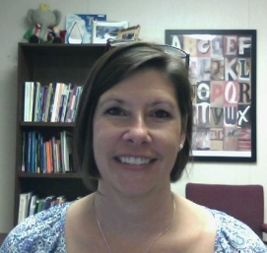

RESOURCES
Susan Hensley
Elementary Curriculum Specialist
shensley@rps.k12.ar.us
Notes:
We hope these resources will help! Please share any resources you create with your literacy facilitator or Susan Hensley.

