Slide 1

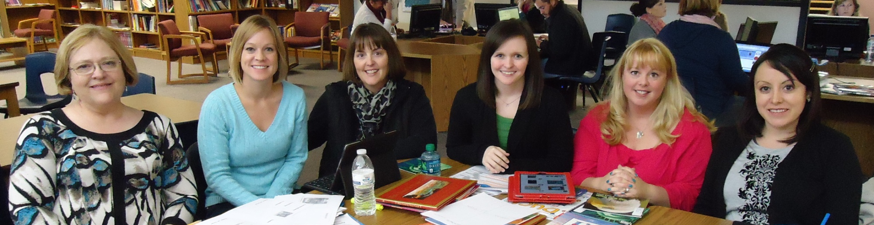

America: Symbols and Celebrations
Kindergarten Unit 4
Planning Team
Deborah Goff, Jenny Griffin, Kerri Wells, Jillian King, Krista Roth, and Jessica Falcon

Slide 2
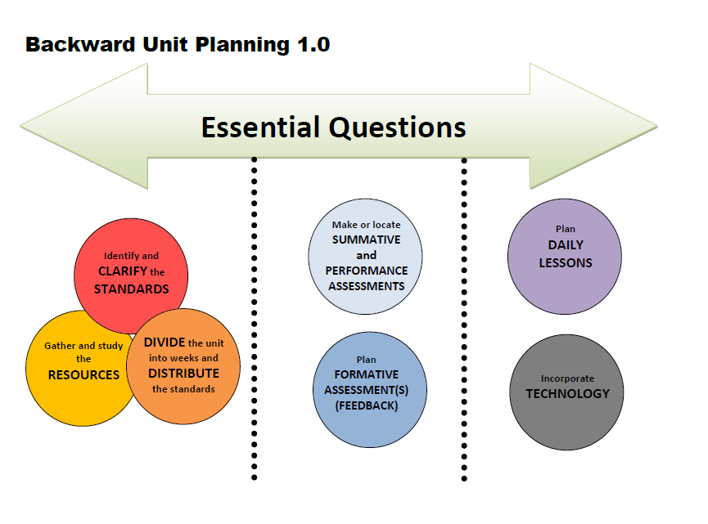

Slide 3

America:
Symbols and Celebrations
Essential Question
Why are symbols and celebrations important?

Slide 4
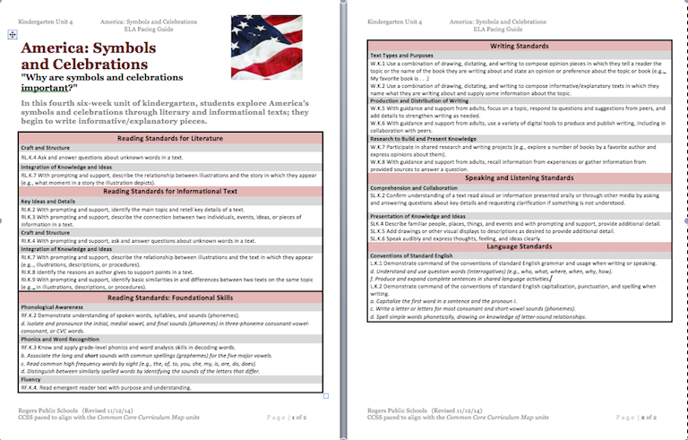
Pacing Guide Here

Slide 5
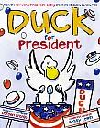
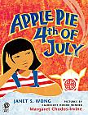
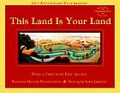
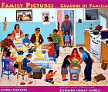
Literature
Kindergarten
Print Resources
Unit 4
Picture Books
(Read Aloud)
Music & Songs
John Phillip Sousa
Stars and Stripes Forever Lyrics Listen
The Liberty Bell Listen
The Washington Post Listen
America the Beautiful
America (My Country, ‘Tis of thee)
Yankee Doodle
You’re a Grand Old Flag
Out of Print
(2 copies per building purchased 2011-2012)
Poems (Read Aloud)
“Celebration” Alonzo Lopez
“Thanksgiving Day” Lydia Maria Child

Slide 6
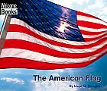
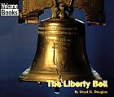
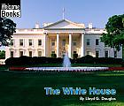
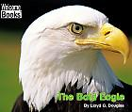
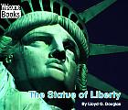
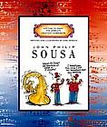
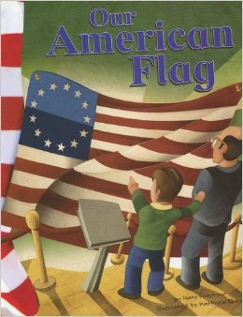
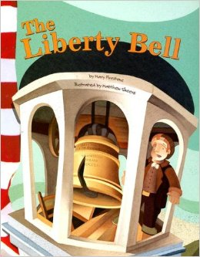
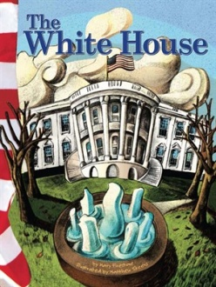
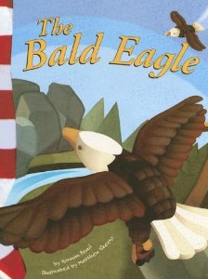
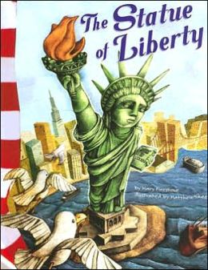
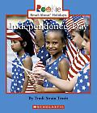
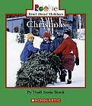
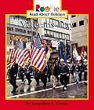
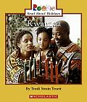
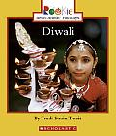
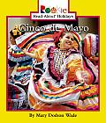
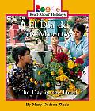
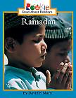
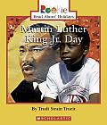
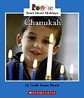
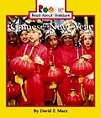
Informational Text
Out of Print
(2 copies per building purchased 2011-2012)

Slide 7
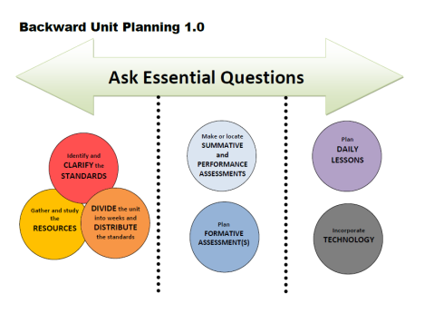
Week | Standards | Texts
Foundational Skills to be taught throughout the unit: RF.K.2d; RF.K.3 a-d; RF.K.4 Language Standards to be taught throughout the unit: L.K.1d, f; L.K.2a, c, d
1 | RL.K.4 Ask and answer questions about unknown words in a text. RL.K.7 with prompting and support, describe the relationship between illustrations and the story in which they appear (e.g., what moment in a story the illustration depicts). RI.K.2 With prompting and support, identify the main topic and retell key details of a text. W.K.2 Use a combination of drawing, dictating, and writing to compose informational/explanatory texts in which they name what they are writing about and supply some information about the topic. W.K.8 With guidance and support from adults, recall information from experiences or gather information from provided sources to answer a question. SL.K.2 Confirm understanding of a text read aloud or information presented orally or through other media by asking and answering questions about key details and requesting clarification if something is not understood. SL.K.4 Describe familiar people, places, things, and events wand with prompting and support, provide additional detail. | Christmas Kwanzaa Chanukah Family Pictures (RL.K.4) Use Comparison Matrix
DIVIDE the unit into weeks and DISTRIBUTE the standards
Notes:
Story kit tutorial
https://www.youtube.com/watch?v=RSWQkUS4kXk

Slide 8
Week | Standards | Texts
2 | RI.K.2 With prompting and support, identify the main topic and retell key details of a text. RI.K.3 With prompting and support, describe the connection between two individuals, events, ideas, or pieces of information in a text. RI.K.7 With prompting and support, describe the relationship between illustrations and the text in which they appear (e.g.., illustrations, descriptions, or procedures). SL.K.2 Confirm understanding of a text read aloud or information presented orally or through other media by asking and answering questions about key details and requesting clarification if something is not understood. SLK.4 Describe familiar people, places, things, and events and with prompting and support, provide additional detail. W.K.2 Use a combination of drawing, dictating, and writing to compose informative/explanatory texts in which they name what they are writing about and supply some information about the topic. | El Dia de los Muertos Cinco de Mayo Ramadan Diwali Continue Matrix ISN pages for celebrations available on district website.
DIVIDE the unit into weeks and DISTRIBUTE the standards
Notes:
Story kit tutorial
https://www.youtube.com/watch?v=RSWQkUS4kXk

Slide 9
Week | Standards | Texts
3 | RI.K.2 With prompting and support, identify the main topic and retell key details of a text. RI.K.3 With prompting and support, describe the connection between two individuals, events, ideas, or pieces of information in a text. RI.K.7 With prompting and support, describe the relationship between illustrations and the text in which they appear (e.g.., illustrations, descriptions, or procedures). W.K.1 Use a combination of drawing, dictating, and writing to compose opinion pieces in which they tell a reader the topic or the name of the book they are writing about and state an opinion or preference about the topic or book (e.g.., My favorite book is . . .) W.K.2 Use a combination of drawing, dictating, and writing to compose informative/explanatory texts in which they name what they are writing about and supply some information about the topic. W.K.8 With guidance and support from adults, recall information from experiences or gather information from provided sources to answer a question. | Apple Pie and the 4th of July Chinese New Year Independence Day
DIVIDE the unit into weeks and DISTRIBUTE the standards
Notes:
Story kit tutorial
https://www.youtube.com/watch?v=RSWQkUS4kXk

Slide 10
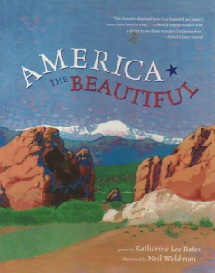
Week | Standards | Texts
4 | RL.K.4 Ask and answer questions about unknown words in a text. RI.K.7 With prompting and support, describe the relationship between illustrations and the text in which they appear (e.g.., illustrations, descriptions, or procedures). RI.K.2 With prompting and support, identify the main topic and retell key details of a text. RI.K.4 With prompting and support, ask and answer questions about unknown words in a text. W.K.2 Use a combination of drawing, dictating, and writing to compose informative/explanatory texts in which they name what they are writing about and supply some information about the topic. W.K.5 With guidance and support from adults, focus on a topic, respond to questions and suggestions from peers, and add details to strengthen writing as needed. W.K.7 Participate in shared research and writing projects (e.g., explore a number of books by a favorite author and express opinions about them). SL.K.5 Add drawings or other visual displays to descriptions as desired to provide additional detail. SL.K.6 Speak audibly and express thoughts, feeling, and ideas clearly. | This Land is Your Land John Philip Sousa The American Flag America the Beautiful
DIVIDE the unit into weeks and DISTRIBUTE the standards
Notes:
Story kit tutorial
https://www.youtube.com/watch?v=RSWQkUS4kXk

Slide 11
Week | Standards | Texts
5 | RI.K.8 Identify the reasons an author gives to support points in a text. RI.K.9 With prompting and support, identify basic similarities in and differences between two texts on the same topic (e.g.., in illustrations, descriptions, or procedures). W.K.1 Use a combination of drawing, dictating, and writing to compose opinion pieces in which they tell a reader the topic or the name of the book they are writing about and state an opinion or preference about the topic or book (e.g.., My favorite book is . . .) W.K.2 Use a combination of drawing, dictating, and writing to compose informative/explanatory texts in which they name what they are writing about and supply some information about the topic. W.K.5 With guidance and support from adults, focus on a topic, respond to questions and suggestions from peers, and add details to strengthen writing as needed. W.K.6 With guidance and support from adults, use a variety of digital tools to produce and publish writing, including in collaboration with peers. W.K.7 Participate in shared research and writing projects (e.g., explore a number of books by a favorite author and express opinions about them). W.K.8 With guidance and support from adults, recall information from experiences or gather information from provided sources to answer a question. SL.K.5 Add drawings or other visual displays to descriptions as desired to provide additional detail. SL.K.6 Speak audibly and express thoughts, feeling, and ideas clearly. | Bald Eagle, Liberty Bell Option: Story Kit: My Favorite Symbol Story Kit Tutorial
DIVIDE the unit into weeks and DISTRIBUTE the standards
Notes:
Story kit tutorial
https://www.youtube.com/watch?v=RSWQkUS4kXk

Slide 12
Week | Standards | Texts
6 | RI.K.8 Identify the reasons an author gives to support points in a text. RI.K.9 With prompting and support, identify basic similarities in and differences between two texts on the same topic (e.g.., in illustrations, descriptions, or procedures). W.K.1 Use a combination of drawing, dictating, and writing to compose opinion pieces in which they tell a reader the topic or the name of the book they are writing about and state an opinion or preference about the topic or book (e.g.., My favorite book is . . .) W.K.2 Use a combination of drawing, dictating, and writing to compose informative/explanatory texts in which they name what they are writing about and supply some information about the topic. W.K.5 With guidance and support from adults, focus on a topic, respond to questions and suggestions from peers, and add details to strengthen writing as needed. W.K.7 Participate in shared research and writing projects (e.g., explore a number of books by a favorite author and express opinions about them). W.K.8 With guidance and support from adults, recall information from experiences or gather information from provided sources to answer a question. SL.K.5 Add drawings or other visual displays to descriptions as desired to provide additional detail. SL.K.6 Speak audibly and express thoughts, feeling, and ideas clearly. | Statue of Liberty, White House, Duck for President
DIVIDE the unit into weeks and DISTRIBUTE the standards
Notes:
Story kit tutorial
https://www.youtube.com/watch?v=RSWQkUS4kXk

Slide 13
Week | Standards | Essential Questions
1 | RL.K.4 W.K.2 RI.K.2 W.K.8 SL.K.2 SL.K.4
2 | RI.K.2 SL.K.2 RI.K.3 SL.K.4 RI.K.7 W.K.2
3 | RL.K.7 W.K.1 RI.K.2 W.K.2 RI.K.3 W.K.8 RI.K.7 | Why are symbols and celebrations important?
4 | RL.K.4 W.K.5 RL.K.7 W.K.7 RI.K.2 SL.K.5 RI.K.4 SL.K.6 W.K.2
5 | RI.K.8 W.K.6 RI.K.9 W.K.7 W.K.1 W.K.8 W.K.2 SL.K.5 W.K.5 SL.K.6
6 | RI.K.8 W.K.7 RI.K.9 W.K.8 W.K.1 SL.K.5 W.K.2 SL.K.6 W.K.5 | Why are symbols and celebrations important?

Slide 14
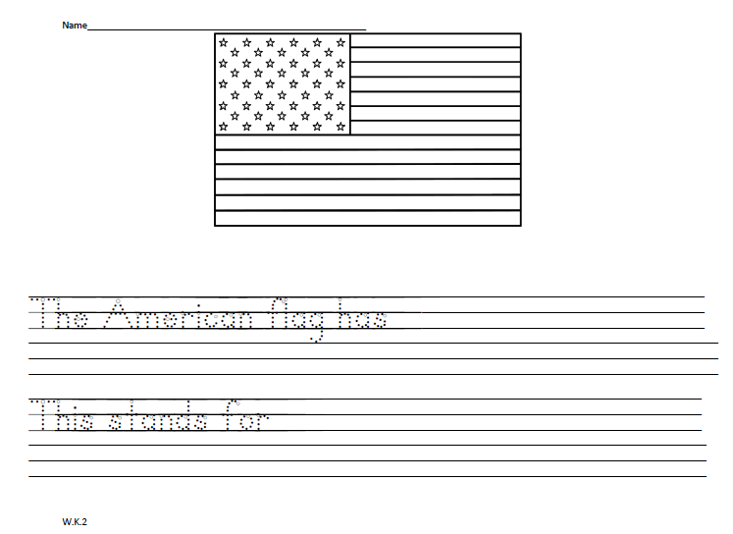

Slide 15
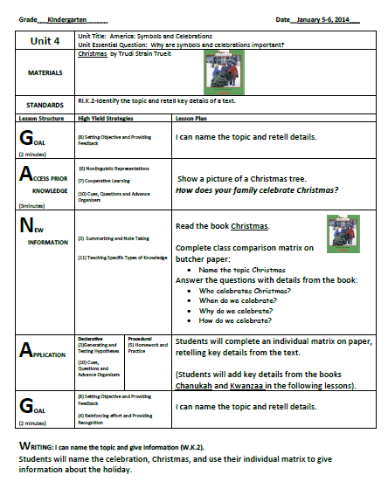
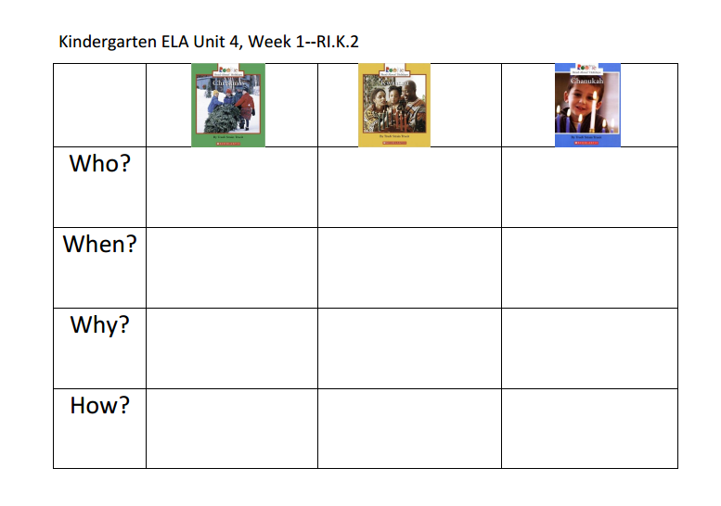

Slide 16

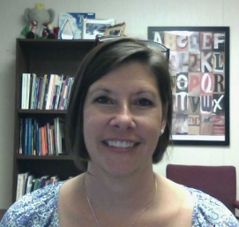

RESOURCES
Susan Hensley
Elementary Curriculum Specialist
shensley@rps.k12.ar.us

