Slide 1
GANAG
Making Connections
Knuffle Bunny and
Knuffle Bunny, Too by Mo Willems
Old Wire Elementary School
Sherri Yates’s Kindergarten Class
Deborah Goff, Literacy Facilitator
Notes:
The books Knuffle Bunny and Knuffle Bunny, Too were chosen because students were familiar with the first text. This familiarity helped the students to make connections between the first and second books without the added burden of introduction to completely new material.

Slide 2
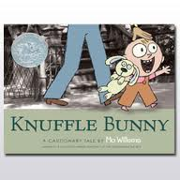
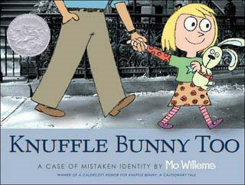
G Goal: R.9.K.3 – Make Connections between texts during a read aloud.
Two texts were read aloud previously. (See day one and two of GANAG lessons)
Notes:
The texts had been read aloud to students the day before so that the stories were fresh in their minds.
Knuffle Bunny: Trixie and her dad go to the laundromat – with Knuffle Bunny in tow. They accidentally leave Knuffle Bunny in the washer. Trixie realizes that Knuffle Bunny has been left behind, and tries to communicate this to her dad, but she is still babbling, and can’t make herself understood. When they reach their home, Mom asks “Where is Knuffle Bunny?” The entire family races back to the laundromat, where Knuffle Bunny is found again, and Trixie says her first words, “Knuffle Bunny!”
Knuffle Bunny, Too: Trixie and her dad are walking to Pre-K. Trixie is excited to show her one-of-a-kind Knuffle Bunny to the class. When she arrives at school, Sonja also has a Knuffle Bunny (although the inside ear color of the toys are different). The girls fight over their toys, and they are taken away from them for the day. At the end of the day, the girls are accidentally given the wrong toys. They go home, go to bed, and in the middle of the night they both realize they have the wrong bunny. They arrange an exchange. The girls become best friends.

Slide 3
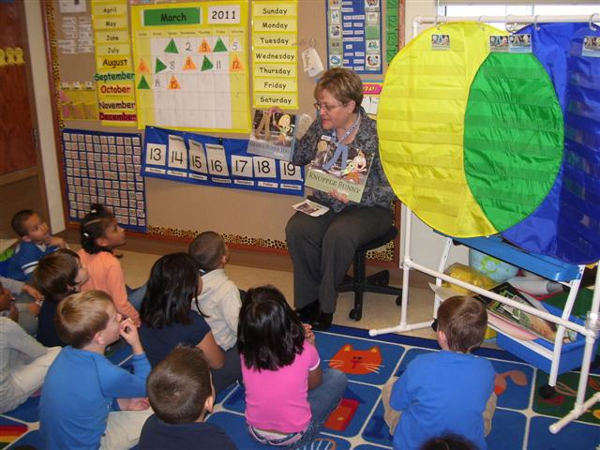
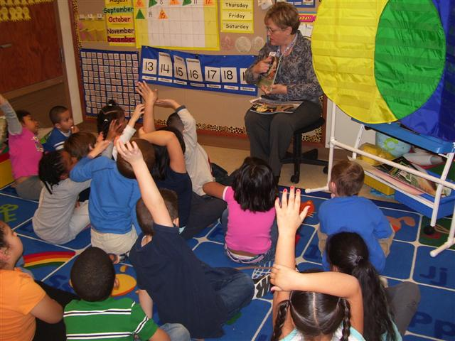
A Students Access prior knowledge by reviewing elements of the two books.

Slide 4
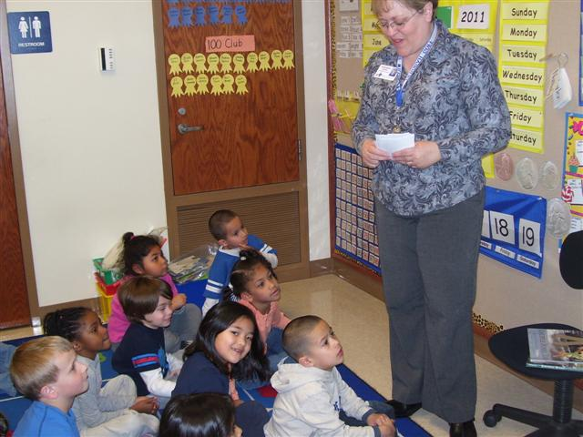
Students make instant connections between the two stories, and are able to independently begin to make comparisons.
Notes:
We reviewed the two books so that students could orally make connections between the books.

Slide 5
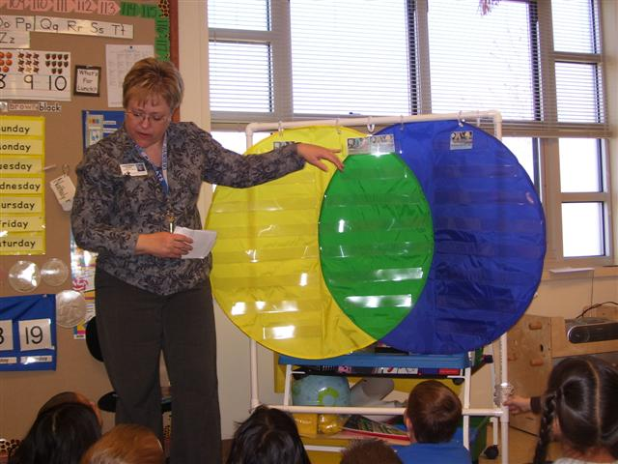
N New Information: Venn Diagram
Mrs. Goff explains how the venn diagram will help the students show their connections between the books.
Students learn that they will be able to show how the books are alike, and how the books are different.
Notes:
We discussed the venn diagram, and how we could use it to show how the books were alike and how they are different. Pictures of the books were put on the chart in this way: Yellow – a picture of the book Knuffle Bunny. Green - A picture of the books Knuffle Bunny and Knuffle Bunny, Too. Blue – a picture of the book Knuffle Bunny, Too.

Slide 6
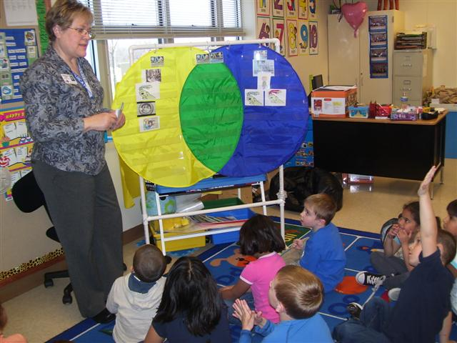
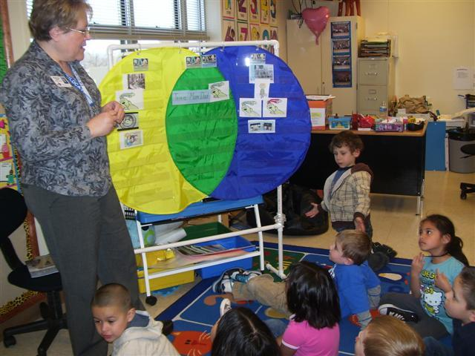
N Students complete the venn diagram as a class, comparing and contrasting setting, characters, problem, and solution.
Notes:
Pictures were used to make connections between the books, and identify similarities and differences. Students discussed the completed venn diagram, and discussed how this helps us to show the connections between the books.

Slide 7
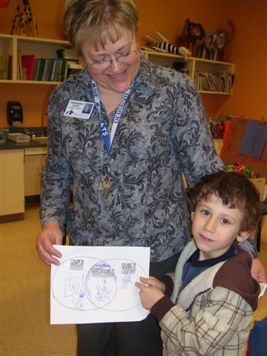
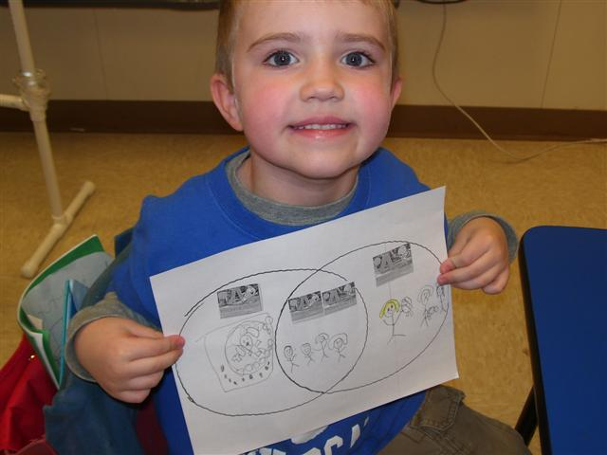
A Students apply knowledge independently with their own venn diagram.
Notes:
Students received a venn diagram with the pictures of the books on the graphic organizer. Students were asked to draw or write one thing that was common to both books, and an event that happened in each book. The student on the right drew Trixie, her mom, dad, and Knuffle Bunny in the middle. On the left, he drew the washing machine with Knuffle Bunny inside from Knuffle Bunny. On the right, he drew the two girls who fought over their Knuffle Bunnies in Knuffle Bunny, Too.

Slide 8
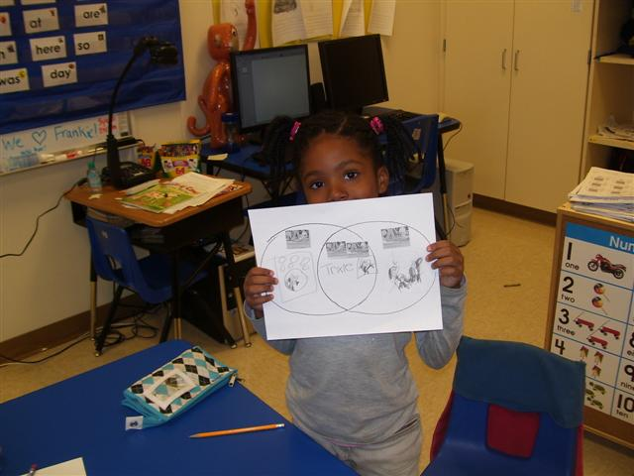
G Students show how they made connections between the texts.
Notes:
Students shared their completed venn diagrams with each other, discussing the events that they had chosen. We discussed how using the venn diagram helped them to remember the connections they had made to the texts individually, and between texts.

