Slide 1


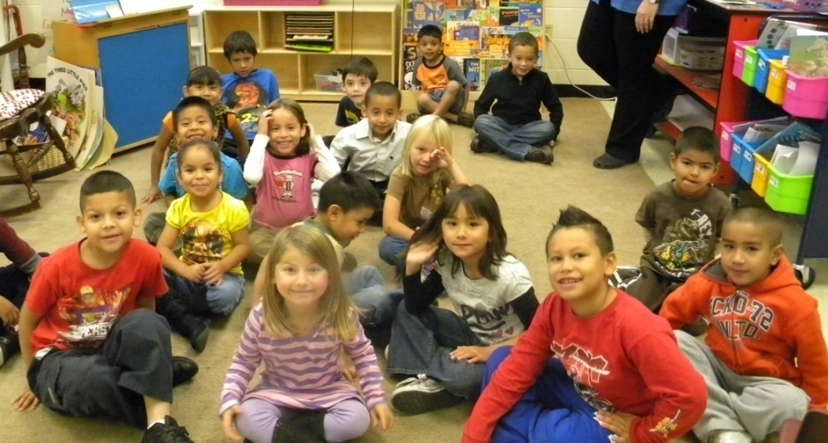
Ask and Answer Questions
Mrs. Kirkland’s Kindergarten Class
Grace Hill Elementary
Rogers, Arkansas
October 20, 2011

Slide 2
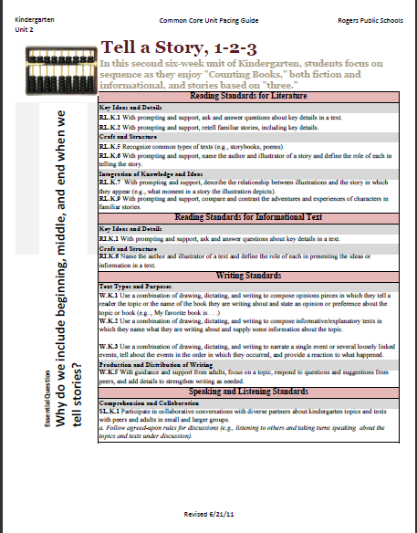
Unit 2 Pacing Guide- Kindergarten
Mrs. Kirkland started with the standard she wanted the kids to perform.
RI.K.1 With prompting and support, ask and answer questions about key details in text.

Slide 3
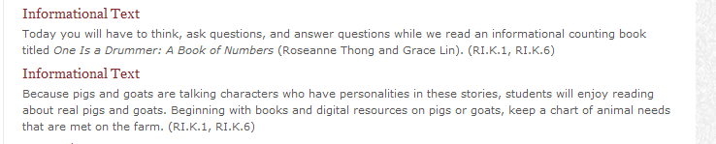
Common Core Curriculum Map- Unit 2
She then looked at the Common Core Curriculum Unit for lesson ideas.
RI.K.1 With prompting and support, ask and answer questions about key details in text.
For the first lesson, she decided to use pictures instead of a text. (She will move to text in future lessons.)

Slide 4
Anchor Standard 1: Read closely to determine what the text says explicitly and to make logical inferences from it; cite specific textual evidence when writing or speaking to support conclusions drawn from the text.
K | With prompting and support, ask and answer questions about key details in a text.
1st | Ask and answer questions about key details in a text.
2nd | Ask and answer such questions as who, what, where, when, why and how to demonstrate understanding of key details in a text.
3rd | Ask and answer questions to demonstrate understanding of a text, referring explicitly to the text as the basis for the answer.
4th | Refer to details and examples in a text when explaining what the text says explicitly and when drawing inferences from the text.
5th | Quote accurately from a text when explaining what the text says explicitly and when drawing inferences from the text.
6th | Cite textual evidence to support analysis of what the text says explicitly as well as inferences drawn from the text.
7th | Cite several pieces of textual evidence to support analysis of what the text says explicitly as well as inferences drawn from the text.
8th | Cite the textual evidence that most strongly supports an analysis of what the text says explicitly as well as inferences drawn from the text.
9-10 | Cite strong and thorough textual evidence to support analysis of what the text says explicitly as well as inferences drawn from the text.
11-12 | Cite strong and thorough textual evidence to support analysis of what the text says explicitly as well as inferences drawn from the text, including determining where the text leaves matters uncertain.

Slide 5
The purpose of the GANAG structure
To give students the opportunity to actively use the nine high-yield strategies:
(2) Identifying Similarities and Differences
(7) Cooperative Learning
(8) Setting Objectives and Providing Feedback
(3) Summarizing and Note Taking
(4) Reinforcing Effort and Providing Recognition
(9) Generating and Testing Hypotheses
(5) Homework and Practice
(10) Cues, Questions and Advance Organizers
(6) Nonlinguistic Representations

Slide 6
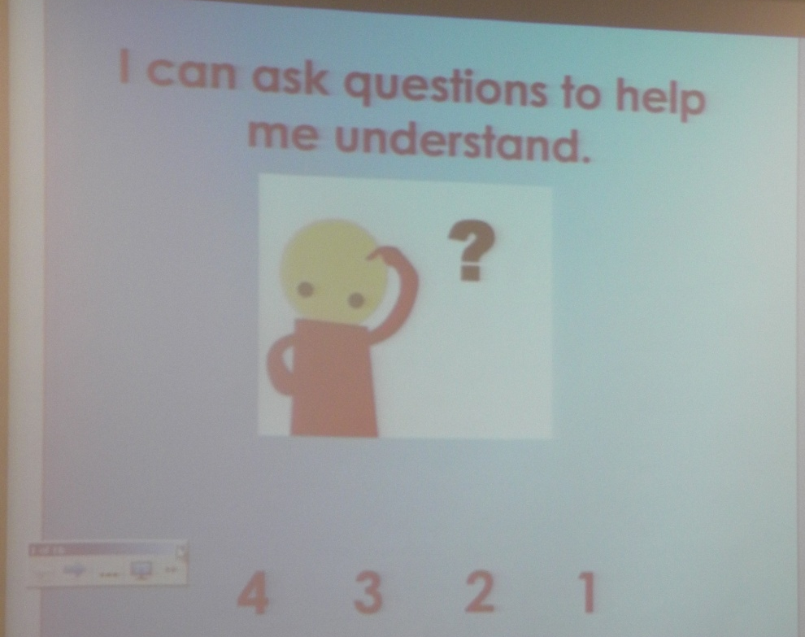
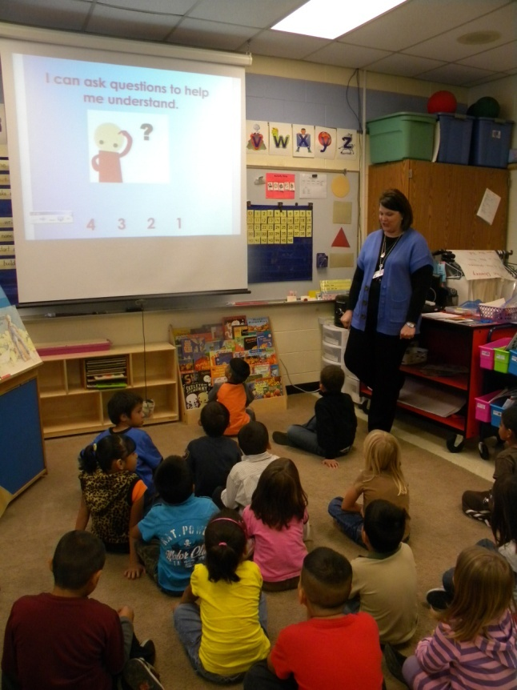
Goal:
Say it with me…
“I can ask questions to help me understand.”
(8) Setting Objectives and Providing Feedback

Slide 7
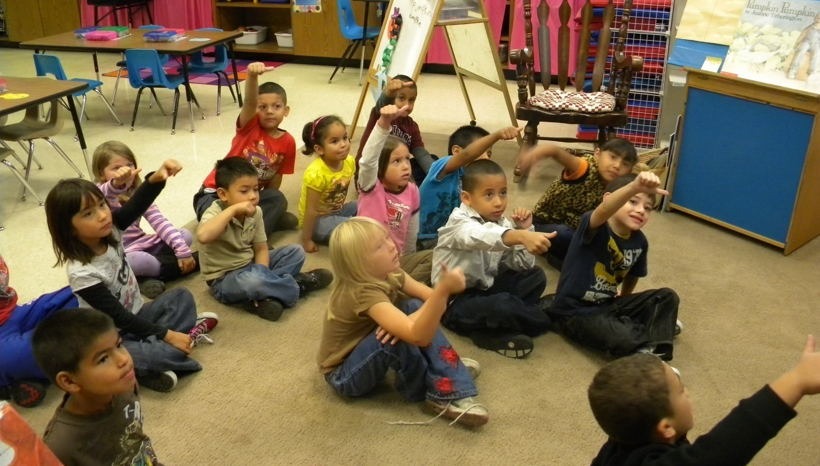


Score yourself…
“I can ask questions to help me understand.”
3
4
1
2

Slide 8
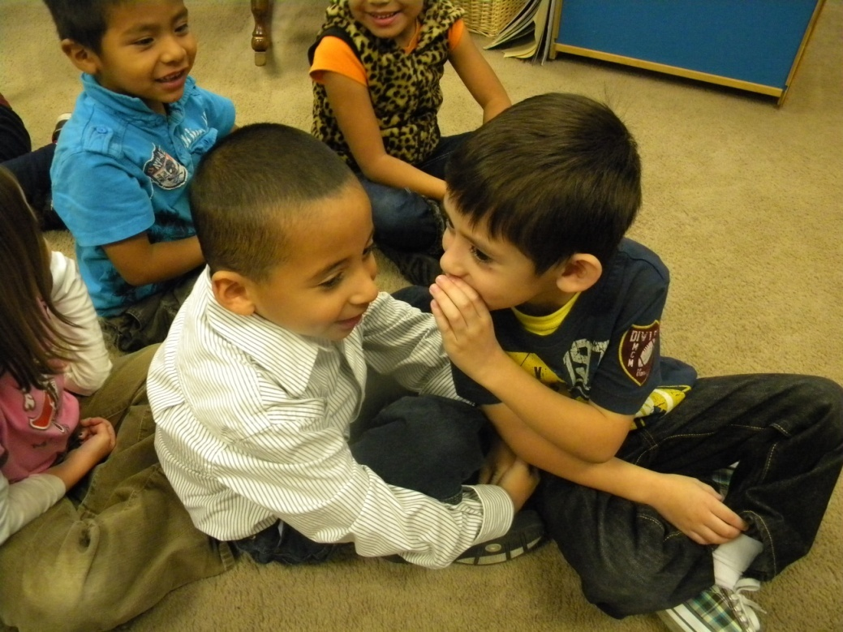
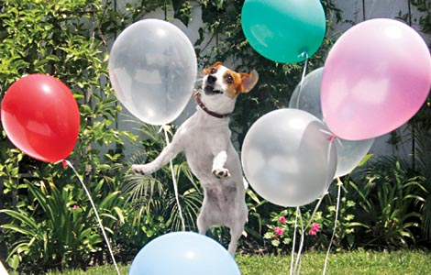
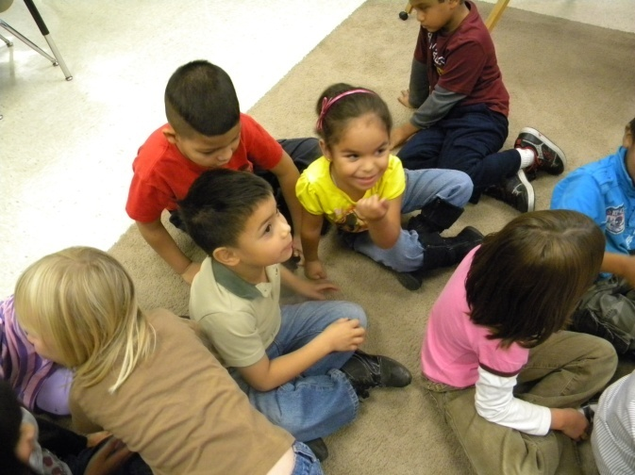
Access Prior Knowledge:
“Talk to your friend about this picture.”
“What did you talk about?”
(6) Nonlinguistic Representations
(7) Cooperative Learning

Slide 9
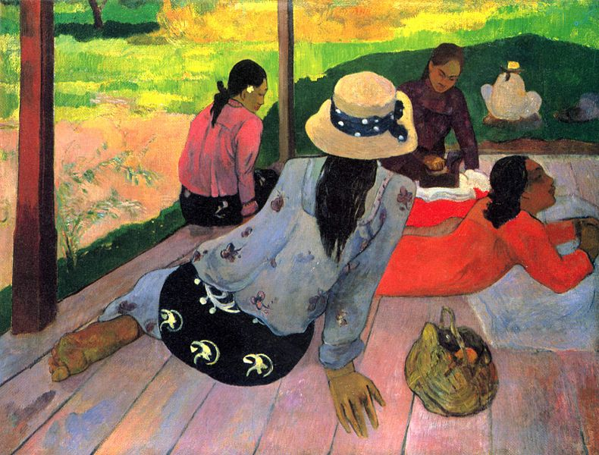
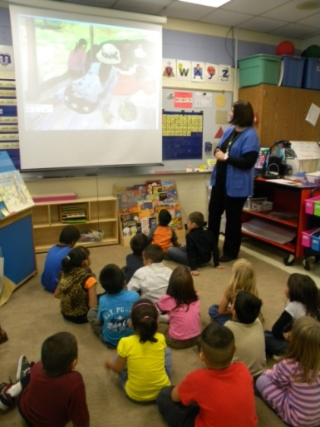
New Information: Modeling
“When I look at this painting, I ask myself a lot of questions..”
“Why is she lying down?”
“Are they listening to someone?”
“Who?”
“What is in the bag?”
“Where are they?”
“I wish I could talk
to the artist to
find out the answers
to my questions.”
(This painting is from Unit 1)
Paul Gauguin, The Midday Nap (1894)
(6) Nonlinguistic Representations
(10) Cues, Questions and Advance Organizers

Slide 10
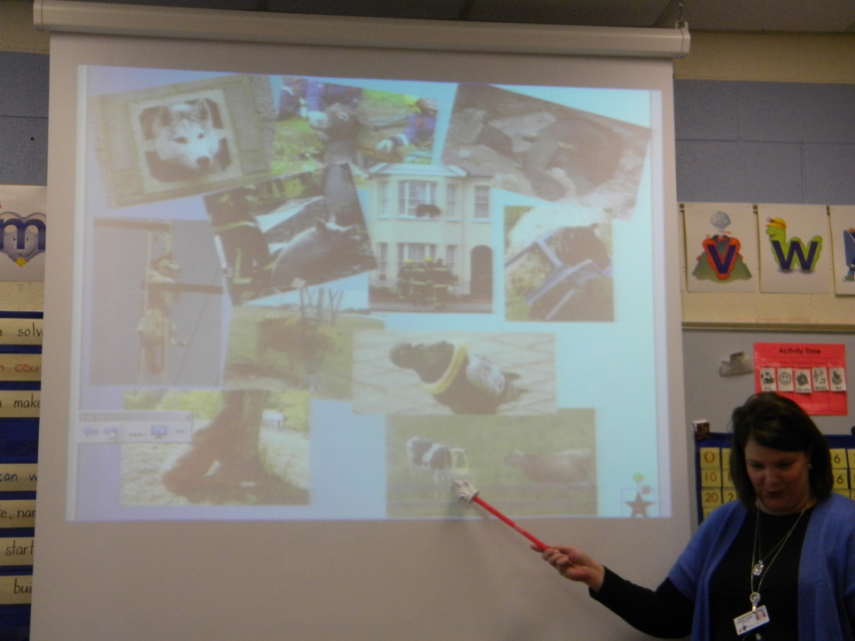
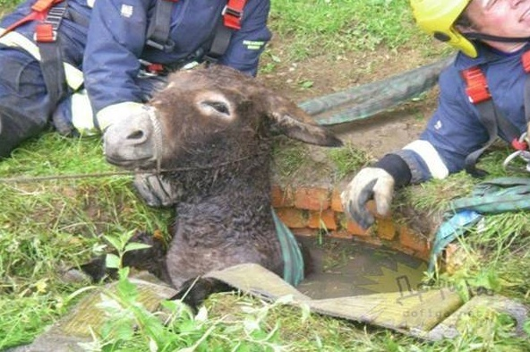
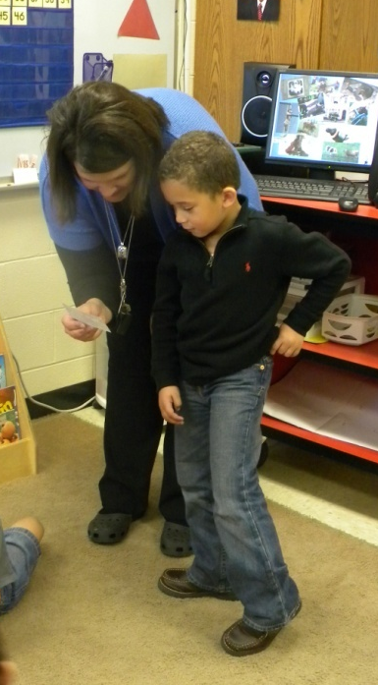
Application:
“Look at all these silly pictures. I am going to give one of them to you and a partner, so you can practice asking questions to help you understand.”
A student helped Mrs. Kirkland model how to ask questions about the picture.

Slide 11
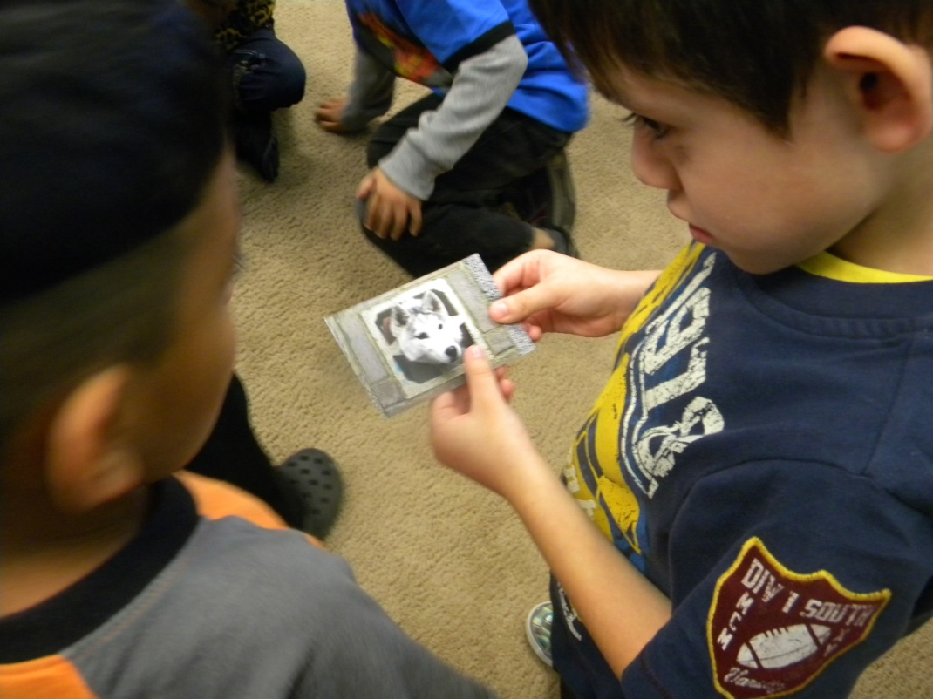
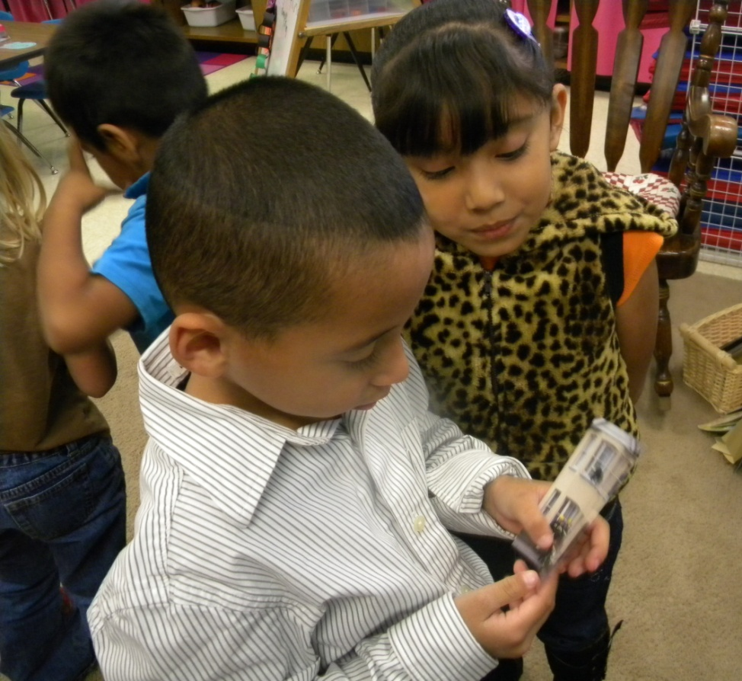
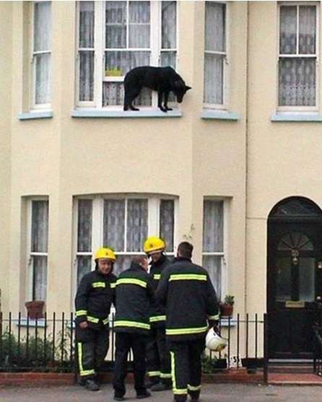
Application:
(7) Cooperative Learning
(5) Homework and Practice

Slide 12
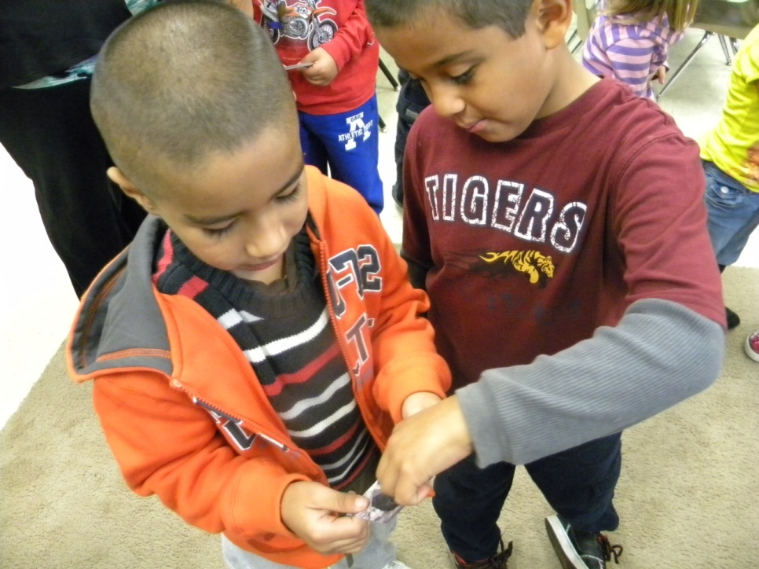
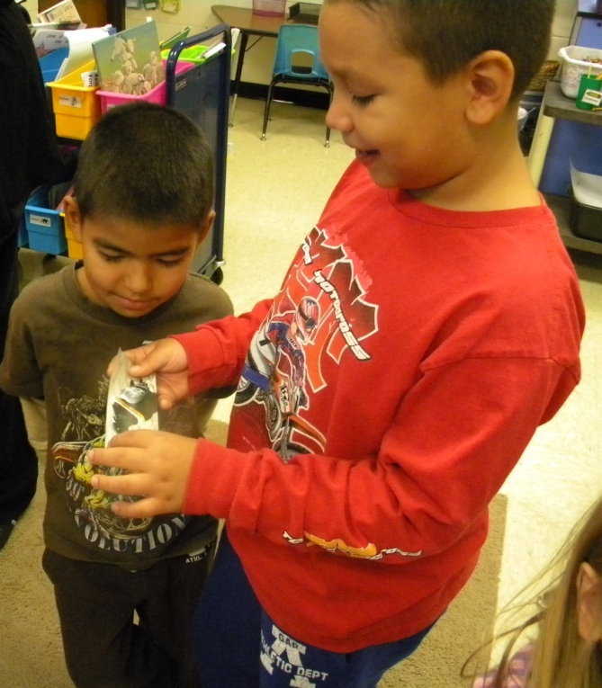
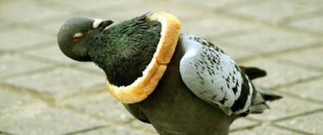
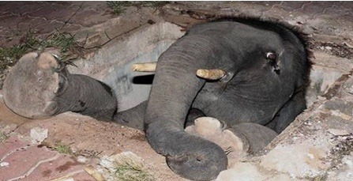
Application:
(7) Cooperative Learning
(5) Homework and Practice

Slide 13
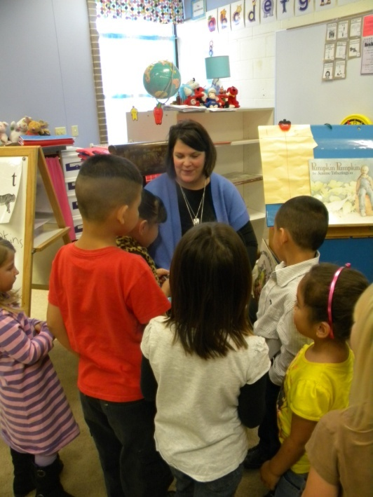
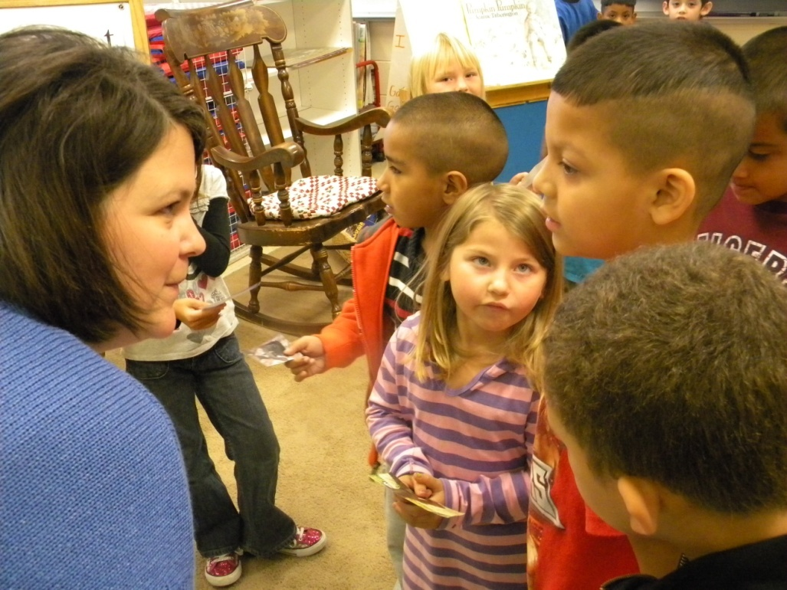
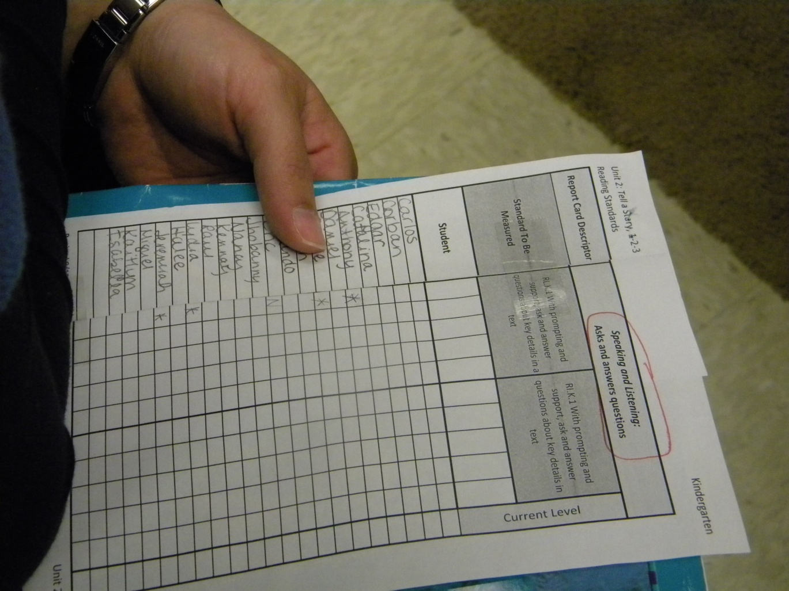
(4) Reinforcing Effort and Providing Recognition
Mrs. Kirkland listened and talked with partners.
She scored their performance to the standard.

Slide 14
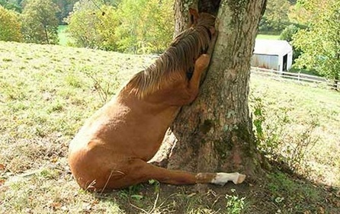
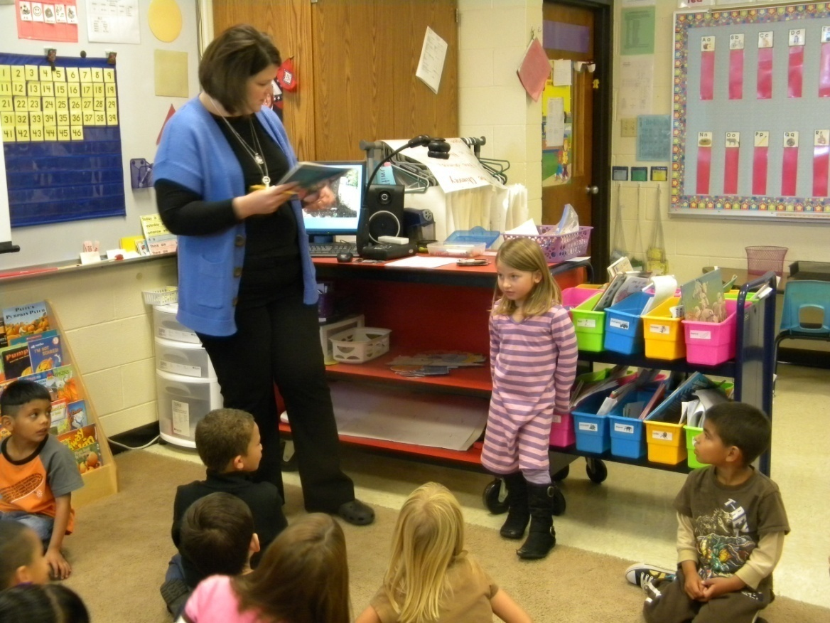
Sharing
Student-
“Did some grass fall in the tree?”
“Did he go in to get it?”

Slide 15
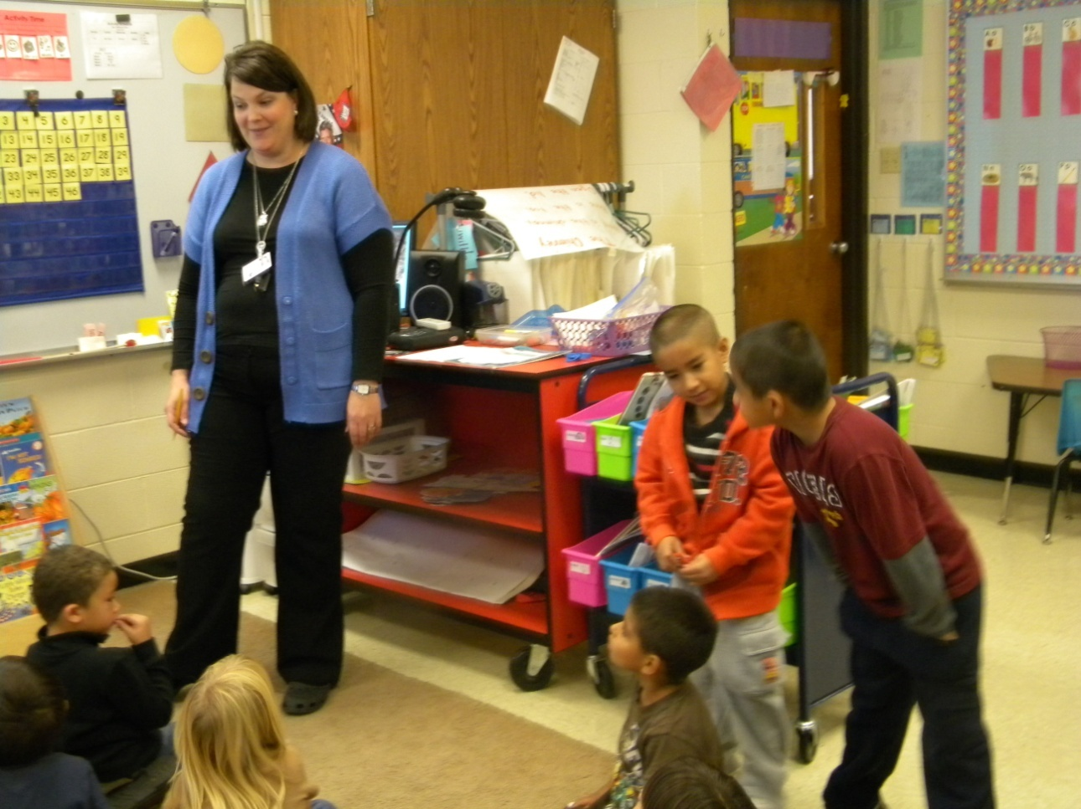
Students-
“Is the fireman going to come get it out?”
“Did the rain come down and make it fall in the hole?”

Slide 16
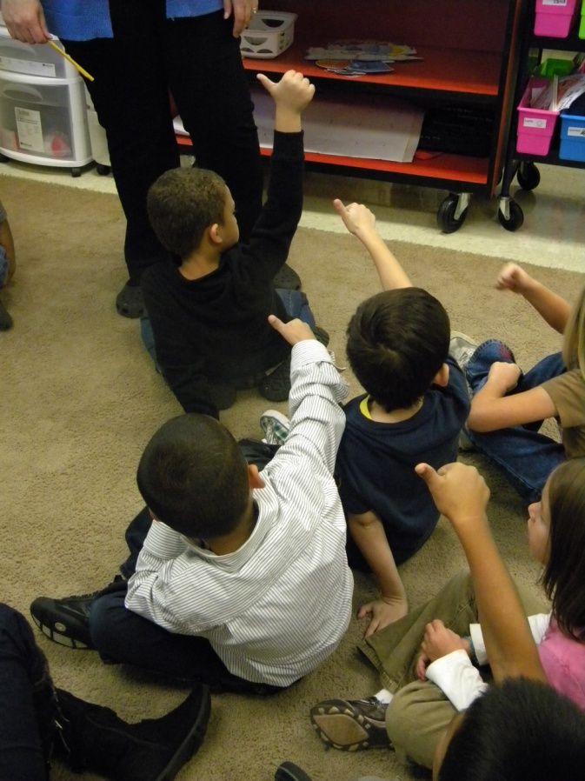
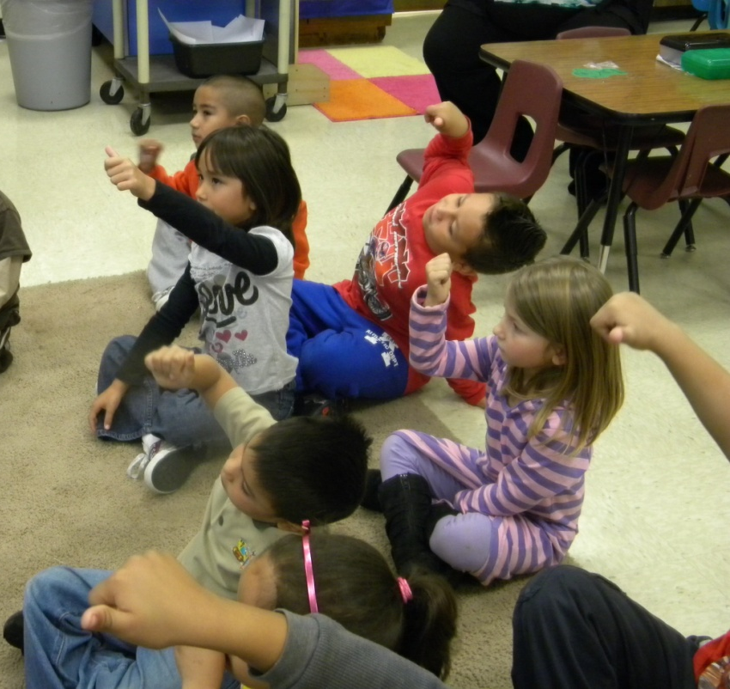
Generalize the Goal- Now how would you score yourself?
“I can ask questions to help me understand.”
3
4
1
2
(8) Setting Objectives and Providing Feedback

Slide 17
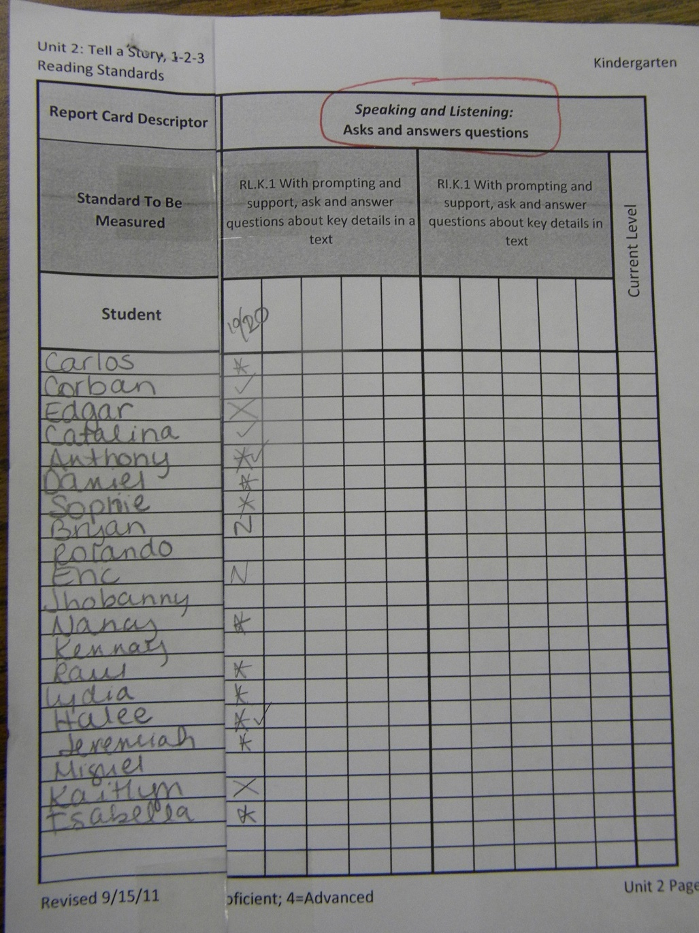
*= with support
X= absent
N= not yet
= proficient

