Slide 1
The American Flag
Notebooks in Kindergarten
Mrs. Kirkland’s Class
January 2013

Slide 2
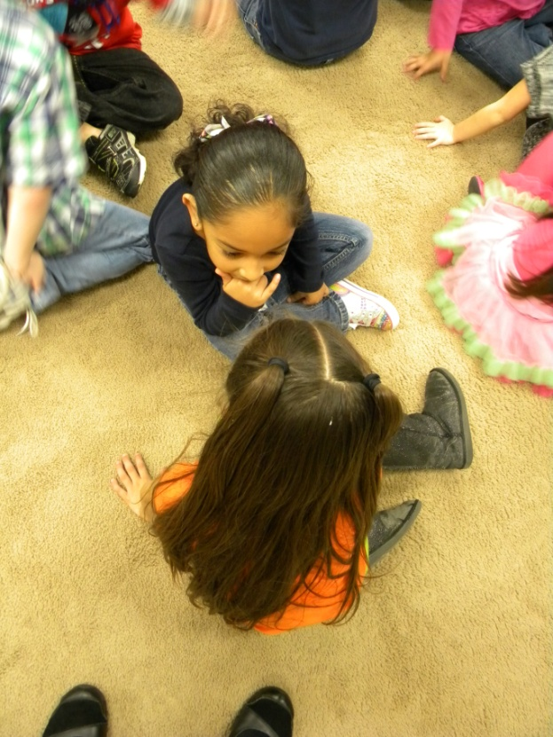
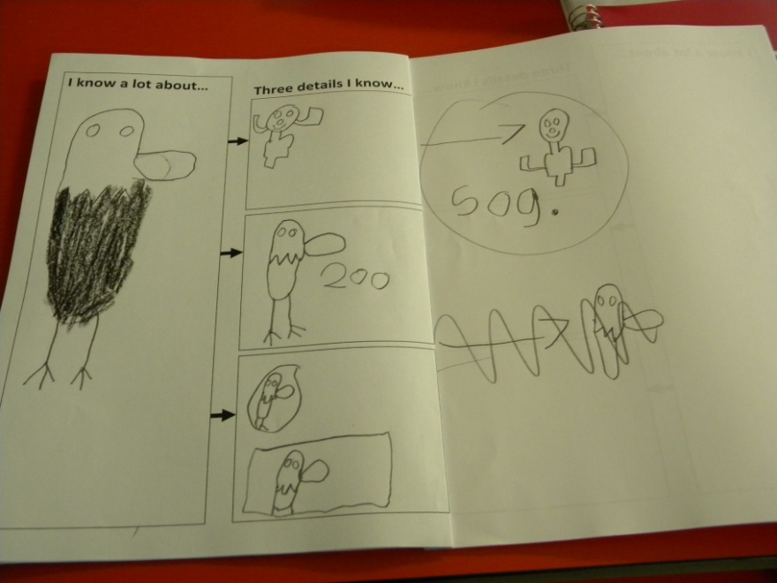
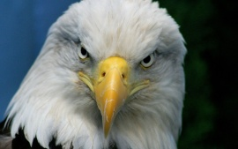
Access Prior Knowledge
Turn and Talk
“Do you remember what we learned about yesterday?”

Slide 3
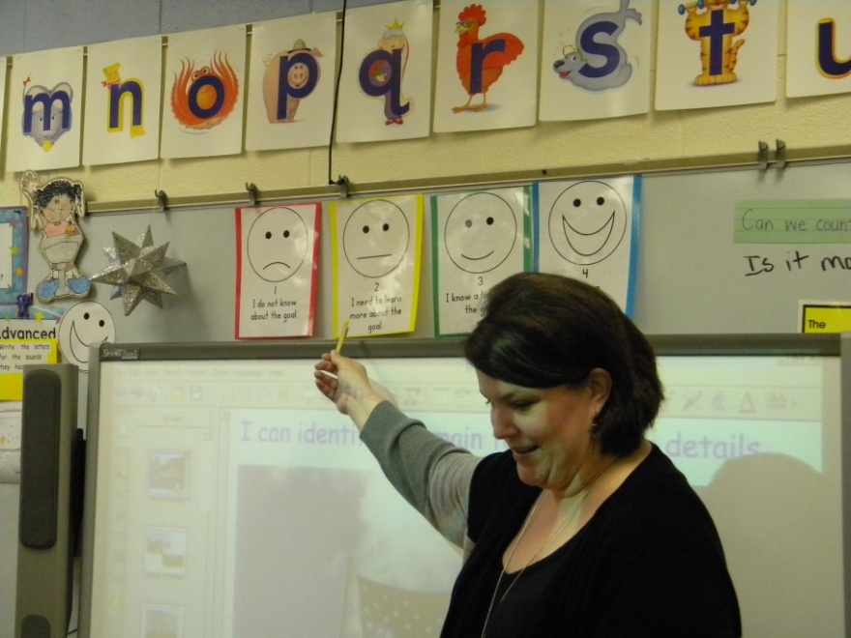
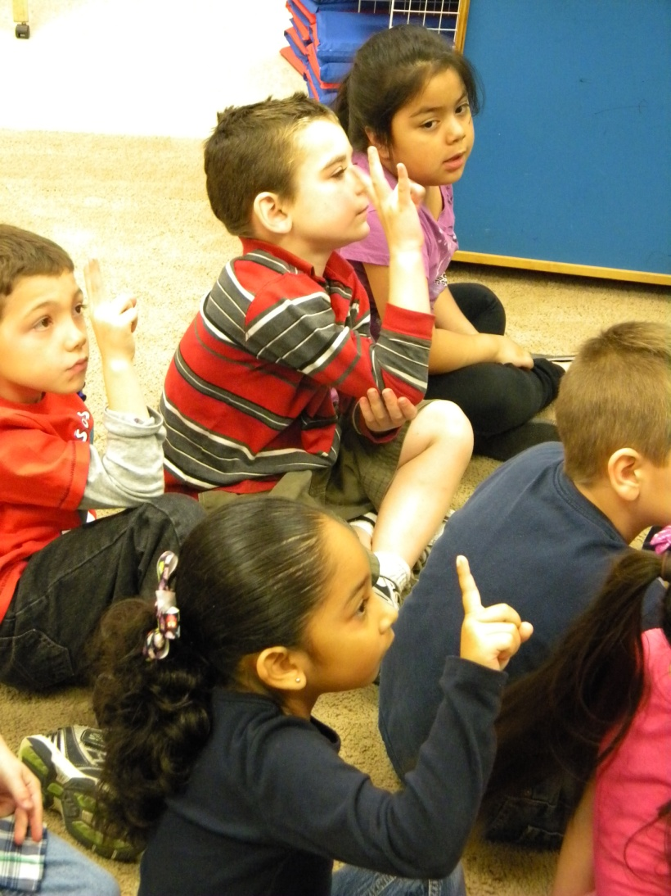
Goal
I can identify the main topic and key details.
Students scored their understanding of the goal.

Slide 4
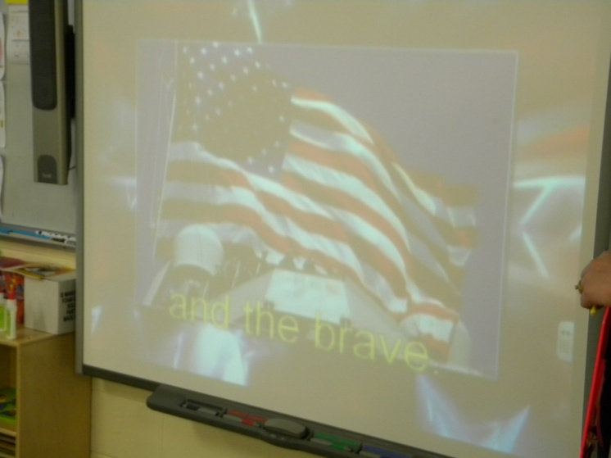
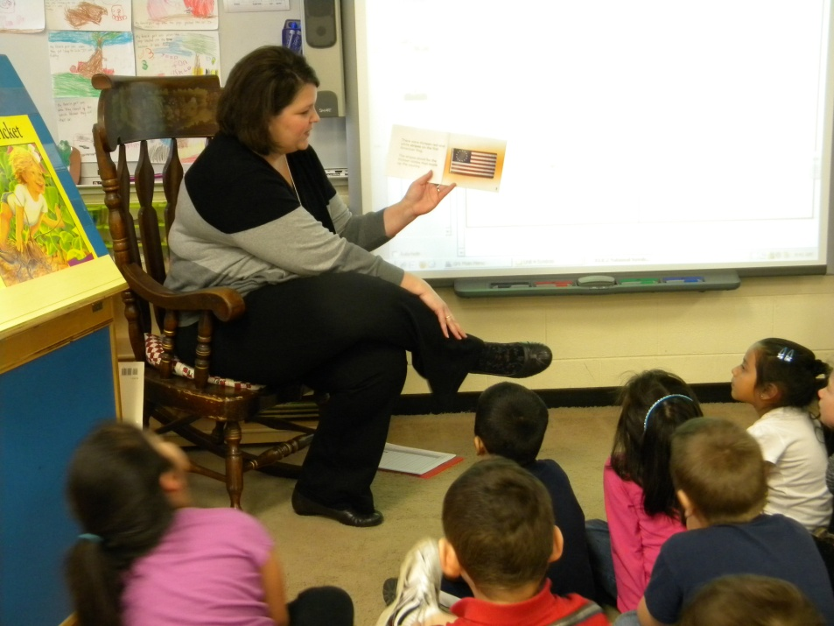
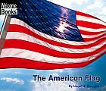
New Information
The students watched a YouTube video and then
Mrs. Kirkland read
The American Flag.

Slide 5
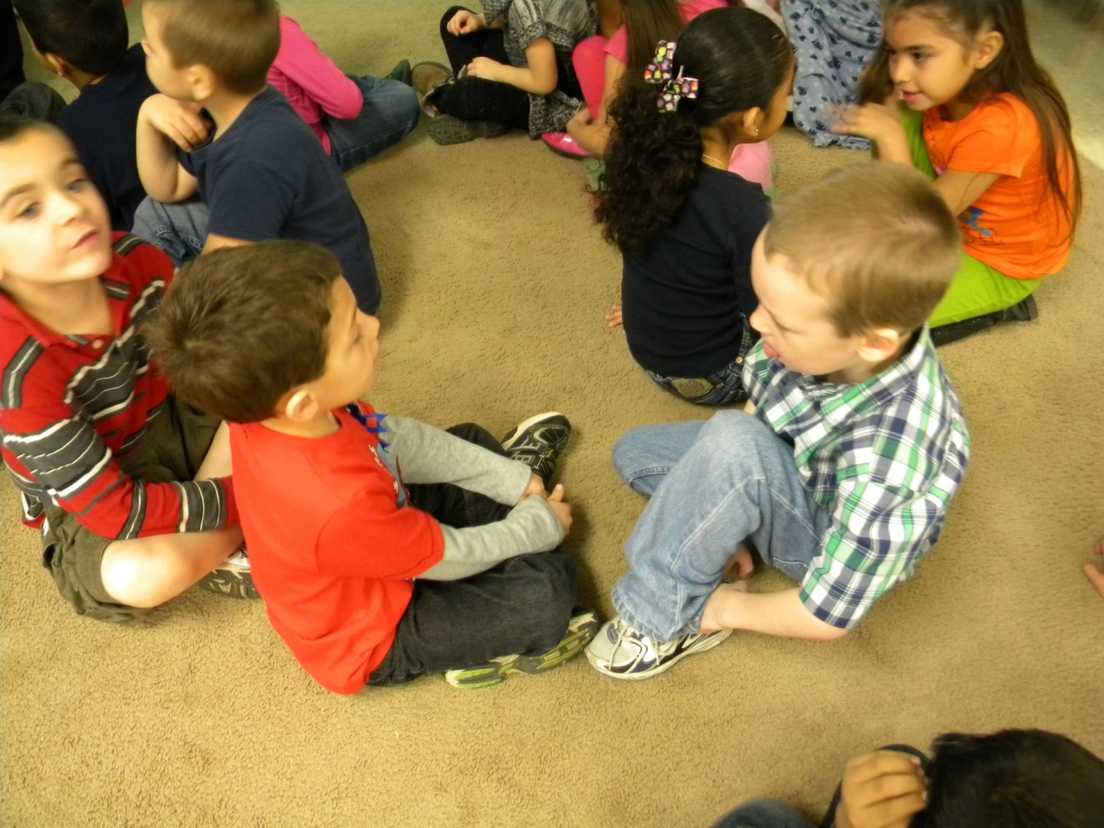
“What do you think is the topic of the book?”
Turn and talk with a partner.

Slide 6
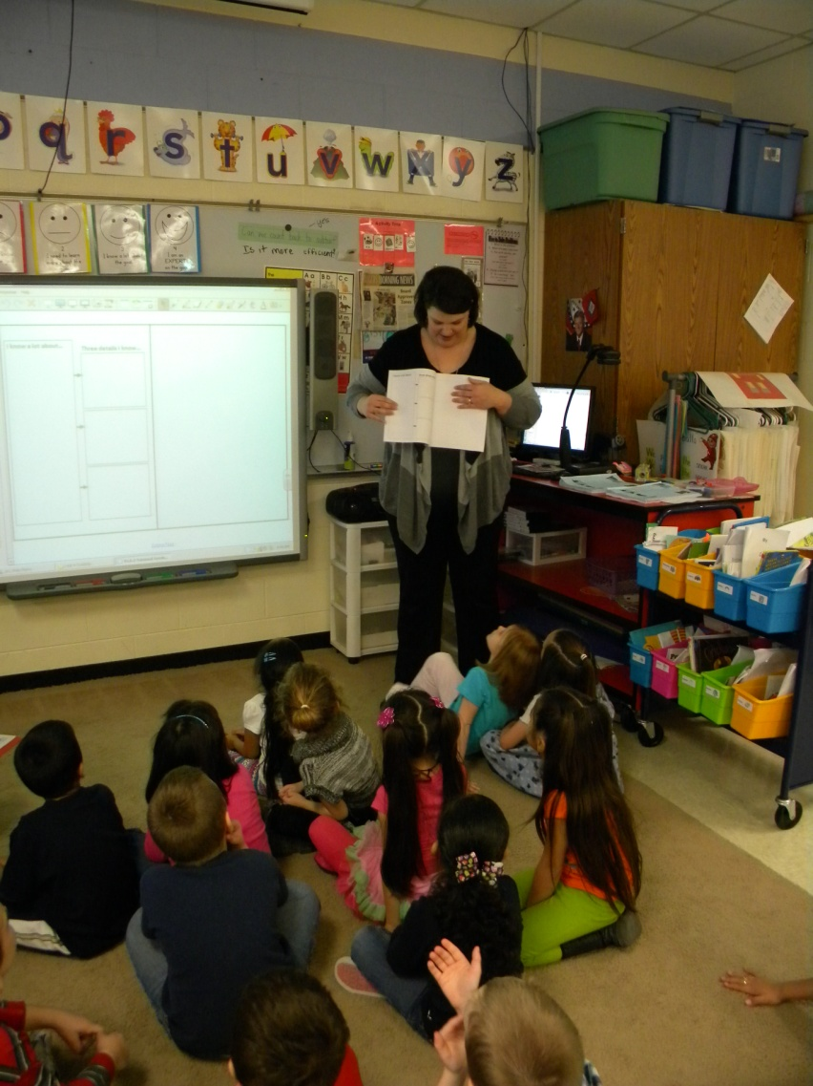
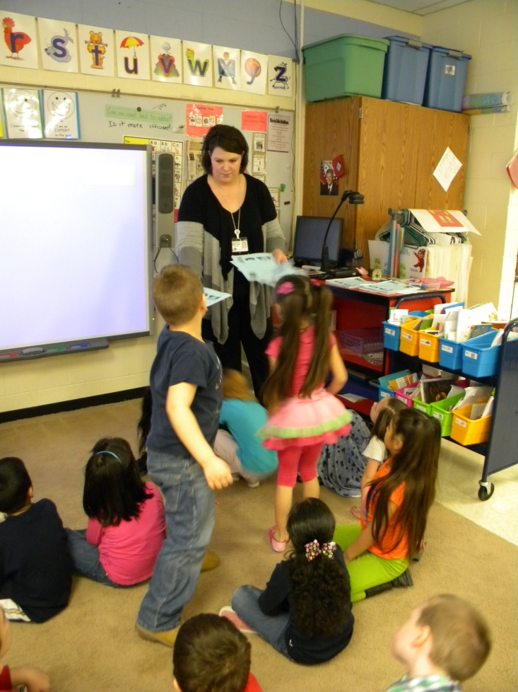
Mrs. Kirkland modeled finding the first clean page and then passed out the notebooks.

Slide 7
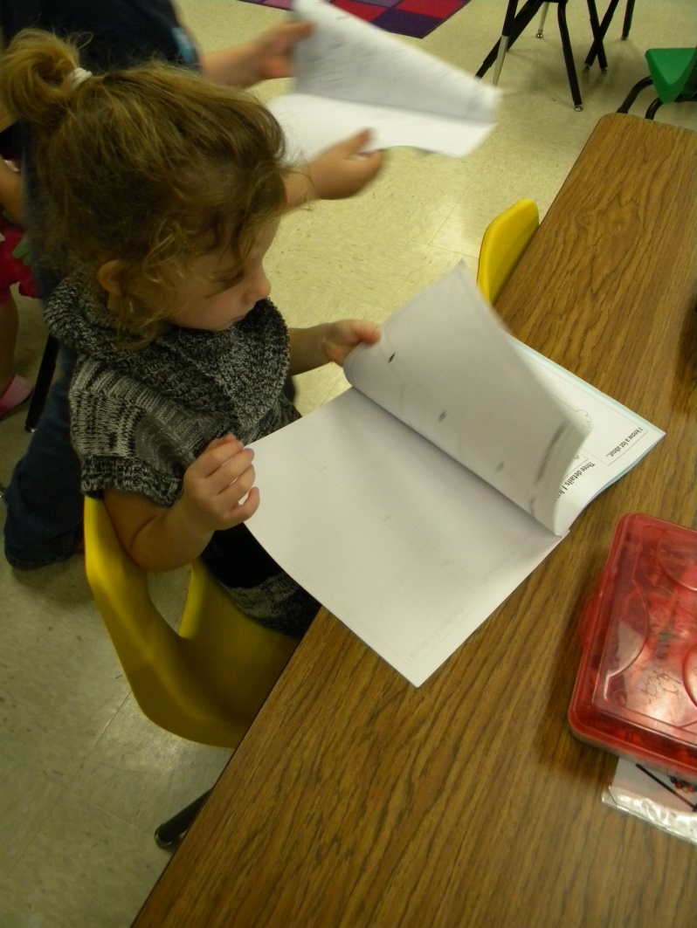
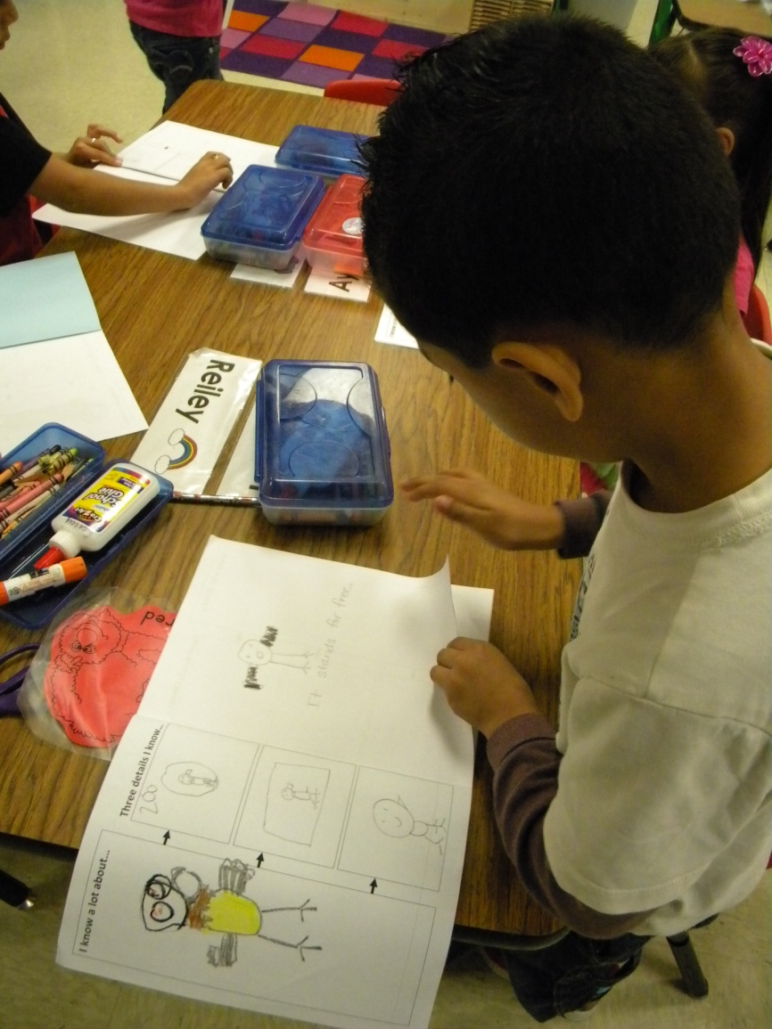

Slide 8
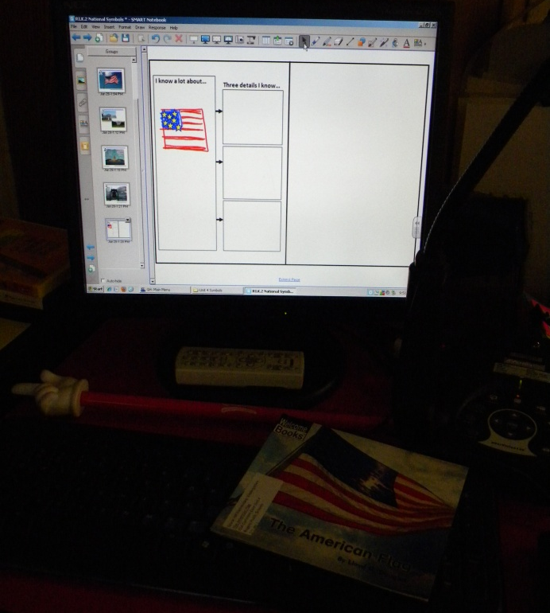
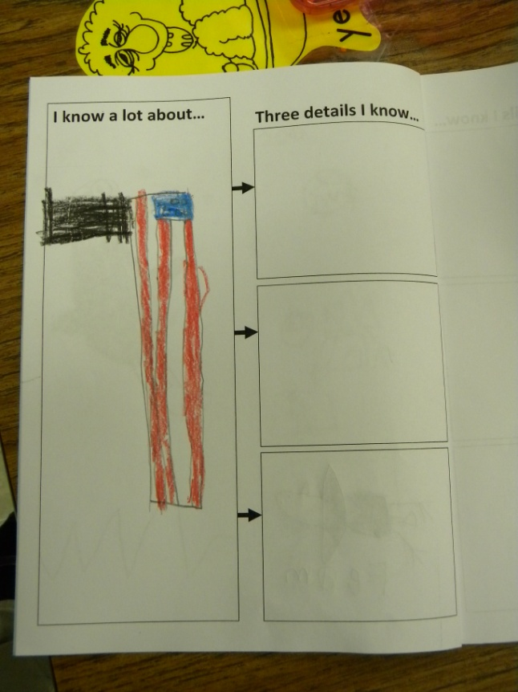
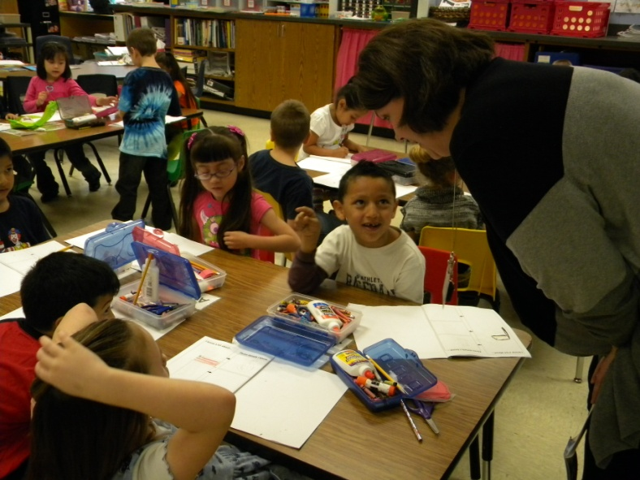
The class decided that the main topic of the book was the American flag.
Mrs. Kirkland modeled drawing a picture in the biggest box on her SMARTboard.

Slide 9
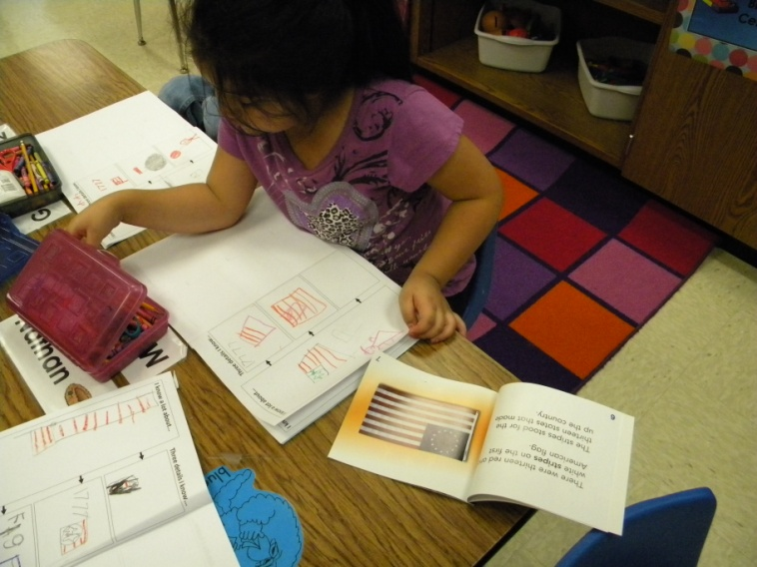
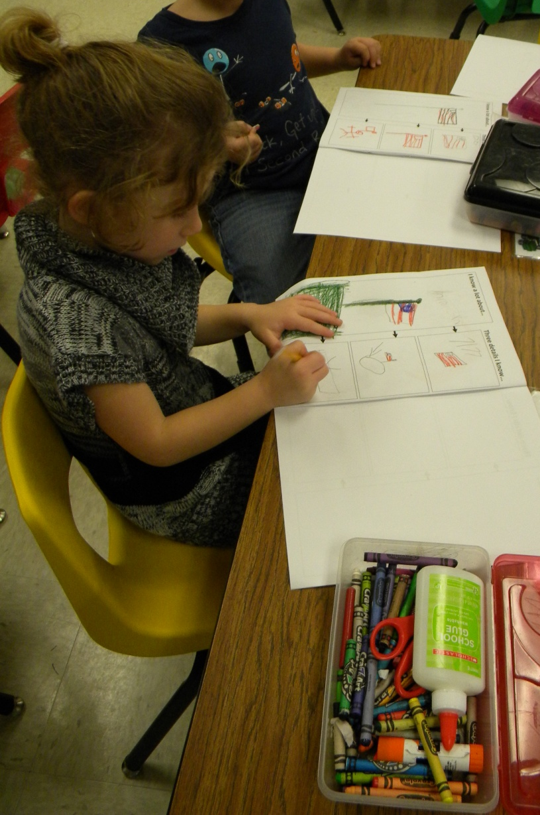
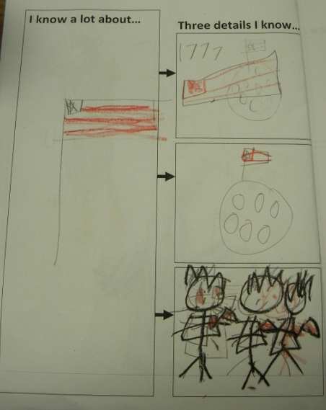
Application
Students added three key details they remembered. (Mrs. Kirkland modeled the first detail.)

Slide 10
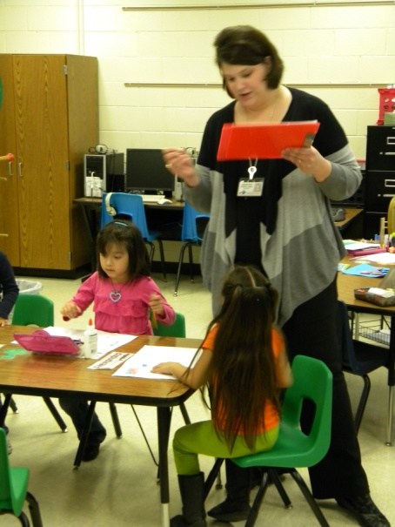
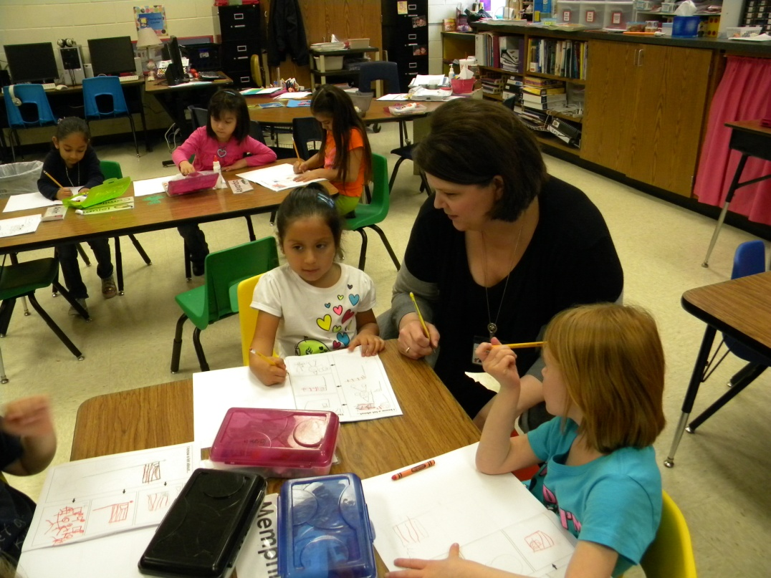
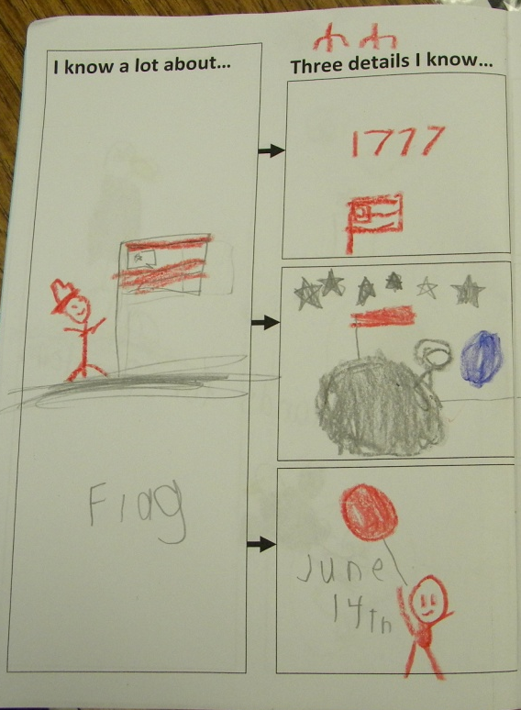
Mrs. Kirkland scored students ability to identify key details as they worked.

Slide 11
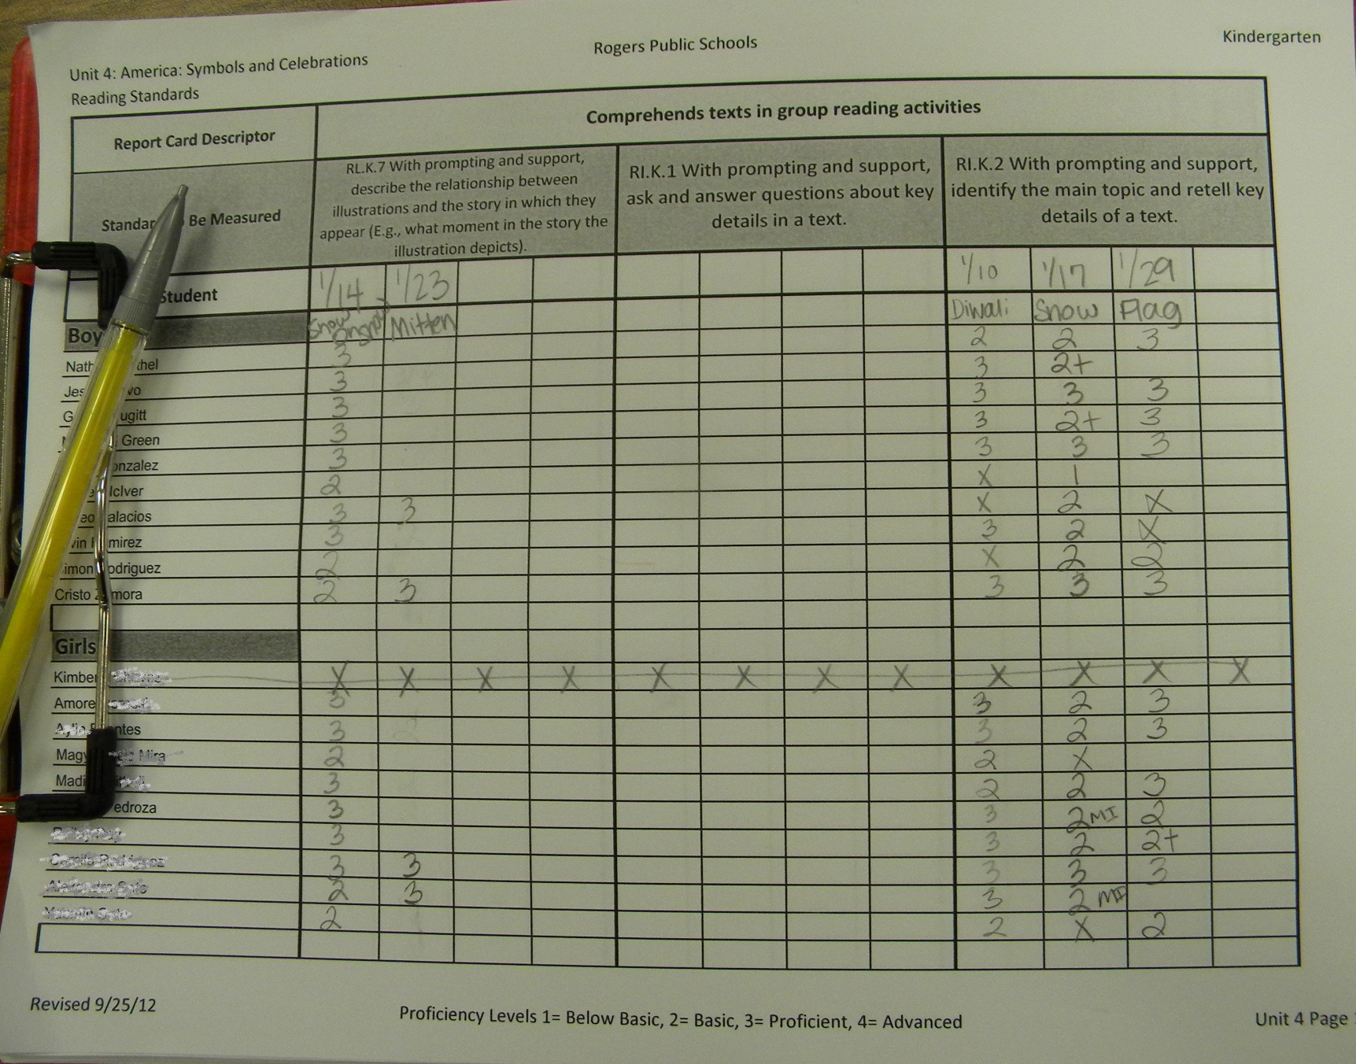

Slide 12
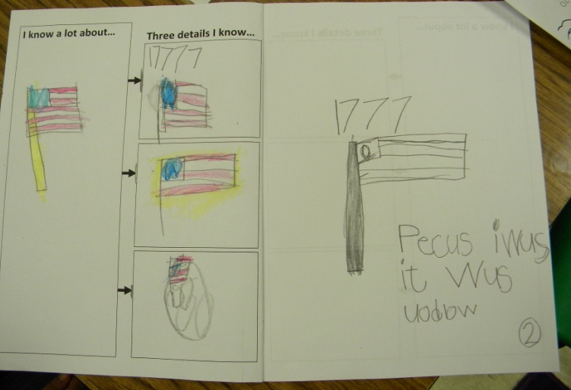
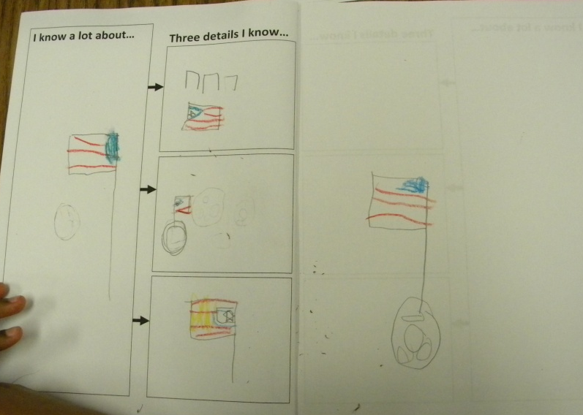
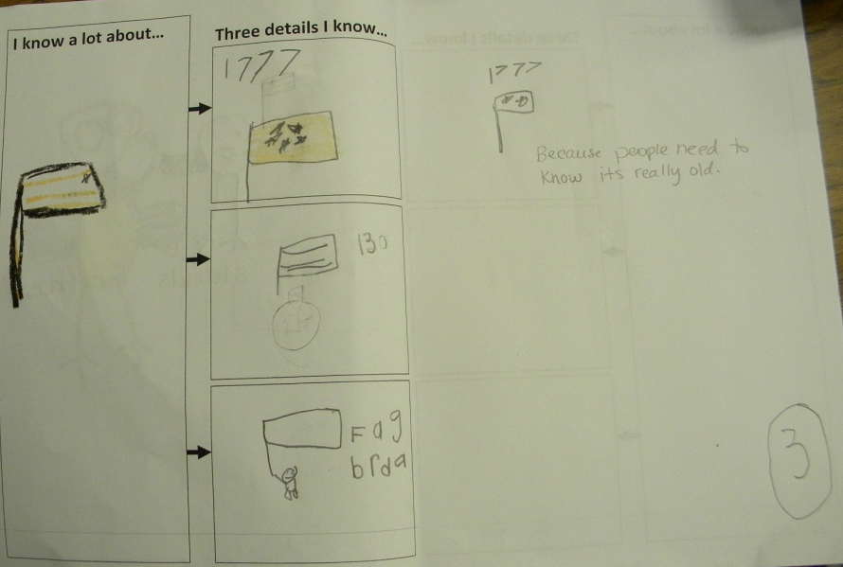
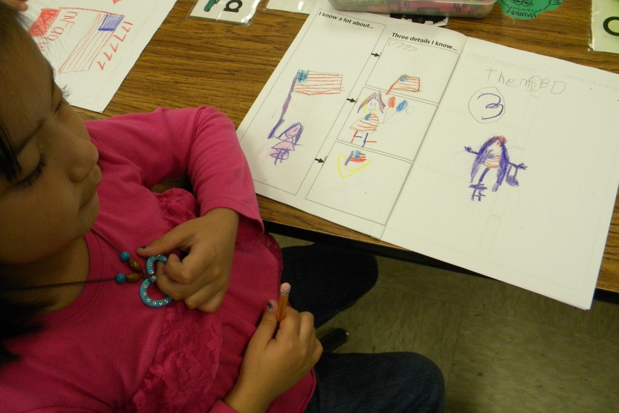
The students wrote about one important detail.
Because it was old.
They put it on the moon.
The parade.

Slide 13
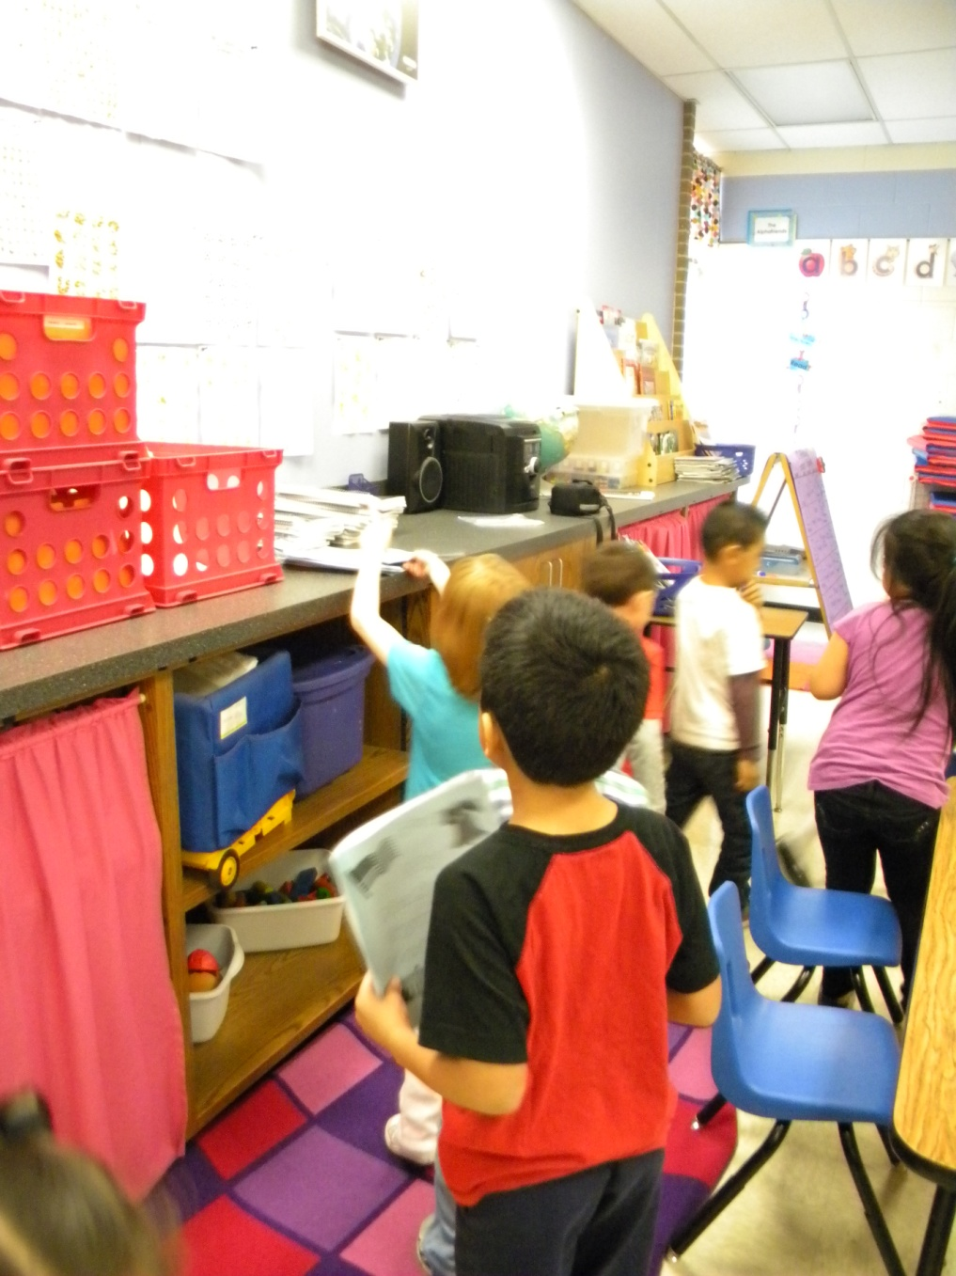
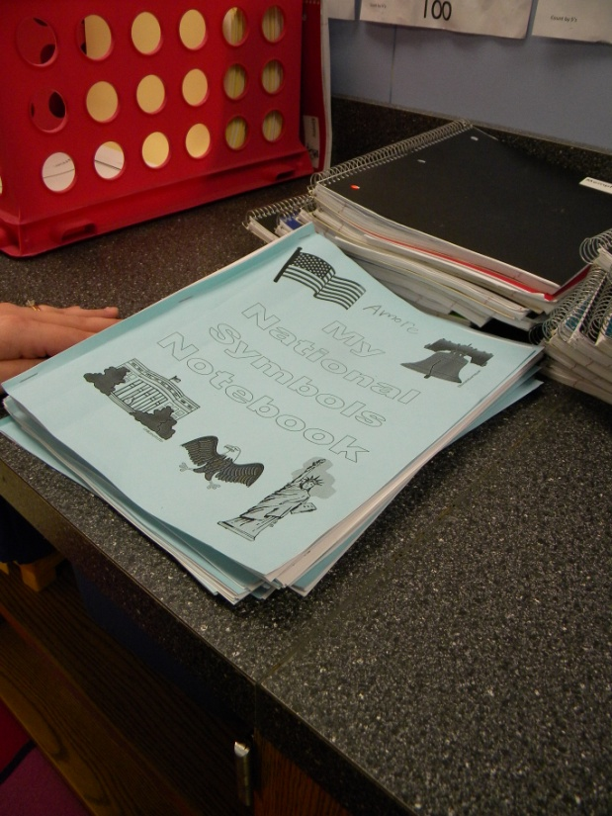
The students put their notebooks away.

