Slide 1

RL.9
(Comparing Stories)
Compare & Contrast
The treatment of similar themes and topics
(opposition of good and evil)
And patterns of events
(the quest)
In stories, myths, and traditional literature from different cultures
4th
Compare & Contrast
Adventures and experiences of characters in familiar stories
(with prompting)
K
Compare & Contrast
Two or more versions of the same story
2nd
Compare & Contrast
The themes, settings, and plots of stories written by the same author about the same or similar characters
(books in a series)
3rd
Compare & Contrast
Stories in the same genre on their approaches to similar themes and topics
(mysteries and adventure stories)
5th
Compare & Contrast
Adventures and experiences of characters in stories
1st

Slide 2
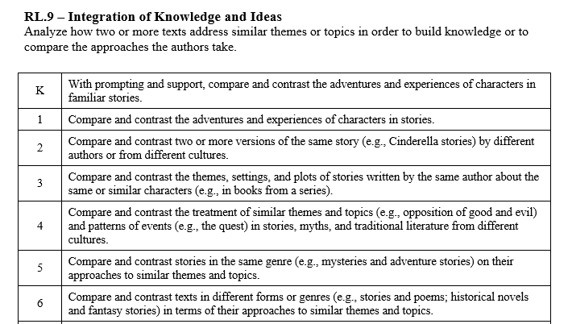

Slide 3
I can compare stories.
RL.K.9
1st Grade | 4 | Compare and contrast the adventures and experiences of characters in stories.
Kindergarten | 3 | With help from the teacher- Compare and contrast the adventures and experiences of characters in familiar stories.
Pre- K | 2 | Listen to stories and poems.
 | 1 | No attempt.

Slide 4
I can compare stories.
RL.1.9
2nd Grade | 4 | Compare and contrast two or more versions of the same story by different authors or from different cultures.
1st Grade | 3 | Compare and contrast the adventures and experiences of characters in stories.
Kindergarten | 2 | With help from the teacher- Compare and contrast the adventures and experiences of characters in familiar stories.
Pre- K | 1 | Listen to stories and poems.

Slide 5
I can compare stories.
RL.2.9
3rd Grade | 4 | Compare and contrast the themes, settings, and plots of stories written by the same author about the same or similar characters (books from a series).
2nd Grade | 3 | Compare and contrast two or more versions of the same story by different authors or from different cultures.
1st Grade | 2 | Compare and contrast the adventures and experiences of characters in stories.
Kindergarten | 1 | With help from the teacher- Compare and contrast the adventures and experiences of characters in familiar stories.

Slide 6
I can compare stories.
RL.3.9
4th Grade | 4 | Compare and contrast the treatment of similar themes and topics and patterns of events in stories, myths, and traditional literature from different cultures.
3rd Grade | 3 | Compare and contrast the themes, settings, and plots of stories written by the same author about the same or similar characters (books from a series).
2nd Grade | 2 | Compare and contrast two or more versions of the same story by different authors or from different cultures.
1st Grade | 1 | Compare and contrast the adventures and experiences of characters in stories.

Slide 7
I can compare stories.
RL.4.9
5th Grade | 4 | Compare and contrast stories in the same genre on their approaches to similar themes and topics (mysteries and adventure stories).
4th Grade | 3 | Compare and contrast the treatment of similar themes and topics and patterns of events in stories, myths, and traditional literature from different cultures (opposition of good and evil).
3rd Grade | 2 | Compare and contrast the themes, settings, and plots of stories written by the same author about the same or similar characters (books from a series).
2nd Grade | 1 | Compare and contrast two or more versions of the same story by different authors or from different cultures.

Slide 8
I can compare stories.
RL.5.9
6th Grade | 4 | Compare and contrast texts in different forms or genres in terms of their approaches to similar themes or topics (stories & poems; historical novels & fantasy novels).
5th Grade | 3 | Compare and contrast stories in the same genre on their approaches to similar themes and topics (mysteries and adventure stories).
4th Grade | 2 | Compare and contrast the treatment of similar themes and topics and patterns of events in stories, myths, and traditional literature from different cultures (opposition of good and evil).
3rd Grade | 1 | Compare and contrast the themes, settings, and plots of stories written by the same author about the same or similar characters (books from a series).

