Slide 1
RL.7
(Integrate and evaluate content presented in diverse media)
Use
Information gained from illustrations and words to demonstrate understanding of:
Characters
Setting
Plot
2nd
Make Connections
Between the text of a story or drama and a visual presentation of the text
Identify
Where each version reflects descriptions and directions in the text
4th
Describe
Relationship between illustrations and the story in which they appear
With prompting
K
Explain
How specific aspects of a text’s illustrations contribute to the words in a story
(create mood, emphasize aspects of a character or setting)
3rd
Use
Illustrations and details in a story to describe:
Characters
Setting
Major events
1st
Analyze
How visual and multimedia elements contribute to the meaning, tone or beauty of a text
(graphic novel, multimedia presentation)
5th

Slide 2
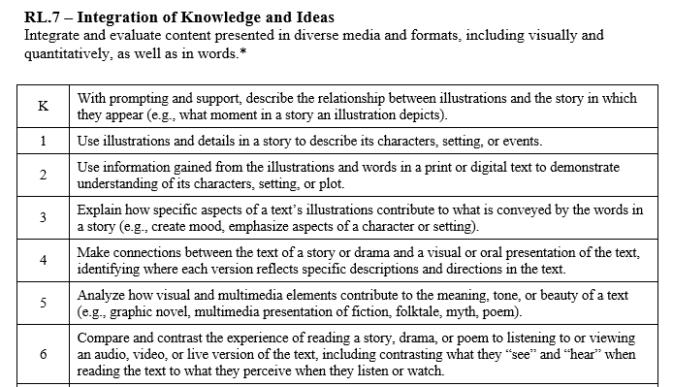

Slide 3
I can tell how illustrations help me understand a story.
RL.K.7
1st Grade | 4 | Use illustrations and details to describe characters, setting or events.
Kindergarten | 3 | With help from the teacher- Tell what moment in a story the illustration depicts.
Pre- K | 2 | Listen to stories and poems.
 | 1 | No attempt.

Slide 4
I can tell how illustrations help me understand a story.
RL.1.7
2nd Grade | 4 | Use information gained from the illustrations and words in a text to demonstrate understanding of its characters, setting or plot.
1st Grade | 3 | Use illustrations and details to describe characters, setting or events.
Kindergarten | 2 | With help from the teacher- Tell what moment in a story the illustration depicts.
Pre- K | 1 | Listen to stories and poems.

Slide 5
I can tell how illustrations help me understand a story.
RL.2.7
3rd Grade | 4 | Explain how illustrations in a text help create mood and emphasize aspects of a character or setting.
2nd Grade | 3 | Use information gained from the illustrations and words in a text to demonstrate understanding of its characters, setting or plot.
1st Grade | 2 | Use illustrations and details to describe characters, setting or events.
Kindergarten | 1 | With help from the teacher- Tell what moment in a story the illustration depicts.

Slide 6
I can tell how illustrations help me understand a story.
RL.3.7
4th Grade | 4 | Make connections between the text of a story or drama and a visual or oral presentation identifying where each version reflects specific descriptions and directions in a text.
3rd Grade | 3 | Explain how illustrations in a text help create mood and emphasize aspects of a character or setting.
2nd Grade | 2 | Use information gained from the illustrations and words in a text to demonstrate understanding of its characters, setting or plot.
1st Grade | 1 | Use illustrations and details to describe characters, setting or events.

Slide 7
I can tell how visual and/or oral elements help me understand a story.
RL.4.7
5th Grade | 4 | Analyze how visual or multimedia elements contribute to the meaning, tone, or beauty of a text.
4th Grade | 3 | Make connections between the text of a story or drama and a visual or oral presentation identifying where each version reflects specific descriptions and directions in a text.
3rd Grade | 2 | Explain how illustrations in a text help create mood and emphasize aspects of a character or setting.
2nd Grade | 1 | Use information gained from the illustrations and words in a text to demonstrate understanding of its characters, setting or plot.

Slide 8
I can tell how visual and/or oral elements help me understand a story.
RL.5.7
6th Grade | 4 | Compare and contrast the experience of reading a story, drama or poem to listening or viewing an audio, video or live version of the text. Contrast what you see and hear when reading the text to what you perceive when listening or watching.
5th Grade | 3 | Analyze how visual or multimedia elements contribute to the meaning, tone, or beauty of a text.
4th Grade | 2 | Make connections between the text of a story or drama and a visual or oral presentation identifying where each version reflects specific descriptions and directions in a text.
3rd Grade | 1 | Explain how illustrations in a text help create mood and emphasize aspects of a character or setting.

