Slide 1
RL.5
(Analyzing the structure of a text)
Describe
The overall structure of a story
How the beginning introduces the story
How the ending concludes the action
2nd
Explain
The major difference between poems, drama and prose
Refer to structural elements
(verse, rhythm, meter, casts of characters, settings, descriptions, dialogue, stage directions)
4th
Recognize
Common types of text
Story books, Poems
K
Refer to Parts of Stories, Dramas and Poems
(Chapter, scene, and stanza)
Describe how each successive part builds on earlier sections
3rd
Explain
Major differences between books that:
Tell stories
Give information
1st
Explain
How a series of chapters, scenes, or stanzas fit together to provide the overall structure of a story, drama or poem
5th

Slide 2
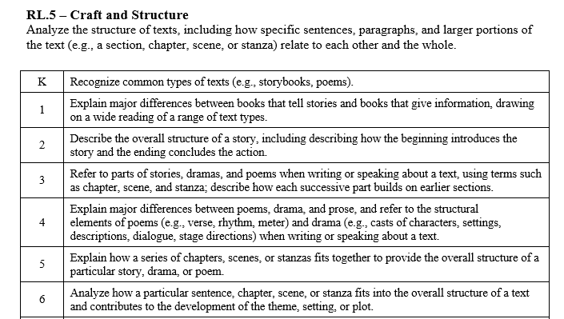

Slide 3
I can describe the structure of a text.
RL.K.5
1st Grade | 4 | Explain differences between books that tell stories and books that give information
Kindergarten | 3 | Recognize common types of text (story books and poems)
Pre- K | 2 | Listen to stories and poems
 | 1 | No attempt

Slide 4
I can describe the structure of a text.
RL.1.5
2nd Grade | 4 | Describe the overall structure of a story How the beginning introduces the story How the ending concludes the action
1st Grade | 3 | Explain differences between books that tell stories and books that give information
Kindergarten | 2 | Recognize common types of text (story books and poems)
Pre- K | 1 | Listen to stories and poems

Slide 5
I can describe the structure of a text.
RL.2.5
3rd Grade | 4 | Refer to parts of stories, dramas and poems when writing or speaking about them (chapter, scene, stanza) Explain how each successive part builds on earlier sections
2nd Grade | 3 | Describe the overall structure of a story How the beginning introduces the story How the ending concludes the action
1st Grade | 2 | Explain differences between books that tell stories and books that give information
Kindergarten | 1 | Recognize common types of text (story books and poems)

Slide 6
I can describe the structure of a text.
RL.3.5
4th Grade | 4 | Explain the major differences between poems, drama, and prose Refer to structural elements (verse, rhythm, meter, cast of characters, settings, descriptions, dialogue, stage directions)
3rd Grade | 3 | Refer to parts of stories, dramas and poems when writing or speaking about them (chapter, scene, stanza) Explain how each successive part builds on earlier sections.
2nd Grade | 2 | Describe the overall structure of a story How the beginning introduces the story How the ending concludes the action
1st Grade | 1 | Explain differences between books that tell stories and books that give information.

Slide 7
I can describe the structure of a text.
RL.4.5
5th Grade | 4 | Explain how a series of chapters, scenes, or stanzas fit together to create the structure of a story, drama, or poem
4th Grade | 3 | Explain the major differences between poems, drama, and prose Refer to structural elements (verse, rhythm, meter, cast of characters, settings, descriptions, dialogue, stage directions)
3rd Grade | 2 | Refer to parts of stories, dramas and poems when writing or speaking about them (chapter, scene, stanza) Explain how each successive part builds on earlier sections.
2nd Grade | 1 | Describe the overall structure of a story How the beginning introduces the story How the ending concludes the action

Slide 8
I can describe the structure of a text.
RL.5.5
6th Grade | 4 | Analyze how a particular sentence, chapter, scene or stanza fits into the overall structure of a text and contributes to the development of the theme, setting and plot.
5th Grade | 3 | Explain how a series of chapters, scenes, or stanzas fit together to create the structure of a story, drama, or poem.
4th Grade | 2 | Explain the major differences between poems, drama, and prose Refer to structural elements (verse, rhythm, meter, cast of characters, settings, descriptions, dialogue, stage directions)
3rd Grade | 1 | Refer to parts of stories, dramas and poems when writing or speaking about them (chapter, scene, stanza) Explain how each successive part builds on earlier sections.

