Slide 1

RL.4
(Interpret words and phrases)
Describe
How words and phrases supply rhythm and meaning
Regular beats
Alliteration
Rhymes
Repeated lines
2nd
Ask & Answer
Questions about Unknown Words
K
Determine
The meaning of words and phrases
4th- including those that allude to characters found in mythology
5th- figurative language such as metaphors and similes
4-5
Identify
Words and phrases that suggest feelings or appeal to the senses
1st
Determine
The meaning of words and phrases
Distinguish literal from nonliteral language
3rd

Slide 2
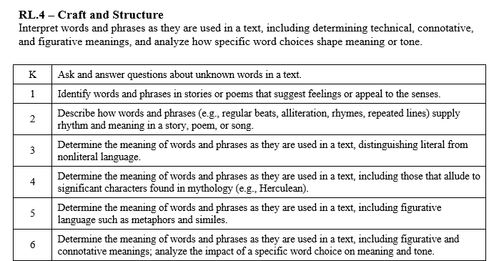

Slide 3
I can determine the meaning of words.
RL.K.4
1st Grade | 4 | Identify words and phrases that suggest feelings. Identify words and phrases that appeal to the senses.
Kindergarten | 3 | Recognize unknown words. Ask and answer questions to help figure out the meaning of the unknown words.
Pre- K | 2 | Talk about words in a story.
Pre-School | 1 | Listen to a story.

Slide 4
I can determine the meaning of words and phrases.
RL.1.4
2nd Grade | 4 | Describe how words and phrases supply rhythm and meaning in a story poem or song (beats, alliteration, rhymes, repeated lines).
1st Grade | 3 | Identify words and phrases that suggest feelings. Identify words and phrases that appeal to the senses.
Kindergarten | 2 | Recognize unknown words. Ask and answer questions to help figure out the meaning of the unknown words.
Pre- K | 1 | Talk about words in a story.

Slide 5
I can determine the meaning of words and phrases.
RL.2.4
3rd Grade | 4 | Determine the meaning words and phrases in a text. Determine literal from nonliteral language.
2nd Grade | 3 | Describe how words and phrases supply rhythm and meaning in a story poem or song (beats, alliteration, rhymes, repeated lines).
1st Grade | 2 | Identify words and phrases that suggest feelings. Identify words and phrases that appeal to the senses.
Kindergarten | 1 | Recognize unknown words. Ask and answer questions to help figure out the meaning of the unknown words.

Slide 6
I can determine the meaning of words and phrases.
RL.3.4
4th Grade | 4 | Ask and answer questions to help determine or clarify the meaning of words and phrases in a text.
3rd Grade | 3 | Determine the meaning words and phrases in a text. Determine literal from nonliteral language.
2nd Grade | 2 | Describe how words and phrases supply rhythm and meaning in a story poem or song (beats, alliteration, rhymes, repeated lines).
1st Grade | 1 | Identify words and phrases that suggest feelings. Identify words and phrases that appeal to the senses.

Slide 7
I can determine the meaning of words and phrases.
RL.4.4
5th Grade | 4 | Determine the meaning of words and phrases including figurative language (metaphors and similes).
4th Grade | 3 | Ask and answer questions to help determine or clarify the meaning of words and phrases in a text.
3rd Grade | 2 | Determine the meaning words and phrases in a text. Determine literal from nonliteral language.
2nd Grade | 1 | Describe how words and phrases supply rhythm and meaning in a story poem or song (beats, alliteration, rhymes, repeated lines).

Slide 8
I can determine the meaning of words and phrases.
RL.5.4
6th Grade | 4 | Determine the meaning of words and phrases, including figurative and connotative meanings. Analyze the impact of word choice on meaning and tone.
5th Grade | 3 | Determine the meaning of words and phrases including figurative language (metaphors and similes).
4th Grade | 2 | Ask and answer questions to help determine or clarify the meaning of words and phrases in a text.
3rd Grade | 1 | Determine the meaning words and phrases in a text. Determine literal from nonliteral language.

