Slide 1

RL.3
(Analyzing Character, Setting and Plot)
Describe Characters
2nd –how characters respond to major events and challenges
3rd – character traits, motivations, or feelings and how their actions contribute to the sequence of events
2-3
Identify
Characters, Setting & Major Events
with prompting & support
K
Describe in Depth
Characters, Setting , Event
drawing on specific details
(character’s thoughts, words, or actions)
4th
Describe
Characters, Setting & Major Events
using key details
1st
Compare & Contrast
Characters, Setting , Event
drawing on specific details
(how characters interact)
5th

Slide 2
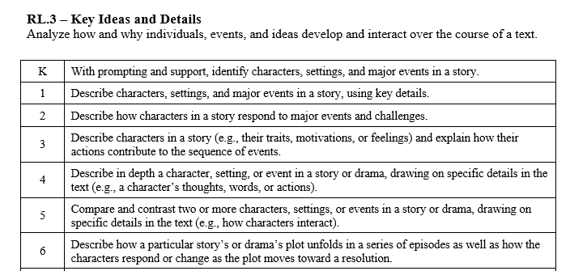

Slide 3
I can identify characters, settings and major events in a story.
RL.K.3
1st Grade | 4 | Use key details to describe characters, settings, and major events in a story.
Kindergarten | 3 | With help from the teacher- Identify characters, settings and major events in a story.
Pre- K | 2 | Talk about a story.
Pre-School | 1 | Listen to a story.

Slide 4
I can describe characters, settings and major events in a story.
RL.1.3
2nd Grade | 4 | Describe how characters respond to major events and challenges.
1st Grade | 3 | Use key details to describe characters, settings, and major events in a story.
Kindergarten | 2 | With help from the teacher- Identify characters, settings and major events in a story.
Pre- K | 1 | Talk about a story.

Slide 5
I can describe characters, settings and major events in a story.
RL.2.3
3rd Grade | 4 | Describe characters’ traits, motivations or feelings and explain how their actions contribute to the sequence of events.
2nd Grade | 3 | Describe how characters respond to major events and challenges.
1st Grade | 2 | Use key details to describe characters, settings, and major events in a story.
Kindergarten | 1 | With help from the teacher- Identify characters, settings and major events in a story.

Slide 6
I can describe characters, settings and major events in a story.
RL.3.3
4th Grade | 4 | Describe a character drawing on their thoughts, words and actions. Use key details to describe setting or events.
3rd Grade | 3 | Describe characters’ traits, motivations or feelings and explain how their actions contribute to the sequence of events.
2nd Grade | 2 | Describe how characters respond to major events and challenges.
1st Grade | 1 | Use key details to describe characters, settings, and major events in a story.

Slide 7
I can describe characters, settings and major events in a story.
RL.4.3
5th Grade | 4 | Compare and contrast two or more characters, settings, or events using key details such as how characters interact.
4th Grade | 3 | Describe a character drawing on their thoughts, words and actions. Use key details to the describe setting or events.
3rd Grade | 2 | Describe characters’ traits, motivations or feelings and explain how their actions contribute to the sequence of events.
2nd Grade | 1 | Describe how characters respond to major events and challenges.

Slide 8
I can describe characters, settings and major events in a story.
RL.5.3
6th Grade | 4 | Describe how a story or drama’s plot unfolds in a series of episodes as well as how characters respond to change as the plot moves toward a resolution.
5th Grade | 3 | Compare and contrast two or more characters, settings, or events using key details such as how characters interact.
4th Grade | 2 | Describe a character drawing on their thoughts, words and actions. Use key details to the describe setting or events.
3rd Grade | 1 | Describe characters’ traits, motivations or feelings and explain how their actions contribute to the sequence of events.

