Slide 1
RL.2
(Summarizing)
Retell
Oral Activity
Natural sharing of what someone remembers about a text
K-1
Summarize
A shortened version of an original text, stating the main ideas and important details of the text with the same structure and order of the original
4-5
Recount
Oral or Written
Chronological Order
Past Tense Verbs
Answers the 5Ws & H
2-3
(Theme)
Determine
Central Message, Lesson or Moral
2nd
Determine
Central Message, Lesson or Moral
Explain
How it is conveyed
3rd
Understand
Central Message
or Lesson
1st
Determine
A Theme
4-5

Slide 2
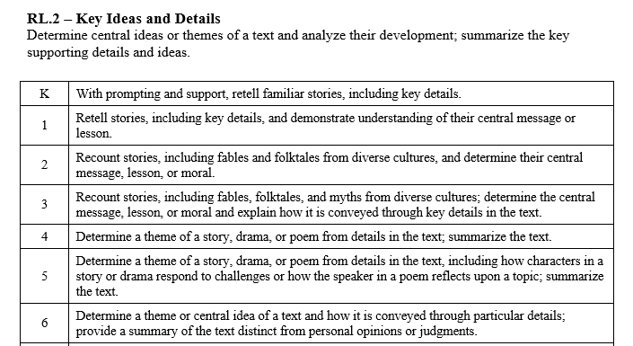

Slide 3
I can retell a story.
RL.K.2
1st Grade | 4 | Use key details to retell a story. Understand the central message or lesson.
Kindergarten | 3 | With help from the teacher- Use key details to retell a story.
Pre- K | 2 | Use props to act out a story.
 | 1 | No attempt.

Slide 4
I can retell a story.
I understand the central message or lesson.
RL.1.2
2nd Grade | 4 | Recount stories and determine the central message, lesson or moral.
1st Grade | 3 | Use key details (characters, setting, events) to retell a story. Understand the central message or lesson.
Kindergarten | 2 | With help from the teacher- Use key details to retell a story.
Pre- K | 1 | Use props to act out a story.

Slide 5
I can recount a story.
I can determine the central message, lesson or moral.
RL.2.2
3rd Grade | 4 | Recount stories. Determine the central message lesson or moral and explain how it is conveyed.
2nd Grade | 3 | Recount stories and determine the central message, lesson or moral.
1st Grade | 2 | Use key details (characters, setting, events) to retell a story. Understand the central message or lesson.
Kindergarten | 1 | With help from the teacher- Use key details to retell a story.

Slide 6
I can recount a story.
I can determine the central message, lesson or moral.
RL.3.2
4th Grade | 4 | Summarize a text. Determine the theme.
3rd Grade | 3 | Recount stories. Determine the central message lesson or moral and explain how it is conveyed.
2nd Grade | 2 | Recount stories and determine the central message, lesson or moral.
1st Grade | 1 | Use key details (characters, setting, events) to retell a story. Understand the central message or lesson.

Slide 7
I can summarize a story, drama or poem.
I can determine the theme.
RL.4.2
5th Grade | 4 | Summarize a text. Determine the theme- Explain how characters respond to challenges or a poet reflects on a topic.
4th Grade | 3 | Summarize a text. Determine the theme.
3rd Grade | 2 | Recount stories. Determine the central message lesson or moral and explain how it is conveyed.
2nd Grade | 1 | Recount stories and determine the central message, lesson or moral.

Slide 8
I can summarize a story, drama or poem.
I can determine the theme.
RL.5.2
6th Grade | 4 | Summarize the text without using personal opinions or judgments. Determine a theme or central idea , explaining how it unfolds in the text.
5th Grade | 3 | Summarize a text. Determine the theme- Explain how characters respond to challenges or a poet reflects on a topic.
4th Grade | 2 | Summarize a text. Determine the theme.
3rd Grade | 1 | Recount stories. Determine the central message lesson or moral and explain how it is conveyed.

