Slide 1
RI.9
(Comparing Texts)
Integrate
Information from two texts on the same topic in order to write or speak about the subject knowledgably
4th
Identify
Basic similarities and differences between two texts on the same topic
Illustrations, descriptions or procedures
(with prompting)
K
Compare & Contrast
The most important points presented by two texts on the same topic
2nd
Compare & Contrast
The most important points and key details presented by two texts on the same topic
3rd
Identify
Basic similarities and differences between two texts on the same topic
Illustrations, descriptions or procedures
1st
Integrate
Information from several texts on the same topic in order to write or speak about the subject knowledgably
5th

Slide 2
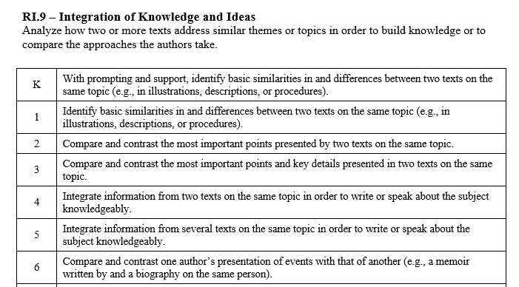

Slide 3
I can compare texts.
RI.K.9
1st Grade | 4 | Identify basic similarities in and differences between two texts on the same topic (illustrations, descriptions, or procedures) .
Kindergarten | 3 | With help from the teacher- Identify basic similarities in and differences between two texts on the same topic (illustrations, descriptions, or procedures).
Pre- K | 2 | Listen to text read aloud.
 | 1 | No attempt.

Slide 4
I can compare texts.
RI.1.9
2nd Grade | 4 | Compare and contrast the most important points presented by two texts on the same topic.
1st Grade | 3 | Identify basic similarities in and differences between two texts on the same topic (illustrations, descriptions, or procedures).
Kindergarten | 2 | With help from the teacher- Identify basic similarities in and differences between two texts on the same topic (illustrations, descriptions, or procedures).
Pre- K | 1 | Listen to text read aloud.

Slide 5
I can compare texts.
RI.2.9
3rd Grade | 4 | Compare and contrast the most important points and key details presented in two texts on the same topic.
2nd Grade | 3 | Compare and contrast the most important points presented by two texts on the same topic.
1st Grade | 2 | Identify basic similarities in and differences between two texts on the same topic (illustrations, descriptions, or procedures).
Kindergarten | 1 | With help from the teacher- Identify basic similarities in and differences between two texts on the same topic (illustrations, descriptions, or procedures).

Slide 6
I can compare texts.
RI.3.9
4th Grade | 4 | Integrate information from two texts on the same topic in order to write or speak about the subject knowledgeably.
3rd Grade | 3 | Compare and contrast the most important points and key details presented in two texts on the same topic.
2nd Grade | 2 | Compare and contrast the most important points presented by two texts on the same topic.
1st Grade | 1 | Identify basic similarities in and differences between two texts on the same topic (illustrations, descriptions, or procedures).

Slide 7
I can compare texts.
RI.4.9
5th Grade | 4 | Integrate information from several texts on the same topic in order to write or speak about the subject knowledgeably.
4th Grade | 3 | Integrate information from two texts on the same topic in order to write or speak about the subject knowledgeably.
3rd Grade | 2 | Compare and contrast the most important points and key details presented in two texts on the same topic.
2nd Grade | 1 | Compare and contrast the most important points presented by two texts on the same topic.

Slide 8
I can compare texts.
RI.5.9
6th Grade | 4 | Compare and contrast one author’s presentation of events with that of another (memoir written by and a biography on the same person).
5th Grade | 3 | Integrate information from several texts on the same topic in order to write or speak about the subject knowledgeably.
4th Grade | 2 | Integrate information from two texts on the same topic in order to write or speak about the subject knowledgeably.
3rd Grade | 1 | Compare and contrast the most important points and key details presented in two texts on the same topic.

