Slide 1
RI.8
(Evaluate an argument)
Explain
How an author uses reasons and evidence to support particular points in a text
Identify
Which reasons and evidence support which point(s)
2nd
Explain
How an author uses reasons and evidence to support points in a text
4th
Identify
The reasons an author gives to support points in a text
K- with prompting
1st- no prompting
K-1
Explain
How an author uses reasons and evidence to support points in a text
Identify
Which reasons and evidence supports which point(s)
5th
Describe
The logical connection between particular sentences an paragraphs in a text
(comparison, cause/effect, first/second/third in a sequence)
3rd

Slide 2
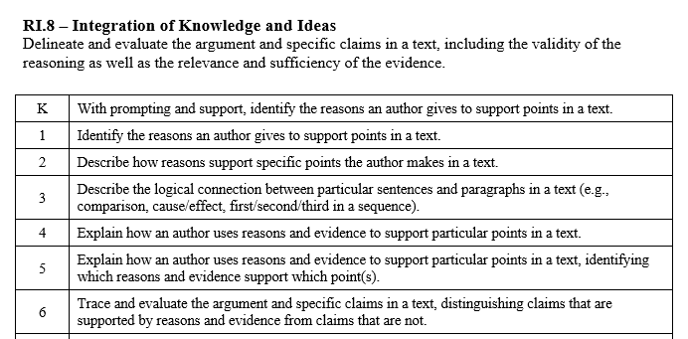

Slide 3
I can evaluate an argument.
RI.K.8
1st Grade | 4 | Identify the reasons an author gives to support points in a text.
Kindergarten | 3 | With help from the teacher- Identify the reasons an author gives to support points in a text.
Pre- K | 2 | Listen to texts read aloud.
 | 1 | No attempt.

Slide 4
I can evaluate an argument.
RI.1.8
2nd Grade | 4 | Describe how reasons support specific points the author makes in a text.
1st Grade | 3 | Identify the reasons an author gives to support points in a text.
Kindergarten | 2 | With help from the teacher- Identify the reasons an author gives to support points in a text.
Pre- K | 1 | Listen to texts read aloud.

Slide 5
I can evaluate an argument.
RI.2.8
3rd Grade | 4 | Describe the logical connection between particular sentences and paragraphs in a text (comparison, cause/effect, first/second/third in a sequence) .
2nd Grade | 3 | Describe how reasons support specific points the author makes in a text.
1st Grade | 2 | Identify the reasons an author gives to support points in a text.
Kindergarten | 1 | With help from the teacher- Identify the reasons an author gives to support points in a text.

Slide 6
I can evaluate an argument.
RI.3.8
4th Grade | 4 | Explain how an author uses reasons and evidence to support particular points in a text.
3rd Grade | 3 | Describe the logical connection between particular sentences and paragraphs in a text (comparison, cause/effect, first/second/third in a sequence) .
2nd Grade | 2 | Describe how reasons support specific points the author makes in a text.
1st Grade | 1 | Identify the reasons an author gives to support points in a text.

Slide 7
I can evaluate an argument.
RI.4.8
5th Grade | 4 | Explain how an author uses reasons and evidence to support particular points in a text. Identify which reasons and evidence support which point(s).
4th Grade | 3 | Explain how an author uses reasons and evidence to support particular points in a text.
3rd Grade | 2 | Describe the logical connection between particular sentences and paragraphs in a text (comparison, cause/effect, first/second/third in a sequence) .
2nd Grade | 1 | Describe how reasons support specific points the author makes in a text.

Slide 8
I can evaluate an argument.
RI.5.8
6th Grade | 4 | Trace and evaluate the argument and specific claims in a text. Distinguish claims that are supported by reasons and evidence from claims that are not.
5th Grade | 3 | Explain how an author uses reasons and evidence to support particular points in a text. Identify which reasons and evidence support which point(s).
4th Grade | 2 | Explain how an author uses reasons and evidence to support particular points in a text.
3rd Grade | 1 | Describe the logical connection between particular sentences and paragraphs in a text (comparison, cause/effect, first/second/third in a sequence).

