Slide 1
RI.7
(Integrate and evaluate content presented in diverse media)
Explain
How specific images contribute to and clarify a text
(diagrams showing how something works)
2nd
Interpret
Information presented visually, orally or quantitatively
(charts, graphs, diagrams, timelines, animations, or interactive elements)
Explain
How the information contributes to an understanding of the text
4th
Describe
Relationship between illustrations and the text in which they appear
With prompting
K
Use
Information gained from illustrations (maps and photographs)
and words in a text to demonstrate understanding (where, when, why, and how key events occur)
3rd
Use
The illustrations and details in a text to describe key ideas.
1st
Draw on
Information from multiple print or digital sources
Demonstrating
The ability to locate an answer to a question quickly or to solve a problem efficiently
5th

Slide 2
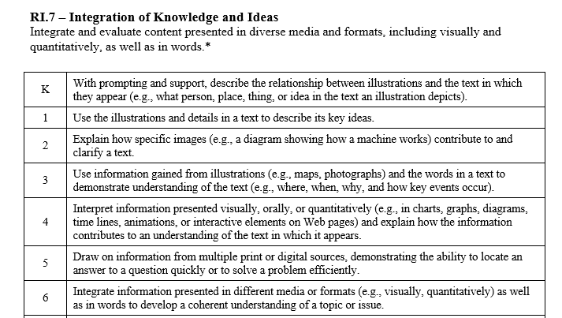

Slide 3
I can tell how illustrations help me understand a text.
RI.K.7
1st Grade | 4 | Use the illustrations and details in a text to describe its key ideas.
Kindergarten | 3 | With help from the teacher- Describe the relationship between illustrations and the text in which they appear.
Pre- K | 2 | Listen to texts read aloud. Look at the pictures/illustrations.
 | 1 | No attempt

Slide 4
I can tell how illustrations help me understand a text.
RI.1.7
2nd Grade | 4 | Explain how specific images contribute to and clarify a text (a diagram showing how something works).
1st Grade | 3 | Use the illustrations and details in a text to describe its key ideas.
Kindergarten | 2 | With help from the teacher- Describe the relationship between illustrations and the text in which they appear.
Pre- K | 1 | Listen to texts read aloud. Look at the pictures/illustrations.

Slide 5
I can tell how illustrations help me understand a text.
RI.2.7
3rd Grade | 4 | Use information gained from illustrations (maps, photographs) and words in a text to demonstrate understanding of the text (where, when, why, and how key events occur).
2nd Grade | 3 | Explain how specific images contribute to and clarify a text (a diagram showing how something works).
1st Grade | 2 | Use the illustrations and details in a text to describe its key ideas.
Kindergarten | 1 | With help from the teacher- Describe the relationship between illustrations and the text in which they appear.

Slide 6
I can tell how illustrations help me understand a text.
RI.3.7
4th Grade | 4 | Interpret information presented visually, orally, or quantitatively (in charts, graphs, diagrams, timelines, animations, or interactive elements). Explain how the information contributes to an understanding of the text.
3rd Grade | 3 | Use information gained from illustrations (maps, photographs) and words in a text to demonstrate understanding of the text (where, when, why, and how key events occur).
2nd Grade | 2 | Explain how specific images contribute to and clarify a text (a diagram showing how something works).
1st Grade | 1 | Use the illustrations and details in a text to describe its key ideas.

Slide 7
I can tell how visual elements help me understand a text.
RL.4.7
5th Grade | 4 | Draw on information from multiple print or digital sources demonstrating the ability to locate an answer to a question quickly or to solve a problem efficiently.
4th Grade | 3 | Interpret information presented visually, orally, or quantitatively (in charts, graphs, diagrams, timelines, animations, or interactive elements). Explain how the information contributes to an understanding of the text.
3rd Grade | 2 | Use information gained from illustrations (maps, photographs) and words in a text to demonstrate understanding of the text (where, when, why, and how key events occur).
2nd Grade | 1 | Explain how specific images contribute to and clarify a text (a diagram showing how something works).

Slide 8
I can use visual elements to help me understand a text.
RL.5.7
6th Grade | 4 | Integrate information presented in different media or formats (visually, quantitatively) as well as in words to develop a coherent understanding of a topic or issue.
5th Grade | 3 | Draw on information from multiple print or digital sources demonstrating the ability to locate an answer to a question quickly or to solve a problem efficiently.
4th Grade | 2 | Interpret information presented visually, orally, or quantitatively (in charts, graphs, diagrams, timelines, animations, or interactive elements). Explain how the information contributes to an understanding of the text.
3rd Grade | 1 | Use information gained from illustrations (maps, photographs) and words in a text to demonstrate understanding of the text (where, when, why, and how key events occur).

