Slide 1
RI.6
(Assessing how point of view or purpose shapes a text)
Name
The Author and Illustrator
Define
Their role in presenting ideas or information
With prompting and support
K
Identify
The main purpose of a text
Include
What the author wants to answer, explain or describe
2nd
Compare & Contrast
A firsthand and secondhand account of the same event or topic
Describe
The differences in focus and information provided
4th
Analyze
Multiple accounts of the same event or topic
Note
Important similarities and differences in the point of view they represent
5th
Distinguish
their own point of view from that of author of the text
3rd
Distinguish
Between information provided by pictures/illustrations and information provided by words in a text
1st

Slide 2
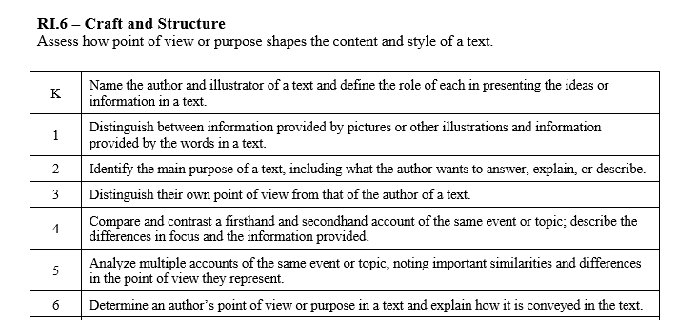

Slide 3
I can tell how point of view affects a text.
RI.K.6
1st Grade | 4 | Distinguish between information provided by pictures/illustration and information provided by words in the text.
Kindergarten | 3 | With help from the teacher- Name the author. Name the illustrator. Define their roles in presenting ideas or information.
Pre- K | 2 | Listen to texts read aloud.
 | 1 | No attempt.

Slide 4
I can tell how point of view affects a text.
RI.1.6
2nd Grade | 4 | Identify the main purpose of a text. Include what the author wants to answer, explain or describe.
1st Grade | 3 | Distinguish between information provided by pictures/illustration and information provided by words in the text.
Kindergarten | 2 | With help from the teacher- Name the author. Name the illustrator. Define their roles in presenting ideas or information.
Pre-K | 1 | Listen to texts read aloud.

Slide 5
I can tell how point of view affects a text.
RI.2.6
3rd Grade | 4 | Distinguish their own point of view from that of the author of the text.
2nd Grade | 3 | Identify the main purpose of a text. Include what the author wants to answer, explain or describe.
1st Grade | 2 | Distinguish between information provided by pictures/illustration and information provided by words in the text.
Kindergarten | 1 | With help from the teacher- Name the author. Name the illustrator. Define their roles in presenting ideas or information.

Slide 6
I can tell how point of view affects a text.
RI.3.6
4th Grade | 4 | Compare and contrast a firsthand and second hand account of the same event or topic. Describe the difference in focus and then information provided.
3rd Grade | 3 | Distinguish their own point of view from that of the author of the text.
2nd Grade | 2 | Identify the main purpose of a text. Include what the author wants to answer, explain or describe.
1st Grade | 1 | Distinguish between information provided by pictures/illustration and information provided by words in the text.

Slide 7
I can tell how point of view affects a text.
RI.4.6
5th Grade | 4 | Analyze multiple accounts of the same event or topic. Note important similarities and differences in the point of view they represent.
4th Grade | 3 | Compare and contrast a firsthand and second hand account of the same event or topic. Describe the difference in focus and then information provided.
3rd Grade | 2 | Distinguish their own point of view from that of the author of the text.
2nd Grade | 1 | Identify the main purpose of a text. Include what the author wants to answer, explain or describe.

Slide 8
I can tell how point of view affects a text.
RI.5.6
6th Grade | 4 | Determine the author’s point of view or purpose. Explain how it is conveyed in the text.
5th Grade | 3 | Analyze multiple accounts of the same event or topic. Note important similarities and differences in the point of view they represent.
4th Grade | 2 | Compare and contrast a firsthand and second hand account of the same event or topic. Describe the difference in focus and then information provided.
3rd Grade | 1 | Distinguish their own point of view from that of the author of the text.

