Slide 1
RI.5
(Analyzing the structure of a text)
Know & Use
Text features to locate key facts and information EFFICIENTLY
(captions, bold print, subheadings, glossaries, indexes, electronic menus, icons)
2nd
Describe
The overall structure of events, ideas, concepts, or information in a text or part of a text
(chronology, comparison, cause/effect, problem/solution)
4th
Identify
Front cover
Back cover
Title page
K
Know & Use
Text features to locate key facts and information
(headings, table of contents, glossaries, electronic menus, icons)
1st
Use
Text features and search tools to locate information
(key words, sidebars, hyperlinks)
3rd
Compare & Contrast
The overall structure of events, ideas, concepts, or information in two or more texts
(chronology, comparison, cause/effect, problem/solution)
5th

Slide 2
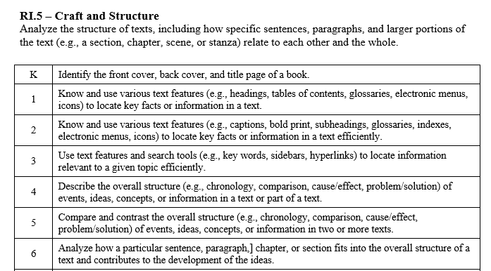

Slide 3
I can use the structure of a text to locate information.
RI.K.5
1st Grade | 4 | Know and use text features to locate key facts and information (headings, table of contents, glossaries, electronic menus, icons).
Kindergarten | 3 | Identify the front cover, back cover and title page of a book.
Pre- K | 2 | Listen to texts read aloud.
 | 1 | No attempt

Slide 4
I can use the structure of a text to locate information.
RI.1.5
2nd Grade | 4 | Know and use text features to locate key facts and information efficiently (captions, bold print, subheadings, glossaries, indexes, electronic menus, icons).
1st Grade | 3 | Know and use text features to locate key facts and information (headings, table of contents, glossaries, electronic menus, icons).
Kindergarten | 2 | Identify the front cover, back cover and title page of a book.
Pre- K | 1 | Listen to texts read aloud.

Slide 5
I can use the structure of a text to locate information.
RI.2.5
3rd Grade | 4 | Use text features and search tools to locate information efficiently (key words, sidebars, hyperlinks).
2nd Grade | 3 | Know and use text features to locate key facts and information efficiently (captions, bold print, subheadings, glossaries, indexes, electronic menus, icons).
1st Grade | 2 | Know and use text features to locate key facts and information (headings, table of contents, glossaries, electronic menus, icons).
Kindergarten | 1 | Identify the front cover, back cover and title page of a book.

Slide 6
I can use the structure of a text to locate information.
RI.3.5
4th Grade | 4 | Describe the overall structure of events, ideas, concepts, or information in a text or part of a text (chronology, comparison, cause/effect, problem solution).
3rd Grade | 3 | Use text features and search tools to locate information efficiently (key words, sidebars, hyperlinks).
2nd Grade | 2 | Know and use text features to locate key facts and information efficiently (captions, bold print, subheadings, glossaries, indexes, electronic menus, icons).
1st Grade | 1 | Know and use text features to locate key facts and information (headings, table of contents, glossaries, electronic menus, icons).

Slide 7
I can describe the structure of a text.
RI.4.5
5th Grade | 4 | Compare and contrast the overall structure of events, ideas, concepts, or information in two or more texts (chronology, comparison, cause/effect, problem solution).
4th Grade | 3 | Describe the overall structure of events, ideas, concepts, or information in a text or part of a text (chronology, comparison, cause/effect, problem solution).
3rd Grade | 2 | Use text features and search tools to locate information efficiently (key words, sidebars, hyperlinks).
2nd Grade | 1 | Know and use text features to locate key facts and information efficiently (captions, bold print, subheadings, glossaries, indexes, electronic menus, icons).

Slide 8
I can describe the structure of a text.
RI.5.5
6th Grade | 4 | Analyze how a particular sentence, paragraph, chapter, or section fits into the overall structure of a text and contributes to the development of the ideas.
5th Grade | 3 | Compare and contrast the overall structure of events, ideas, concepts, or information in two or more texts (chronology, comparison, cause/effect, problem solution).
4th Grade | 2 | Describe the overall structure of events, ideas, concepts, or information in a text or part of a text (chronology, comparison, cause/effect, problem solution).
3rd Grade | 1 | Use text features and search tools to locate information efficiently (key words, sidebars, hyperlinks).

