Slide 1
(Interpret words and phrases)
RI.4
Ask & Answer
Questions about unknown words
K
Determine
The meaning of words and phrases
General academic
Domain-Specific
3-5
Ask & Answer
Questions to help determine or clarify the meaning of words and phrases
1st
General Academic Vocabulary common to written texts but not commonly a part of speech. General Academic words and phrases are analogous to Tier Two words.
Domain Specific Vocabulary specific to a particular field of study (domain), such as the human body. Domain-specific words and phrases are analogous to Tier Three words.
CCSS Appendix A pg. 42
Determine
The meaning of words and phrases
2nd

Slide 2
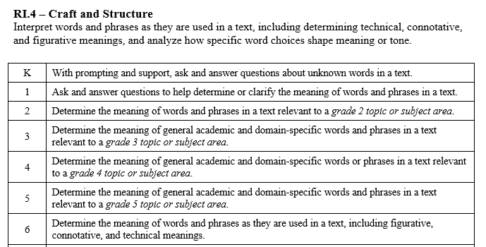

Slide 3
I can determine the meaning of words.
RI.K.4
1st Grade | 4 | Ask and answer questions to help determine or clarify the meaning of words and phrases.
Kindergarten | 3 | With help from the teacher- Recognize unknown words. Ask and answer questions to help figure out the meaning of the unknown words.
Pre- K | 2 | Talk about words in a story.
Pre-School | 1 | Listen to a story.

Slide 4
I can determine the meaning of words and phrases.
RI.1.4
2nd Grade | 4 | Determine the meaning of words and phrases relevant to a grade 2 topic.
1st Grade | 3 | Ask and answer questions to help determine or clarify the meaning of words and phrases.
Kindergarten | 2 | With help from the teacher- Recognize unknown words. Ask and answer questions to help figure out the meaning of the unknown words.
Pre- K | 1 | Talk about words in a story.

Slide 5
I can determine the meaning of words and phrases.
RI.2.4
3rd Grade | 4 | Determine the meaning of general academic and domain specific words and phrases relevant to a grade 3 topic.
2nd Grade | 3 | Determine the meaning of words and phrases relevant to a grade 2 topic.
1st Grade | 2 | Ask and answer questions to help determine or clarify the meaning of words and phrases.
Kindergarten | 1 | With help from the teacher- Recognize unknown words. Ask and answer questions to help figure out the meaning of the unknown words.

Slide 6
I can determine the meaning of words and phrases.
RI.3.4
4th Grade | 4 | Determine the meaning of general academic and domain specific words and phrases relevant to a grade 4 topic.
3rd Grade | 3 | Determine the meaning of general academic and domain specific words and phrases relevant to a grade 3 topic.
2nd Grade | 2 | Determine the meaning of words and phrases relevant to a grade 2 topic.
1st Grade | 1 | Ask and answer questions to help determine or clarify the meaning of words and phrases.

Slide 7
I can determine the meaning of words and phrases.
RI.4.4
5th Grade | 4 | Determine the meaning of general academic and domain specific words and phrases relevant to a grade 5 topic.
4th Grade | 3 | Determine the meaning of general academic and domain specific words and phrases relevant to a grade 4 topic.
3rd Grade | 2 | Determine the meaning of general academic and domain specific words and phrases relevant to a grade 3 topic.
2nd Grade | 1 | Determine the meaning of words and phrases relevant to a grade 2 topic.

Slide 8
I can determine the meaning of words and phrases.
RI.5.4
6th Grade | 4 | Determine the meaning of words and phrases, including figurative, connotative, and technical meanings.
5th Grade | 3 | Determine the meaning of general academic and domain specific words and phrases relevant to a grade 5 topic.
4th Grade | 2 | Determine the meaning of general academic and domain specific words and phrases relevant to a grade 4 topic.
3rd Grade | 1 | Determine the meaning of general academic and domain specific words and phrases relevant to a grade 3 topic.

