Slide 1
RI.3
(Analyzing how events and ideas develop over time)
Describe the Connection
Between a series of:
Historical Events
Scientific Ideas or Concepts
Steps in a Technical Procedure
2nd
Explain
Events
Procedures
Ideas
Concepts
(in historical, scientific or technical text)
Drawing on specific information to explain what happened and why
4th
Describe the Connection
Between two:
Individuals
Events
Ideas
Pieces of Information
K-with prompting
1st- no prompting
K-1
Describe the Relationship
Between a series of:
Historical Events
Scientific Ideas or Concepts
Steps in a Technical Procedure
Using language that pertains to time, sequence and cause & effect
3rd
Explain the Relationships or Interactions Between
Individuals
Events
Ideas
Concepts
(in historical, scientific or technical text)
Based on specific information in the text
5th

Slide 2
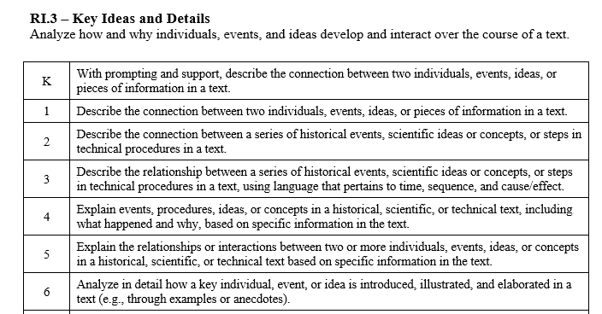

Slide 3
I can describe connections in a text.
RI.K.3
1st Grade | 4 | Describe the connection between two individuals, events, ideas or pieces of information in a text.
Kindergarten | 3 | With help from the teacher- Describe the connection between two individuals, events, ideas or pieces of information in a text.
Pre- K | 2 | Talk about a text.
 | 1 | No attempt

Slide 4
I can describe connections in a text.
RI.1.3
2nd Grade | 4 | Describe the connection between a series of historical events, scientific ideas or concepts, or steps in a technical procedure in a text.
1st Grade | 3 | Describe the connection between two individuals, events, ideas or pieces of information in a text.
Kindergarten | 2 | With help from the teacher- Describe the connection between two individuals, events, ideas or pieces of information in a text.
Pre- K | 1 | Talk about a text.

Slide 5
I can describe connections in a text.
RI.2.3
3rd Grade | 4 | Describe the relationship between a series of historical events, scientific ideas or concepts, or steps in a technical procedure. Use language that pertains to time, sequence and cause/effect.
2nd Grade | 3 | Describe the connection between a series of historical events, scientific ideas or concepts, or steps in a technical procedure in a text.
1st Grade | 2 | Describe the connection between two individuals, events, ideas or pieces of information in a text.
Kindergarten | 1 | With help from the teacher- Describe the connection between two individuals, events, ideas or pieces of information in a text.

Slide 6
I can explain relationships in a text.
RI.3.3
4th Grade | 4 | Explain events, procedures, ideas, or concepts in a historical, scientific, or technical text, including what happened and why. Use specific information from the text.
3rd Grade | 3 | Describe the relationship between a series of historical events, scientific ideas or concepts, or steps in a technical procedure. Use language that pertains to time, sequence and cause/effect.
2nd Grade | 2 | Describe the connection between a series of historical events, scientific ideas or concepts, or steps in a technical procedure in a text.
1st Grade | 1 | Describe the connection between two individuals, events, ideas or pieces of information in a text.

Slide 7
I can explain relationships in a text.
RI.4.3
5th Grade | 4 | Explain the relationships or interactions between tow or more individuals, events, ideas, or concepts in a historical, scientific, or technical text. Use specific information from the text.
4th Grade | 3 | Explain events, procedures, ideas, or concepts in a historical, scientific, or technical text, including what happened and why. Use specific information from the text.
3rd Grade | 2 | Describe the relationship between a series of historical events, scientific ideas or concepts, or steps in a technical procedure. Use language that pertains to time, sequence and cause/effect.
2nd Grade | 1 | Describe the connection between a series of historical events, scientific ideas or concepts, or steps in a technical procedure in a text.

Slide 8
I can explain relationships or interactions in a text.
RI.5.3
6th Grade | 4 | Analyze in detail how a key individual, event, or idea is introduced, illustrated and elaborated in a text (through examples and anecdotes).
5th Grade | 3 | Explain the relationships or interactions between tow or more individuals, events, ideas, or concepts in a historical, scientific, or technical text. Use specific information from the text.
4th Grade | 2 | Explain events, procedures, ideas, or concepts in a historical, scientific, or technical text, including what happened and why. Use specific information from the text.
3rd Grade | 1 | Describe the relationship between a series of historical events, scientific ideas or concepts, or steps in a technical procedure. Use language that pertains to time, sequence and cause/effect.

