Slide 1
RI.1
(Close Reading)
Ask & Answer
Questions to demonstrate understanding
2nd -Answers the 5Ws & How
3rd – cite evidence from text
2-3
Ask & Answer
Questions about key details
K- with prompting
1st- no prompting
K-1
Explain & Infer
4th- cite evidence from text
5th- quote accurately from text
4-5

Slide 2
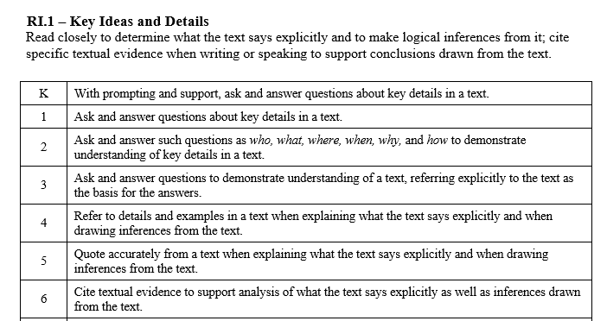

Slide 3
I can read closely.
RI.K.1
1st Grade | 4 | Ask questions about key details in a text. Answer questions about key details in a text.
Kindergarten | 3 | With help from the teacher- Ask questions about a text. Answer questions about a text.
Pre- K | 2 | Talk about the story.
 | 1 | No attempt

Slide 4
I can read closely.
RI.1.1
2nd Grade | 4 | Use who, what, where, when, why and how to ask questions about a text. Answer questions about a text.
1st Grade | 3 | Ask questions about key details in a text. Answer questions about key details in a text.
Kindergarten | 2 | With help from the teacher- Ask questions about a text. Answer questions about a text.
Pre- K | 1 | Talk about the story.

Slide 5
I can read closely.
RI.2.1
3rd Grade | 4 | Ask questions about a text. When answering questions, cite evidence from the text.
2nd Grade | 3 | Use who, what, where, when, why and how to ask questions about a text. Answer questions about a text.
1st Grade | 2 | Ask questions about a text. Answer questions about a text.
Kindergarten | 1 | With help from the teacher- Ask questions about a text. Answer questions about a text.

Slide 6
I can read closely.
RI.3.1
4th Grade | 4 | Use details and examples from the text to explain or infer.
3rd Grade | 3 | Ask questions about a text. When answering questions, cite evidence from the text.
2nd Grade | 2 | Use who, what, where, when, why and how to ask questions about a text. Answer questions about a text.
1st Grade | 1 | Ask questions about a text. Answer questions about a text.

Slide 7
I can read closely.
RI.4.1
5th Grade | 4 | Quote accurately from the text to explain or infer.
4th Grade | 3 | Use details and examples from the text to explain or infer.
3rd Grade | 2 | Ask questions about a text. When answering questions, cite evidence from the text.
2nd Grade | 1 | Use who, what, where, when, why and how to ask questions about a text. Answer questions about a text.

Slide 8
I can read closely.
RI.5.1
6th Grade | 4 | Cite evidence from the text to support analysis of what the text says as well inferences drawn from the text.
5th Grade | 3 | Quote accurately from the text to explain or infer.
4th Grade | 2 | Use details and examples from the text to explain or infer.
3rd Grade | 1 | Ask questions about a text. When answering questions, cite evidence from the text.

