Slide 1
Nonfiction Text Structures
LM – Garfield 2013

Slide 2

I can identify nonfiction text structures.
4 = I am an expert. I can identify 5 text
structures.
3 = I understand text structures.
2 = I have heard about text structures.
1 = I have no idea what you’re talking about.

Slide 3
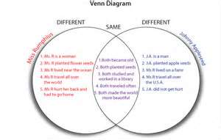
Compare and Contrast

Slide 4
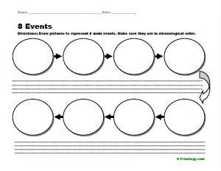

Sequencing

Slide 5
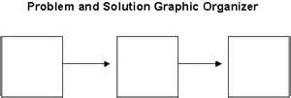
Problem and Solution

Slide 6
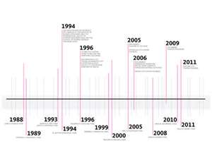
Chronological

Slide 7
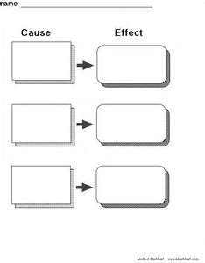

Cause and Effect

Slide 8
Why is text structure important?
How does knowing or being familiar with text structures or how a text is organized help me as a reader?

Slide 9

What are text features?

Slide 10
Fiction Text Features
Title
Chapter Index (for Chapter Books)
Illustrations
Bold Print
Continuous Text
Paragraphing
Dialogue

Slide 11
Non-fiction Text Features
Title
Table of Contents
Index*
Photos
Captions
Diagrams
Glossary
Date line (periodicals)
Bold Print
Headings
Sub-titles

Slide 12


Why are text features important?
What do you think?

Slide 13

I understand that text features provide information that will support the building of meaning.

Slide 14
How are text features and text structures different?

Slide 15

How are text features and text structures different?
Text features are the way a text is presented.

Slide 16
Text structure is how a text is organized.

Slide 17
Let’s watch…………………
www.youtube.com/watch?v=XoudxEM3dRY
www.youtube.com/watch?v=s74XA3tCPt8

Slide 18
Time to think about what you learned.
Discuss with your partner-
1. The difference between text structure and text features.
2. How both help us in our reading.
3. Tell your partner your score for understanding.

