Slide 1
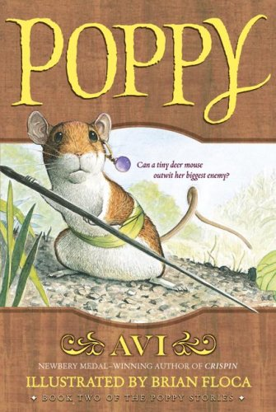
4th Grade
Text Talk
Unit 3
Poppy
Chapter 5

Slide 2
Goal:
I can use words I learn from a text.
(L.4.6)
Notes:
Goal-
Students need to engage with the goal- read it, repeat it, write it, etc.

Slide 3
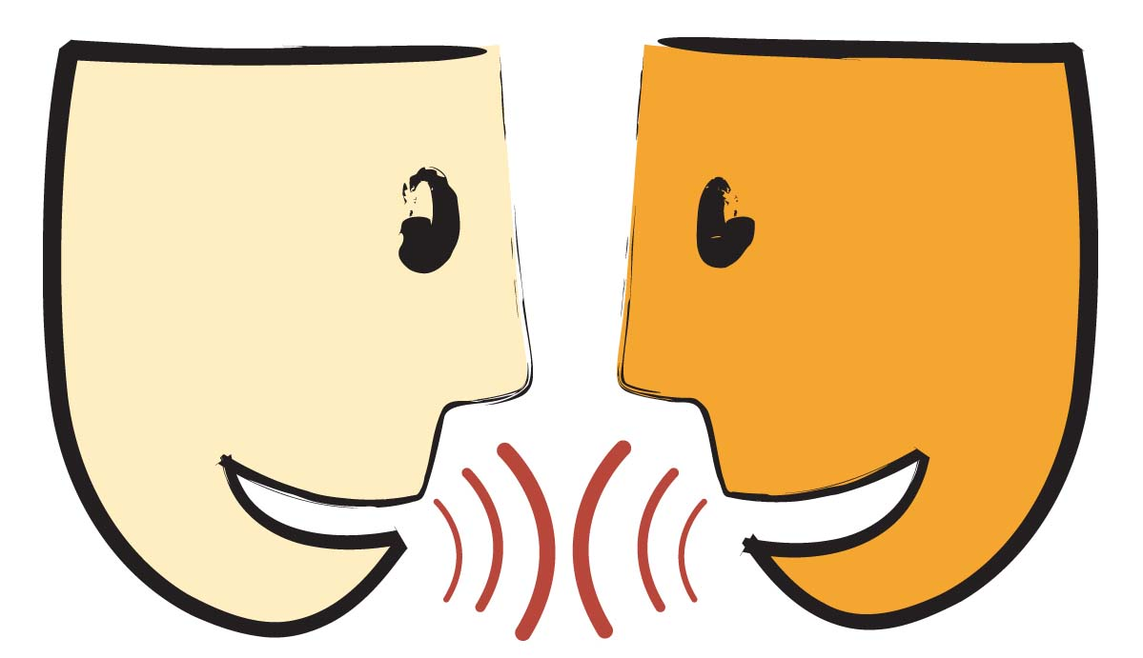
Tell your partner about a new word you saw in a text last week.
Notes:
Access Prior Knowledge- (APK)
Turn and Talk

Slide 4
Who wants to share their neighbor’s new word?
What does it mean?

Slide 5
Notes:
New Information-
Read the book- provide a brief explanation of any words that may be new or unfamiliar to the students.

Slide 6
emerged
Pg. 36
Notes:
Contextualize the word- Find it in the text
Say the word together

Slide 7
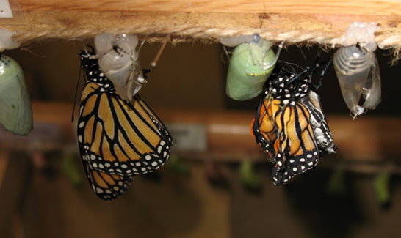
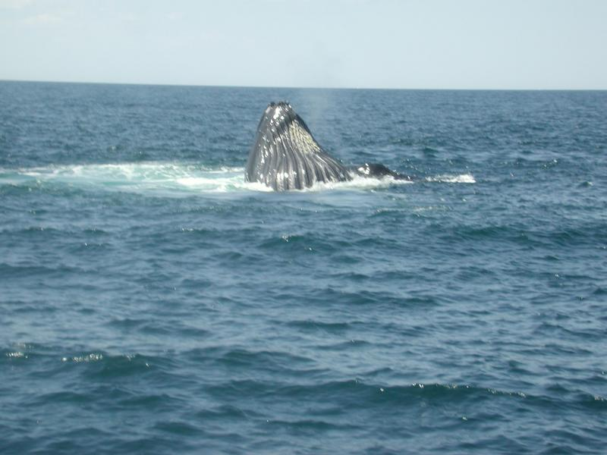
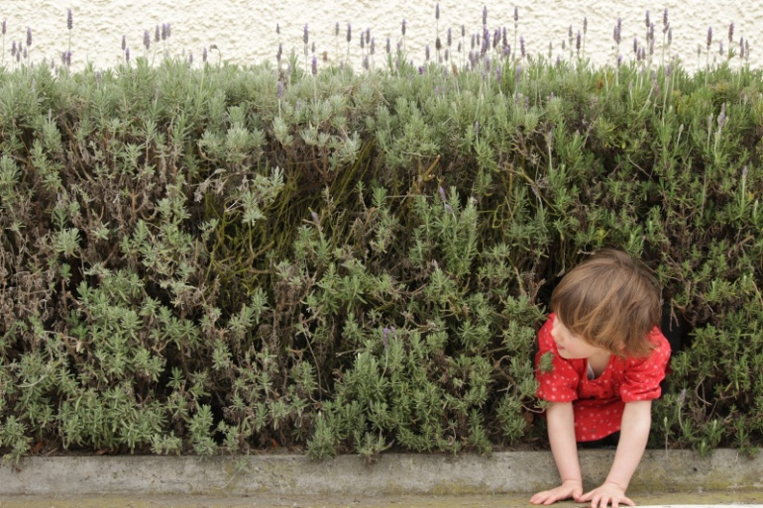
emerge(emerged)
to come into view
Notes:
Give student friendly definition
Use the word in other contexts

Slide 8

Thumbs up, Thumbs down
Which of these could you emerge from?
your room
a basement
the sidewalk
a book
the t.v.
your classroom
Notes:
Engage the students with the word

Slide 9
humble
Pg. 38
Notes:
Contextualize the word- Find it in the text
Say the word together

Slide 10
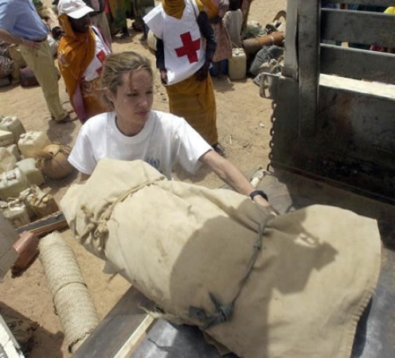
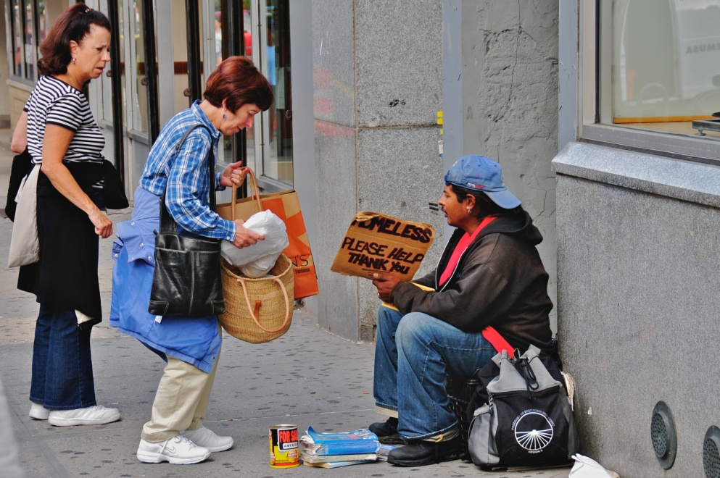
humble
not thinking of yourself as better than others
Notes:
Give student friendly definition
Use the word in other contexts

Slide 11
How might a famous soccer player show they are humble?
How might a doctor show they are humble?
How might you show that you’re humble?
Notes:
Engage the students with the word

Slide 12
scampered
Pg. 38
Notes:
Contextualize the word- Find it in the text
Say the word together

Slide 13
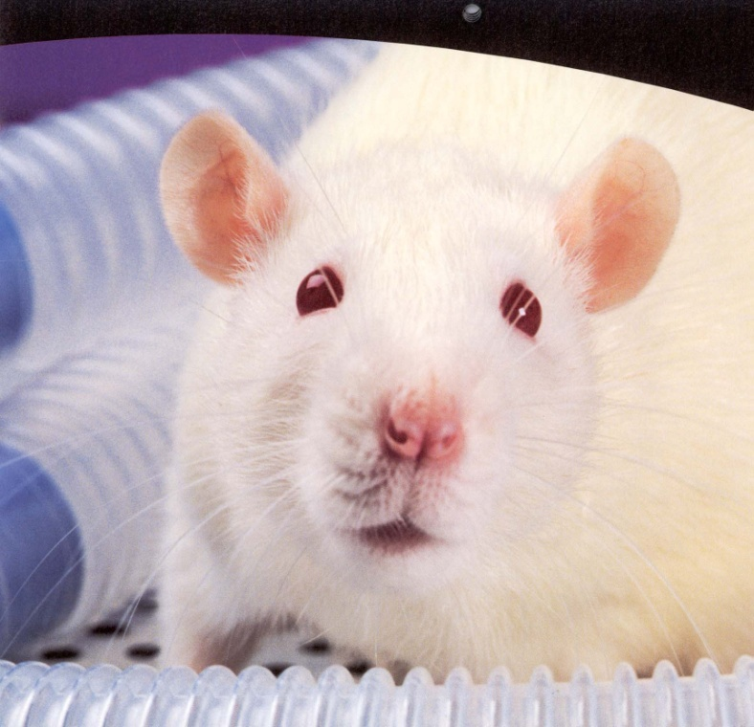
scamper (scampered)
to run with quick, light steps
(click on the picture to see a rat scamper)
Notes:
Contextualize the word- Find it in the text
Say the word together

Slide 14
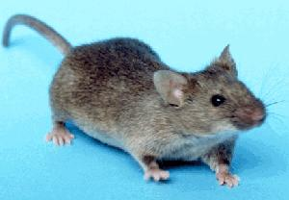
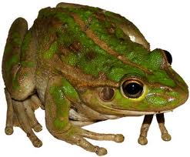
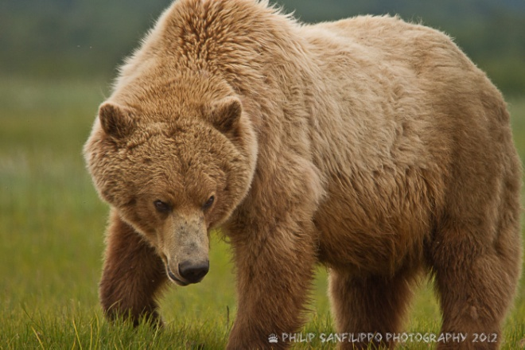
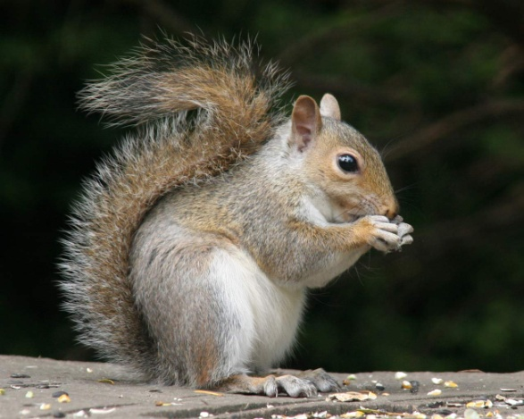
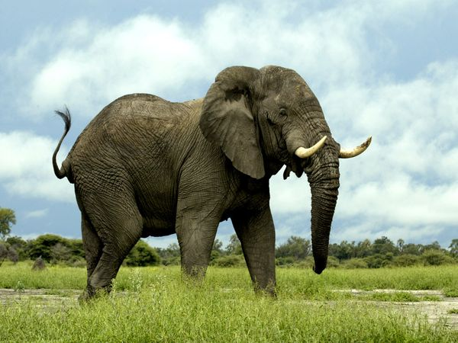
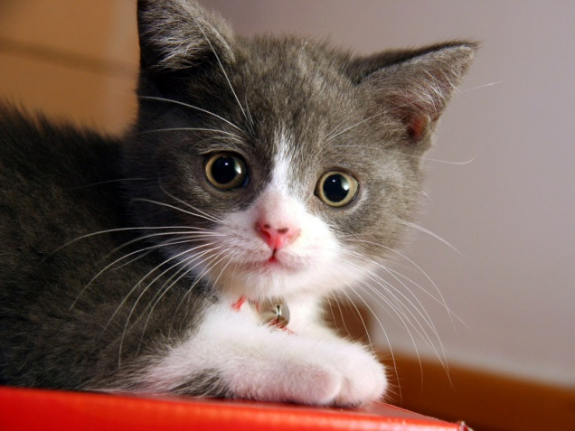
Which of these animals could scamper.
Notes:
Engage the students with the word

Slide 15
Who can use all 3 words in a sentence?
emerged
humble
scampered
Notes:
Read all three words and see if you can use them in one sentence.

Slide 16

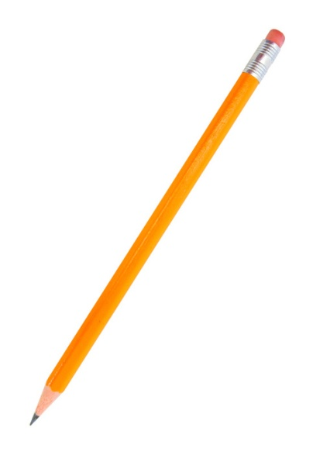
Apply: In your notebook, write a sentence with each of these words.
Challenge: See if you could write a sentence with a word that could go in your realistic fiction piece.
emerged
humble
scampered
Notes:
Application-
Students need an opportunity to use the words they just learned from the text.

Slide 17
I can use words I learn from a text.
Notes:
Goal-
Revisit the Goal

