Slide 1

RI.4.8

Slide 2
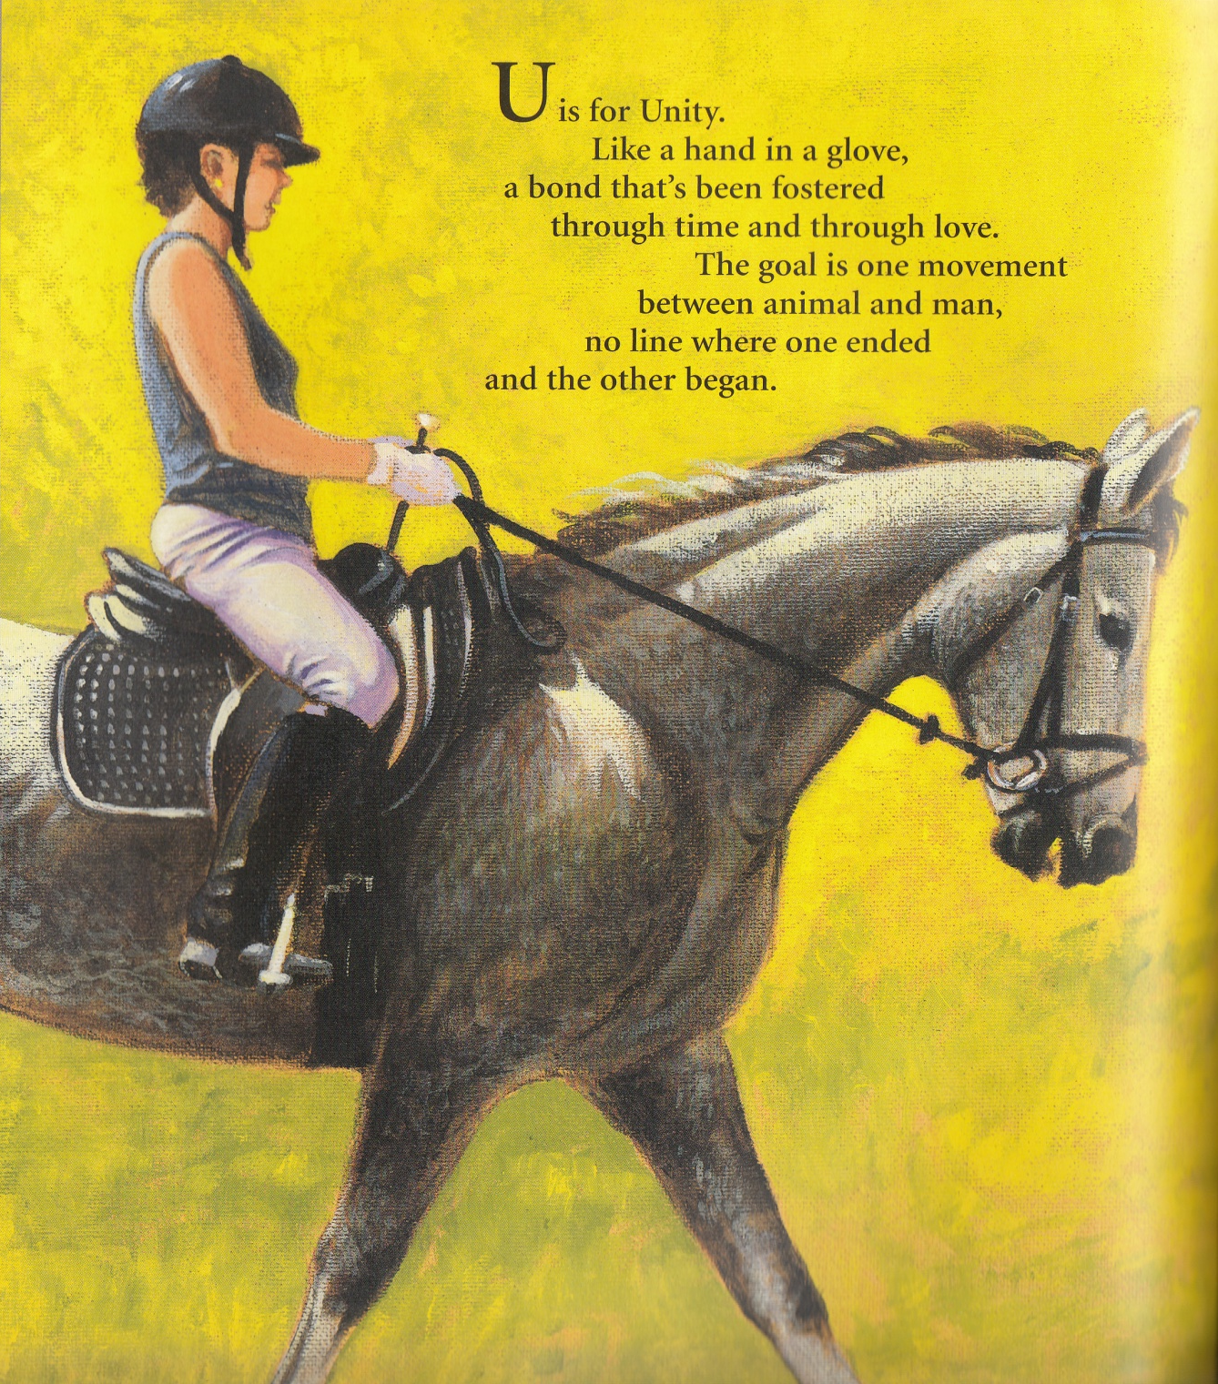
Through gentle work, experience, and practice, horse and human can become a team. It’s as if the horse can sense what the person wants and acts accordingly. This bond can’t be forged through
abuse or inflicting pain. It depends on generosity, the kindness of the rider and the willingness of the horse to respond. Unity is a gift exchanged between horse and rider in ways only the two can feel
and understand.
u
U

Slide 3
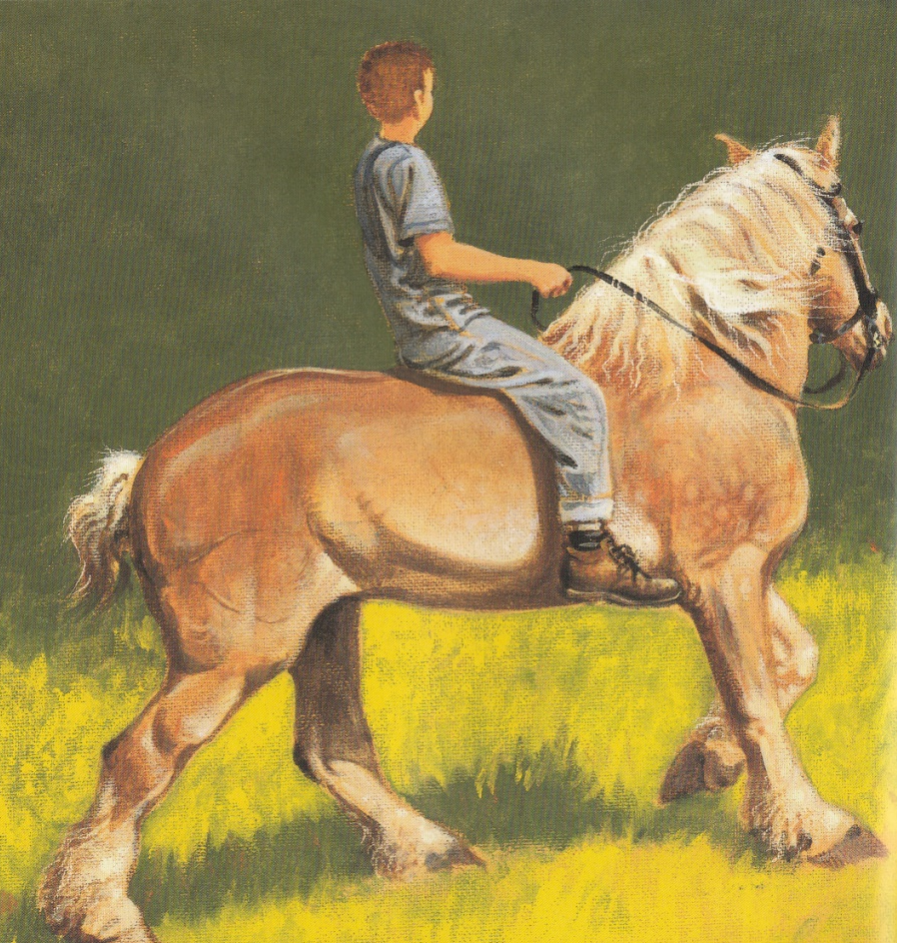
One of the most important things a new rider has to remember is to look where he wants to go, not down at the horse. A horse takes his cues from everything the rider does. That’s why it’s so important to look past your horse’s ears. The slight changes in rein pressure and body position that come when you move your head toward your target is often all a sensitive horse needs to deduce where you want to go.
d
D
D is for the word Direction-
this might come as a surprise-
you can make your own selection
by the way you use your eyes.
Where you look is where you’re heading.
Horses know how this is done,
so when you look where you are going,
know you’re not the only one.

